Slide 1



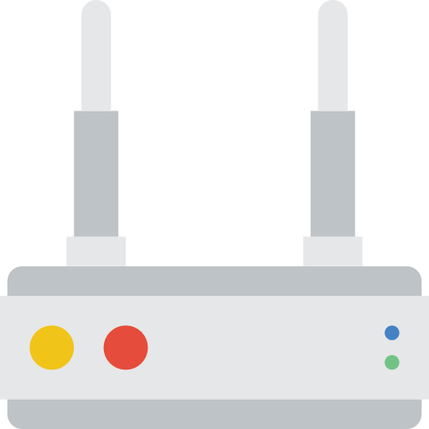
ONOS
Sender 1
Receiver 1
Sender 2
MANE 1
MANE 2
MANE 3
a
Receiver 2
b
c

