Slide 1




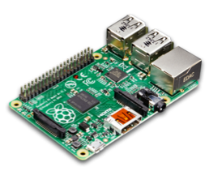
ONOS
Sender
Barefoot
RPi 1
RPi 2
Receiver
d
e
RPi 3
f
g

