Slide 1

China Biographical Database Project (CBDB)
T’ang Studies Society Workshop on the China Biographical Database Harvard University August 22-23, 2013 Sponsored by the T’ang Studies Society
Notes:
1

Slide 2
China Biographical Database Project (CBDB)
Session One:
From Flatland to Modeling Historical Experience: Thinking through Relational Databases
Michael A. Fuller
Notes:
2

Slide 3
China Biographical Database Project (CBDB)
In this session, we will discuss how we organize the data we want to explore.
The key point I hope to convey is the question we need to think about beforehand:
How do we want to structure our data, based on what we want to do with it?
Planning is needed because biographical data for the Tang dynasty are inherently complex:
People are imbedded in social, regional, and bureaucratic networks that inform their actions.
Notes:
3

Slide 4
China Biographical Database Project (CBDB)
A good design:
Recognizes the elements (people, places, texts, genres, offices, etc.) that we consider are of particular significance in our research.
Allows us to focus specifically on the roles of each element (and combinations of elements) in the actions (including writing poems) we want to examine
I will argue that a Relational Database gives us the best way to explore these complex interactions.
Notes:
4

Slide 5
China Biographical Database Project (CBDB)
A relational database is more than just a different sort of tool.
A relational database is a different way of thinking about and understanding data and the world. Simply put, we approach the world of our data as multidimensional, as the intersection of many interacting factors.
As humanists, this is how we have approached our research all along: relational databases allow us to formalize our understandings and test them against large sets of data.
Notes:
5

Slide 6
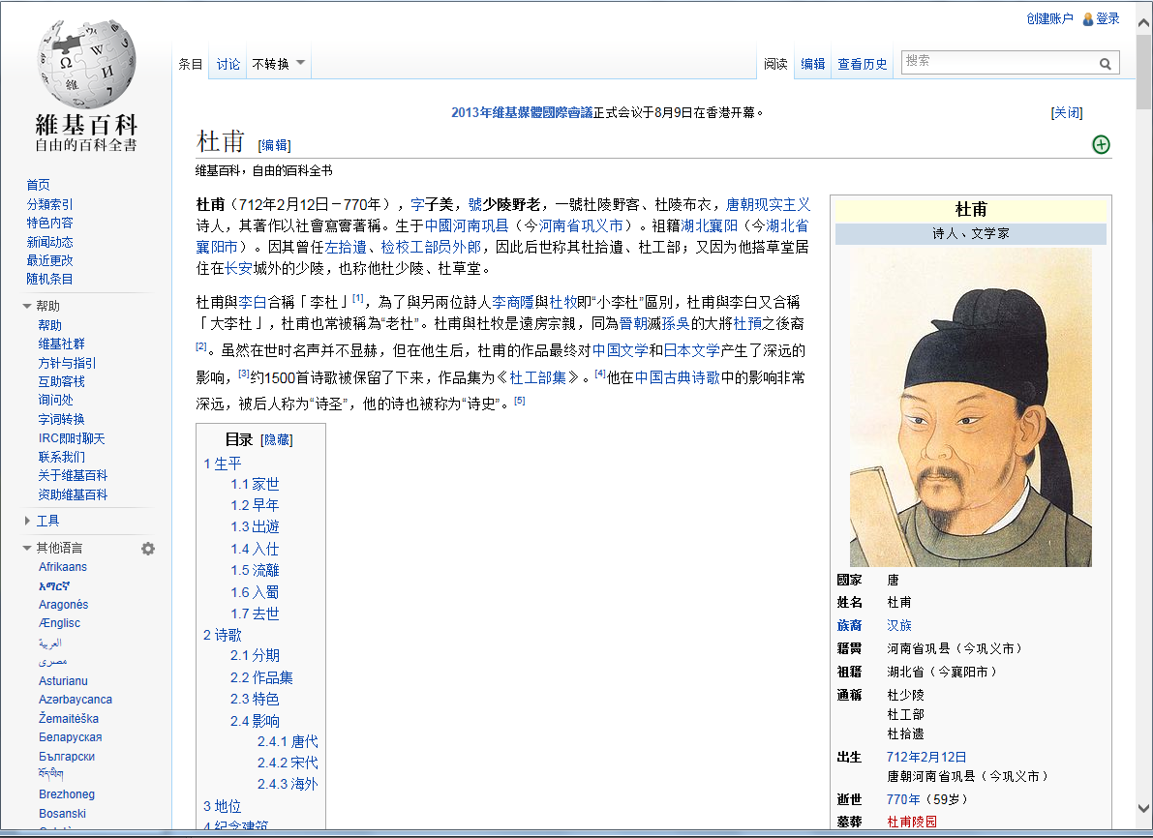
China Biographical Database Project (CBDB)
Lets begin with some information:
Notes:
6

Slide 7
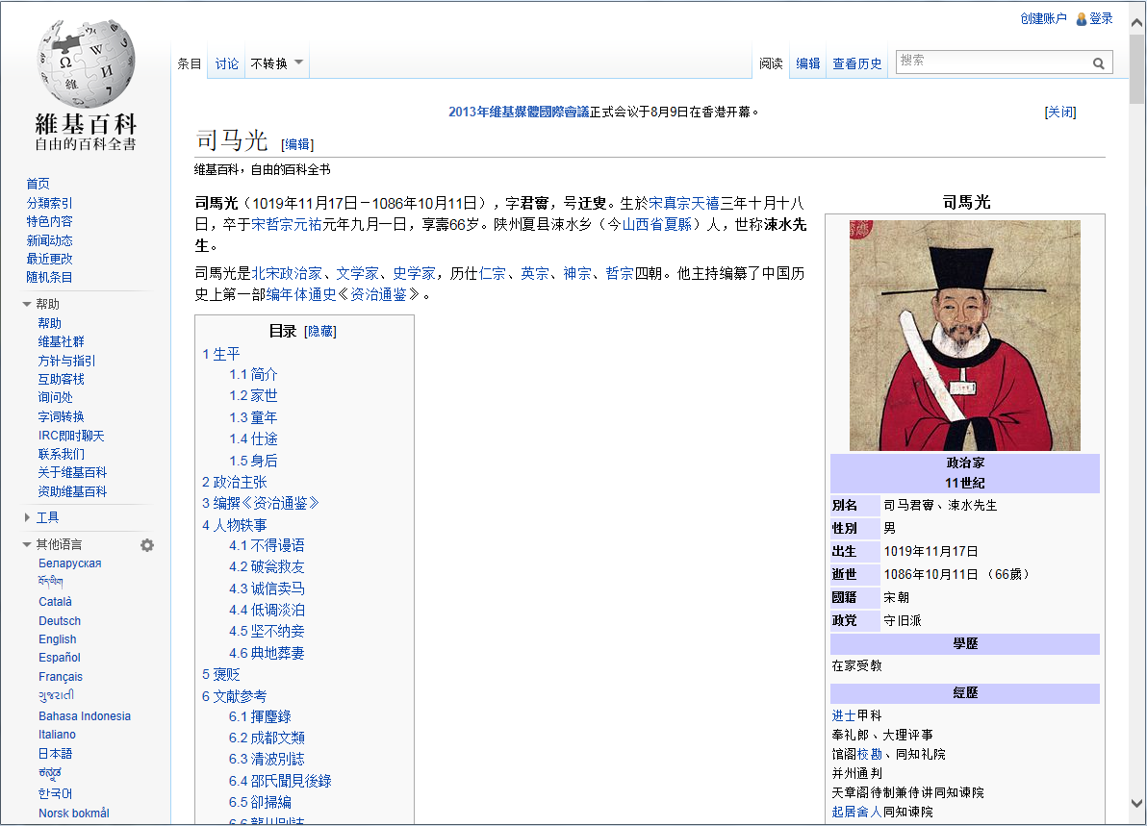
China Biographical Database Project (CBDB)
Just kidding: I need to recycle some old material on Sima Guang:
Notes:
7

Slide 8
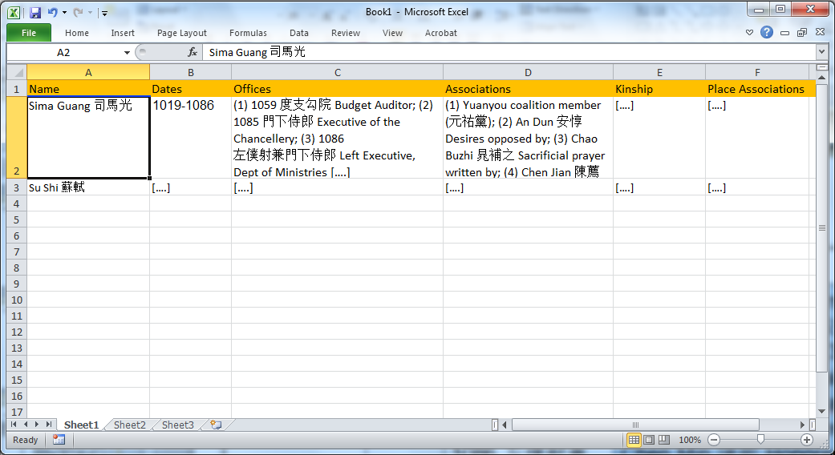
China Biographical Database Project (CBDB)
We first compile data on Sima Guang, as one entry in a large Excel spreadsheet about people:
Notes:
8

Slide 9
China Biographical Database Project (CBDB)
Or, more schematically, this is what we begin with:
Name | Dates | Offices | Associations
Sima Guang 司馬光 | 1019-1086 | (1) 1059 度支勾院 Budget Auditor; (2) 1085 門下侍郎 Executive of the Chancellery; (3) 1086 左僕射兼門下侍郎 Left Executive, Dept of Ministries [….] | (1) Yuanyou coalition member (元祐黨); (2) An Dun 安惇 Desires opposed by; (3) Chao Buzhi 晁補之 Sacrificial prayer written by; (4) Chen Jian 陳薦 Sacrificial prayer written for; (5) Chen Min 陳敏 Honored by; (6) Cheng Yi 程頤 Recommended; (7) Ding Du 丁度 Sacrificial prayer written for; (8) Fan Chunli 范純禮 Patron of; [….]
This approach is “flat:” one record per person. It will not do.
Notes:
9

Slide 10
China Biographical Database Project (CBDB)
Reorganizing the Data on Sima Guang (First Version):
Long columns that contain many individual “factoids” (like “Offices” and “Associations”) are hard to search and a very inflexible way of organizing the information. Therefore we have a first rule to help us restructure the data in a more accessible and flexible way:
If a category of information (a column like “Office” in the table) has more than one “factoid” in a cell, we need to create a separate table for it so that each row in the new table records just one factoid. We then can add as many rows of factoids as we need.
Notes:
10

Slide 11
China Biographical Database Project (CBDB)
First Advantage: As many “One-to-Many” records as you want:
Name | Dates
Sima Guang 司馬光 | 1019-1086
Person | Posting Date | Office Title
Sima Guang 司馬光 | 1059 | 度支勾院 Budget Auditor
Sima Guang 司馬光 | 1085 | 門下侍郎 Executive of the Chancellery
Sima Guang 司馬光 | 1086 | 左僕射兼門下侍郎 Left Executive, Dept of Ministries
Person | Association Type | Associate
Sima Guang 司馬光 | Yuanyou member (元祐黨) | (not applicable)
Sima Guang 司馬光 | Desires opposed by | An Dun 安惇
Sima Guang 司馬光 | Sacrificial prayer written by | Chao Buzhi 晁補之
Sima Guang 司馬光 | Patron of | Fan Chunli 范純禮
Sima Guang 司馬光 | Sacrificial prayer written for | Ding Du 丁度
Notes:
11

Slide 12
China Biographical Database Project (CBDB)
The columns in the three new tables now present distinctive, important aspects that define and structure the information for the particular tables: For office, for example, we have 1. The person 2. The office name 3. The date of the posting
We can add as many columns as we need to convey the information we find important. We also can add as many tables as we need to capture the one-to-many relationships we consider important. This ability to add additional information greatly increases our flexibility in capturing data.
Notes:
12

Slide 13
China Biographical Database Project (CBDB)
One can now sort on the separate columns:
Name 姓名 | Dates 日期
Sima Guang 司馬光 | 1019-1086
Person 人物 | Posting Date 任命日期 | Office Title 官名
Sima Guang 司馬光 | 1059 | 度支勾院 Budget Auditor
Sima Guang 司馬光 | 1085 | 門下侍郎 Executive of the Chancellery
Sima Guang 司馬光 | 1086 | 左僕射兼門下侍郎 Left Executive, Dept of Ministries
Person 人物 | Association Type 社會關係 | Associate 社會關係人
Sima Guang 司馬光 | Yuanyou member (元祐黨) | (not applicable)
Sima Guang 司馬光 | Desires opposed by | An Dun 安惇
Sima Guang 司馬光 | Sacrificial prayer written by | Chao Buzhi 晁補之
Sima Guang 司馬光 | Patron of | Fan Chunli 范純禮
Sima Guang 司馬光 | Sacrificial prayer written for | Ding Du 丁度
Notes:
13

Slide 14
China Biographical Database Project (CBDB)
This ability to sort on individual columns in the tables may seem like a minor advantage.
But in fact it changes how we approach the data:
We no longer are looking just at the people in the first column: we can begin to explore systematically specific offices in the POSTINGS table and types of associations in the ASSOCIATIONS table
Notes:
14

Slide 15
China Biographical Database Project (CBDB)
We started with a single table – a “Flat” database looking at a single entity: PEOPLE.
People Table PersonID Name Birth Year Death Year Associates Birthplace Entry into Office Official Career Writings
Person | Dates | Official Career | Associates
Sima Guang 司馬光 | 1019-1086 | (1) 1059 度支勾院 Budget Auditor; (2) 1085 門下侍郎 Executive of the Chancellery; (3) 1086 左僕射兼門下侍郎 Left Executive, Dept of Ministries [….] | (1) Yuanyou coalition member (元祐黨); (2) An Dun 安惇 Desires opposed by; (3) Chao Buzhi 晁補之 Sacrificial prayer written by; (4) Chen Jian 陳薦 Sacrificial prayer written for; (5) Chen Min 陳敏 Honored by; (6) Cheng Yi 程頤 Recommended; (7) Ding Du 丁度 Sacrificial prayer written for; (8) Fan Chunli 范純禮 Patron of; [….]
Notes:
15

Slide 16
China Biographical Database Project (CBDB)
By breaking the one-to-many relationships into separate tables one person / many postings one person / many associations one person / many kin one person / many texts we have changed from a flat database with a single entity (people) to a relational database.
As the name suggests, a relational database relates data connecting many entities.
In practice, what does this mean?
Notes:
16

Slide 17
China Biographical Database Project (CBDB)
Relational Database:
Many Entities People
Association Types
Offices
Name 姓名 | Dates 日期
Sima Guang 司馬光 | 1019-1086
Person 人物 | Association Type 社會關係 | Associate 社會關係人
Sima Guang 司馬光 | Yuanyou member (元祐黨) | (not applicable)
Sima Guang 司馬光 | Desires opposed by | An Dun 安惇
Sima Guang 司馬光 | Sacrificial prayer written by | Chao Buzhi 晁補之
Sima Guang 司馬光 | Patron of | Fan Chunli 范純禮
Sima Guang 司馬光 | Sacrificial prayer written for | Ding Du 丁度
Person 人物 | Posting Date 任命日期 | Office Title 官名
Sima Guang 司馬光 | 1059 | 度支勾院 Budget Auditor
Sima Guang 司馬光 | 1085 | 門下侍郎 Executive of the Chancellery
Sima Guang 司馬光 | 1086 | 左僕射兼門下侍郎 Left Executive, Dept of Ministries
Notes:
17

Slide 18
China Biographical Database Project (CBDB)
Relational Database:
The second and third tables here give us links between entities of type PEOPLE and entities of type ASSOCIATIONS and OFFICES
Name 姓名 | Dates 日期
Sima Guang 司馬光 | 1019-1086
Person 人物 | Association Type 社會關係 | Associate 社會關係人
Sima Guang 司馬光 | Yuanyou member (元祐黨) | (not applicable)
Sima Guang 司馬光 | Desires opposed by | An Dun 安惇
Sima Guang 司馬光 | Sacrificial prayer written by | Chao Buzhi 晁補之
Sima Guang 司馬光 | Patron of | Fan Chunli 范純禮
Sima Guang 司馬光 | Sacrificial prayer written for | Ding Du 丁度
Person 人物 | Posting Date 任命日期 | Office Title 官名
Sima Guang 司馬光 | 1059 | 度支勾院 Budget Auditor
Sima Guang 司馬光 | 1085 | 門下侍郎 Executive of the Chancellery
Sima Guang 司馬光 | 1086 | 左僕射兼門下侍郎 Left Executive, Dept of Ministries
Notes:
18

Slide 19
China Biographical Database Project (CBDB)
In designing an approach to the “things” we want to explore, we need to think about what interactions (captured by the tables) we want to examine as we accumulate data.
Thinking about and formalizing these interactions is:
Entity Relations Modeling: Abstracting the features of the Biographical World
Association Types
Person
Place
Offices
is an
has an
has a
is at
is a
Association
Postings
Notes:
19

Slide 20
China Biographical Database Project (CBDB)
As we design a database based on the material we want to explore, thinking about entities and interactions is a crucial first step.
However, relational databases have other important features that I would like to introduce because, while seemingly cumbersome, they reduce error and greatly add to the analytic power of the system.
Notes:
20

Slide 21
China Biographical Database Project (CBDB)
Let’s return to our earlier tables: Much of the information in these tables is very repetitive: “Sima Guang 司馬光” appears 8 times
Name 姓名 | Dates 日期
Sima Guang 司馬光 | 1019-1086
Postings Data
Person 人物 | Posting Date 任命日期 | Office Title 官名
Sima Guang 司馬光 | 1059 | 度支勾院 Budget Auditor
Sima Guang 司馬光 | 1085 | 門下侍郎 Executive of the Chancellery
Sima Guang 司馬光 | 1086 | 左僕射兼門下侍郎 Left Executive, Dept of Ministries
Associations Data
Person 人物 | Association Type 社會關係 | Associate 社會關係人
Sima Guang 司馬光 | Yuanyou member (元祐黨) | (not applicable)
Sima Guang 司馬光 | Desires opposed by | An Dun 安惇
Sima Guang 司馬光 | Sacrificial prayer written for | Chen Jian(5) 陳薦
Sima Guang 司馬光 | Patron of | Fan Chunli 范純禮
Sima Guang 司馬光 | Sacrificial prayer written for | Ding Du 丁度
Notes:
21

Slide 22
China Biographical Database Project (CBDB)
We can eliminate this repetition by assigning Sima Guang an ID and using that ID instead of his name in the other tables:
ID | Name 姓名 | Dates 日期
1 | Sima Guang 司馬光 | 1019-1086
Postings Data 任官資料
Person ID | Posting Date 任命日期 | Office Title 官名
1 | 1059 | 度支勾院 Budget Auditor
1 | 1085 | 門下侍郎 Executive of the Chancellery
1 | 1086 | 左僕射兼門下侍郎 Left Executive, Dept of Ministries
Associations Data 社會關係資料
Person ID | Association Type 社會關係 | Associate 社會關係人
1 | Yuanyou member (元祐黨) | (not applicable)
1 | Desires opposed by | An Dun 安惇
1 | Sacrificial prayer written for | Chen Jian(5) 陳薦
1 | Patron of | Fan Chunli 范純禮
1 | Sacrificial prayer written for | Ding Du 丁度
Notes:
22

Slide 23
Reorganizing the Data (2nd Version): Assign IDs to all instances of entities (people, offices, etc.)
Office Titles
ID | Office Name
1 | 度支勾院 Budget Auditor
2 | 門下侍郎 Executive of the Chancellery
3 | 左僕射兼門下侍郎 Left Executive, Dept of Ministries
Postings Data
People
Person ID | Office ID | Posting Date
1 | 1 | 1059
1 | 2 | 1085
1 | 3 | 1086
ID | Name | Dates
1 | Sima Guang 司馬光 | 1019-1086
2 | An Dun 安惇 | 10
3 | Chao Buzhi 晁補之
4 | Chen Jian(5) 陳薦
5 | Chen Min 陳敏
6 | Cheng Yi 程頤
7 | Ding Du 丁度
8 | Fan Chunli 范純禮
Associations
Associations Data
ID | Association Type
1 | Yuanyou coalition member (元祐黨)
2 | Desires opposed by
3 | Sacrificial prayer written by
4 | Sacrificial prayer written for
5 | Honored by
6 | Recommended
7 | Patron of
Assoc Type ID | Person ID | Assoc ID
1 | 1 | -1
2 | 1 | 2
3 | 1 | 3
4 | 1 | 4
5 | 1 | 5
6 | 1 | 6
4 | 1 | 7
7 | 1 | 8
Notes:
23

Slide 24
What we now have are three tables for entities (yellow) and two for interactions between entities (as in the ERM)
Office Titles
ID | Office Name
1 | 度支勾院 Budget Auditor
2 | 門下侍郎 Executive of the Chancellery
3 | 左僕射兼門下侍郎 Left Executive, Dept of Ministries
Postings Data
People
Person ID | Office ID | Posting Date
1 | 1 | 1059
1 | 2 | 1085
1 | 3 | 1086
ID | Name | Dates
1 | Sima Guang 司馬光 | 1019-1086
2 | An Dun 安惇 | 10
3 | Chao Buzhi 晁補之
4 | Chen Jian(5) 陳薦
5 | Chen Min 陳敏
6 | Cheng Yi 程頤
7 | Ding Du 丁度
8 | Fan Chunli 范純禮
Associations
Associations Data
ID | Association Type
1 | Yuanyou coalition member (元祐黨)
2 | Desires opposed by
3 | Sacrificial prayer written by
4 | Sacrificial prayer written for
5 | Honored by
6 | Recommended
7 | Patron of
Assoc Type ID | Person ID | Assoc ID
1 | 1 | -1
2 | 1 | 2
3 | 1 | 3
4 | 1 | 4
5 | 1 | 5
6 | 1 | 6
4 | 1 | 7
7 | 1 | 8
Notes:
24

Slide 25
China Biographical Database Project (CBDB)
This reorganization introduces The Second Advantage of Relational Databases: “Data Normalization”
That is:
Information about entities appears just once in the database.
Errors in information need to be corrected just once.
New information uses “table-look-up” about entities that reduces data-entry mistakes.
Notes:
25

Slide 26
China Biographical Database Project (CBDB)
Second Advantage of Relational Databases: “Data Normalization” An Example
People are instances of the entity PEOPLE.
Their names are information about them.
Misromanization (岑參 as “Cen Can”) needs to be corrected in just one place.
Inputters need not know how to romanize 岑參 since they will get his ID from the “PEOPLE” table.
Notes:
26

Slide 27
China Biographical Database Project (CBDB)
In a Relational Database, we use linked tables based on an Entity-Relations Model where the Entity IDs provide the links.
PEOPLE TABLE
人物資料表
Person ID
Name
姓名
Born
Died
Choronym ID
Dynasty ID, etc
OFFICE TABLE
官名代碼表
Office ID
Office Name
官名
Office Type ID
POSTINGS TABLE
任官資料表
Person ID
Office ID
Address ID
Start Date
End Date
Post Type ID
ADDRESS TABLE
地名代碼表
Address ID
Place Name
地名
Admin Unit ID, etc.
BIOGRAPHY ADDRESS TABLE
地址資料表
Person ID
Address ID
Address Type ID
Start Date
End Date
Notes:
27

Slide 28
China Biographical Database Project (CBDB)
Third Advantage: Relational databases greatly facilitate searches in looking at the interaction of entities.
We use the links between tables created by the shared IDs (people IDs, kinship ID, and office IDs) to pose questions about interactions that can be traced through the connections.
Posing questions is extremely flexible once the initial links are created.
Notes:
28

Slide 29
China Biographical Database Project (CBDB)
For example, “Was the role of medical officials hereditary, that is, were medical officials the sons or nephews of medical officials, and did the families of medical officials marry their children to one another?” What about men who held mid-level military ranks: were those who moved into civil posts likely to marry daughters of men who held civil posts?
Places
Social Relations
People-Places
People-Social Relations
People
People-Kinship
People-Office
Kinship
Office
Querying the Relationship between OFFICE and KINSHIP
Notes:
29

Slide 30
China Biographical Database Project (CBDB)
We can ask similar sorts of questions about PLACE and SOCIAL RELATIONS. Were people from Sichuan, for example, forming local connections, or did they establish empire-wide networks. Did these patterns change from the early to late Tang and then again from the Five Dynasties to the late Southern Song?
Places
Social Relations
People-Places
People-Social Relations
People
People-Kinship
People-Office
Kinship
Office
Querying the Relationship between PLACE and SOCIAL RELATIONS
Notes:
30

Slide 31
China Biographical Database Project (CBDB)
Finally, we can look at the interaction of multiple factors like the role of PLACE in the relationship between KINSHIP and OFFICE. Were officials from Fujian more likely to develop local kinship networks than were officials from Zhejiang? Did patterns differ depending on the rank, and did the patterns change over time?
Places
Social Relations
People-Places
People-Social Relations
People
People-Kinship
People-Office
Kinship
Office
Querying PLACE, KINSHIP, and SOCIAL RELATIONS
Notes:
31

Slide 32
China Biographical Database Project (CBDB)
Sima(1) Guang 司馬光. 1019-1086.
Offices 1059 度支勾院 Budget Auditor 1085 門下侍郎 Executive of the Chancellery 1086 左僕射兼門下侍郎 Left Executive, Dept of Ministries
Employment 1 office: finance 2 office: state council
Entry 入法: 蔭yin 進士 jinshi
Places Basic Affiliation Yongxing 永興, Shan 陝, Xia Xian 夏縣 0-0
Alternate Names Junshi 君實 Capping Name Wenzheng Gong 文正公 Posthumous Name Sushui Xiansheng 涑水先生 Other Yufu 迂夫 Style Name Yusou 迂叟 Style Name
One way of thinking about this is that a relational database (CBDB) sees a person as playing many different roles, interacting with many other types of entities in a complex world.
Notes:
32

Slide 33
China Biographical Database Project (CBDB)
Sima(1) Guang 司馬光. 1019-1086.
Offices 1059 度支勾院 Budget Auditor 1085 門下侍郎 Executive of the Chancellery 1086 左僕射兼門下侍郎 Left Executive, Dept of Ministries
Employment 1 office: finance 2 office: state council
Entry 入法: 蔭yin 進士 jinshi
Places Basic Affiliation Yongxing 永興, Shan 陝, Xia Xian 夏縣 0-0
Alternate Names Junshi 君實 Capping Name Wenzheng Gong 文正公 Posthumous Name Sushui Xiansheng 涑水先生 Other Yufu 迂夫 Style Name Yusou 迂叟 Style Name
Data on people in a relational database (CBDB) is in the interaction between entities (person, place, etc.)
Notes:
33

Slide 34
China Biographical Database Project (CBDB)
And we can rearrange our perspective to look at the data on people from many different angles of their interaction with the world
Sima(1) Guang 司馬光. 1019-1086.
Offices 1059 度支勾院 Budget Auditor 1085 門下侍郎 Executive of the Chancellery 1086 左僕射兼門下侍郎 Left Executive, Dept of Ministries
Employment 1 office: finance 2 office: state council
Entry: yin jinshi
Places Basic Affiliation Yongxing 永興, Shan 陝, Xia Xian 夏縣 0-0
Alternate Names Junshi 君實 Capping Name Wenzheng Gong 文正公 Posthumous Name Sushui Xiansheng 涑水先生 Other Yufu 迂夫 Style Name Yusou 迂叟 Style Name
Notes:
34

