Slide 1
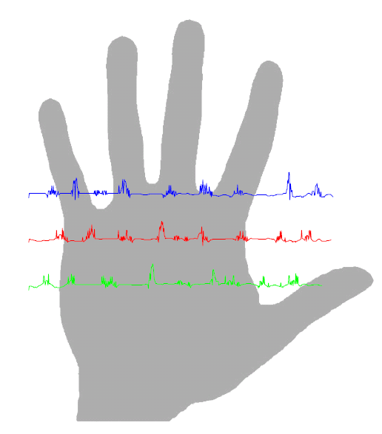
PalmPrint Identification System
By :Hamdi Boukamcha

Slide 2
CONTENTS
Biometrics
Which Biometric is the Best?
Recognition Flow Chart
Feature Extraction
Experiment & Results
Conclusion
http://matlab-recognition-code.com

Slide 3
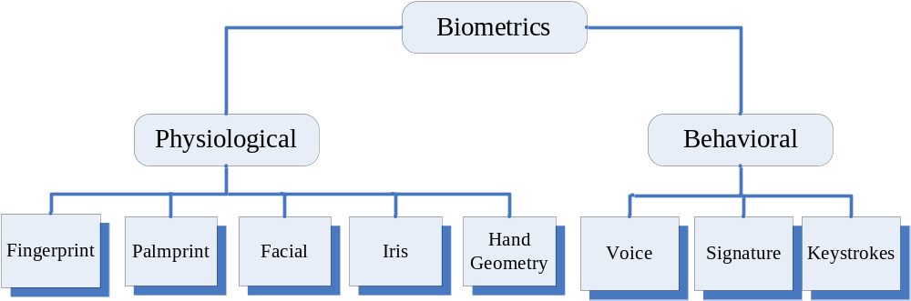
Biometric Recognition System
Biometrics :is the automated use of physiological or behavioral characteristics to determine or verify and identity a person
to determine or verify an identity
http://matlab-recognition-code.com

Slide 4
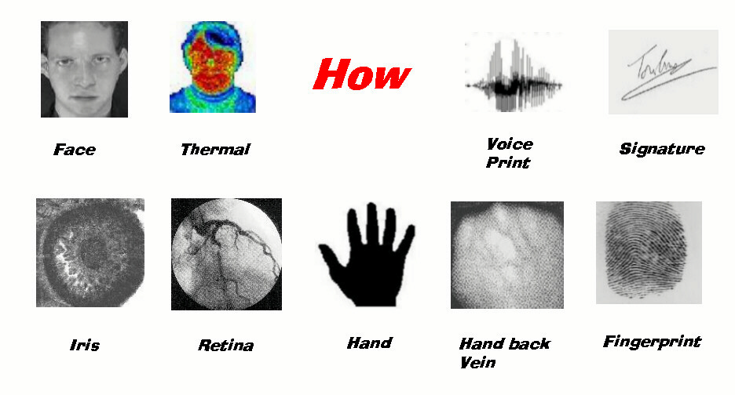
Biometrics Examples
http://matlab-recognition-code.com

Slide 5
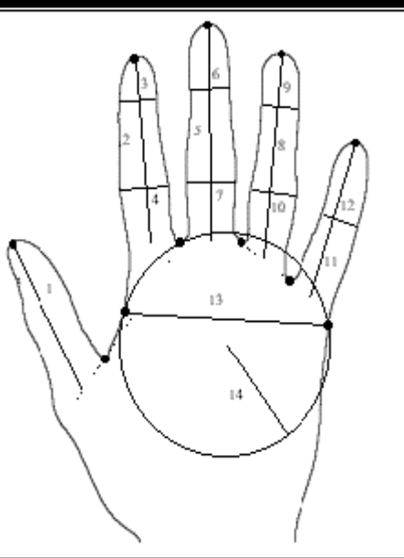
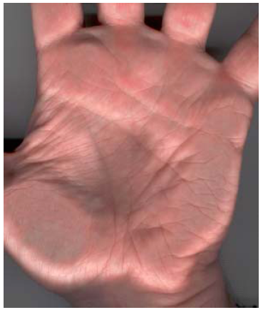
Hand and Palm Recognition
Features: dimensions and shape of the hand, fingers, (size and length)
Features: Palmprint focuses on the inner surface of a hand, its pattern of lines and the shape of its surface.
http://matlab-recognition-code.com

Slide 6
Which Biometric is the Best?
Why PalmPrint?
High Distinctiveness
High Permanence (duration)
High Performance
Medium Collectabillity
Medium Acceptability
Medium Universality
Medium Circumvention (fooling)
http://matlab-recognition-code.com

Slide 7
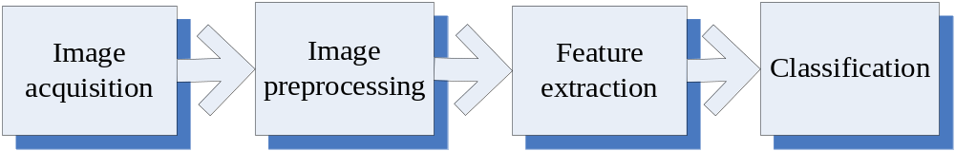
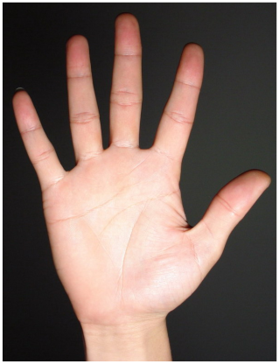
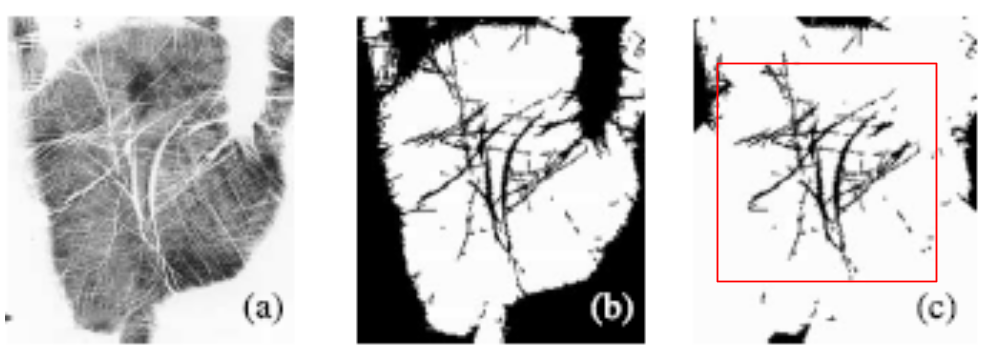
Palmprint Recognition Flowchart
http://matlab-recognition-code.com

Slide 8

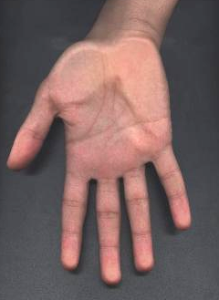
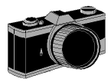
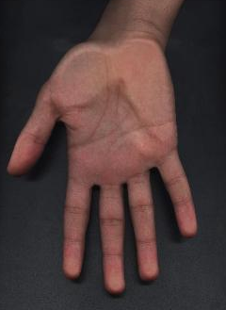
Image Acquisition
A scanner with high resolution
Degraded image
Original image

Slide 9
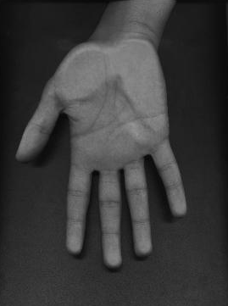
Preprocessing
Transforming image from RGB to Gray
Cut only the palm from the hand
http://matlab-recognition-code.com

Slide 10
Feature Extraction
EignPalm-based approach to extract the features of palmprint.
Find the eign-vectors that best account for the distribution of the palmprint image.
Eignvectors of the covariance matrix palmprint like in appearance, we refer to them as “EignPalms”.
http://matlab-recognition-code.com

Slide 11
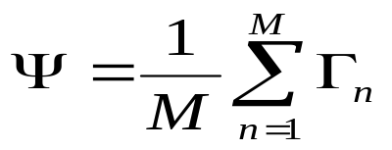
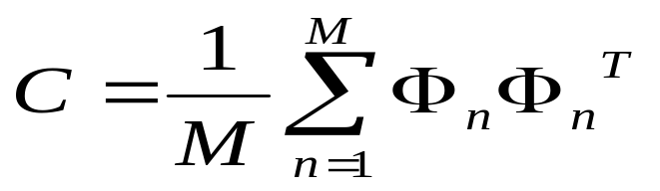

Feature Extraction
Mathematical Calculations:
Mean of training palmprints
Covariance matrix
Eigenvectors and eigenvalues
http://matlab-recognition-code.com

Slide 12
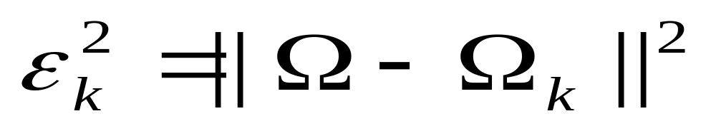

PalmPrint Matching
The Euclidian distance
Chosen threshold (Experimentally) :
Below : palmprint ‘classified’
otherwise :palmprint ‘unknown’
In Our Project : = 0.8
http://matlab-recognition-code.com

Slide 13
Experiment and Results
Steps:
1- a set of palm images of known persons
(5 images for each persons).
2- following the stages as in previous flow chart ( acquisition + pre-processing+ feature extraction)
3- using the matlab program developed of algebraic equations (EigenPalm method)
4- Testing
http://matlab-recognition-code.com

Slide 14
Testing The Program
Demo Show
Comments:
Threshold of 0.75 experminetlly
Recognition rate up to 90%
Good rate in recognition world !!
http://matlab-recognition-code.com

Slide 15
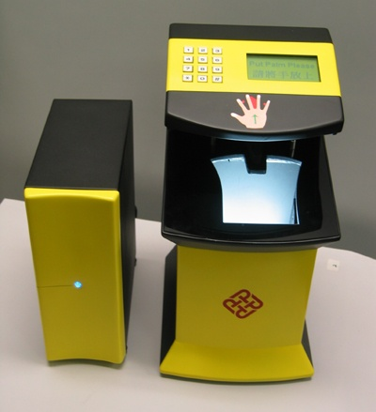
Commercial Application
Palmprint Identification System
( Polytechnic University)
http://matlab-recognition-code.com

Slide 16
CONCLUSION
Biometrics system
Different between PalmPrint &Hand
PalmPrint Recognition Flow Chart
Feature Extraction
Experiment & Results
Commercial Application
http://matlab-recognition-code.com

Slide 17
REFERENCES
[1] A. K. Jain, R. Bolle, and S. Pankanti, Biometrics: Personal Identification in Networked Society, Kulwer Academic, 1999.
[2]M.-H. Yang, D. J. Kriegman, and N. Ahuja, “Detecting faces in images: A Survey,” IEEE Trans. Patt. Anal. Machine Intell., vol. 24, pp. 34-58, Jan. 2002..
[6] J. You, W. Li, and D. Zhang, "Hierarchical palmprint identification via multiple feature extraction," Pattern Recognition., vol. 35, pp. 847-859, 2002.
[7] X. Wu, K. Wang, and D. Zhang, "Fuzzy directional energy element based palmprintidentification," Proc. ICPR-2002, Quebec City (Canada).
[8] W. Shu and D. Zhang, “Automated personal identification by palmprint,” Opt. Eng., vol. 37, no. 8, pp. 2359-2362, Aug. 1998.
[9]D. Zhang and W. Shu, “Two novel characteristics in palmprint verification: datum point invariance and line feature matching,” Pattern Recognition, vol. 32, no. 4, pp. 691-702, Apr. 1999.
[10] N. Duta, A. K. Jain, and Kanti V. Mardia, “Matching of palmprint,” Pattern Recognition. Lett., vol. 23, no. 4, pp. 477-485, Feb. 2002.
http://matlab-recognition-code.com

Slide 18

Thanks
http://matlab-recognition-code.com

