Slide 1
Group 7: Covid-19 Forecast and Analysis
George Garcia, Torreon Green, Alexander Nguyen, Edgar Sosa Leal

Slide 2
## Warning: package 'tidyverse' was built under R version 3.6.3
## -- Attaching packages ------------------------------------------------------------------------ tidyverse 1.3.0 --
## v ggplot2 3.2.1 v purrr 0.3.3 ## v tibble 2.1.3 v dplyr 0.8.4 ## v tidyr 1.0.2 v stringr 1.4.0 ## v readr 1.3.1 v forcats 0.4.0
## Warning: package 'stringr' was built under R version 3.6.3
## -- Conflicts --------------------------------------------------------------------------- tidyverse_conflicts() -- ## x dplyr::filter() masks stats::filter() ## x dplyr::lag() masks stats::lag()
## Warning: package 'forecast' was built under R version 3.6.3
## Registered S3 method overwritten by 'quantmod': ## method from ## as.zoo.data.frame zoo
## Warning: package 'BatchGetSymbols' was built under R version 3.6.3
## Loading required package: rvest
## Warning: package 'rvest' was built under R version 3.6.3
## Loading required package: xml2
## ## Attaching package: 'rvest'
## The following object is masked from 'package:purrr': ## ## pluck
## The following object is masked from 'package:readr': ## ## guess_encoding
##
## Loading required package: xts
## Loading required package: zoo
## ## Attaching package: 'zoo'
## The following objects are masked from 'package:base': ## ## as.Date, as.Date.numeric
## ## Attaching package: 'xts'
## The following objects are masked from 'package:dplyr': ## ## first, last
## Loading required package: TTR
## Version 0.4-0 included new data defaults. See ?getSymbols.

Slide 3
The Data
## date state positive negative pending hospitalized death total ## 1 2020-03-30 AK 114 3540 NA 7 3 3654 ## 2 2020-03-30 AL 859 5694 NA NA 6 6553 ## 3 2020-03-30 AR 473 5262 NA 62 7 5735 ## 4 2020-03-30 AS NA NA NA NA 0 0 ## 5 2020-03-30 AZ 1157 15602 NA 78 20 16759 ## 6 2020-03-30 CA 6447 20549 64400 1432 133 91396 ## hash datechecked totaltestresults ## 1 01a1c96fd2ed214d8747ab778c2fec7203c8cd2f 2020-03-30 20:00:00 3654 ## 2 1ced1dbd9879f8bbc4b1f7b7876b82611895d58e 2020-03-30 20:00:00 6553 ## 3 7199b3f9984cc54342a3d0f5926bff36ef440b6c 2020-03-30 20:00:00 5735 ## 4 955da7e53291581ad33f46d87bad7e4724848fea 2020-03-30 20:00:00 0 ## 5 2f64421fc130d03c93a0fa1b89e44c0324ac15a3 2020-03-30 20:00:00 16759 ## 6 ae23f3ed0050ca169785393619aae098baa36d78 2020-03-30 20:00:00 26996 ## fips deathincrease hospitalizedincrease negativeincrease positiveincrease ## 1 2 1 1 308 12 ## 2 1 2 0 1510 53 ## 3 5 1 14 2235 47 ## 4 60 0 0 0 0 ## 5 4 3 0 2649 238 ## 6 6 10 398 0 739 ## totaltestresultsincrease ## 1 320 ## 2 1563 ## 3 2282 ## 4 0 ## 5 2887 ## 6 739

Slide 4
U.S. Confirmed Cases
corona <- coronavirus %>% filter(Country.Region == "US") %>% filter(type == "confirmed") coronaCases <- corona[, c(5, 6)] coronaTotal <- coronaCases %>% mutate(total = cumsum(cases)) coronaTotal[82:88, ] # Validation set
## date cases total ## 82 2020-04-12 28917 555313 ## 83 2020-04-13 25306 580619 ## 84 2020-04-14 27051 607670 ## 85 2020-04-15 28680 636350 ## 86 2020-04-16 31451 667801 ## 87 2020-04-17 31905 699706 ## 88 2020-04-18 32491 732197

Slide 5
Time Series
coronaTrain <- coronaTotal[1:81, ] coronaValid <- coronaTotal[82:88, ] coronaTrainTS <- ts(coronaTrain$total, start = 1, end = 81, freq = 1) coronaValidTS <- ts(coronaValid$total, start = 82, end = 88, freq = 1)

Slide 6
Linear Model
## ## Call: ## tslm(formula = coronaTrainTS ~ trend) ## ## Residuals: ## Min 1Q Median 3Q Max ## -118150 -75003 -12792 53519 306841 ## ## Coefficients: ## Estimate Std. Error t value Pr(>|t|) ## (Intercept) -96421 21544 -4.48 0.00002528929220 *** ## trend 3901 456 8.55 0.00000000000075 *** ## --- ## Signif. codes: 0 '***' 0.001 '**' 0.01 '*' 0.05 '.' 0.1 ' ' 1 ## ## Residual standard error: 96000 on 79 degrees of freedom ## Multiple R-squared: 0.48, Adjusted R-squared: 0.474 ## F-statistic: 73 on 1 and 79 DF, p-value: 0.000000000000749

Slide 7
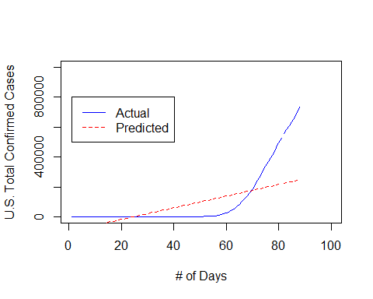
Linear Model: Forecast

Slide 8
Linear Model: Accuracy
## ME RMSE MAE MPE MAPE ACF1 Theil's U ## Test set 404792 408052 404792 63.1 63.1 0.575 14.1

Slide 9
Quadratic Model
## ## Call: ## tslm(formula = coronaTrainTS ~ trend + I(trend^2)) ## ## Residuals: ## Min 1Q Median 3Q Max ## -85436 -44644 7231 40733 135957 ## ## Coefficients: ## Estimate Std. Error t value Pr(>|t|) ## (Intercept) 87603.0 18123.4 4.83 0.000006587539966 *** ## trend -9402.0 1020.1 -9.22 0.000000000000041 *** ## I(trend^2) 162.2 12.1 13.46 < 0.0000000000000002 *** ## --- ## Signif. codes: 0 '***' 0.001 '**' 0.01 '*' 0.05 '.' 0.1 ' ' 1 ## ## Residual standard error: 53000 on 78 degrees of freedom ## Multiple R-squared: 0.844, Adjusted R-squared: 0.84 ## F-statistic: 210 on 2 and 78 DF, p-value: <0.0000000000000002

Slide 10
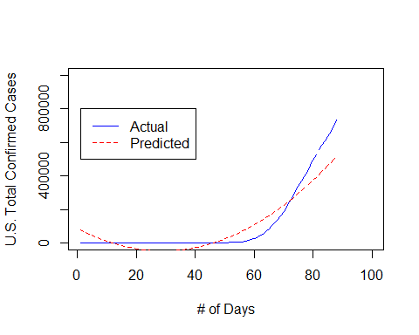
Quadratic Model: Forecast

Slide 11
Quadratic Model: Accuracy
## ME RMSE MAE MPE MAPE ACF1 Theil's U ## Test set 178750 180219 178750 27.8 27.8 0.578 6.23

Slide 12
Exponential Model
## ## Call: ## tslm(formula = coronaTrainTS ~ trend, lambda = 0) ## ## Residuals: ## Min 1Q Median 3Q Max ## -2.017 -0.968 0.174 0.903 1.780 ## ## Coefficients: ## Estimate Std. Error t value Pr(>|t|) ## (Intercept) -1.04467 0.23056 -4.53 0.000021 *** ## trend 0.17483 0.00488 35.79 < 0.0000000000000002 *** ## --- ## Signif. codes: 0 '***' 0.001 '**' 0.01 '*' 0.05 '.' 0.1 ' ' 1 ## ## Residual standard error: 1.03 on 79 degrees of freedom ## Multiple R-squared: 1, Adjusted R-squared: 1 ## F-statistic: 6.8e+11 on 1 and 79 DF, p-value: <0.0000000000000002

Slide 13
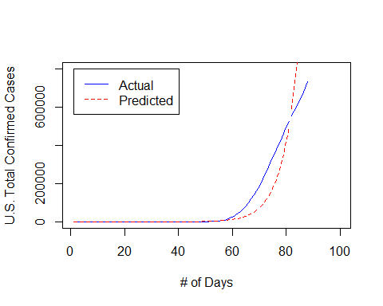
Exponential Model: Forecast

Slide 14
Exponential Model: Accuracy
## ME RMSE MAE MPE MAPE ACF1 Theil's U ## Test set -422488 522567 422488 -62.2 62.2 0.552 17.9

Slide 15
AR(1) Model: Random Walk Test
AR(1) model slope coefficient is within 1-2 standard errors of 1
Fails random walk test -> stick to naive LM
## Series: modelExp$residuals ## ARIMA(1,0,0) with non-zero mean ## ## Coefficients: ## ar1 mean ## 0.974 0.221 ## s.e. 0.019 0.635 ## ## sigma^2 estimated as 0.043: log likelihood=12.1 ## AIC=-18.1 AICc=-17.8 BIC=-10.9 ## ## Training set error measures: ## ME RMSE MAE MPE MAPE MASE ACF1 ## Training set -0.0139 0.205 0.144 7.57 35.4 1 0.00862

Slide 16
Part II: Impact on S&P 500
companies <- 'SPY' begin <- Sys.Date() - 200 end <- Sys.Date() stockData <- BatchGetSymbols(tickers = companies, first.date = begin, last.date = end, do.cache = FALSE)
## ## Running BatchGetSymbols for: ## tickers =SPY ## Downloading data for benchmark ticker ## ^GSPC | yahoo (1|1) ## SPY | yahoo (1|1) - Got 100% of valid prices | Nice!
SPY <- stockData$df.tickers %>% filter(ticker == "SPY") head(SPY)
## price.open price.high price.low price.close volume price.adjusted ## 1 291 295 291 294 65091200 291 ## 2 293 295 293 293 59610500 290 ## 3 291 292 288 289 95708100 285 ## 4 291 292 290 291 62359400 288 ## 5 291 294 291 293 55296300 290 ## 6 296 299 296 296 98720400 293 ## ref.date ticker ret.adjusted.prices ret.closing.prices ## 1 2019-10-04 SPY NA NA ## 2 2019-10-07 SPY -0.00431 -0.00431 ## 3 2019-10-08 SPY -0.01552 -0.01552 ## 4 2019-10-09 SPY 0.00950 0.00950 ## 5 2019-10-10 SPY 0.00676 0.00676 ## 6 2019-10-11 SPY 0.01037 0.01037
SPYTrain <- SPY[1:97, ] SPYValid <- SPY[98:136, ]

Slide 17
Quadratic Model
# Time series til Feb 19, 2020 SPYTS <- ts(SPYTrain$price.close, start = c(2019, 10), end = c(2020, 02), freq = 97) SPYValidTS <- ts(SPYValid$price.close, start = c(2020, 02), end = c(2020, 04), freq = 41) SPYQuad <- tslm(SPYTS ~ trend + I(trend^2)) summary(SPYQuad)
## ## Call: ## tslm(formula = SPYTS ~ trend + I(trend^2)) ## ## Residuals: ## Min 1Q Median 3Q Max ## -8.671 -0.991 0.447 1.521 4.593 ## ## Coefficients: ## Estimate Std. Error t value Pr(>|t|) ## (Intercept) 292.212939 0.783588 372.92 < 0.0000000000000002 *** ## trend 0.608868 0.039745 15.32 < 0.0000000000000002 *** ## I(trend^2) -0.001746 0.000423 -4.13 0.000084 *** ## --- ## Signif. codes: 0 '***' 0.001 '**' 0.01 '*' 0.05 '.' 0.1 ' ' 1 ## ## Residual standard error: 2.42 on 87 degrees of freedom ## Multiple R-squared: 0.96, Adjusted R-squared: 0.96 ## F-statistic: 1.06e+03 on 2 and 87 DF, p-value: <0.0000000000000002

Slide 18
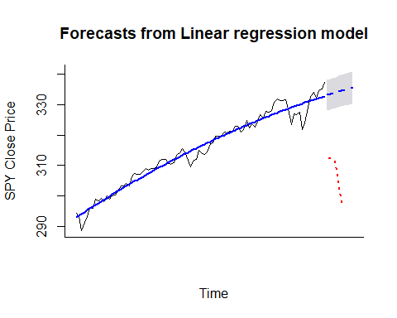
Quadratic Model: Forecast

