Slide 1
Group 7: Covid-19 Forecast and Analysis
George Garcia, Torreon Green, Alexander Nguyen, Edgar Sosa Leal

Slide 2
## Warning: package 'tidyverse' was built under R version 3.6.3
## -- Attaching packages ------------------------------------------------------------------------ tidyverse 1.3.0 --
## v ggplot2 3.2.1 v purrr 0.3.3 ## v tibble 2.1.3 v dplyr 0.8.4 ## v tidyr 1.0.2 v stringr 1.4.0 ## v readr 1.3.1 v forcats 0.4.0
## Warning: package 'stringr' was built under R version 3.6.3
## -- Conflicts --------------------------------------------------------------------------- tidyverse_conflicts() -- ## x dplyr::filter() masks stats::filter() ## x dplyr::lag() masks stats::lag()
## Warning: package 'forecast' was built under R version 3.6.3
## Registered S3 method overwritten by 'quantmod': ## method from ## as.zoo.data.frame zoo
## Warning: package 'BatchGetSymbols' was built under R version 3.6.3
## Loading required package: rvest
## Warning: package 'rvest' was built under R version 3.6.3
## Loading required package: xml2
## ## Attaching package: 'rvest'
## The following object is masked from 'package:purrr': ## ## pluck
## The following object is masked from 'package:readr': ## ## guess_encoding
##

Slide 3
The Data
## date state positive negative pending hospitalized death total ## 1 2020-03-30 AK 114 3540 NA 7 3 3654 ## 2 2020-03-30 AL 859 5694 NA NA 6 6553 ## 3 2020-03-30 AR 473 5262 NA 62 7 5735 ## 4 2020-03-30 AS NA NA NA NA 0 0 ## 5 2020-03-30 AZ 1157 15602 NA 78 20 16759 ## 6 2020-03-30 CA 6447 20549 64400 1432 133 91396 ## hash datechecked totaltestresults ## 1 01a1c96fd2ed214d8747ab778c2fec7203c8cd2f 2020-03-30 20:00:00 3654 ## 2 1ced1dbd9879f8bbc4b1f7b7876b82611895d58e 2020-03-30 20:00:00 6553 ## 3 7199b3f9984cc54342a3d0f5926bff36ef440b6c 2020-03-30 20:00:00 5735 ## 4 955da7e53291581ad33f46d87bad7e4724848fea 2020-03-30 20:00:00 0 ## 5 2f64421fc130d03c93a0fa1b89e44c0324ac15a3 2020-03-30 20:00:00 16759 ## 6 ae23f3ed0050ca169785393619aae098baa36d78 2020-03-30 20:00:00 26996 ## fips deathincrease hospitalizedincrease negativeincrease positiveincrease ## 1 2 1 1 308 12 ## 2 1 2 0 1510 53 ## 3 5 1 14 2235 47 ## 4 60 0 0 0 0 ## 5 4 3 0 2649 238 ## 6 6 10 398 0 739 ## totaltestresultsincrease ## 1 320 ## 2 1563 ## 3 2282 ## 4 0 ## 5 2887 ## 6 739

Slide 4
Compute the number of positive cases daily
covid.diff <-covidData %>% group_by(state) %>% mutate(Diff = positive - lead(positive)) covidData.sort2 <- covid.diff %>% arrange(date) covid.sort3 <- covidData.sort2 %>% group_by(date) %>% summarize(totals = sum(Diff)) covid.sort3
## # A tibble: 27 x 2 ## date totals ## <fct> <int> ## 1 2020-03-04 NA ## 2 2020-03-05 NA ## 3 2020-03-06 NA ## 4 2020-03-07 NA ## 5 2020-03-08 76 ## 6 2020-03-09 167 ## 7 2020-03-10 194 ## 8 2020-03-11 275 ## 9 2020-03-12 262 ## 10 2020-03-13 607 ## # ... with 17 more rows

Slide 5
U.S. Confirmed Cases
corona <- coronavirus %>% filter(Country.Region == "US") %>% filter(type == "confirmed") coronaCases <- corona[, c(5, 6)] coronaTotal <- coronaCases %>% mutate(total = cumsum(cases)) coronaTotal[82:88, ] # Validation set
## date cases total ## 82 2020-04-12 28917 555313 ## 83 2020-04-13 25306 580619 ## 84 2020-04-14 27051 607670 ## 85 2020-04-15 28680 636350 ## 86 2020-04-16 31451 667801 ## 87 2020-04-17 31905 699706 ## 88 2020-04-18 32491 732197

Slide 6
Time Series Exponential Model
coronaTrain <- coronaTotal[1:81, ] coronaValid <- coronaTotal[82:88, ] coronaTrainTS <- ts(coronaTrain$total, start = 1, end = 81, freq = 1) coronaValidTS <- ts(coronaValid$total, start = 82, end = 88, freq = 1) modelLM <- tslm(coronaTrainTS ~ trend, lambda = 0) # Lambda = 0 for exponential fit. summary(modelLM)
## ## Call: ## tslm(formula = coronaTrainTS ~ trend, lambda = 0) ## ## Residuals: ## Min 1Q Median 3Q Max ## -2.017 -0.968 0.174 0.903 1.780 ## ## Coefficients: ## Estimate Std. Error t value Pr(>|t|) ## (Intercept) -1.04467 0.23056 -4.53 0.000021 *** ## trend 0.17483 0.00488 35.79 < 0.0000000000000002 *** ## --- ## Signif. codes: 0 '***' 0.001 '**' 0.01 '*' 0.05 '.' 0.1 ' ' 1 ## ## Residual standard error: 1.03 on 79 degrees of freedom ## Multiple R-squared: 1, Adjusted R-squared: 1 ## F-statistic: 6.8e+11 on 1 and 79 DF, p-value: <0.0000000000000002

Slide 7
Random Walk Test
AR(1) model slope coefficient is within 5 standard errors of 1
Fails random walk test -> stick to naive LM
modelARIMA <- Arima(modelLM$residuals, order = c(1,0,0)) predictARIMA <- forecast(modelARIMA, h = 7) summary(modelARIMA)
## Series: modelLM$residuals ## ARIMA(1,0,0) with non-zero mean ## ## Coefficients: ## ar1 mean ## 0.974 0.221 ## s.e. 0.019 0.635 ## ## sigma^2 estimated as 0.043: log likelihood=12.1 ## AIC=-18.1 AICc=-17.8 BIC=-10.9 ## ## Training set error measures: ## ME RMSE MAE MPE MAPE MASE ACF1 ## Training set -0.0139 0.205 0.144 7.57 35.4 1 0.00862

Slide 8
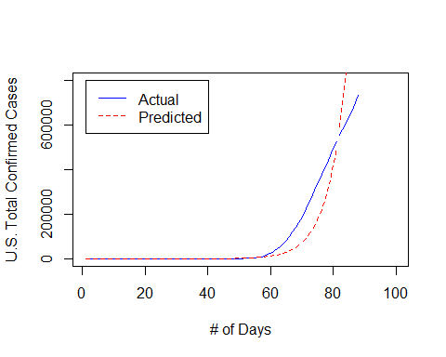
Forecast: Post- April 12, 2020

Slide 9
Quadratic Model
## ## Call: ## tslm(formula = coronaTrainTS ~ trend + I(trend^2)) ## ## Residuals: ## Min 1Q Median 3Q Max ## -85436 -44644 7231 40733 135957 ## ## Coefficients: ## Estimate Std. Error t value Pr(>|t|) ## (Intercept) 87603.0 18123.4 4.83 0.000006587539966 *** ## trend -9402.0 1020.1 -9.22 0.000000000000041 *** ## I(trend^2) 162.2 12.1 13.46 < 0.0000000000000002 *** ## --- ## Signif. codes: 0 '***' 0.001 '**' 0.01 '*' 0.05 '.' 0.1 ' ' 1 ## ## Residual standard error: 53000 on 78 degrees of freedom ## Multiple R-squared: 0.844, Adjusted R-squared: 0.84 ## F-statistic: 210 on 2 and 78 DF, p-value: <0.0000000000000002

Slide 10
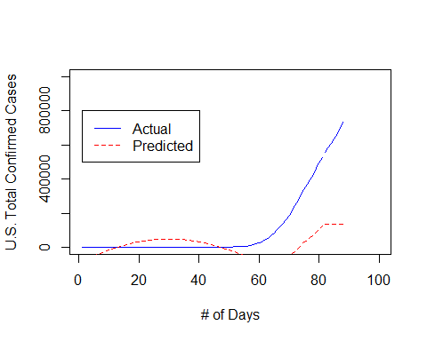
Quadratic Model

Slide 11
Part II: Impact on S&P 500
companies <- 'SPY' begin <- Sys.Date() - 200 end <- Sys.Date() stockData <- BatchGetSymbols(tickers = companies, first.date = begin, last.date = end, do.cache = FALSE)
## ## Running BatchGetSymbols for: ## tickers =SPY ## Downloading data for benchmark ticker ## ^GSPC | yahoo (1|1) ## SPY | yahoo (1|1) - Got 100% of valid prices | Nice!
SPY <- stockData$df.tickers %>% filter(ticker == "SPY") head(SPY)
## price.open price.high price.low price.close volume price.adjusted ## 1 288 290 285 290 85278800 287 ## 2 291 295 291 294 65091200 291 ## 3 293 295 293 293 59610500 290 ## 4 291 292 288 289 95708100 285 ## 5 291 292 290 291 62359400 288 ## 6 291 294 291 293 55296300 290 ## ref.date ticker ret.adjusted.prices ret.closing.prices ## 1 2019-10-03 SPY NA NA ## 2 2019-10-04 SPY 0.01353 0.01353 ## 3 2019-10-07 SPY -0.00431 -0.00431 ## 4 2019-10-08 SPY -0.01552 -0.01552 ## 5 2019-10-09 SPY 0.00950 0.00950 ## 6 2019-10-10 SPY 0.00676 0.00676
SPYTrain <- SPY[1:97, ] SPYValid <- SPY[98:136, ]

Slide 12
Quadratic Model
## ## Call: ## tslm(formula = SPYTS ~ trend + I(trend^2)) ## ## Residuals: ## Min 1Q Median 3Q Max ## -8.328 -1.174 0.381 1.522 4.760 ## ## Coefficients: ## Estimate Std. Error t value Pr(>|t|) ## (Intercept) 291.257345 0.767699 379.39 < 0.0000000000000002 *** ## trend 0.634383 0.038939 16.29 < 0.0000000000000002 *** ## I(trend^2) -0.002011 0.000415 -4.85 0.0000054 *** ## --- ## Signif. codes: 0 '***' 0.001 '**' 0.01 '*' 0.05 '.' 0.1 ' ' 1 ## ## Residual standard error: 2.37 on 87 degrees of freedom ## Multiple R-squared: 0.962, Adjusted R-squared: 0.961 ## F-statistic: 1.11e+03 on 2 and 87 DF, p-value: <0.0000000000000002

Slide 13
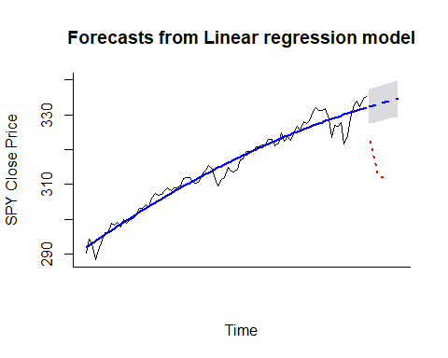
Forecast

