Slide 1
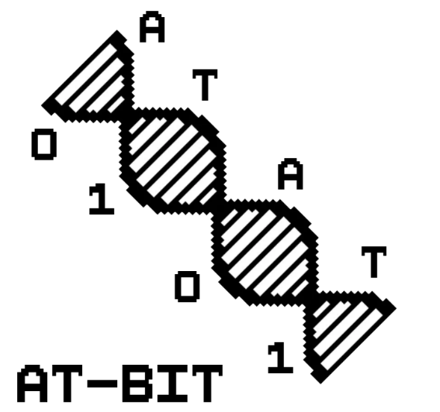
Master 1 – Algorithm Project Presentation
George Alehandro Saad

Slide 2
2 Algorithms, 1 Program
The point of this GUI is making a functional program that can run both of the algorithms:
Burrows–Wheeler transform
Huffman Compression
Comprehensive repartition of the different components by using a MVC model.

Slide 3
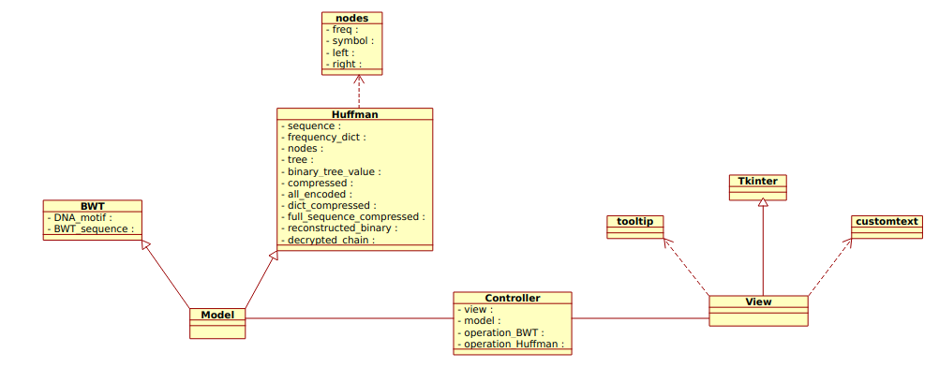
Scripts repartition

Slide 4
Used data structures
For the BWT transformation, I used a normal python list() thanks to its speedy execution.
Also for Huffman compression, most of the operations were based on lists.

Slide 5
Burrows–Wheeler Transform
Transform of a DNA Motif (A, T, C, G, N) into a BWT Sequence that contains a ‘$’.
Part of bzip2 compressions.
Vice-versa -> Concludes the DNA motif from the input BWT Sequence.

Slide 6
Huffman Coding: Compression
All the compression data is stored in one file.
Mapping of the dictionary, limited by 2 white squares (that aren’t coded in 8-bit).
Sequence coded in 8 bit-characters
@#$lldlkfsd@#$#$! 3 □&%^# □N$
Size of the last 8-bit
C
Doesn’t have
A
G
T

Slide 7
Pedagogic Mode
Using python generators, by combining yield and next.
Step-by-step comprehensive method.
Doesn’t store the ancient data in the memory. (It updates it!)

Slide 8
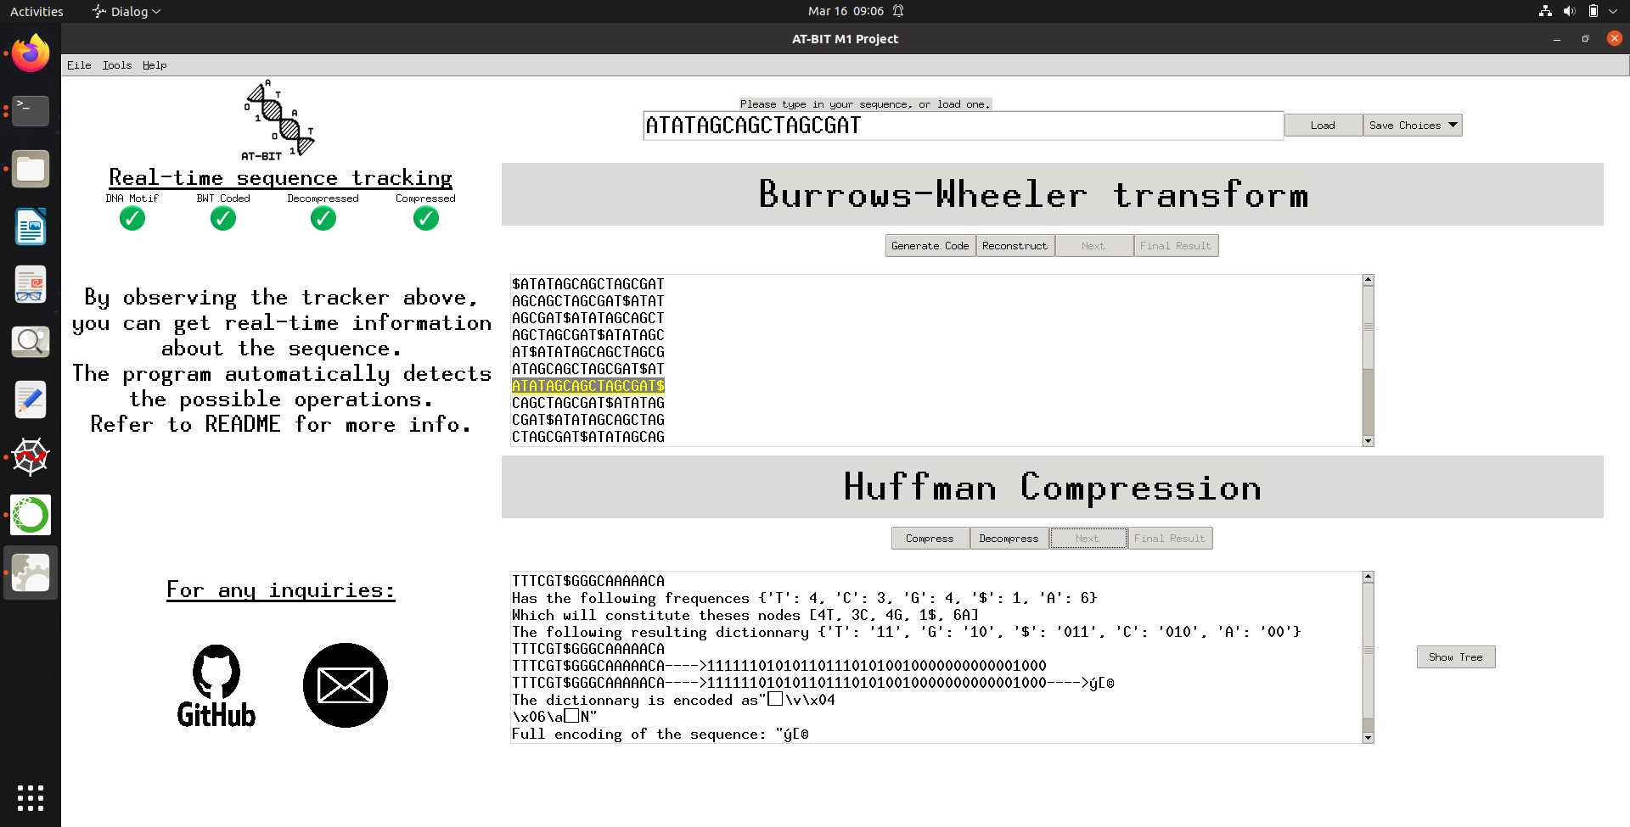
Interface demonstration

Slide 9
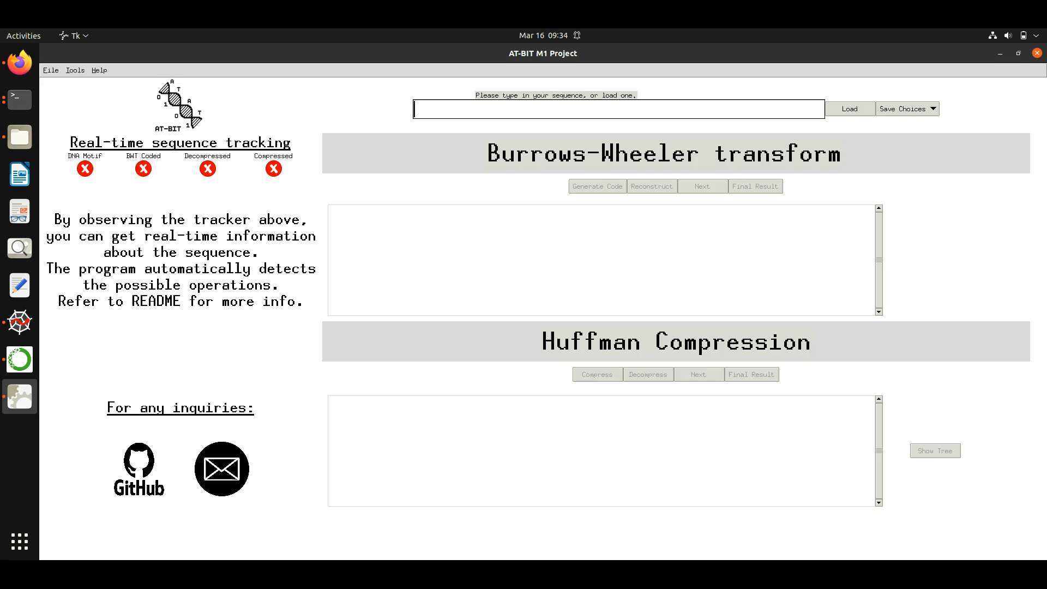
Interface demonstration

