Slide 1
Wordle
George

Slide 2
Mr. Bugs' Wordy Nugz
Josh Wardle Wikipedia
5-bogstaver ord
6 forsøg
Hvert forsøg vil fortælle dig, om bogstaverne i dit gæt findes i det rigtige ord
Notes:
Tried to google it
Original name- good they changed it

Slide 3
Opgaven
Byg spillet
UI ☹
Testning
ReadMe
Præsentation
Demo
Notes:
UI hopefully next week

Slide 4
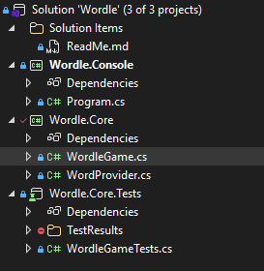
Arkitektur

Slide 5
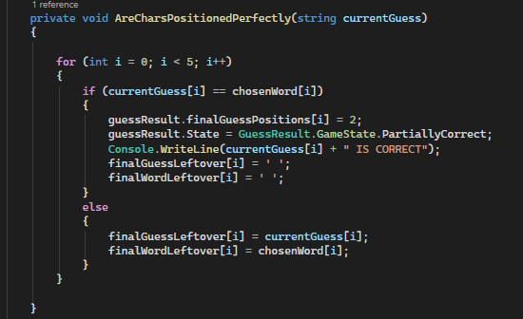
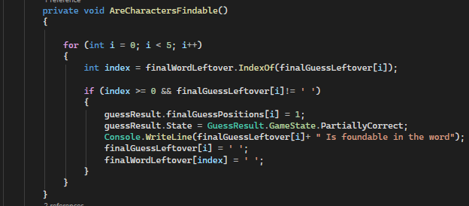
Dagens ord: CELLO
Notes:
2 tracking systems
One for UI
One internal char removal

Slide 6
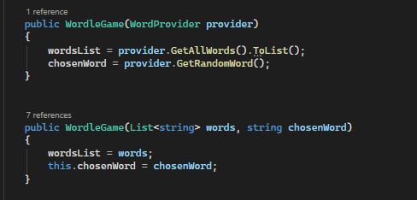
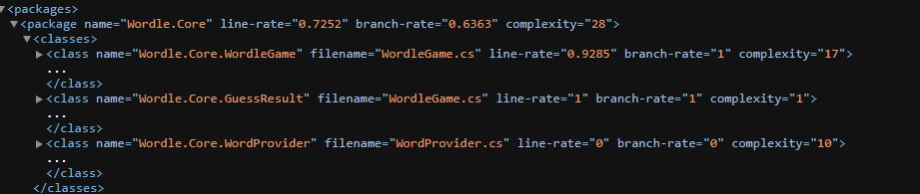
Test
Notes:
Code coverage
Test mostly the games logic
Found out if you delete the code, test coverage shoots up.

Slide 7
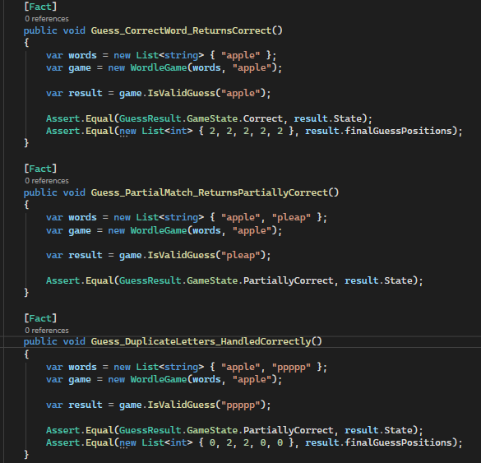
Test II
Notes:
Code coverage
Test mostly the games logic
Found out if you delete the code, test coverage shoots up.

Slide 8
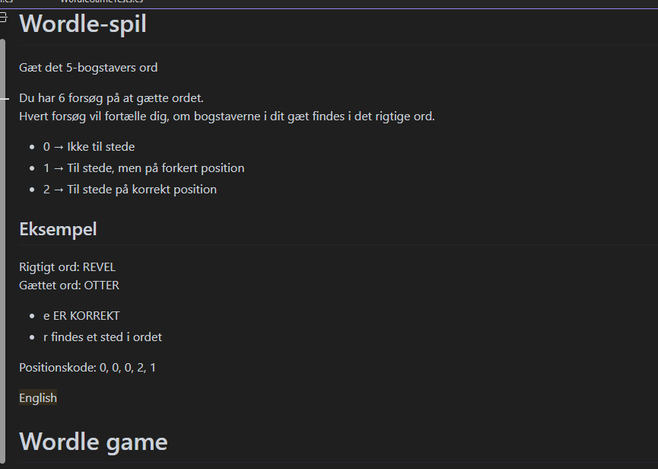
Readme

Slide 9
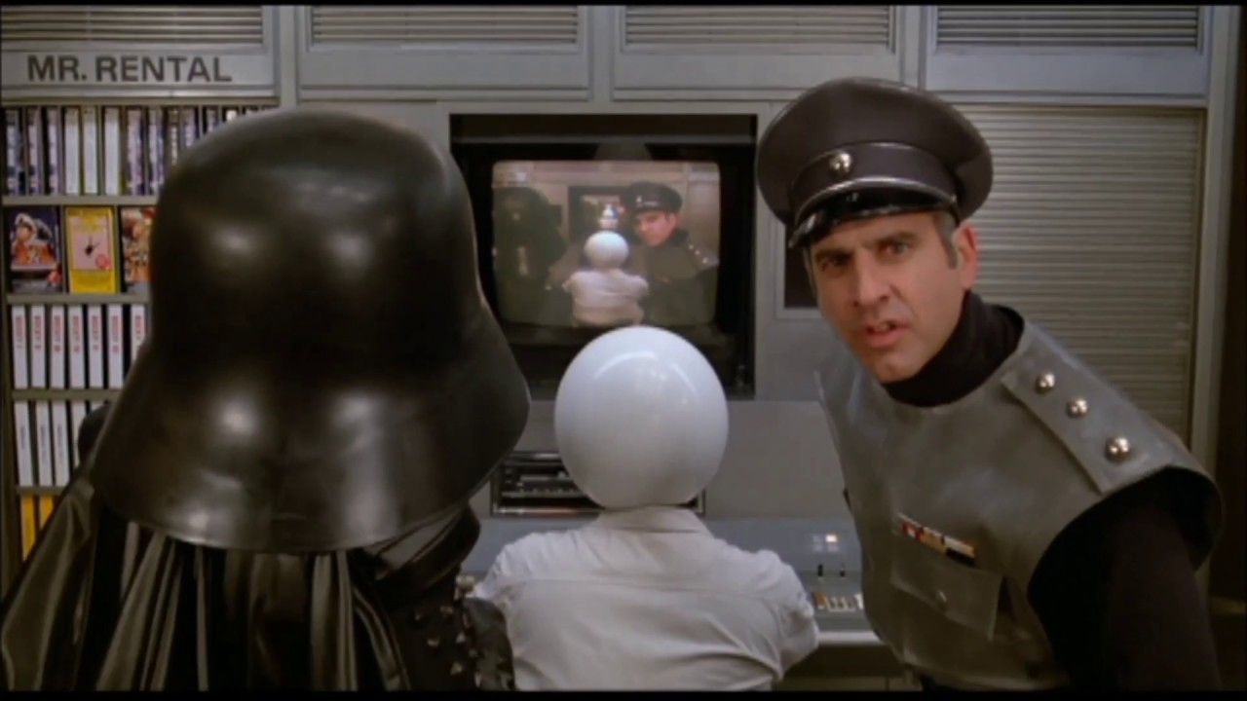
Præsentation

Slide 10
DEMO_

Slide 11
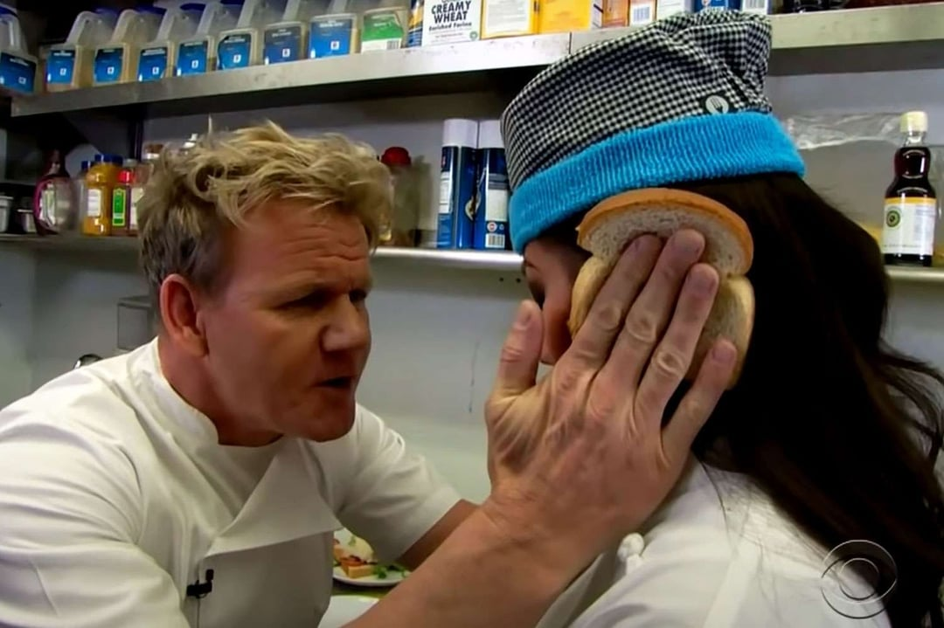
Feedback

