Slide 1
Medico automatic polyp segmentation challenge*
George Batchkala, November 2020
* https://multimediaeval.github.io/editions/2020/

Slide 2
Motivation
Colorectal cancer (CRC) is the third most prevailing strain in terms of cancer incidence and second in terms of mortality globally.
Colonoscopy is mainly used to detect abnormalities such as cancer.
~ 20% of polyps are missed during colonoscopy
An automated computer-aided diagnosis (CAD) system could be one of the potential solutions for the overlooked polyps.

Slide 3
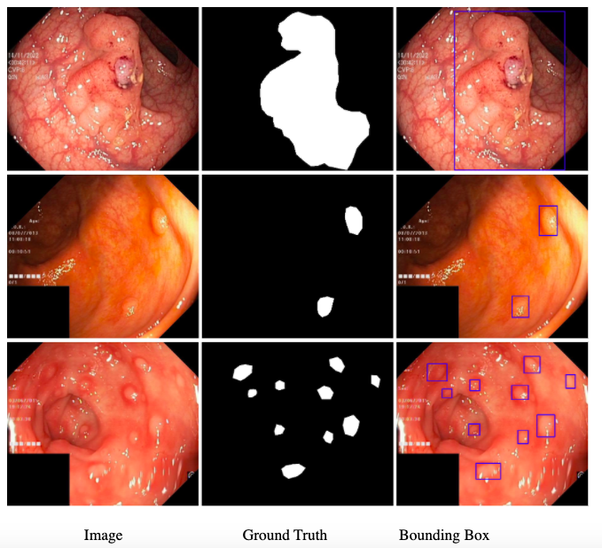
Data: Kvasir-SEG Dataset
1000 training pairs
Pre-defined split: 880/120
Sizes: from 332x487 to 1920x1072 pixels
Separate testing set
Note, we only focus on the segmentation problem.

Slide 4
Typical Metrics for Segmentation Tasks
Challenge Focus
Binary Cross Entropy
Intersection over Union (IoU)
Dice Coefficient
Intersection over Union (IoU)
Dice Coefficient (to resolve ties)

Slide 5
Methods 1: Preprocessing
Resize to 256 x 256 pixels
Normalize Images. Use means and std-s pre-computed from training set.
Binarize masks

Slide 6
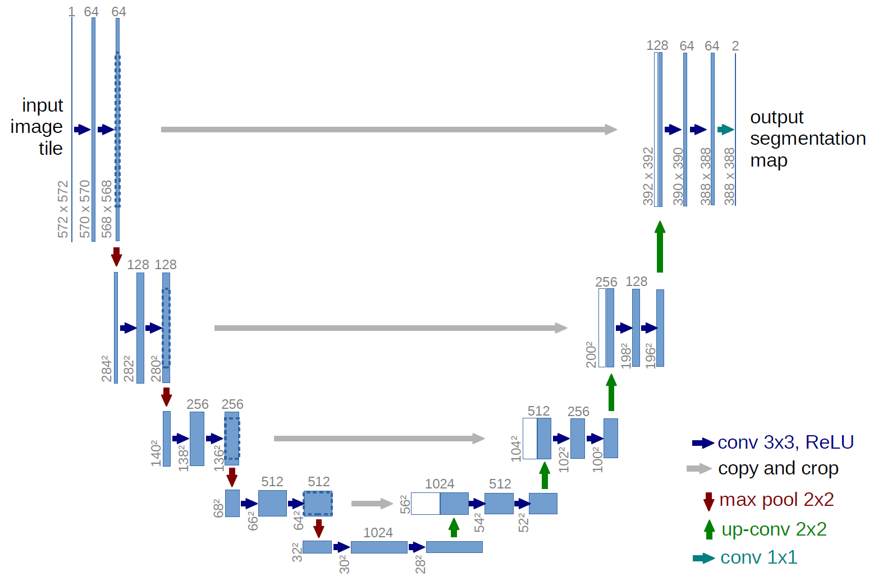
Methods 2: Architecture

Slide 7
Methods 3: Losses
Problems
Intersection over Union (IoU)
Binary Cross Entropy (BCE)
Combined
IoU requires binary mask as an output of the model
Binarizing IoU reduces gradient-flow
Using non-binarized IoU is hard to interpret

Slide 8
Methods 3: Losses - Decision
Training:
Non-binarized Intersection over Union (IoU)
Binary Cross Entropy (BCE)
Combined
Validation:
Binarized Intersection over Union (IoU)

Slide 9
Methods 4: Epochs, Optimisation
40 epochs, best model chosen according to the validation IoU
Optimiser: Adam
Learning rate: 1e-4
Weight decay: 1e-8

Slide 10
Results, Validation set
Loss | Best Epoch | Train IoU | Val IoU
BCE | 34 | 0.932 | 0.689
IoU | 37 | 0.893 | 0.685
Combined | 34 | 0.908 | 0.665
BCE: Binary Cross Entropy
IoU: Intersection over Union
Combined: BCE and IoU together
Note, reported IoU scores were computed for resized masks.

Slide 11
Possible Improvements
Use Augmentation and Dropout for regularisation
Try different variations of the U-Net:
Trainable downsampling layers, e.g. convolutions with stride > 1
Sophisticated “Information” blocks, e.g. Inception blocks, Dilated convolutions
ResNet blocks after Concationations
Try different optimisers
Note, mean IoU score for the test set will be provided by the challenge organisers.

