Slide 1
Image Analysis of Pap-Smear dataset.
George Batchkala

Slide 2
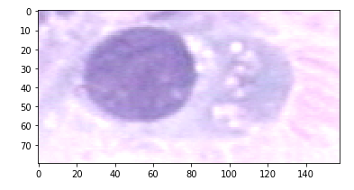
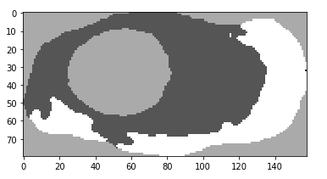
EDA
The data is split into 7 classes
Images are given in 3 channels
Masks are given in 4 channels
Example of an image from `normal_columnar` set (left) with the corresponding mask (right).

Slide 3
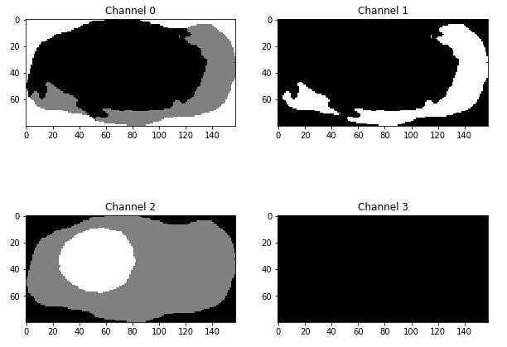
Choosing How to Work with Data: 1
Masks contain 4 channels and segment many images in 4 regions while only 3 regions representing the nucleus, cytoplasm, and the background are desired.

Slide 4
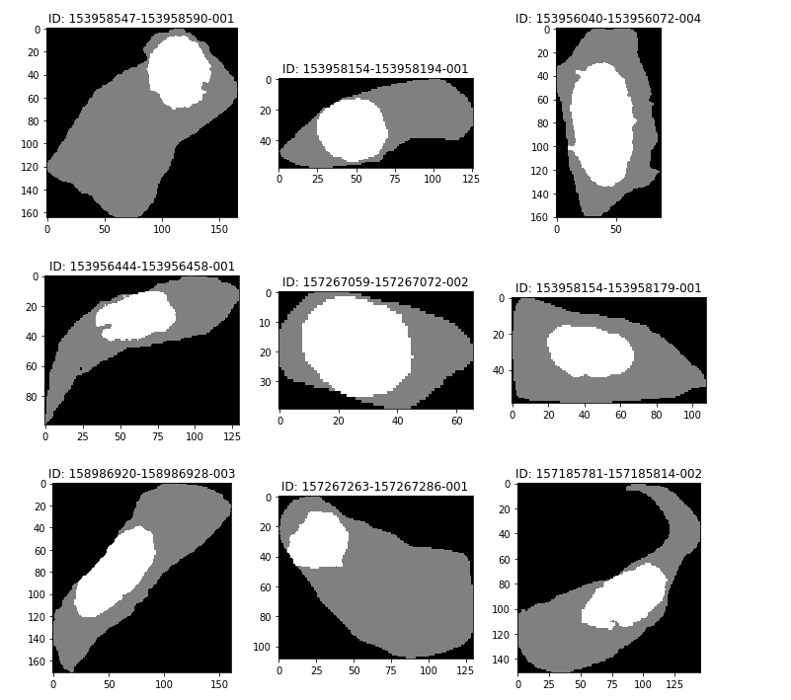
Choosing How to Work with Data: 2
9 randomly selected channel-2 masks across all sets.
Inspection of all masks in `normal_columnar` set shows that channel-2 has exactly 3 distinct values of intensity:
Background: 0
Cytoplasm: 128
Nucleus: 255

Slide 5
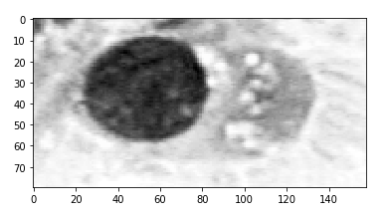
Thresholding
To perform the segmentation using thresholding original images were first converted into one channel by averaging the intensities.
Example of an image from `normal_columnar` set (left ) and the corresponding image averaged across channels (right).

Slide 6
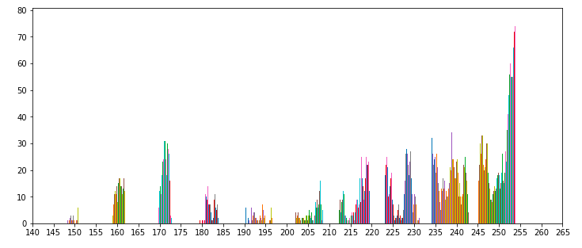
Manual Thresholding: 1
First an attempt of thresholding the image manually using the histogram of intensities was performed.

Slide 7
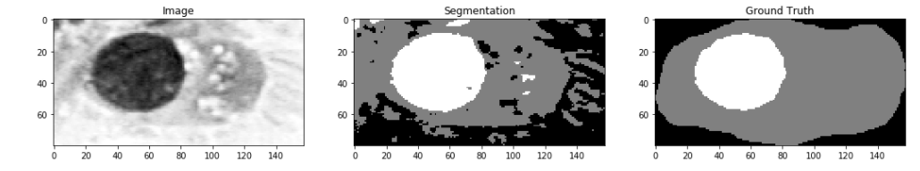
Manual Thresholding: 2
I decided to cut off at intensities of 200 and 245. Result below:
Dice Scores for Nucleus, Cytoplasm, and Background respectively :
This Particular Image: 0.94, 0.74, 0.49
normal_columnar all: 0.40, 0.17, 0.09
As expected, I overfitted when choosing thresholds by looking at the histogram

Slide 8
Otsu Thresholding into Multiple Classes
Next, I decided to do exactly the same, but now use an automatically selected thresholds (otsu) for each image. Note, that 2-threshold method was used: https://scikit-image.org/docs/dev/auto_examples/segmentation/plot_multiotsu.html
Dice Scores for Nucleus, Cytoplasm, and Background respectively :
First image: 0.95, 0.51, 0.45
All images: 0.72, 0.58, 0.47
This resulted in an improvement of the mean dice-score across all images compared to using manually selected thresholds at a computational cost of computing thresholds for all images separately.

Slide 9
Otsu Thresholding, Median Filter
Now I decided to use the median filter for denoising original images before applying the otsu-thresholding method. However, the size of the filter had to be chosen – it was overfitted to the dataset.
The filter radius was run from 0 (no change) to 15 included.
Both for the 1-image (with disk of radius 9) and all-images cases (with disc of radius 4) there was an improvement in the dice scores. See Table of the results for exact numbers.

Slide 10
Otsu Thresholding, Other Filters
Finally, I decided to explore the 4 filters shown in the lectures for vessel detection:
Sato;
Meijering;
Frangi; and
Hessian
None of them improved upon the results of otsu-thresholding.

Slide 11
Results: Binary Dice Coefficient
One image from `normal_columnar` set
All images from `normal_columnar` set
Method | Nucleus: 1 | Cytoplasm: 1 | Background: 1 | Nucleus: all | Cytoplasm: all | Background: all
Manual | 0.94 | 0.74 | 0.49 | 0.40 | 0.17 | 0.09
Otsu | 0.95 | 0.51 | 0.45 | 0.72 | 0.58 | 0.47
Otsu + median | 0.97 | 0.62 | 0.45 | 0.73 | 0.59 | 0.48
Otsu + sato | 0.00 | 0.46 | 0.06 | 0.05 | 0.37 | 0.09
Otsu + meijering | 0.00 | 0.27 | 0.00 | 0.08 | 0.27 | 0.04
Otsu + frangi | 0.06 | 0.04 | 0.00 | 0.13 | 0.15 | 0.02
Otsu + hessian | 0.41 | 0.28 | 0.4 | 0.37 | 0.28 | 0.42
Median filtering with disk radius 4 followed by otsu-thresholding with 2 thresholds produced best results for the normal_columnar subset of the pap-smear dataset.

Slide 12
Possible Improvements
K-Means will be very interesting to explore, however the automatic procedure to map clusters to the corresponding labels (nucleus, cytoplasm, background) must be established before trying to assess the performance
Using SLIC Superpixels is another pre-processing method to consider
Segmentation via Deep-Learning U-Net-type models will be interesting to perform

