Slide 1
38T Bogie spring leaf removal
Field Conversion trial - ESK

Slide 2
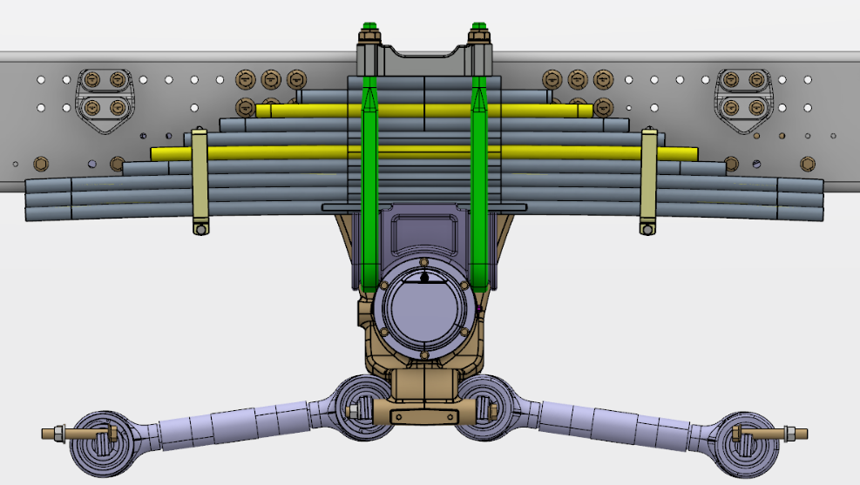
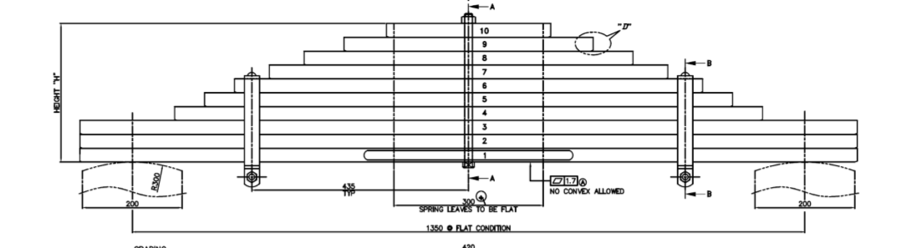
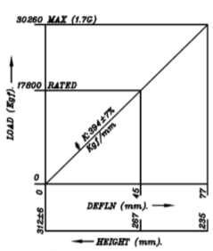
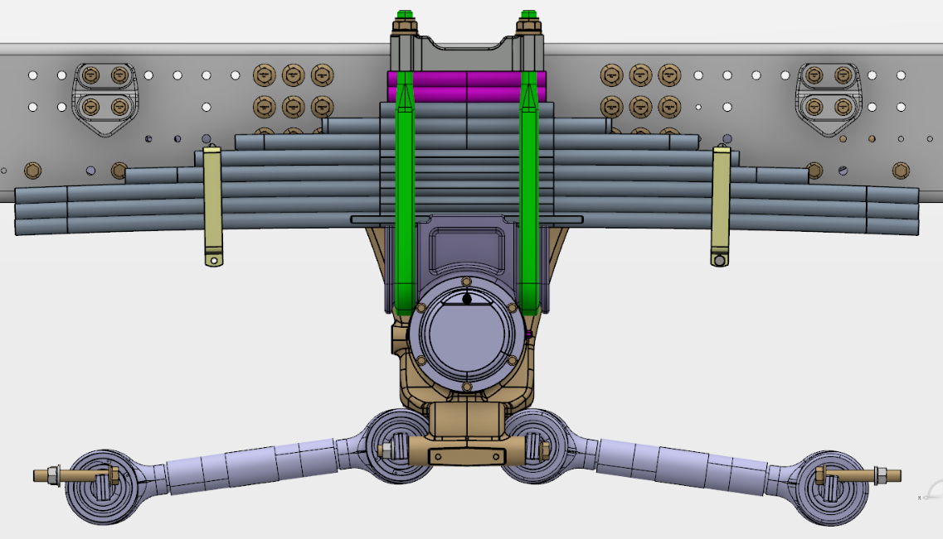
38T Bogie leaf removal
38T Bogie Spring
38T Bogie Spring conversion proposal
5th & 8th leaf to be removed
Stack Height-270mm (same)
Stack Height-270mm
Stiffness-394 Kgf /mm
Leaf no 10 SPD no – P9F00604
-2 Nos to be added to achieve the equivalent stack height
- Same U bolt and nut can be used
Clamp in loosen condition
Applicable for both HR & SR axles

Slide 3
Steps for conversion
1. Remove U bolt, nut & top clamp
2. Loosen bogie spring rebound clips
3. Loosen and remove center bolt
4. Remove leaf no 5 & 8
5. Add 2 no's of leaf no 10
6. Tighten rebound clamps to 60 Nm
7. Tighten spring center bolt to 250 Nm
8. Assemble top clamp, U bolt & nut over the leaf and torque as per spec 1450 Nm

Slide 4
Thank you

