Slide 1
38T Bogie to 28.8T Bogie
Field Conversion

Slide 2
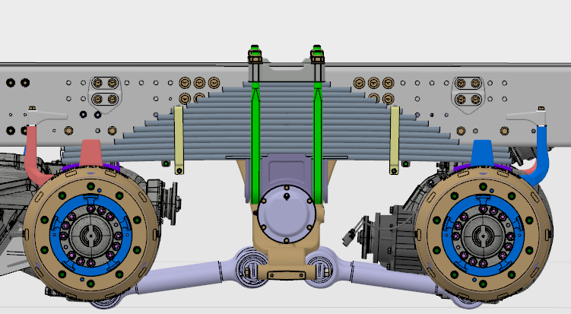
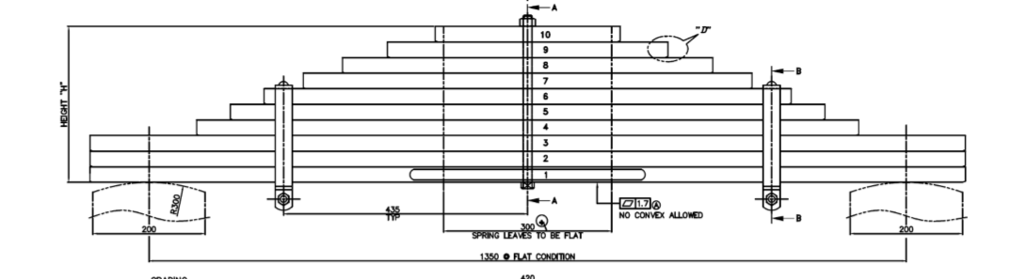
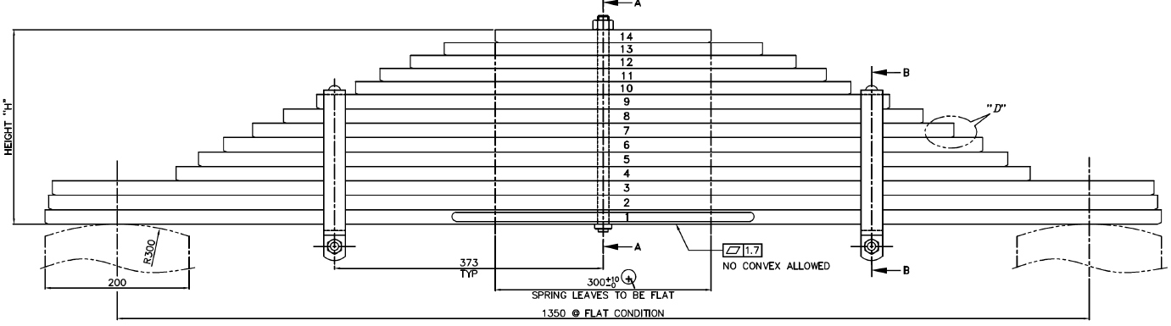
38T Bogie conversion to 28.8T Bogie
FTW00199 / FTW08210 - 38T Bogie Spring
FTW12200
Stack Height-270mm
FTW12200 - 28.8T Bogie Spring
1. Remove U bolt, nut & top clamp
2. Remove existing 38T bogie spring assembly
3. Assemble new 28.8T bogie spring assembly
4. Assemble top clamp, U bolt & nut and torque as per spec 1450 Nm
Stack Height-270mm
Applicable for both HR & SR axles

Slide 3
Thank you

