Slide 1
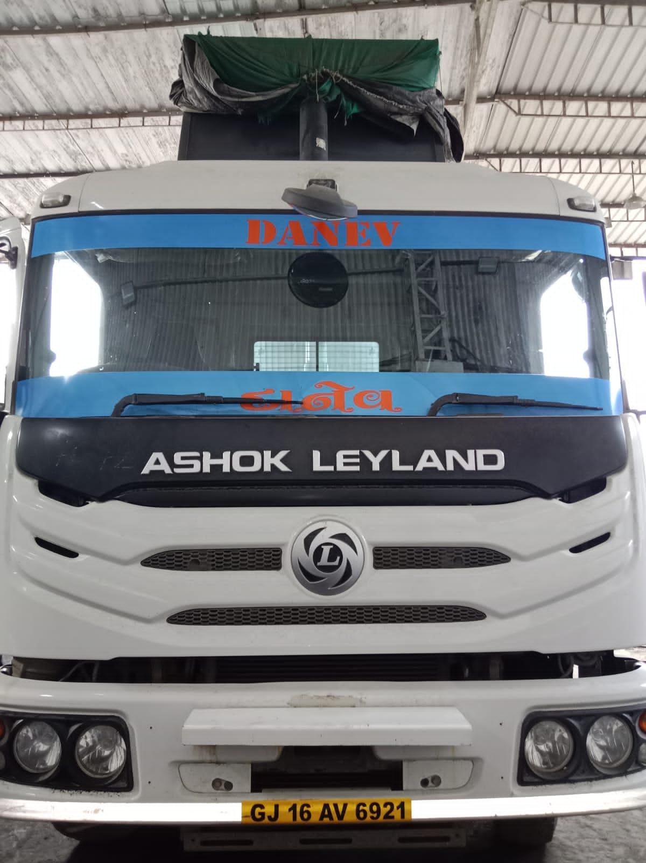
Customer complaint :- RA2 AXLE CAGE AND CARRIER CAP ASSY CRACKED.
Customer name | KANUBHAI POPATBHAI PAGHADAL
Reg. No. | GJ16AV6921
CBN | CTN482529C0002
Chassis no | MB1XEVLD5NPMP7672
Engine no | NMPZ500200
Vehicle model | NR4825N/66 T CC
Dealer Code/ SAC Code | 44621/ 2604 – DMIPL BH CC/FC :- 42B0 / BS
DOS | 16.02.2022
DOF | 24.03.2023
Kms/Hour | 83239KMS
Location | BHARUCH
Category | REAR AXLE RA2
ALSE | VISHAL BEHERE

Slide 2
FOUR BUCKET APPROCH
Driver Voice through interaction
Symptoms and external evidences
Service History through DBM
Detailed Observations & Cause of failure
Vehicle reported for rear axle oil leakage from RA2 axle.
Check vehicle found empty condition.
Vehicle running form Rajpardi to Dahej.
Sai Nath Crusher.
LR Metrix - L2R1
Load material - Blue stone 10, 12mm.
Load tonnage - 17T
Pay Load - 36T
GVW - 54T
Rear Axle oil leakage from RA2 Drive head cracked area.
RA2 Drain oil found 16Ltr oil Approx.
Propeller shaft condition observed as OE fitted.
Inter axle shaft condition observed ok.
RH/LH Bogie Rear Suspension Leaf found no hit marks at End.
FA1 and FA2 no bump stopper marking observed LH/RH side.
No 10th Leaf Spring modification done.
Load body found non OE fitted.
V rod found bush and MTG bolts tighten ok.
Balanced rod found LH and RH side MTG bolts found tighten ok.
LH and RH side Leaf Spring U bolt found tighten ok.
Removed RA1 Axle shafts found tighten ok.
Removed RA2 Drive head from RA2 axle Housing.
As per History, Diff Carrier Cap Assy Replaced on 27.08.2022 and 43002 km Dhruv Motors Bharuch.
RA2 axle Housing found cracked at 2 o'clock position.
RA2 Drive head carrier found ok.
Side rings and lock found tighten ok.
RA2 Drive head found caps bots found tighten ok.
Checked CWP and found ok.
Crown wheel pinion MTG bolts found tighten ok
Side Bearing LH and RH found ok.
Side gears found ok.
RA2 Diff. cage and nest assy found ok.
Checked spider shaft and gears found ok. Shaft lock pins found ok.
Gears washers found ok.
RA1 Axle Housing found ok

Slide 3
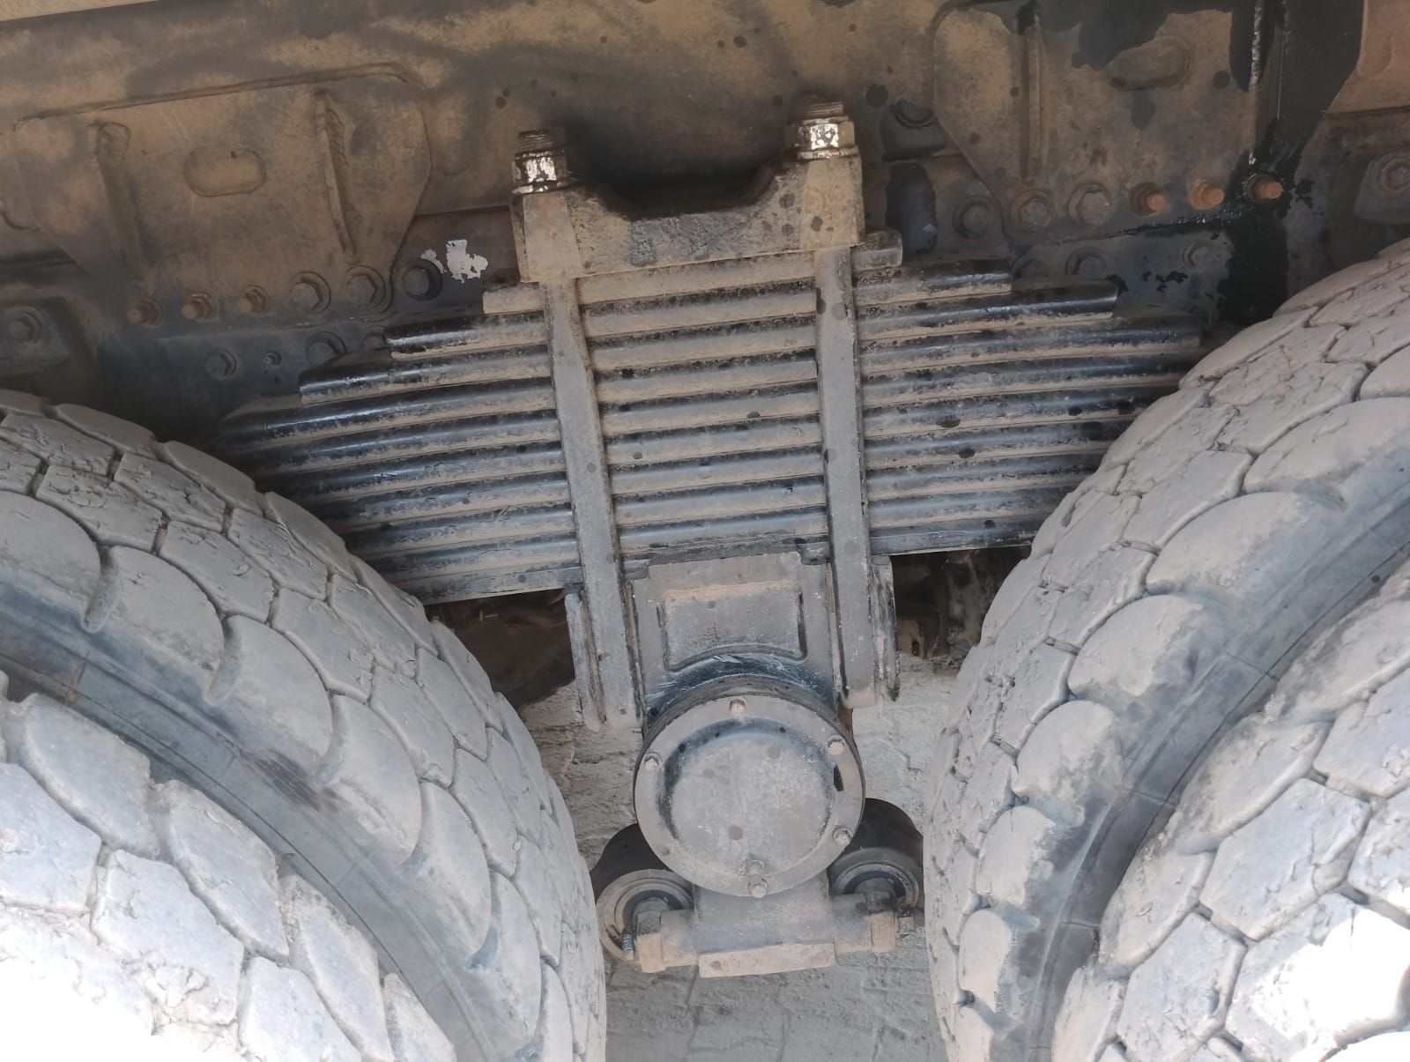
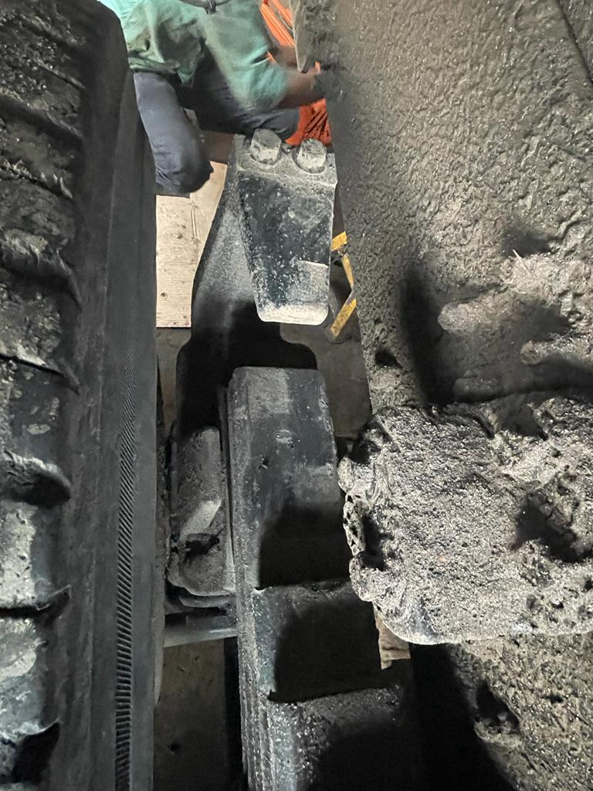
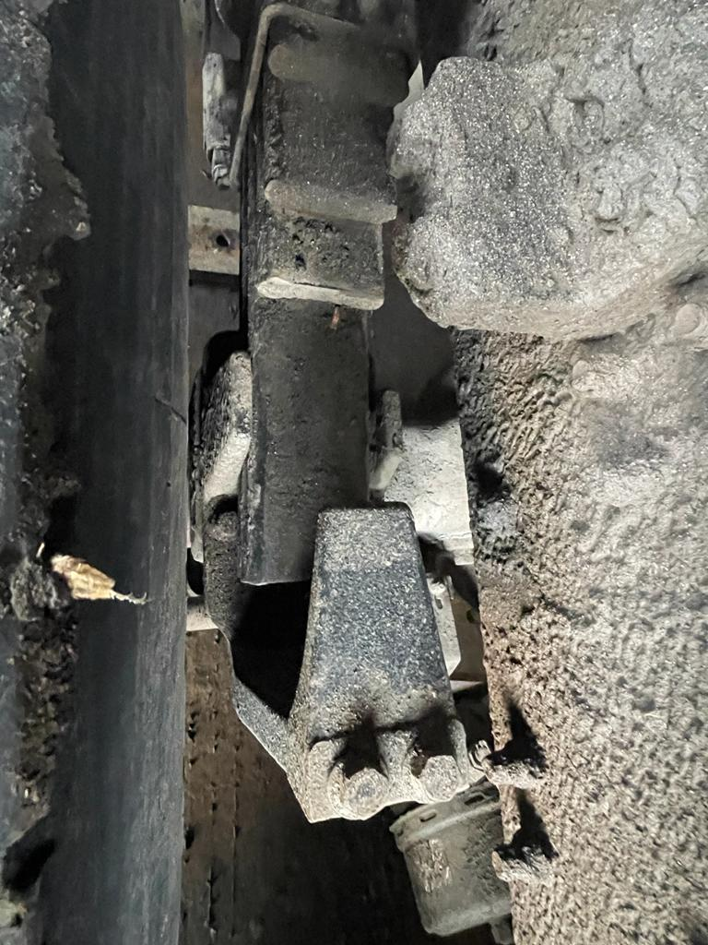
SUSPENSION
R.H. SIDE U BOLT
R.H.S RA1 TO RA2 REAR LEAF SPRING
NO HEATING MARKS
R.H.S RA1 TO RA2 FRONT LEAF SPRING
NO HEATING MARKS

Slide 4
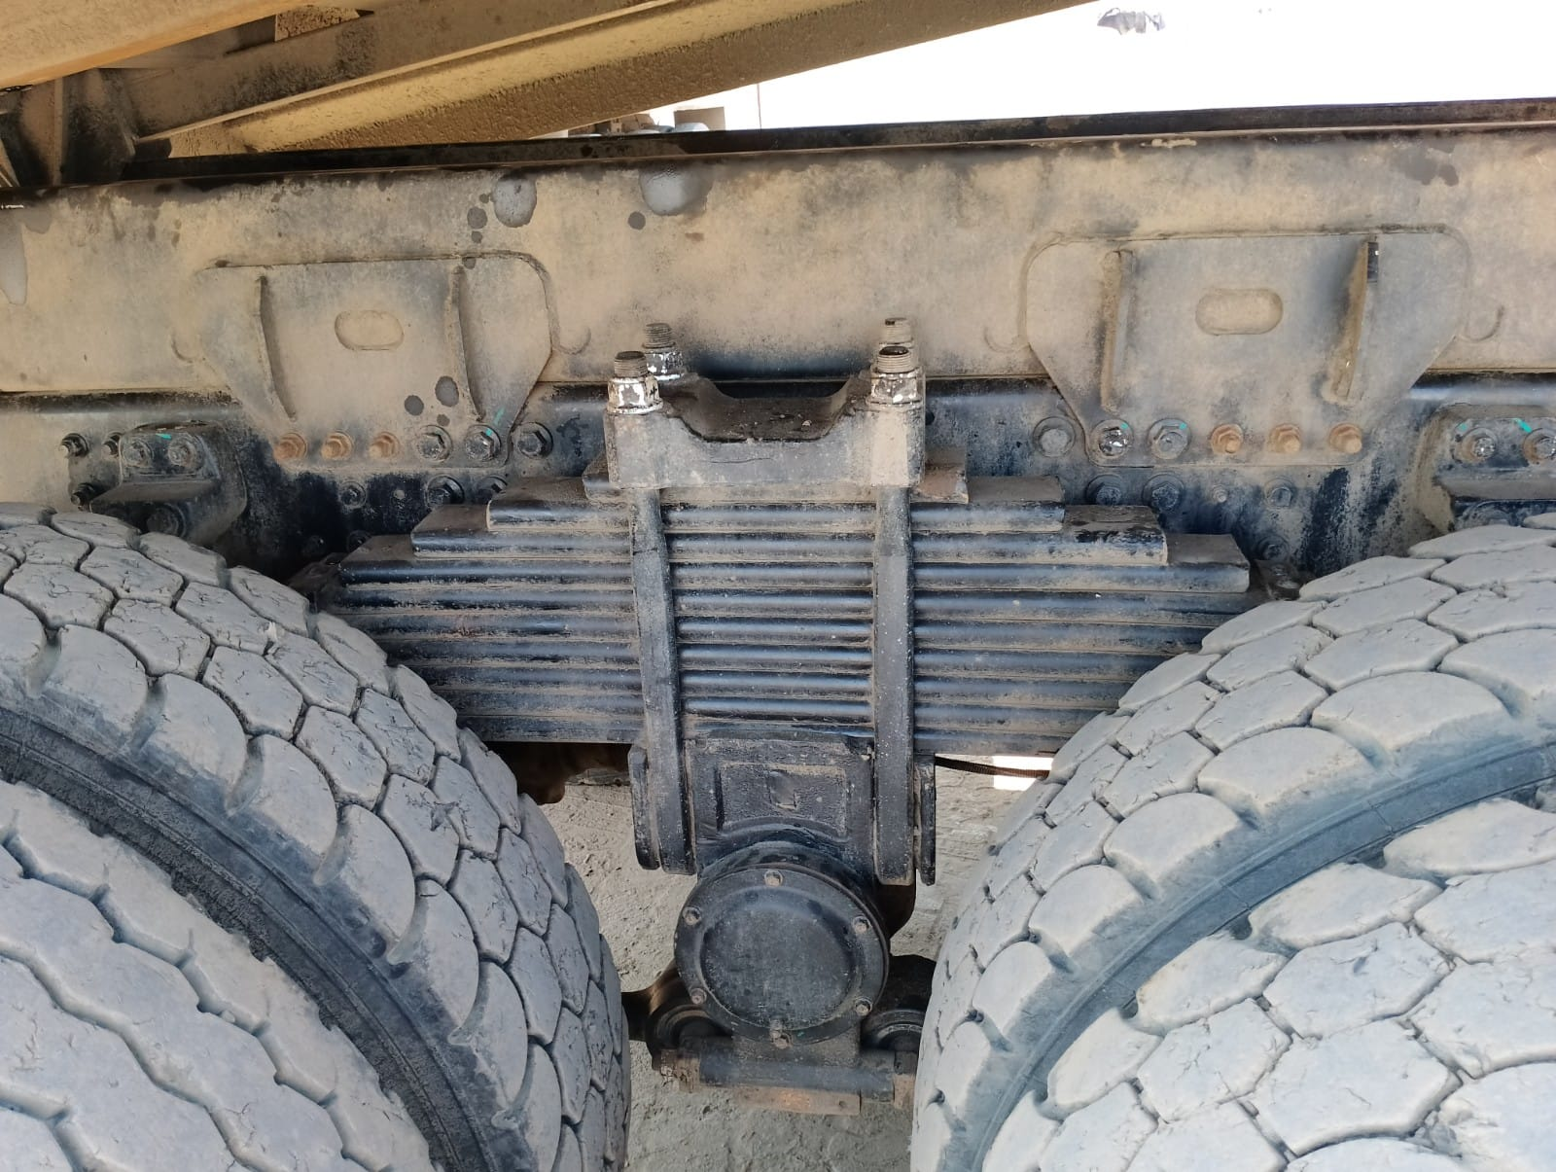
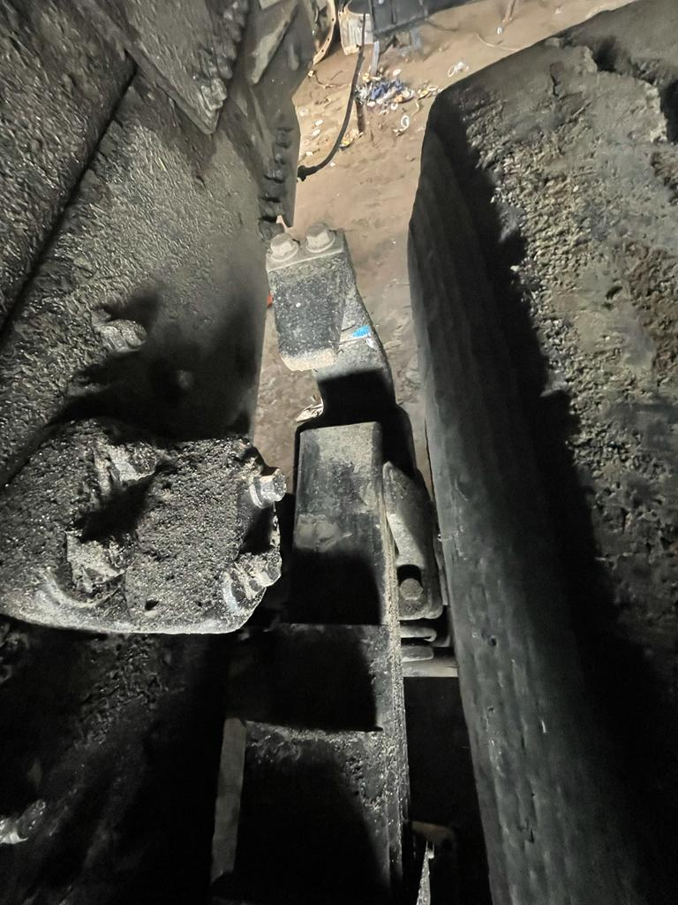
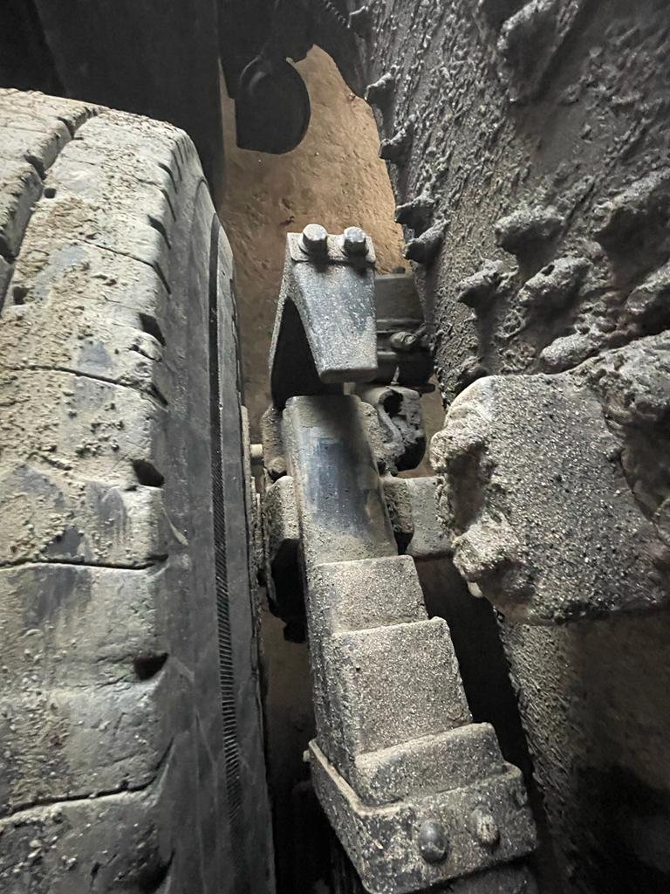
SUSPENSION
L.H. SIDE U BOLT
L.H. RA1 TO RA2 FRONT LEAF SPRING
NO HEATING MARKS
L.H. RA1 TO RA2 REAR LEAF SPRING
NO HEATING MARKS

Slide 5
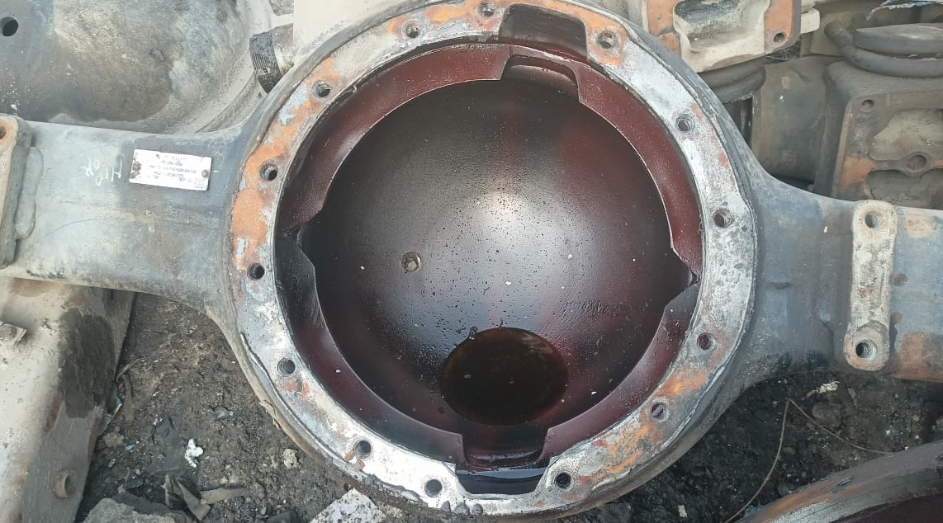
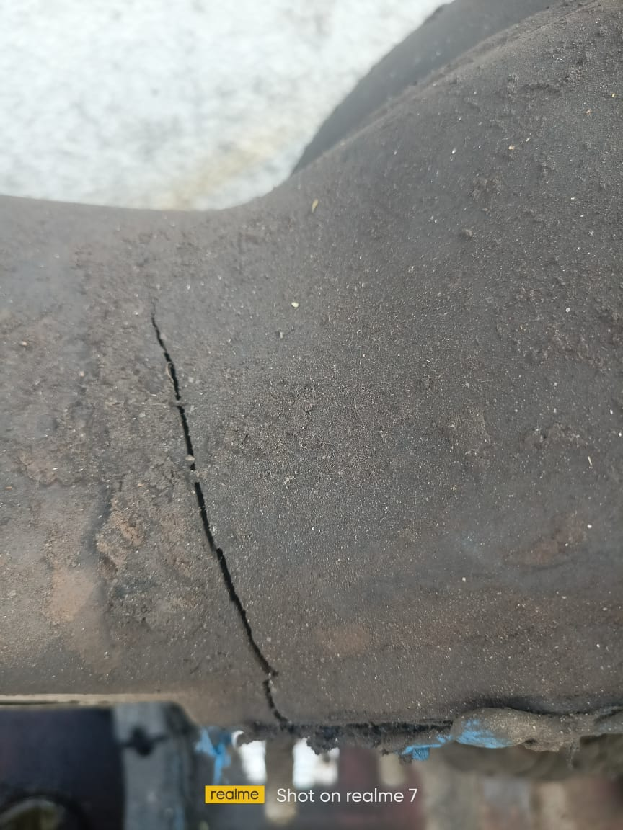
RA2 AXLE HOUSING
RA2 Axle housing cracked at 2 o'clock position.

