Slide 1
COMP7033 CW2 ADMIN SYSTEM
19294349
George Chapman

Slide 2
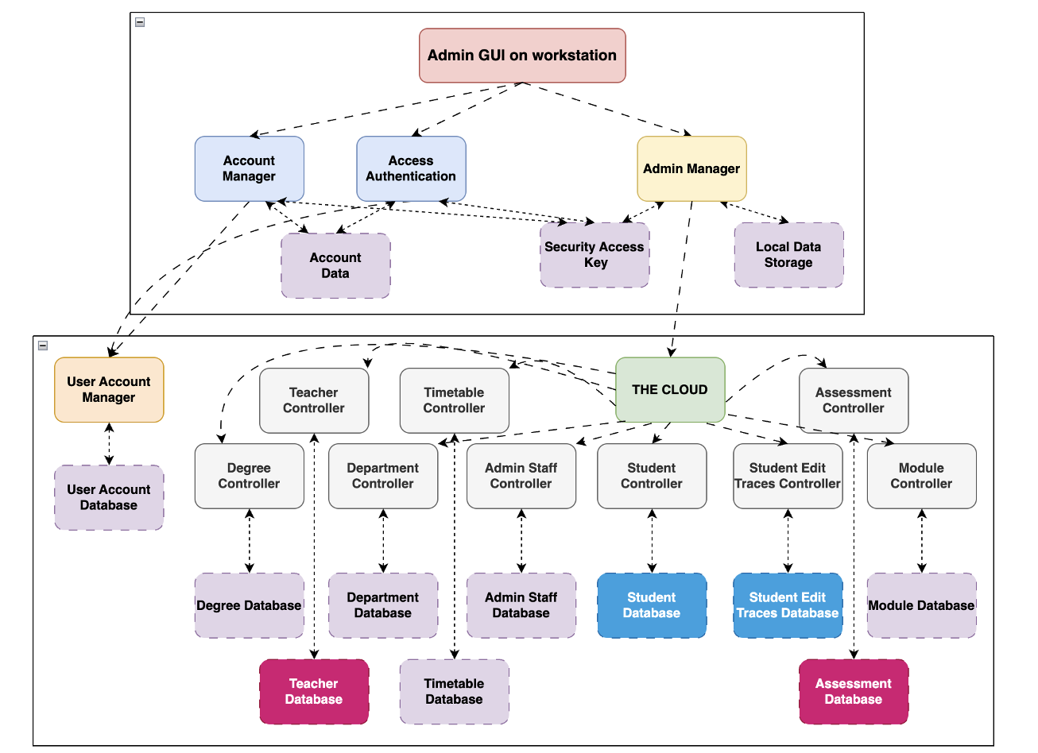
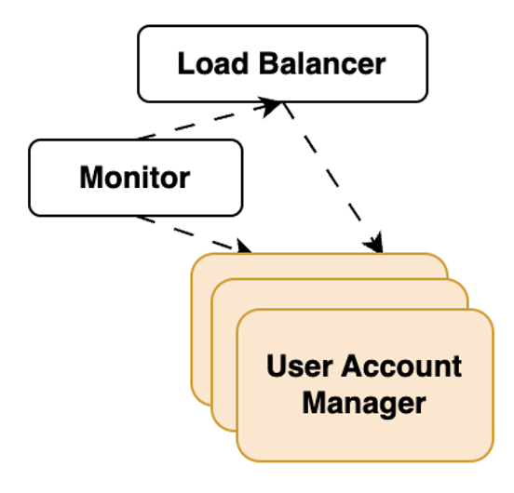

System Design

Slide 3
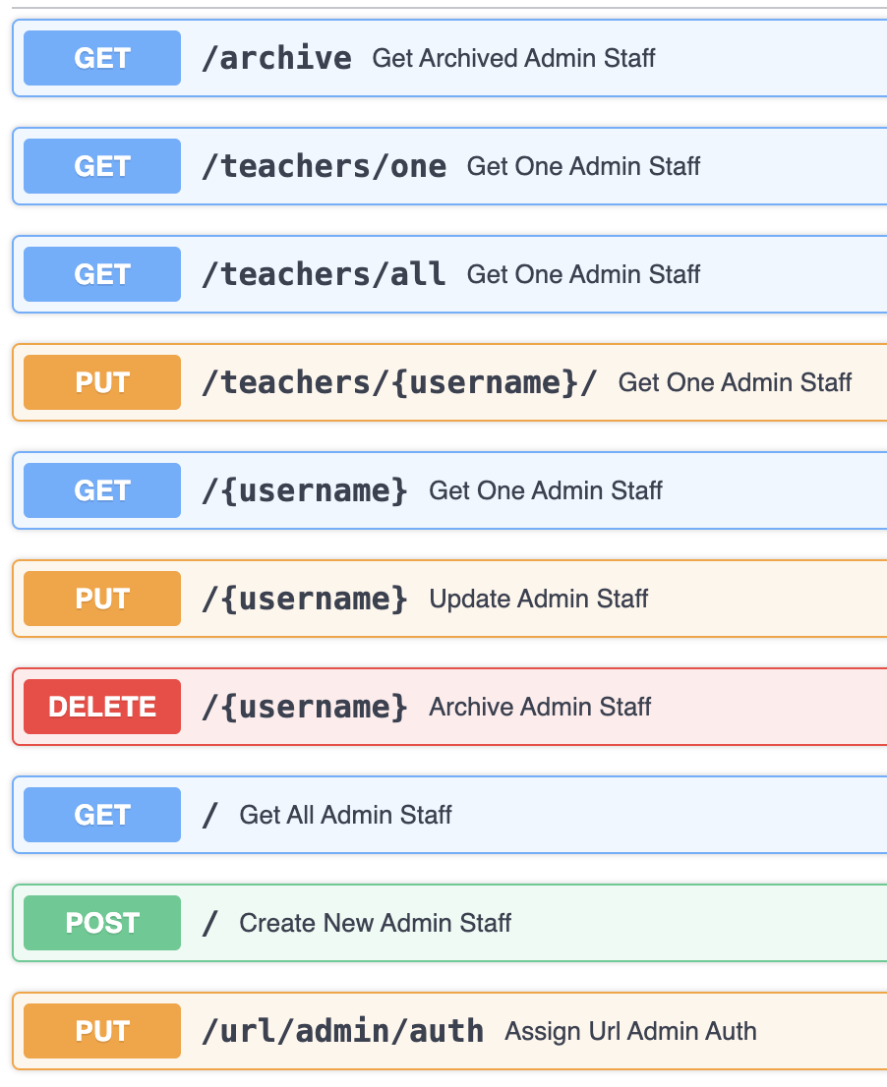
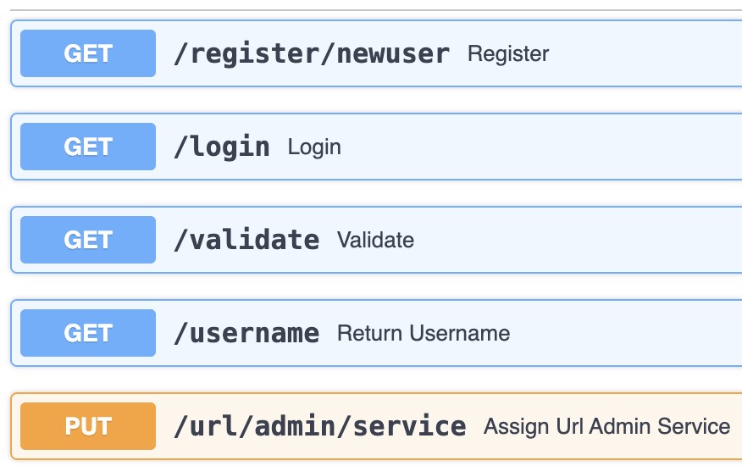
API:
admin-staff service
admin-auth service

Slide 4
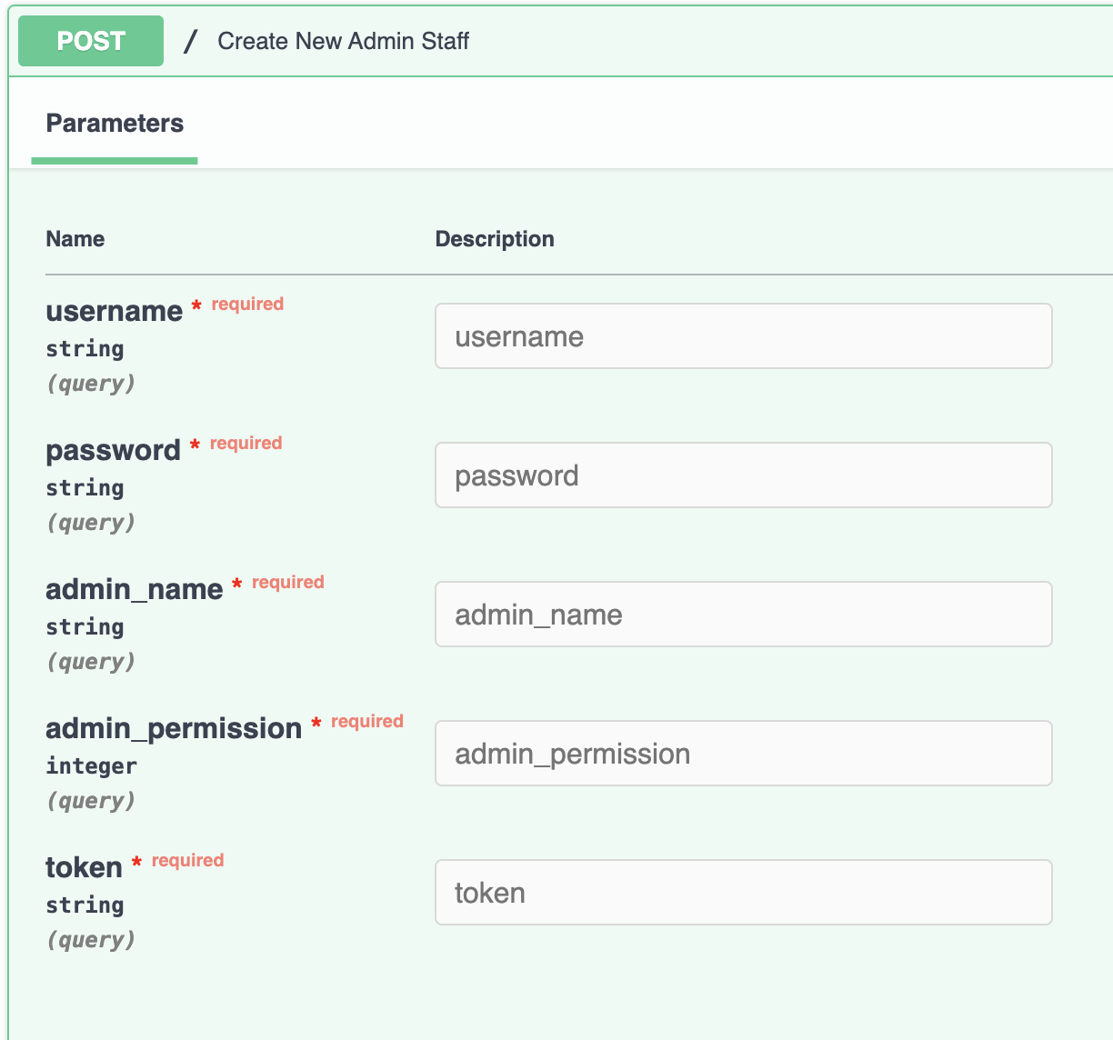
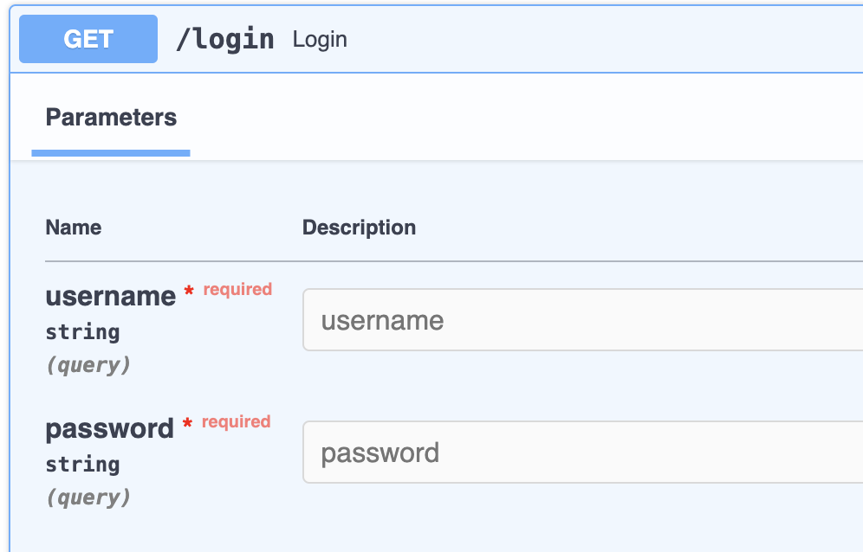
API:
admin-staff service
admin-auth service

Slide 5
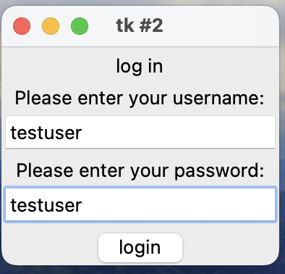
GUI
logging in upon launching the desktop app
pressing “login” sends request to admin-auth
GET[/,params=(username=username, password=password)]
as these are valid credentials, admin-auth replies with the generated
session token such as testuserNZxMIilQ7-58l4v2emTVcEIEQMM
this token is then used to authenticate the user for the rest of the session
during this testing it has a lifespan of 24 hours.

Slide 6
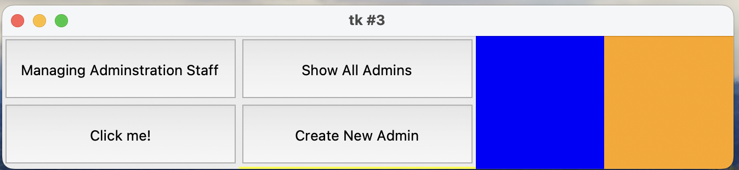
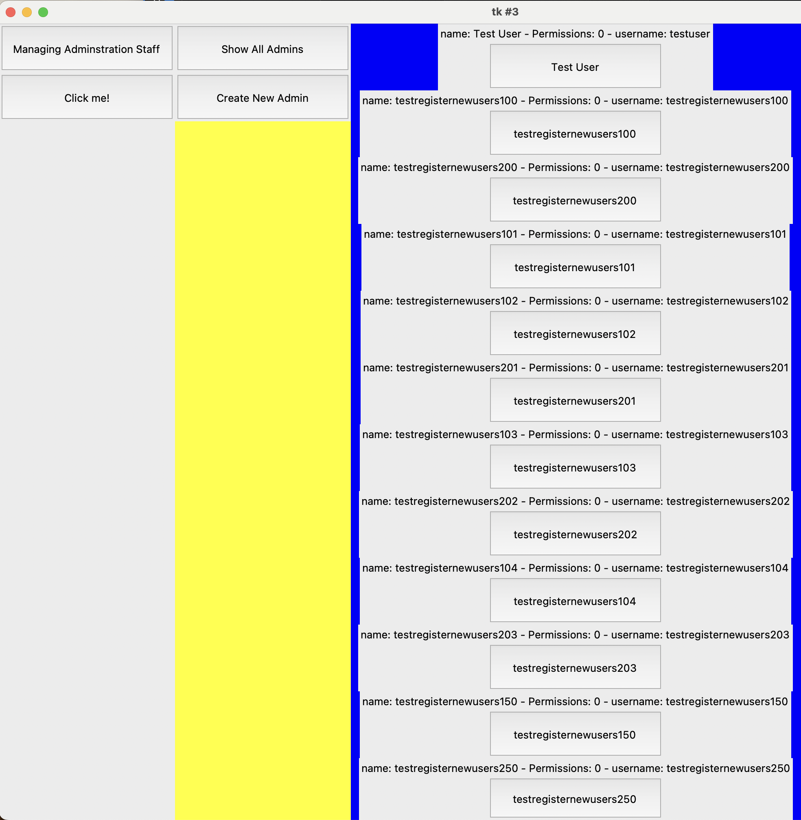
GUI
Show all admins:
admin-staff service GET[/, params=(token=token)]

Slide 7
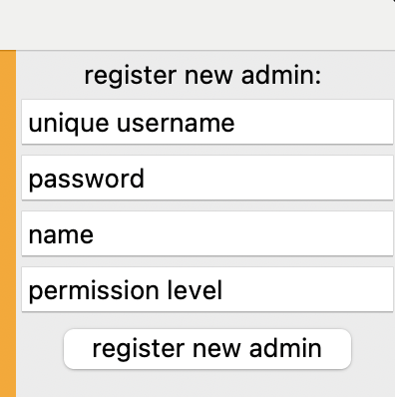
GUI
Create New Admin:
admin-staff service POST[/, params=(
username=username,
password=password,
admin_name=name,
admin_permission=permission,
token=token)]

Slide 8
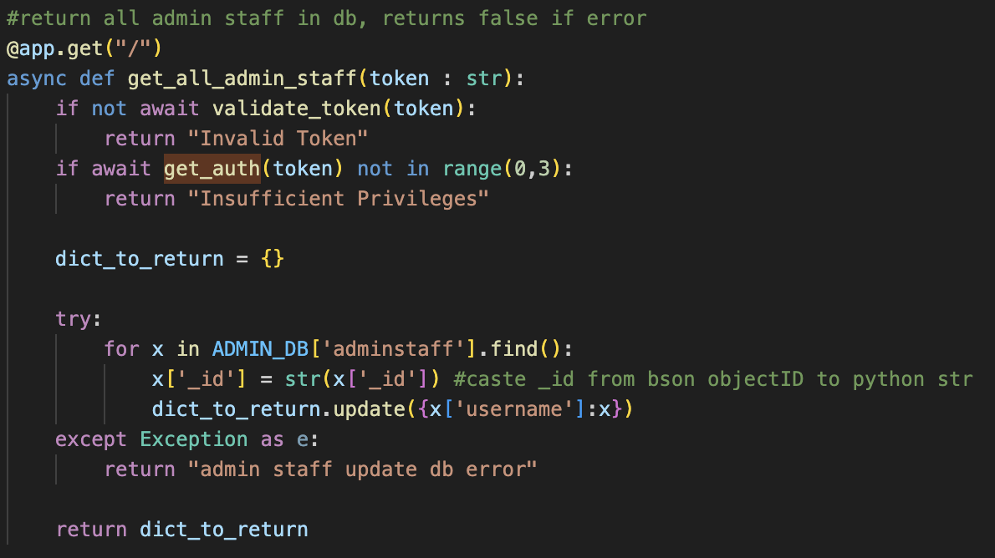
Implementation
-Python based FastAPI – RESTful API
-Using uvicorn inside docker
-Kubernetes on google cloud using dockerhub to pull docker images
-Load balancer on ingress for each micro-service
-Kubernetes monitoring each pod for container errors, crashes and killing and reloading as necessary
-Also monitoring for horizontal or vertical scaling of pods and resources as necessary depending on observed load to achieve scalability, reliability and performance requirements

Slide 9
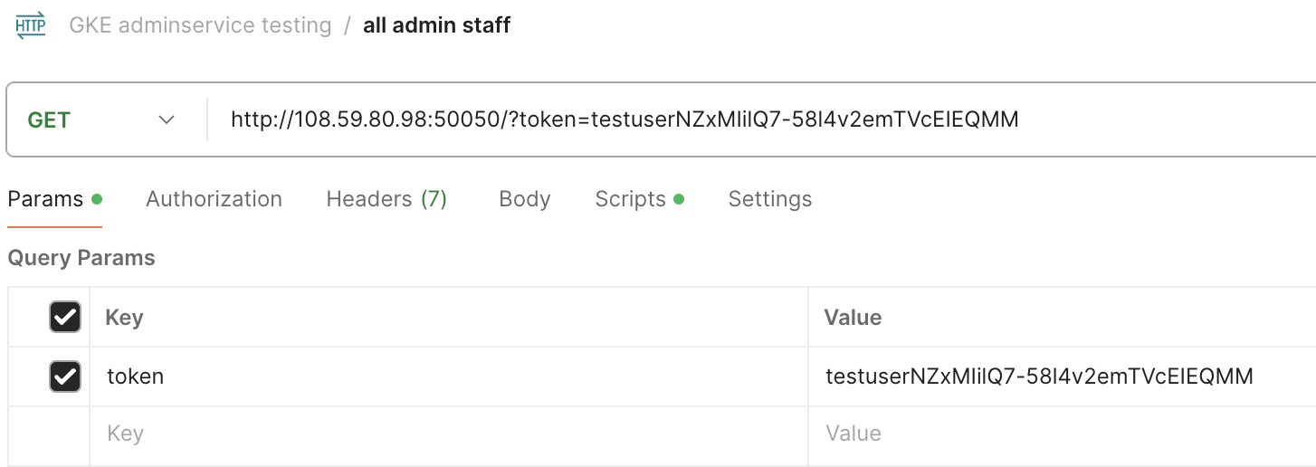
Testing
POSTMAN was used to help send and receive RESTful API requests as well as the FastAPI docs

Slide 10
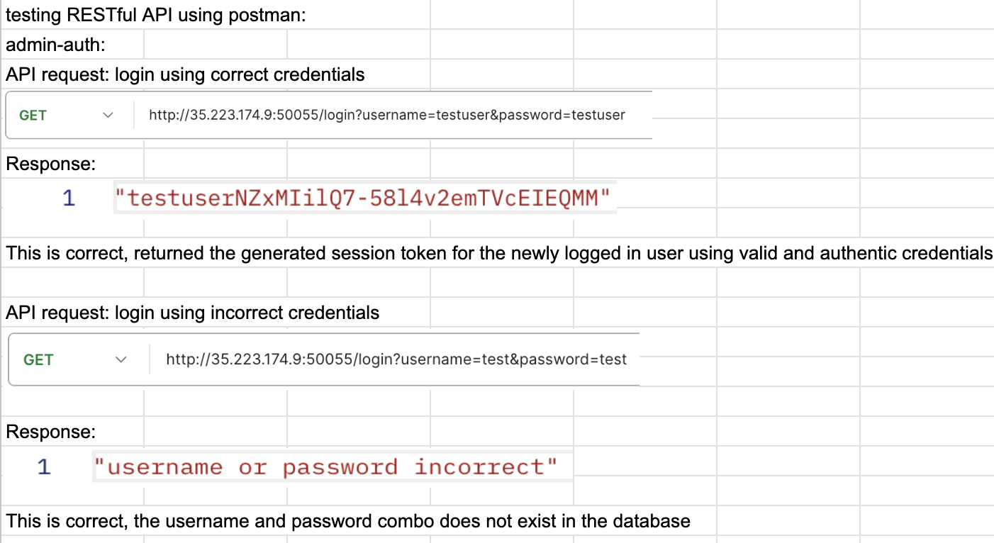
Testing
POSTMAN was used to help send and receive RESTful API requests as well as the FastAPI docs

Slide 11
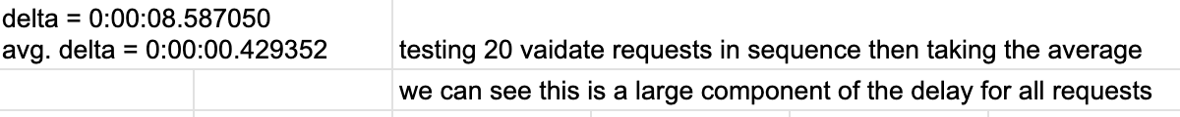
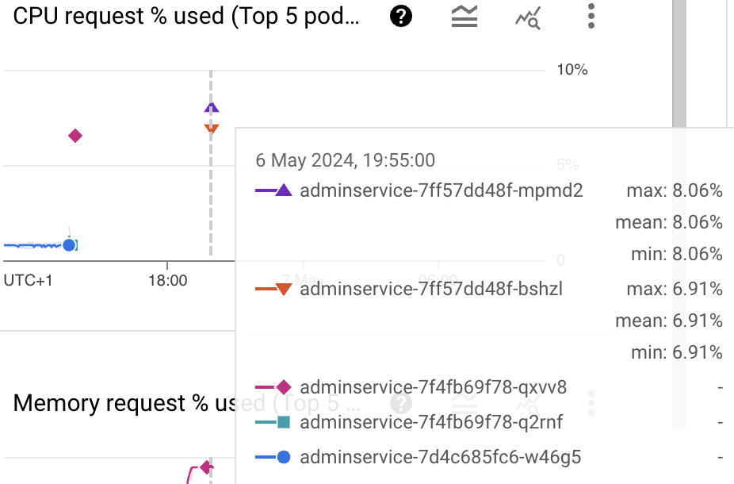
Testing
using scripts to perform API requests, taking start and end times
and averaging results
using multiple terminals with the same script
to perform API requests against the admin-staff service
to see how resource intensive the demands of fulfilling
the requests can be.
approx. 10 requests a second gave 2 pods about 8%
and 7% load

Slide 12
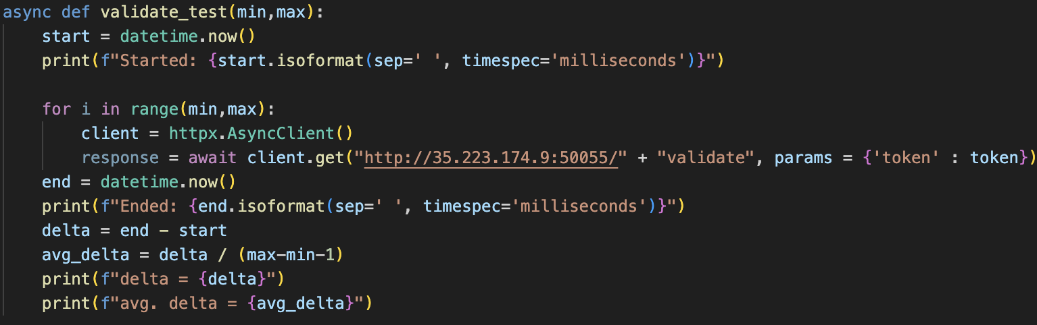
Testing
using scripts to perform API requests, taking start and end times
and averaging results

Slide 13


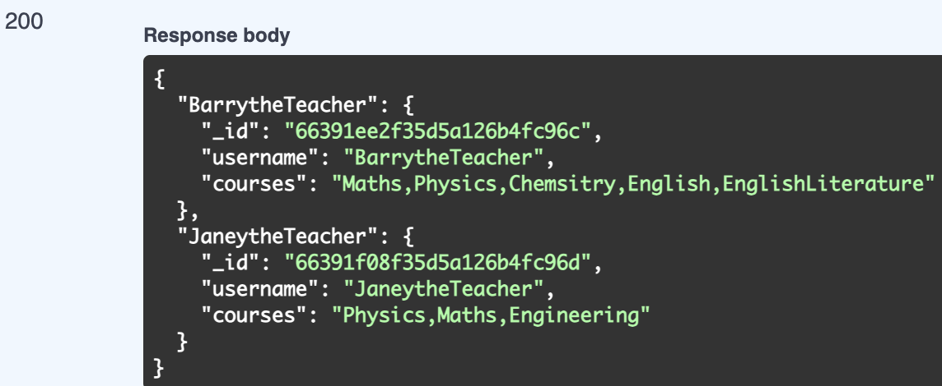
Testing
using teacher-stub service via admin-staff service
request GET[/teachers/all, params=(token=token)] from admin-auth
validates the token and then sends
GET[/, ] to teacher-stub which retrieves all teacher records from the database
and returns them to admin-auth
admin-auth then passes this response back to
client

Slide 14
Show Google and RESTful API
https://github.com/GeorgeChapmanBrookes/COMP7033

