Slide 1
freelance
What is freelance

Slide 2
Overview of freelance
What is freelancing ?
Why freelance ?
What should you freelance in ?
The advantages and disadvantages of freelancing
Finding clients
Freelance marketplaces

Slide 3
What is freelancing ?
Freelancing is working as a self employed person/professional for multiple employers without an formal agreement or contact for long period of time .
a freelancer may work part time or full time.

Slide 4
Why freelance ?
Freelancing & the Future of Work
The economy needs more freelancers
Businesses prefer to hire freelancers
Portfolio careers will become the new normal
Technology is bridging the flexible working gap

Slide 5
Why freelance ?
Below are the common reasons for freelancing
Work remotely
Do more purposeful work
More capacity to work on other hobbies
Start or spend more time with the family and friends

Slide 6
Continue…
Gain professional experience
Take professional development into your own hands
Create a start-up

Slide 7
what should you freelance in ?
Leverage your own domain expertise
Research industry reports ,blogs , articles etc
Talk to somebody in the industry
Consult a recruiter
Put it to the test it . Pitch your services to potential clients and see if people actually need what you are offering

Slide 8
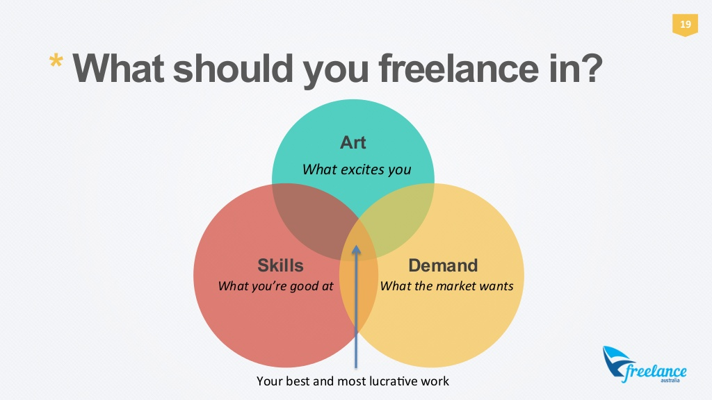

Slide 9
The advantages and disadvantages of freelancing
The advantage of being a freelancer is your hours are flexible, you are able to work from multiple places such as home, workplace making it more convenient for yourself .
you're in control of the workload , you can choose when to accept or turn away to do work , as a freelancer you gain new skills while building on your strengths and weaknesses such as marketing, management, sales .
you are entitled to work with whichever clients you chose to work with and your maintenance and as you work , you're making new connections with clients.

Slide 10
The advantages and disadvantages of freelancing
The disadvantages being that they do not receive enough benefits, such as health insurance, no pay for when you are ill or for your professional liability .
having to manage a busy schedule and completing priorities and deadlines .
they're payments are variable, making it difficult to predict .
having always make yourself available and reliable and all resources used has to be brought the freelancer themselves .

Slide 11
Finding clients
Networking events
Social networks
Advertising
Job boards
Freelance Marketplaces

Slide 12
Freelance marketplaces
Below are the common sites for freelance marketplaces
Freelancer
Upwork
Fiverr
Elance

Slide 13
thanks

