Slide 1
Microsoft's
New Movie Studio
Authors
Bradly Horn / George Ferre

Slide 2
Outline
● Business Problem ●
● Summary ●
● Data Sources ●
● Results ●
● Conclusions ●

Slide 3
Business Problem
Microsoft New to Film Industry
Profitable Movies
Critical Acclaim

Slide 4
Summary: Suggestions for Microsoft
Genres
Writers
Director

Slide 5
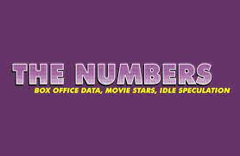


Data Sources

Slide 6
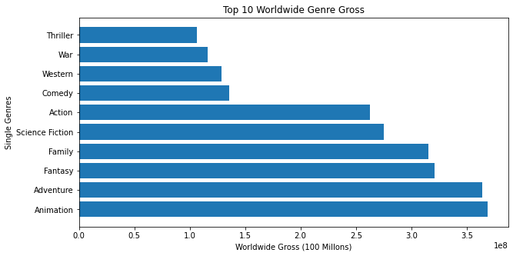
Results: Genre

Slide 7
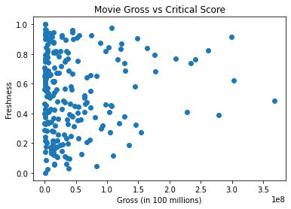
Quality or Gross?

Slide 8
Both!
Freshness: Ratio of fresh to rotten reviews
Gross Profit x Freshness (GxF)

Slide 9
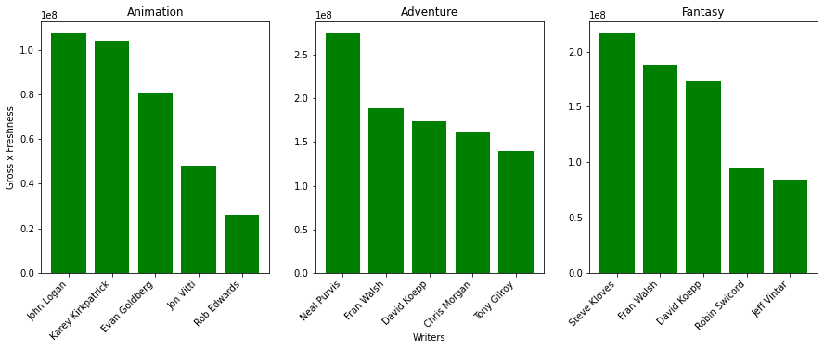
Results: Writers

Slide 10
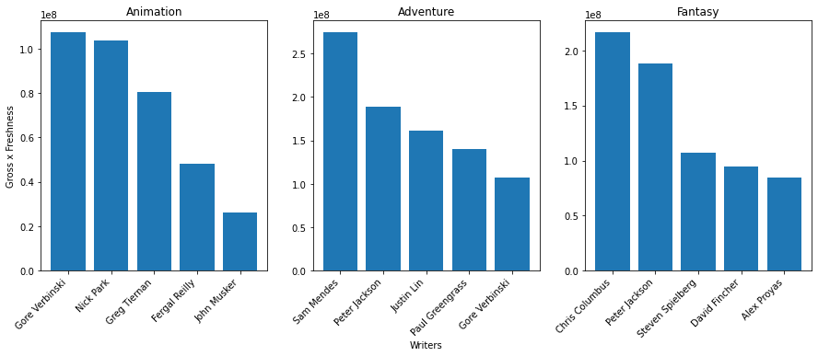
Results: Directors

Slide 11
Conclusions
Genre | Animation | Adventure | Fantasy
Writer | John Logan | Neal Purvis | Steve Kloves
Director | Gore Verbinski | Sam Mendes | Chris Columbus

Slide 12
Thank You! Questions?
Bradly Horn
Email: wolfnchaos@gmail.com
Github: https://github.com/WolfnChaos
Linkedin: N/A
George Ferre
Email: georgeaferre@gmail.com
Github: https://github.com/GeorgeFerre
Linkedin: https://www.linkedin.com/in/georgeferre/

