Slide 1

HTML 1
Lecturers: P. Aggelatos, D. Zindros
Slides: D. Zindros
Electrical and Computer Engineering

Slide 2
Targets
What is HTML and CSS?
Separate content/presentation
When to use the one and when the other?
Introducing the HTML language basics:
Basic syntax, tags
Titles, paragraphs, headlines
Lists, links, images
Tables, forms

Slide 3
HTML and CSS
The languages of the web
HTML: Describes content
HyperText Markup Language
CSS: Describes presentation
Cascading StyleSheets
Separate correctly from the beginning and always

Slide 4
HTML
CSS
Content
Title
Text
List
Table
Image
Link
Presentation
Colors
Position
Size
Alignment
Borders
Lines
Background

Slide 5
Example: Book
Content
Presentation
Title
Author
Chapter titles
Text
Chapter separation
Paragraph separation
Footnotes
Size of title
Position of author’s name
Headline alignment
Text margins
Blank pages between chapters
Footnotes in italics

Slide 6


Example: Book
Presentation changes, content doesn’t:
Same book, different edition
Notes:
Book demo.

Slide 7


Example: Book
Content changes, presentation doesn’t:
Different book, same edition
Notes:
Book demo.

Slide 8
Content or presentation?
A paragraph’s text is red.
Page numbers are on the right.
Book has 30 chapters.
First chapter doesn’t contain the letter “x”.
In the first paragraph, the name of the protagonist is emphasized.
The emphasis is given in italic letters.
The emphasis is given in bold letters.
Notes:
Ποιες φράσεις περιγράφουν περιεχόμενο και ποιες μορφοποίηση?

Slide 9
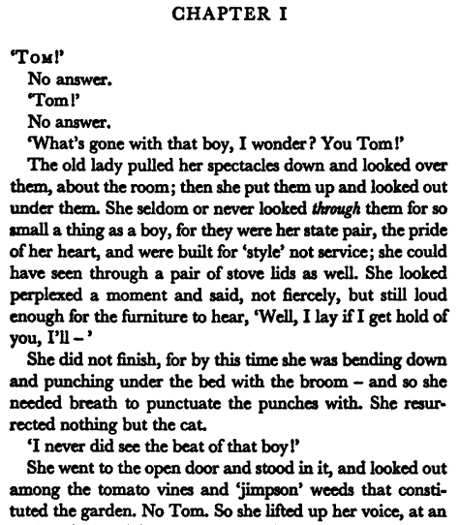
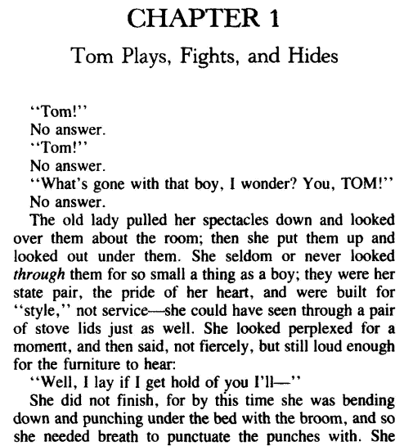
Different font family
Notes:
Η πρώτη σελίδα του Tom Sawyer σε δύο διαφορετικές εκδόσεις. Το περιεχόμενο είναι το ίδιο. Η μορφοποίηση είναι διαφορετική. Πού?

Slide 10
Smaller size
Bigger size

Slide 11
Arabic numeral
Latin numeral

Slide 12
Single quotes
Double quotes

Slide 13
Chapter subtitle not shown
Chapter subtitle shown

Slide 14
No line break
Line break exists

Slide 15
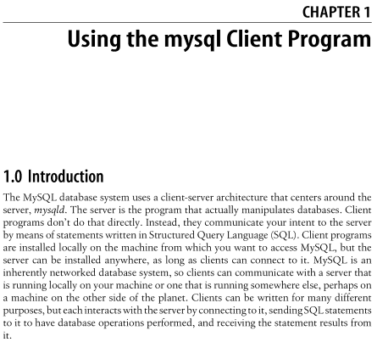
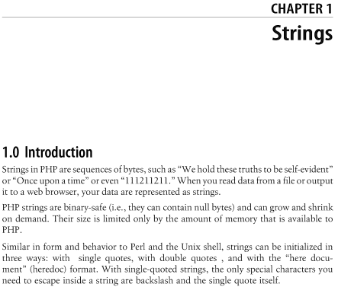
Different titles
Notes:
Δύο διαφορετικά βιβλία: MySQL Cookbook (αριστερά) και PHP Cookbook (δεξιά), από τις εκδόσεις O’Reilly. Χρησιμοποιείται πανομοιότυπη μορφοποίηση, όμως το περιεχόμενο είναι διαφορετικό.

Slide 16
Different text

Slide 17
HTML
We write in .html files
We edit them using a simple editor
e.g. Notepad, vim, emacs, etc.
Contains code in plaintext format
It’s interpreted and not compiled
It runs within the browsers
It can run locally

Slide 18
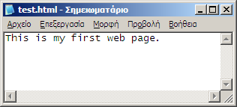
Simplest HTML page
Just an .html file with some text!
The extension must be .html and not .html.txt
Notes:
Demo this.

Slide 19





Browser
A program that “runs” web applications
Notes:
Μέγεθος ανάλογο της δημοτικότητας

Slide 20
Popular browsers
Name | By | Open Source | Usage | Engine
Internet Explorer | Microsoft | No | 52% | Trident
Firefox | Mozilla | Yes | 31% | Gecko
Chrome | Google | Yes* | 10% | Webkit
Safari | Apple | Yes* | 5% | Webkit
Opera | Opera | No | 2% | Presto
Notes:
Θα χρησιμοποιήσουμε τον Firefox για τις ασκήσεις

Slide 21
We write «hand-written» code
Understand how the technologies work
And how they’ll work tomorrow
Control looks and behavior 100%
Understand security
Pages that are snappy and correct
Extensible code
Ability to combine languages
We follow web standards
Notes:
Προγράμματα όπως Frontpage ή Dreamweaver παράγουν κώδικα που δεν ακολουθεί standards για να μας «βοηθούν». Αν θέλετε να μάθετε HTML και CSS σοβαρά, θα πρέπει να γράφετε κώδικα στο «χέρι».

Slide 22
Basic page structure
<!DOCTYPE html PUBLIC "-//W3C//DTD XHTML 1.0 Strict//EN" "http://www.w3.org/TR/xhtml1/DTD/xhtml1-strict.dtd">
<html>
<body>
This is my first web page.
</body>
</html>
Notes:
Demo this. Αυτό δεν αλλάζει κάτι στην εμφάνιση, αλλά η δουλειά της HTML είναι να δηλώσει ΠΕΡΙΕΧΟΜΕΝΟ, όχι ΕΜΦΑΝΙΣΗ. Αυτός ο κώδικας έχει δώσει νόημα στη σελίδα.

Slide 23
DOCTYPE
<!DOCTYPE html PUBLIC "-//W3C//DTD XHTML 1.0 Strict//EN" "http://www.w3.org/TR/xhtml1/DTD/xhtml1-strict.dtd">
Declares the version of the HTML language
Makes the browser act correctly
We copy/paste it at the beginning of the page

Slide 24
Tags
<html>
…
</html>
Each tag has a name: html
Each tag must open: <html>
Each tag must close: </html>
Between the opening and the closing code of the tag lies the content of the tag.

Slide 25
Open tag html
<html>
<body>
This is my first web page.
</body>
</html>
Content of html tag
Close tag html
Notes:
Πού είναι το άνοιγμα, το κλείσιμο, και το περιεχόμενο της ετικέτας html?

Slide 26
Open tag body
<html>
<body>
This is my first web page.
</body>
</html>
body tag contents
Close tag body
Notes:
Πού είναι το άνοιγμα, το κλείσιμο, και το περιεχόμενο της ετικέτας body?

Slide 27
Self-closing tags
Tags that don’t have content are self-closing
No content!
<br />
br tag opens and closes

Slide 28
<html>, <head>, <title> and <body>
<html>: Contains a whole page
<head>: Contains meta-information about the page
<title>: Contains the title of the page
<body>: Contains the contents of the page
<html> must only contain <head> and <body>, in this order. Τhe <title> tag must be contained within the <head>.

Slide 29
Basic structure of a page
<!DOCTYPE html PUBLIC "-//W3C//DTD XHTML 1.0 Strict//EN" "http://www.w3.org/TR/xhtml1/DTD/xhtml1-strict.dtd">
<html>
<head>
<title>Μy first web page</title>
</head>
<body>
This is my first web page.
</body>
</html>
Notes:
Demo this. Ο τίτλος εμφανίζεται στη μπάρα τίτλου, καθώς και στα αγαπημένα.

Slide 30
Tag hierarchy
A tag can be fully contained within another.
It’s a tree structure.
What opens first closes last (LIFO).
<html>
<body>
This is my first web page.
</body>
</html>
body contained within html
Notes:
Boxes demo.

Slide 31
Tag hierarchy
<html>
<head>
<title>Page</title>
</head>
<body>
My first web page.
</body>
</html>
Α parent of Β
Α immediately contains Β.
Α child of Β
Α immediately contained within Β.
Α ancestor of Β
Α contains Β.
Α descendant of Β
A contained within Β.
Α sibling of Β:
Α has the same parent as Β.

Slide 32
Paragraphs
HTML ignores new lines and whitespace.
Repeated spaces and line breaks are replaced by a single space.
This is my first webpage
So exciting!
This is my first webpage So exciting!

Slide 33
Paragraphs
<p>: Defines a paragraph
<p>This is my first webpage</p>
<p>So exciting!</p>
This is my first webpage
So exciting!

Slide 34
Paragraphcs
<br />: Defines a line break
Careful: Do not use this for presentation!
Increase or decrease vertical distance using presentation through CSS.

Slide 35
Emphasis
<em>: Gives emphasis to a piece of text
<strong>: Gives strong emphasis to a piece of text
It’s common for <em> to be formatted in italics and for <strong> to be formatted in bold.
Do not use <strong> and <em> for presentation formatting!
Define what will be in bold or italics using CSS. The <strong> and <em> tags only define emphasis at the content-level.
Notes:
Π.χ. Αν θέλουμε όλο το κείμενό μας να είναι bold, αυτό δεν πρόκειται για έμφαση, αλλά για μορφοποίηση. Επιπλέον, αν δώσουμε έμφαση σε μία λέξη, το CSS μπορεί να επιλέξει αν θα την τονίσει με έντονα γράμματα ή λόγου χάρη με κόκκινο χρώμα.

Slide 36
Headlines
<h1>: 1st level headline
<h2>: 2nd level headline
…
<h6>: 6th level headline
<h1> used only once.
Next should be below previous.
There is no h7.

Slide 37
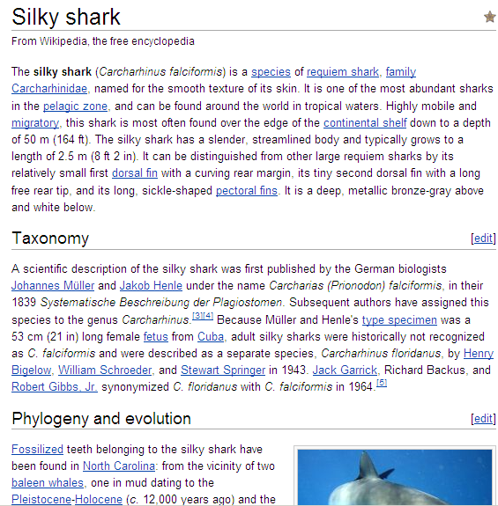
Headlines
<h1>
<h2>
<h2>
Notes:
Άρθρο από τη Wikipedia. Παρατηρήστε ότι η επικεφαλίδα “Phylogeny and evolution” είναι h2 και όχι h3!

Slide 38
Lists
Ordered: Order matters, use <ol>
Unordered: Order does not matter, use <ul>
<li>: A list item
Same HTML code for describing them both.
<ol>
<li>First item</li>
<li>Second item</li>
<li>Third item</li>
</ol>

Slide 39
Lists
<li> can only be contained within <ol> or <ul>
<ol> and <ul> must only contain <li>

Slide 40
Lists
Ordered
Unordered
Weekdays
Clothes I’ll wear
Formula 1 winners
Photoshop editions
Shopping list
Students in class
My e-mail addresses
This very list

Slide 41
Ordered list: Days
<ol>
<li>Monday</li>
<li>Tuesday</li>
<li>Wednesday</li>
<li>Thursday</li>
<li>Friday</li>
<li>Saturday</li>
<li>Sunday</li>
</ol>
Monday
Tuesday
Wednesday
Thursday
Friday
Saturday
Sunday

Slide 42
Unordered list: Shopping
Kinder Riegel
Kinder Bueno
Happy Hippo
Kinder Eggs
Kinder Delice
Kinder Duplo
Kinder Maxi
<ul>
<li>Kinder Riegel</li>
<li>Kinder Bueno</li>
<li>Happy Hippo</li>
<li>Kinder Eggs</li>
<li>Kinder Delice</li>
<li>Kinder Duplo</li>
<li>Kinder Maxi</li>
</ul>

Slide 43
Nesting
The simplicity and power of HTML!
Nesting allowed in lists, paragraphs, etc.
<h1>Reasons for attending this seminar</h1>
<ol>
<li>To impress:
<ul>
<li>My cat</li>
<li>My dog</li>
</ul>
</li>
<li>To learn</li>
<li>To become famous</li> </ol>

Slide 44
Reasons for attending this seminar
To impress:
My cat
My dog
To learn
To become famous
Notes:
Demo this.

Slide 45
Addresses
Absolute: They start with the protocol
“http://www.google.com/”
“http://www.htmldog.com/guides/htmlbeginner/links/”
Relative: Produced based on the current address
“foo” at http://mysite.gr/bar → http://mysite.gr/bar/foo
“/foo” at http://mysite.gr/bar → http://mysite.gr/foo
“#foo” at http://mysite.gr/bar → http://mysite.gr/bar#foo

Slide 46
Tag attributes
Show up in the opening of a tag after the name
Every attribute has a name and a value
Name and value separated with =
Value contained within “quotes”
Single or double as you please
Attributes separated with a space from the name of the tag and the other attributes.

Slide 47
Tag attributes
<a href=“val”>
Hello, world!
</a>
Opening tag
Closing tag
Tag content

Slide 48
Tag attributes
Attribute name
Attribute value
<a href=“val”> Hello, world! </a>
Attribute href

Slide 49
Links
<a>: Defines a link
href: Defines the target of a link

Slide 50
Links
<a href=“http://htmldog.com”>Learn HTML!</a>
Learn HTML!

Slide 51
Document sections
id: Identifies a tag. Can exist in any tag.
<a href=“#names”>Go to the names</a>
…
<h2 id=“names”>Contestant names</h2>

Slide 52
Images on the web
 | Use | Colors | Transparency | Size
JPG | Images | Many | No | Small
PNG | Graphics | Many | Full | Average
GIF | Graphics | 256 | Binary | Minimal

Slide 53
Images
<img>: Describes an image
src: The filename as an address (compulsory)
alt: A description of the image (compulsory)
width: Width of the image in pixels
height: Height of the image in pixels
The <img> tag doesn’t have content.
Notes:
Τα width και height είναι προαιρετικά. Αν παραληφθούν τότε ο browser εντοπίζει το μέγεθος αφού κατεβάσει την εικόνα. Το alt εμφανίζεται σε περίπτωση που οι εικόνες είναι απενεργοποιημένες.

Slide 54
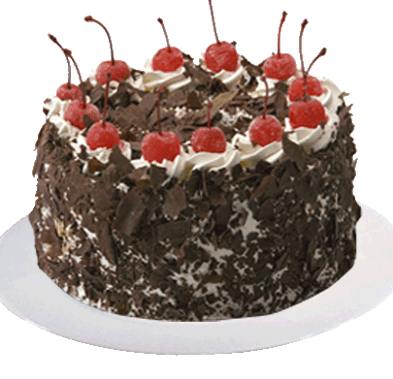
Images
<img
src=“cake.gif”
alt=“The cake is not a lie…”
width=“200”
height=“200” />

Slide 55
Tables
Used only for tabular data
For positioning elements in specific positions, use CSS and not HTML tables!
The hardest part for today :-)
Example:
Table of students with name, surname, and grade.
Table of famous scientists with name, surname, discipline, and most famous invention.

Slide 56
Famous scientists
Alan | Turing | Computer Science | Turing Machines
Ludwig | Wittgenstein | Philosophy | Tractatus
Bertrand | Russel | Logic | Principia Mathematica
Archimedes |  | Engineering | Level
Leonhard | Euler | Mathematics | e^{ιπ} + 1 = 0
<table>: Defines a table

Slide 57
Table row
Alan | Turing | Computer Science | Turing Machines
Ludwig | Wittgenstein | Philosophy | Tractatus
Bertrand | Russel | Logic | Principia Mathematica
Archimedes |  | Engineering | Lever
Leonhard | Euler | Mathematics | e^{ιπ} + 1 = 0
<tr>: Defines a table row. Immediate child of <table>

Slide 58
Table cell
Alan | Turing | Computer Science | Turing Machines
Ludwig | Wittgenstein | Philosophy | Tractatus
Bertrand | Russel | Logic | Principia Mathematica
Archimedes |  | Engineering | Lever
Leonhard | Euler | Mathematics | e^{ιπ} + 1 = 0
<td>: Defines a table cell. Immediate child of <tr>

Slide 59
Tables
<table>: Defines a table
<tr>: Defines a table row
<td>: Defines a table cell (mnemonic: table data)
<table> contains only <tr>
<tr> contains only <td>
<td> only contained within <tr>
<tr> only contained within <table>

Slide 60
<table>
<tr>
<td>Alan</td><td>Turing</td>
<td>Computer Science</td><td>Turing Machines</td>
</tr>
<tr>
<td>Ludwig</td><td>Wittgenstein</td>
<td>Philosophy</td><td>Tractatus</td>
</tr>
<tr>
<td>Bertrand</td><td>Russel</td>
<td>Logic</td><td>Principia Mathematica</td>
</tr>
<tr>
<td>Archimedes</td><td></td>
<td>Engineering</td><td>Lever</td>
</tr>
<tr>
<td>Leonhard</td><td>Euler</td>
<td>Mathematics</td><td>e<sup>ιπ</sup> + 1 = 0</td>
</tr>
</table>

Slide 61
We learned
Content/presentation separation
Basic HTML structure
Titles
Paragraphs
Headlines
Lists
Links
Images
Tables

Slide 62

Congratulations!
You learned HTML.
You can now make your first webpage!

Slide 63
Next time…
Introduction to CSS
Colors
Fonts
Margins
Borders

