Slide 1
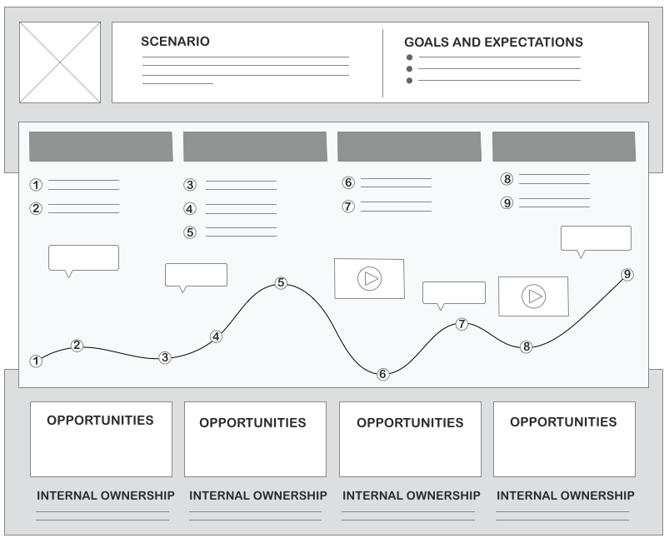
TO KEEP THINGS SIMPLE USE THIS TEMPLATE
NNGROUP.COM
Original article - When and How to Create Customer Journey Maps - https://www.nngroup.com/articles/customer-journey-mapping/

Slide 2
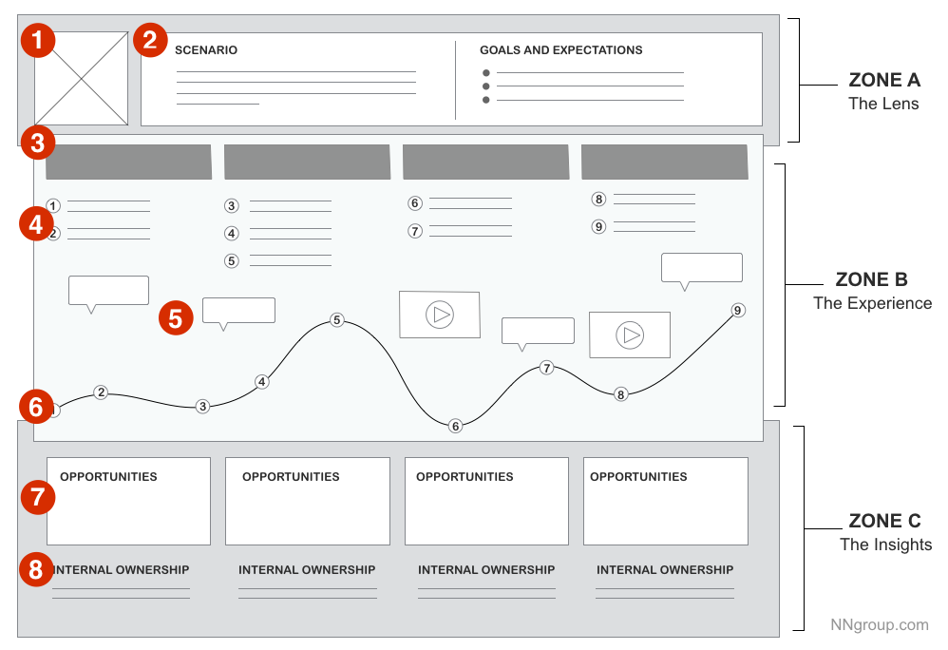
Notes:
When and How to Create Customer Journey Maps by KATE KAPLAN on July 31, 2016
https://www.nngroup.com/articles/customer-journey-mapping/

Slide 3
Using that template
Your persona (1).
You need a scenario plus context & goals/expectations (2).
The visualized experience, usually aligned across (3) chunkable phases of the journey. The (4) actions, (5) thoughts, and (6) emotional experience of the user has throughout the journey.
insights and pain points discovered, and the (7) opportunities. Ignore (8).

Slide 4
Instructions
Create your own version of the template using the software of your choice (MSWord, PowerPoint, Photoshop etc).
Prototype the user experience using post-its etc.
Discuss opportunities
Define and create one for each persona

