Slide 1
JACK HENRY // COMMUNITY BANKING & CREDIT UNIONS
Unlocking Revenue with Data Science
Turning Intelligence into Growth
Churn detection and personal-to-commercial growth, built for community financial institutions
Mike Ames
30-Minute Briefing | July 2026
Notes:
Open warm. State the thesis in one breath: community FIs sit on two of the richest, most under-used revenue signals in banking -- who's about to leave, and who's quietly running a business through a personal account. Data science turns both into growth, but only if detection is paired with the right offer at the right moment. That's the throughline for the next 30 minutes.

Slide 2
AGENDA
Where we're headed
01
02
03
04
The Business Case
Building the Model
Making It Explainable
Making It Work
Why churn and small-business drift both cost community FIs real revenue — today
Data, exploration, sampling, and evaluation behind the score — one shared ML pipeline
SHAP, calibrated scores, and AI narrative — turning a model output into an insight
Offer optimization, a rollout roadmap, and the guardrails that protect trust
2
Notes:
Four sections, thirty minutes: roughly 5 on the business case, 9 on churn, 9 on personal-to-commercial, 7 on making it work and close. Same underlying pattern shows up twice -- that repetition is intentional, it's the point.

Slide 3
THE BUSINESS CASE — PART 1 OF 2
Attrition is quietly draining the balance sheet
$195B
55%
83.1%
lost annually to customer churn across U.S. banks
of federally insured credit unions had fewer members at year-end 2025 than a year earlier
average community-bank retention rate — solid, but eroding at the margin
Sources: NCUA 2025 year-end call report data; industry churn-cost estimates, 2025–26.
3
Notes:
Lead with the NCUA number -- it lands because it's not a vendor stat, it's a regulator's own call-report data. Retention at 83% sounds fine until you translate it into dollars: a 5-point swing in retention moves profit by 25-95% depending on the product, because acquisition is roughly five times more expensive than keeping who you have.

Slide 4
THE BUSINESS MODEL
Retention is the cheapest growth lever you have
~5x cost, acquire vs. retain
12–18 months
25–95%
average cost to acquire a new banking customer vs. retain an existing one, a ratio consistently found across banking and consumer research
typical payback window on a newly acquired banking customer — retention returns value immediately, without the wait
profit lift from just a 5-point improvement in retention, depending on the product line
The economics only pay off if you can see risk early enough to act — which is the entire design goal of the model that follows.
Sources: Reichheld & Sasser, “Zero Defections,” Harvard Business Review, 1990 (reprinted 2014); Bain & Company; Invesp and Backbase CAC/retention-cost benchmarks, 2023–26.
4
Notes:
This is the finance slide -- the one the CFO in the room cares about. Every dollar spent detecting risk earlier is leveraged roughly 5x versus spending it on acquisition later. That's the business case for the model, before we've even talked about the model.

Slide 5
THE BUSINESS MODEL — PART 2 OF 2
Three formulas that turn detection into dollars
Net Value = (Saves × CLV) − (Flags × Cost)
$870–$1,639 vs. ~$25–$50
ROI = (Hrs Saved × Rate) ÷ AI Cost
Cost-benefit. Value of relationships saved, minus the cost of every outreach — including the false alarms.
Precision/recall economics. Annual checking-relationship value vs. the cost of reviewing one flagged alert (fraud/AML alert-review benchmarks, used here as the closest published proxy). At that ratio, a wider net almost always pays.
Automation ROI. A directly analogous benchmark: AI context-enrichment cut fraud/AML case handling from 22 minutes to 9 minutes per alert — the same mechanics apply to a churn narrative layer.
These are cross-industry proxies, not this book's numbers — the formulas are what to sponsor; validate the inputs against your own portfolio.
Sources: StrategyCorps checking-account profitability data; American Bankers Association account-maintenance benchmarks; Sphinx alert-review studies; McKinsey, "Financial Crime Operations," 2025.
5

Slide 6
THE BREAKEVEN CASE — A $1B COMMUNITY FI
What deflecting churn is actually worth
Illustrative math for a $1B-asset institution — swap in your own numbers where you have them.
~33,000 households
8–12% annual churn
~$700/household/yr
$150K/yr + $150/save
$820M deposits (82% of $1B assets) ÷ ~$25K avg. relationship balance (Fed SCF, 2022)
≈2,600–4,000 households at risk/yr — within industry's 5–15% range (FI Works, The Financial Brand)
average relationship revenue at risk (StrategyCorps checking-profitability data)
illustrative program cost — data pipeline, model upkeep, review capacity
Value saved vs. program cost, by households deflected per year
$300K
$200K
$100K
$0
6
6
6
6
6
Households deflected per year
Value saved ($700/household)
Program cost ($150K fixed + $150/save)
Breakeven ≈ 273 households deflected/year — about 8% of at-risk accounts. Above that, every household saved is straight to the bottom line.
6

Slide 7
THE BUSINESS CASE — PART 2 OF 2
The small-business opportunity you're built to win
Community FIs already win on trust and access
$130B
Loan approval rate — small FIs
82%
Loan approval rate — large banks
68%
small-business banking revenue opportunity nationally — much of it still winnable by community FIs
SMBs likely to switch to a community FI if comparable digitally
60%
SMBs highly likely to switch to a community-oriented FI in 5 yrs
16%
99.9% of U.S. businesses are small businesses, employing 45% of the private workforce.
The gap isn't trust — it's visibility. Most community FIs can't yet see which of today's personal-account holders is already running a business.
7
Notes:
Community banks and credit unions approve SMB loans at a much higher rate than large banks, and 60% of SMB decision-makers say they'd switch to a community institution if the digital experience were comparable. The barrier isn't trust or appetite -- it's that most of these small businesses are invisible, banking through a personal account nobody has flagged.

Slide 8
THE HIDDEN BUSINESS PROBLEM
The gig economy is banking through personal accounts
Side hustles, freelancers, and sole proprietors keep growing — and most never open a business account. That's three costs at once:
Lost revenue
Owner risk
Compliance exposure
No treasury management, merchant services, business card, or business lending relationship — all of it goes to whoever notices first
Personal accounts carry Reg E consumer protections, not business liability protections — the member is more exposed than they realize
Commingled personal and business funds are a BSA/AML red flag and complicate the institution's own monitoring and reporting
The trend is accelerating: 36% of U.S. workers now identify as independent — up from 27% in 2016 — contributing over $1 trillion to the economy annually, with gig-economy payment volume up 93% year-over-year at institutions already tracking it.
Sources: McKinsey American Opportunity Survey via Independent Banker/ICBA, 2023; The Financial Brand / Segmint gig-economy transaction data, 2022.
8
Notes:
Frame this as a two-sided story: it's a growth opportunity for the institution, but it's also a genuine risk-management gap for the member and for BSA/AML monitoring. That combination is what makes the business case for funding this model much easier internally than a pure marketing ask.

Slide 9
THE BUSINESS MODEL — PERSONAL TO COMMERCIAL
Every hidden business is a warm lead, not a cold one
Same 33,000 households as the churn model — a different lens on the same base.
33,000
households at a $1B-asset institution — the same base used throughout this deck
~1,320
show a credible, explainable business signal — roughly 4% of households, based on real transaction-signal incidence: 2.35% merchant-processing inflows plus 1.35% payments to a payroll service from a personal account (The Financial Brand / Segmint, 2022)
~330
convert to a full business relationship — a 25% warm-lead conversion rate, typical for relationship-based SMB outreach
~$825K in new annual revenue — from converting just 330 of 33,000 households
330 conversions × ~$2,500 avg. incremental annual revenue per relationship (illustrative — validate against your own SMB pricing), at $300–$600 to detect & convert each one vs. up to $4,000 to acquire a commercial customer externally.
Detection turns an existing relationship into the cheapest commercial lead your institution has — roughly 7–13x cheaper than buying one.
Sources: The Financial Brand / Segmint gig-economy transaction data, 2022; McKinsey American Opportunity Survey via Independent Banker/ICBA, 2023; Forbes & CRNRstone commercial-lending CAC benchmarks; StrategyCorps/ABA account-value data. Figures are illustrative planning assumptions.
9

Slide 10
THE THROUGHLINE
Detection is necessary. It is not sufficient.
Both problems in this talk — churn and personal-to-commercial growth — run through the same four-stage engine.
Data
Detect
Explain
Act
Curated signals, not everything
Tree-based ML scores the risk or the opportunity
SHAP turns a score into a reason
Offer optimization deflects or converts
A fifth stage, Learn, feeds outcomes back into the model — every deflected churn and every converted account makes the next score sharper.
10
Notes:
This is the mental model for the rest of the talk. Data-Detect-Explain-Act, with Learn closing the loop. I'll walk it once for churn, then again for personal-to-commercial, so notice how much of the plumbing -- the feature pipeline, the SHAP layer, the offer-ranking logic -- is genuinely shared infrastructure, not two separate projects.

Slide 11
PART TWO
Building the Model
Data, exploration, sampling, modeling, and evaluation — the CRISP-DM steps behind the score
11

Slide 12
WHAT CHURN LOOKS LIKE BEFORE IT HAPPENS
The leading indicators
Single-product relationship
Declining balance trend
One-product members/customers churn at far higher rates than multi-product households
Sustained drawdown often precedes departure by months
Direct deposit drop-off
Falling transaction volume
Loss of DD or payroll routing is one of the strongest early signals available
Fewer logins, fewer swipes, fewer transfers — quiet disengagement
Loan non-renewal / falling utilization
Service friction
An expiring loan not renewed, or shrinking card utilization, signals a relationship in motion
Complaints, repeated fee disputes, or unresolved service issues cluster before exit
12
Notes:
None of these signals is exotic -- every core and digital banking platform already captures them. The insight isn't discovering new data, it's fusing signals that today live in separate silos into one member-level view.

Slide 13
DATA SELECTION
Curated features beat 'throw everything in'
The model is only as good as the five data domains feeding it — each chosen because it maps to a specific behavioral question.
Core & Transaction
Digital Engagement
Credit & Lending
Service Interactions
External Context
Balances, DD status, transaction frequency & size, product holdings
Banno logins, feature usage, channel mix, session trends
Utilization, delinquency, loan maturity/renewal events
Call center, complaints, branch visits, chat transcripts
Life-stage & geographic signals, local market/rate moves
13
Notes:
Deliberately not a big-data pitch. The craft is in picking the right five domains and engineering features that actually carry signal -- trend deltas, ratios, and recency windows outperform raw balances every time. Credit and lending data is highlighted because loan renewal timing is often the single highest-value trigger point.

Slide 14
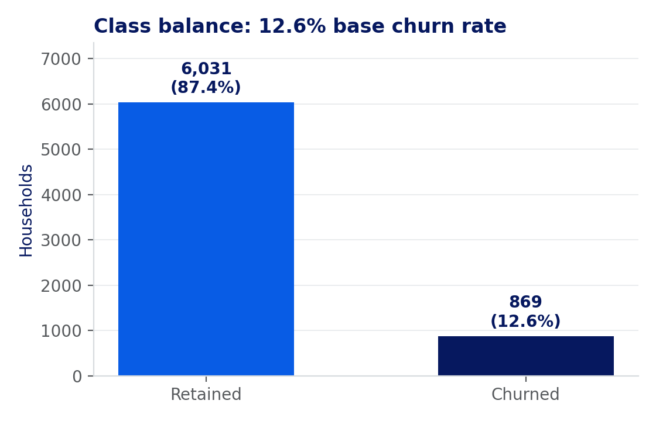
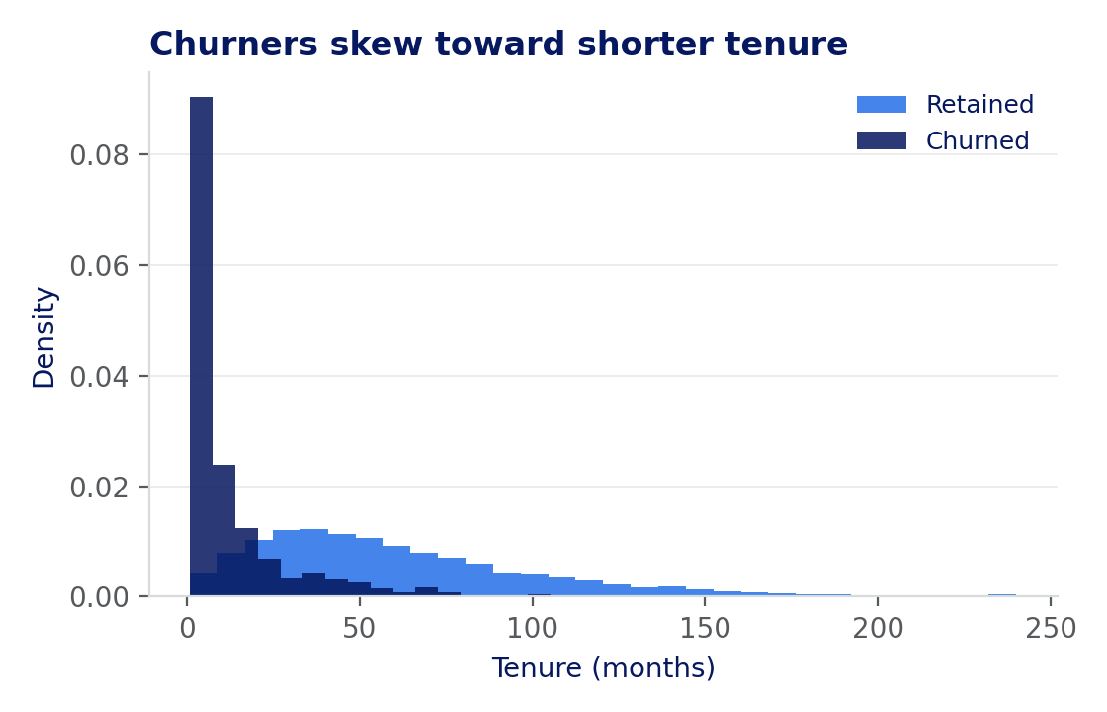
STEP 2 — EXPLORE
What the data actually looks like
6,900 synthetic households, modeled on real community-FI behavior patterns
What jumps out: churners skew toward shorter tenure, lower product counts, and a negative recent balance trend — exactly the signals a relationship manager already watches for informally. The model's job is to watch all of them, continuously, across every household at once.
This is real output from a GradientBoosting model trained on synthetic data built to mirror community-FI behavior — illustrative, not production figures.
14

Slide 15
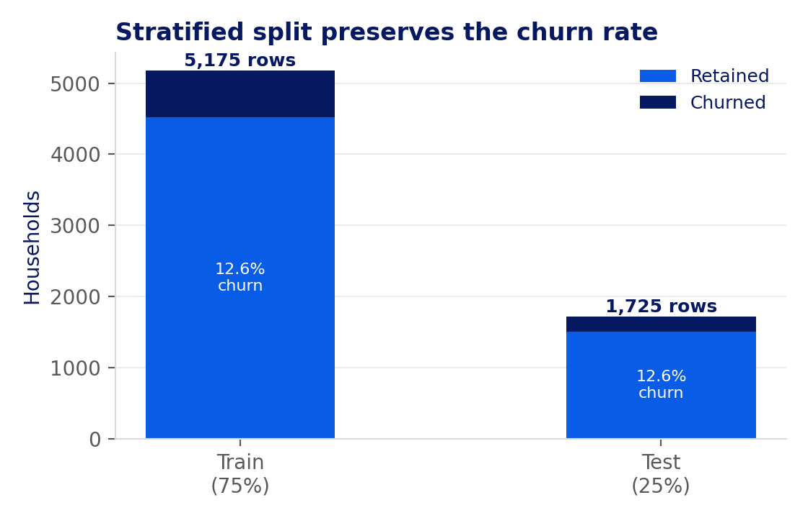
STEP 3 — SAMPLE
Splitting the data without cheating
1
Stratified, not random
Splitting on a coin flip can leave the test set with almost no churners at a 5-10% base rate — stratification keeps both sets representative.
2
Time-aware where it matters
Features are built only from information available before the observation window, so the model never trains on the future.
3
Held-out means held out
The test set is never touched during feature selection or tuning — every metric on the next few slides comes from data the model has not seen.
5,175 households train the model; 1,725 never seen during training grade every metric that follows.
15

Slide 16
THE ML APPROACH
From raw data to a monthly risk tier
1
2
3
4
Feature
Engineering
Model Ensemble
Monthly Scoring
Risk Tiers
Trend deltas, ratios, recency windows
XGBoost / CatBoost, AutoGluon-selected
Batch-scored across the member base
Low / Medium / High, routed to action
Why an ensemble, not one model
Gradient-boosted trees (XGBoost, CatBoost) handle the mixed numeric/categorical, missing-heavy data typical of core banking systems better than linear models or deep nets at this data scale. AutoGluon automates model selection, tuning, and stacking so the team spends its time on features and validation, not framework plumbing — critical for lean data science teams at community FIs.
16
Notes:
Keep this conceptual for an exec audience: tree-based ensembles because banking data is tabular, messy, and mixed-type; AutoGluon because it gives a small data science team leverage without needing a research staff. Monthly batch scoring is a deliberate, practical cadence -- fast enough to act, slow enough to stay explainable and auditable.

Slide 17
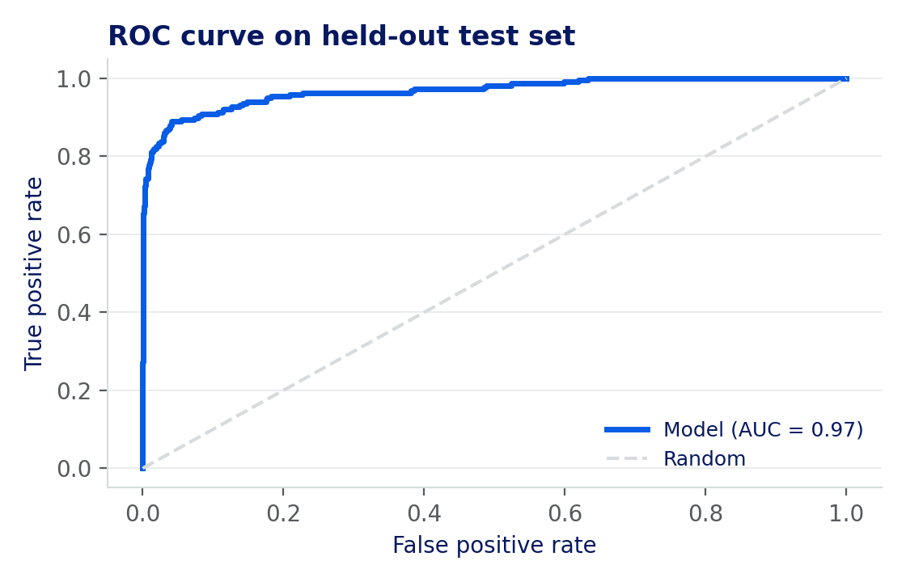
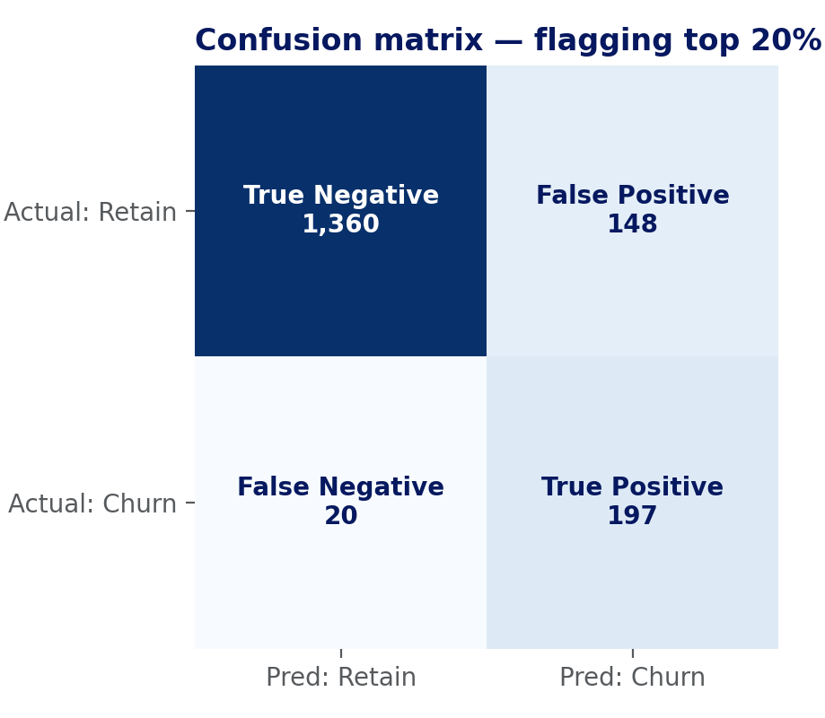
STEP 5 — EVALUATE
Does it actually work, on data it hasn't seen?
0.97
91%
~4.5x
ROC-AUC on held-out test data
of actual churners caught in the top 20% flagged
lift over the base rate in that top 20%
Real metrics from a real held-out test set on synthetic data — the shape of the story, not a guarantee of production performance.
17

Slide 18
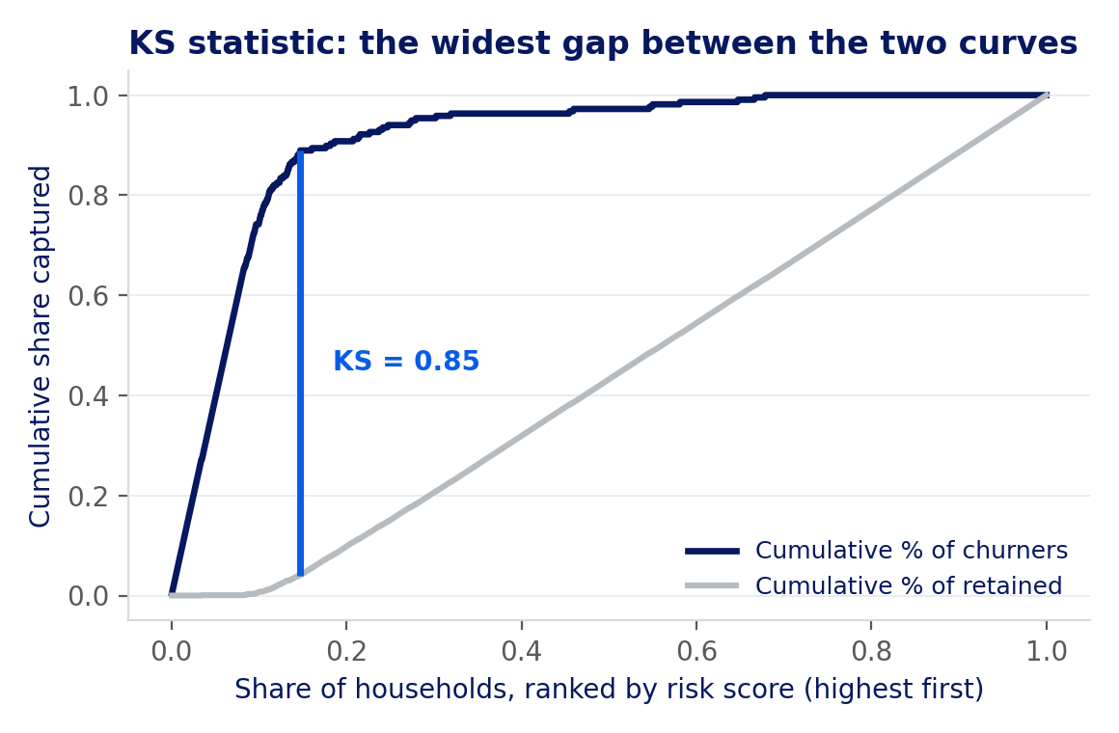
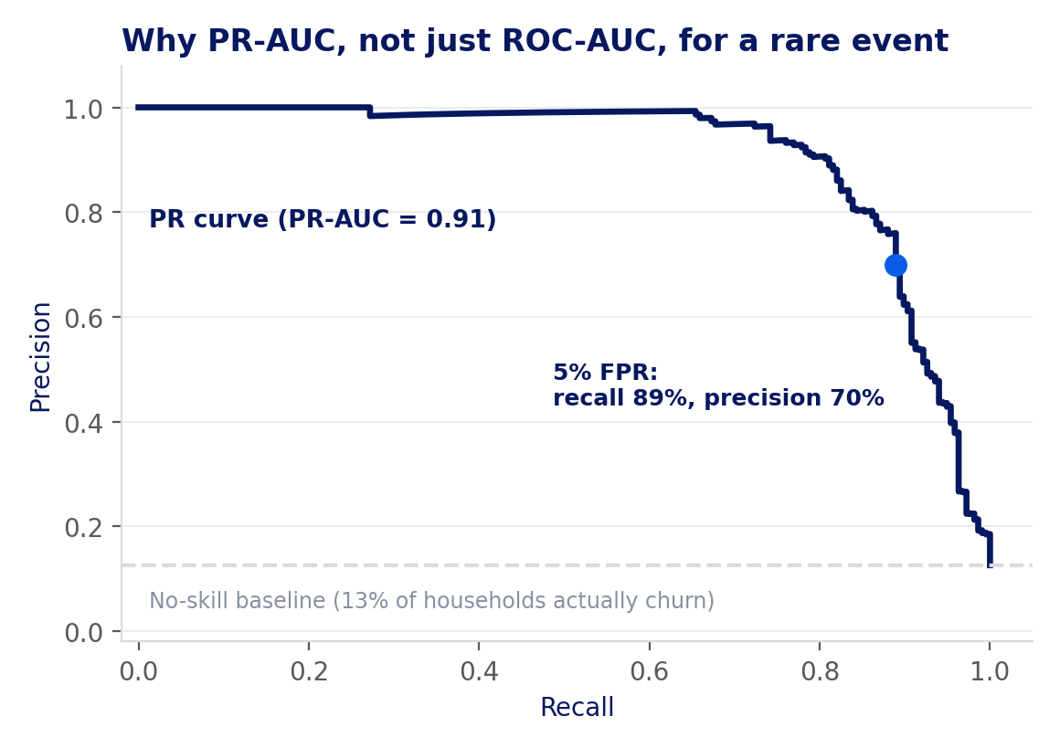
KEY METRICS, TRANSLATED FOR EXECUTIVES
The numbers a board will actually ask about
Assume we operate the model at a 5% false-positive rate — flagging roughly 16% of the book for review.
AUC
PR-AUC
F1 @ 5% FPR
KS STATISTIC
0.97
0.91
0.78
0.85
Ability to separate. Pick one churner and one non-churner at random — the model ranks the churner riskier this often.
Rare-event honesty. ROC-AUC flatters imbalanced problems; PR-AUC is judged against the true base rate, not 50/50.
One balance number. Blends precision and recall at our chosen operating point into a single score to track quarter to quarter.
The classic risk-team metric. Widest gap between cumulative churner vs. non-churner curves — >0.4 is typically considered strong.
At this operating point: 89% of actual churners caught, 70% precision, and roughly 5.6x lift over the 13% base rate — real numbers from the held-out test set.
18

Slide 19
MODEL VALIDATION, NOT JUST A SCORE
The rigor a data science team actually checks
AUC and accuracy are a start, not the finish line — four checks separate a model that ships from one that's actually trustworthy.
Precision-recall over accuracy
Calibration, not just ranking
Two importance methods, cross-checked
Drift triggers a look, not just a wait
Churn is rare — accuracy hides that. The threshold is tuned on the precision-recall curve (PR-AUC), not a single accuracy number.
A 0.7 risk score should mean 70% actually churn. Reliability diagrams and Expected Calibration Error (ECE) confirm the score can be trusted, not just ordered correctly.
TreeSHAP (exact Shapley attribution) and permutation importance (AUC drop when a feature is shuffled) have to agree before a driver is trusted.
Population Stability Index (PSI) on key features flags drift automatically; a challenger model has to beat the champion on live data before it earns the promotion.
None of this shows up in a demo — it's what keeps the score honest six months after launch.
19

Slide 20
THE SAME PIPELINE, A DIFFERENT LABEL
P2C runs through every step you just saw
Data → Explore → Sample → Model → Evaluate → Explain — the pipeline doesn't change. Two things do.
DATA: new signals, same discipline
LABELING: a harder problem than churn
Payment-aggregator patterns
Churn has a clean label — the account closed. “This personal account is really a business” rarely gets confirmed unless the member says so.
Deposit rhythms shaped like Stripe, Square, or PayPal payouts
Counterparty diversity
Path A — Unsupervised
Many distinct payers instead of a small repeating circle
Anomaly detection surfaces accounts that behave unlike typical personal activity — no labels required
Deposit timing & velocity
Business-hours cadence and a rising average ticket size
Path B — Supervised
Memo & name matching
Trained on accounts that later opened a business account — learns the signature that preceded conversion
Invoice language or a business name in the transaction memo
Both paths feed one blended propensity score, reviewed through the same TreeSHAP layer used for churn — one governance process, two revenue plays.
20

Slide 21
PART THREE
Making It Explainable
SHAP, AI narrative, and calibrated scorecards — turning a model output into an insight
21

Slide 22
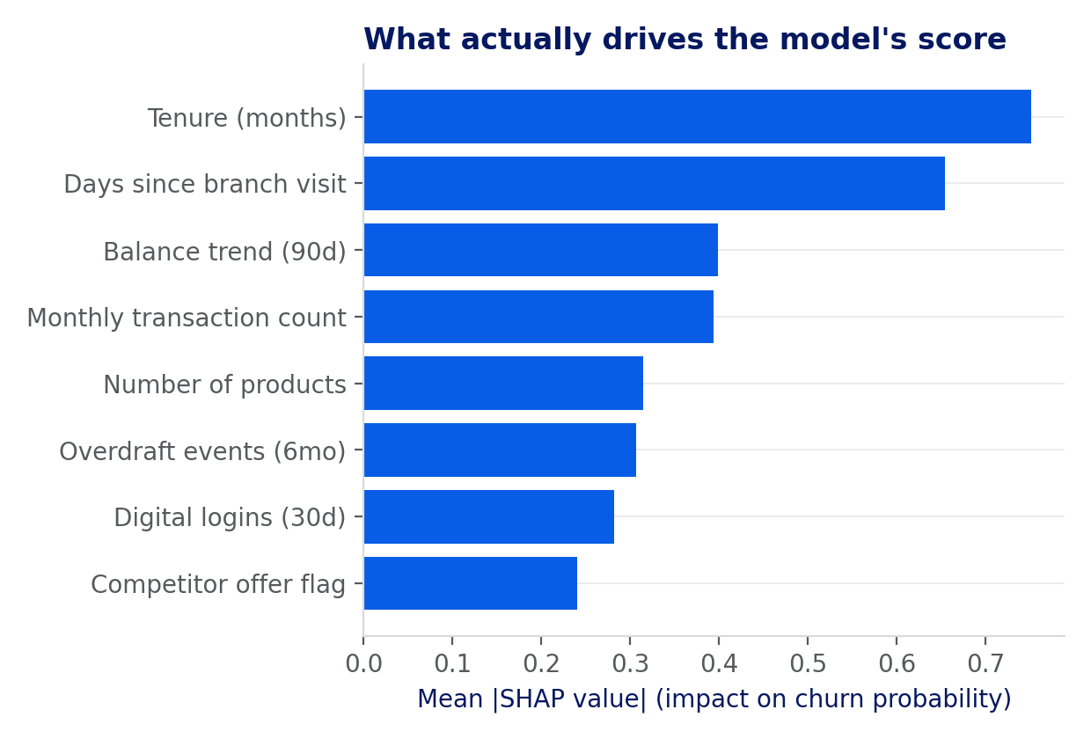
WHY EXPLAINABILITY ISN'T OPTIONAL
Every score needs a reason
Model governance
Real TreeSHAP output — synthetic 6,900-household model
SR 11-7 / OCC 2011-12 require documentation that someone unfamiliar with the model can understand — TreeSHAP is now the standard way examiners expect that shown.
Feature contribution to churn-risk score
Frontline usability
A risk score with no reason is unusable. "Declining direct deposit + single product" is something a relationship manager can act on today.
A scorecard, not a black box
SHAP turns one opaque number into an itemized scorecard — the same format examiners and boards already trust, just generated by the model instead of a manual rubric.
22
Notes:
This chart is illustrative, not a live model output -- but it's exactly the shape of artifact the model should produce for every flagged member: which features pushed risk up, which pulled it down, in plain language. That's the artifact that satisfies the examiner and the relationship manager with the same output.

Slide 23
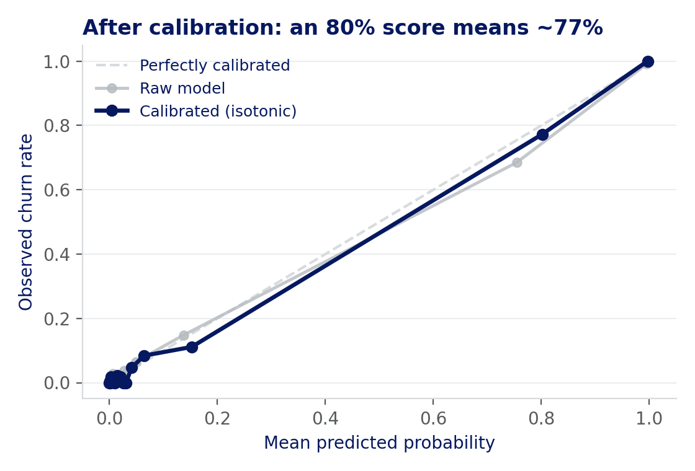
SCORE CALIBRATION
A 0.31 isn't always a 31% chance
Raw model output is a pseudo-probability. It can systematically over- or under-state the real thing.
Why raw scores drift
Trained on a rare event (12.6% churn), a model's confidence and the true frequency can pull apart, especially at the extremes — a raw “high” score can still be an overstatement.
What calibration fixes
Isotonic regression remaps the raw output so it matches observed outcomes: of every household the calibrated model calls 90%, about 90% actually go on to churn.
What it doesn't change
Calibration never changes who gets flagged or in what order — only whether the number itself can be trusted at face value.
Every probability used from here forward is the calibrated version — never the raw one.
23

Slide 24
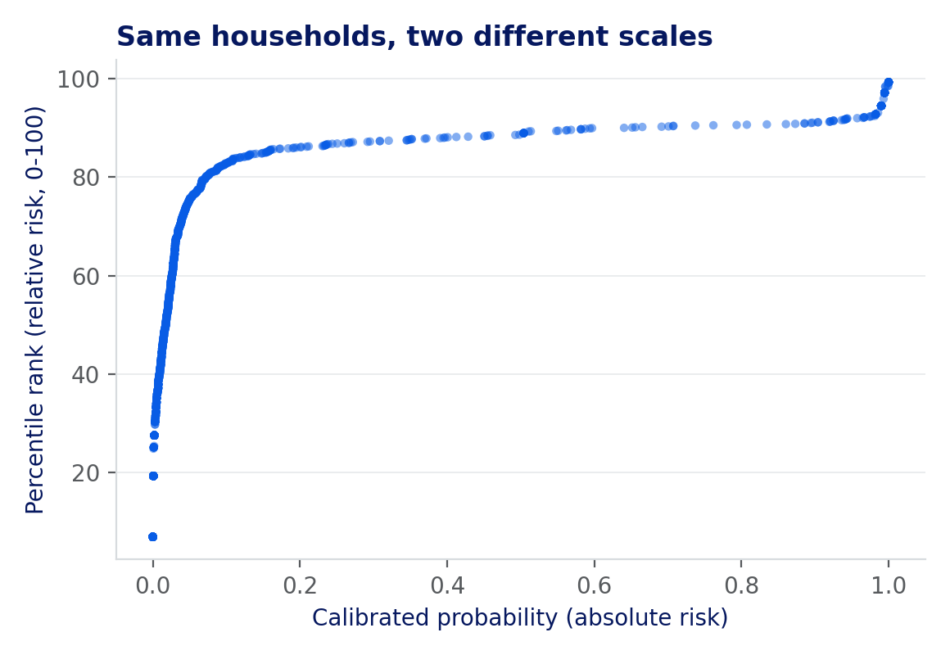
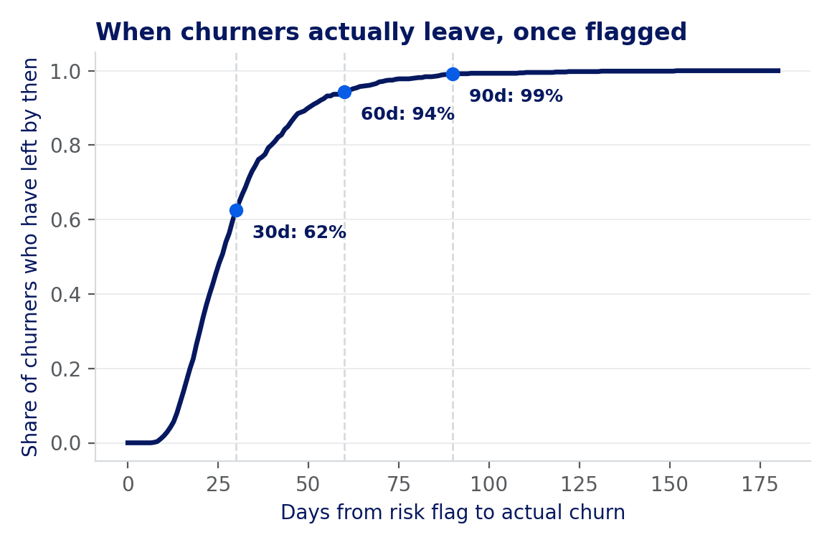
SCORE NORMALIZATION
A probability isn't the only number you need
Two more translations turn one calibrated score into something a team can actually work from.
RANK — how urgent, relative to the book
TIME — not just if, but when
A percentile of 90 doesn't mean “90% probability” — it means riskier than 90% of the portfolio. Useful when the constraint is outreach capacity: “call the top 10%” is a to-do list.
Multiplying the calibrated probability by the empirical share of churners who've already left by then gives a time-boxed number that actually drives this week's call list.
Example: a household scoring 97% calibrated sits at the 92nd percentile of the book, with a 96% chance of churning in the next 90 days — not just “eventually.”
24

Slide 25
FROM SIGNAL TO SENTENCE
AI turns the SHAP output into something a person reads in five seconds
Narrative generation
Illustrative — one member
A lightweight language layer reads the ranked SHAP contributions and drafts a two-sentence summary in plain business language.
Raw signal vs. AI-generated narrative
RAW SHAP OUTPUT
Visualization, simplified
Direct deposit drop → +0.31
Single product → +0.18
Login frequency ↓ → +0.09
Tenure (6 yrs) → −0.12
The same output renders as a simple contribution bar on the RM's dashboard — the underlying TreeSHAP math never changes, only the presentation.
A draft, not a verdict
The AI-written narrative is a starting point for the reviewer that follows — every word traces back to an actual SHAP value.
AI NARRATIVE
“Risk is rising mainly because direct deposit stopped three weeks ago and they hold only one product — partly offset by six years of tenure.”
25

Slide 26
EXPLAINABILITY, REUSED
The same SHAP layer prevents a costly mistake
Gives the banker a real reason code
Why this matters twice
Not just "likely business" — specifically: 14 distinct counterparties in 60 days, deposit cadence matching weekday business hours, and a memo pattern matching invoice language. That's a real conversation starter.
Trust: frontline adoption dies the moment a flag turns out to be embarrassing
Governance: the same SR 11-7-aligned documentation standard applies to every model that touches a member relationship, not just this one
Precision over volume: fewer, better-explained flags convert at a much higher rate than a long, noisy list
Protects against false positives
A member selling a couch on Venmo isn't a business. Explainability lets frontline staff sanity-check a flag before an outreach that would otherwise feel presumptuous — or worse, wrong.
26
Notes:
The reused-infrastructure point is worth making explicitly: once the TreeSHAP governance pipeline exists for churn, extending it to this model is incremental, not a second build. And precision matters more than recall here -- a wrong flag costs goodwill in a way a missed one doesn't.

Slide 27
THE SCORECARD, APPLIED TO P2C
The same waterfall, a different question
Illustrative business-signal scorecard — one flagged account
Feature contribution to the business-likelihood score
Increases business likelihood
Offsets toward personal-only
14 distinct counterparties in 60 days
+17
Weekday business-hours deposit cadence
+12
Memo pattern matches invoice language
+9
Long tenure as personal-only customer
-8
-10
-5
0
5
10
15
20
The RM's accept, override, or escalate decision retrains this score — the same way it does for churn.
27

Slide 28
FROM FLAG TO OFFER
The conversion moment has a sequence
Detection tells you when. Sequencing and propensity tell you what to offer first — get this wrong and a well-earned flag converts nobody.
1
2
3
4
Business Checking
Debit & Treasury Tools
Merchant Services / Card
Business Lending
The foundational move — frictionless, ideally pre-filled digital onboarding via Banno Business
Cash flow visibility and payment tools that mirror what they already use personally
Card acceptance and a business credit line once volume is established
Working capital or growth financing once the relationship has depth and history
Each step is propensity-ranked per account, not applied as a fixed script — the next section covers how.
28

Slide 29
HUMAN IN THE LOOP
The model proposes. A person decides.
Every flag reaches a reviewer before it reaches a member — automation stops at the recommendation, not the relationship
1
2
3
4
5
Flag + Narrative
Context Check
Human Decision
Action Taken
Feedback Loop
A churn-risk flag or a business-signal flag — SHAP reason and AI-written summary attached — lands in the RM's queue the same way
RM pulls up recent history and any notes the model couldn't see
Accept, override, or escalate — the RM's judgment is the last word, every time
A retention call, a business-conversion outreach, or a deliberate no-action — logged with the reason either way
Every override — on a churn flag or a business flag — retrains both models; disagreement is signal, not noise
The goal was never to remove the person from the decision — it was to make sure they never see a score without a reason.
29

Slide 30
“
A risk score sitting in a dashboard has never once saved a relationship.
Detection tells you who. It doesn't tell you what to offer, through which channel, or how urgently — that's a second model, not an afterthought.
30
Notes:
This is the hinge of the churn section -- the point I want to land before moving to the second use case. Detection is a necessary condition, and most vendor pitches stop right here. The differentiated value is in what happens next, which I'll show concretely once we've covered personal-to-commercial too, so the offer-optimization section can serve both.

Slide 31
PART FOUR
Making It Work
Offer optimization, the rollout roadmap, and the guardrails that keep it trustworthy
31
Notes:
Final act. This is where the two use cases converge into one operating model.

Slide 32
OFFER OPTIMIZATION
One engine, two revenue plays
Ranked by propensity × relationship value × urgency, then routed to the right channel
1
2
3
4
5
Flag Raised
Reason Code
Best Action Ranked
Channel & Timing
Outcome Logged
Churn risk or business-signal score crosses threshold
TreeSHAP explanation attached automatically
Retention offer or product sequence, propensity-scored
RM call, digital nudge, or branch conversation
Accepted, declined, or no response — feeds back
Outcomes retrain the model every cycle — a declined retention offer or a converted business account both sharpen the next score.
32
Notes:
This is the same five-node flow for both churn and personal-to-commercial -- only what counts as 'flag' and 'best action' differs. That reuse is what makes the second use case materially cheaper to build once the first one exists.

Slide 33
WHY COMMUNITY FIS ARE POSITIONED TO WIN THIS
Local trust, at data-science scale
Relationship trust
Approval advantage
Shared infrastructure
60% of SMB decision-makers say they'd switch to a community FI with comparable digital tools — trust already exists
Community FIs approve 82% of SMB loan applications vs. 68% at large banks — the appetite is real, not just marketing
Nearly 1,000 community and regional institutions run on Jack Henry core, with Banno Business named a market leader in digital small-business banking
Source: Datos Insights, 2025 digital small-business banking market recognition.
33
Notes:
The point here is that community FIs aren't starting from a trust deficit -- they're starting from a visibility deficit. Data science is what closes that gap without sacrificing the relationship-first model that's the actual competitive advantage.

Slide 34
THE ROADMAP
Crawl, walk, run
Phase 1
Phase 2
Phase 3
Phase 4
Data Foundation & Churn Pilot
Explainability & Governance
Personal-to-Commercial Pilot
Unified Offer Optimization
Consolidate the five data domains; ship a first churn model on a limited segment
Stand up the TreeSHAP layer and SR 11-7-aligned documentation for that model
Reuse the pipeline; add business-signal features and the blended propensity model
One ranking engine drives retention and conversion offers across both use cases at scale
34
Notes:
Sequencing matters: churn first because the label is clean and the ROI case is easiest to prove quickly, governance second because it has to exist before anything customer-facing scales, then the harder personal-to-commercial problem once the team has reps.

Slide 35
GUARDRAILS
What to get right from day one
Model governance
Fairness & bias testing
SR 11-7-aligned documentation and validation before any model touches a real member or customer
Test scores and offers across protected classes — proactively, not after an exam finding
False-positive cost
Frontline adoption
A wrong churn flag wastes an RM's time; a wrong business flag can feel invasive — tune thresholds accordingly
The best model fails if the RM doesn't trust or use the reason code — change management is part of the build
35
Notes:
Worth saying explicitly: none of this is optional overhead bolted onto the model afterward, it's part of the same build. That's exactly why the SHAP/explainability layer was introduced early in the churn section, not as a footnote.

Slide 36
BRINGING IT TOGETHER
One engine. Two revenue plays.
Data
Detect
Explain
Act
Churn Detection
Personal → Commercial
Retains relationships worth 5x their acquisition cost, before the exit decision is final
Converts hidden businesses into full commercial relationships, ahead of the competition
Same data pipeline. Same explainability layer. Same offer-optimization engine. Two very different revenue outcomes.
36
Notes:
This is the summary slide -- if someone only remembers one image from the talk, it should be this one. The infrastructure reuse is the actual pitch: build it once, fund two growth motions.

Slide 37
Thank you
Unlocking Revenue with Data Science: Turning Intelligence into Growth
Mike Ames
mames@jackhenry.com
Questions & discussion
38
Notes:
Open the floor. Likely questions to be ready for: data privacy/consent for the business-signal model, how false-positive rates were validated, and how this integrates with existing core and Banno data feeds.

