Slide 1
Digital Circuit Experiment Digital Decoder （译码器）
Lecture 4
Zheng Guan（官铮）

Slide 2
Theoretical Basis
Digital Decode
BCD to Seven Segment Decoder
BCD to seven segment decoder is a circuit used to convert the input BCD into a form suitable for the Seven segment display.
Binary Decoder

Slide 3
Theoretical Basis
BCD to Seven Segment Decoder
BCD (Binary Coded Decimal)
BCD or Binary Coded Decimal is that number system or code which has the binary numbers or digits to represent a decimal number. It is an encoding scheme which represents each of the decimal numbers by its equivalent 4-bit binary pattern.
A decimal number contains 10 digits ：(0-9）
The binary number formed by four binary digits contains 16 codes: 0000~1111 (0-15)
In case of BCD, the binary number formed by four binary digits, will be the equivalent code for the given decimal digits. Only the binary number from 0000-1001 are used to express the decimal equivalent from 0-9 respectively.

Slide 4
Theoretical Basis
BCD (Binary Coded Decimal)
For single decimal digit, it’s equivalent BCD will be the respective four binary digits of that decimal number
0—0000 1—0001 2-0010 3—0011 4–0100 5–0101 6–0110 7–0111 8–1000 9--1001
For two decimal digits, it’s equivalent BCD will be the respective eight binary of the given decimal number. Four for the first decimal digit and next four for the second decimal digit. It may be cleared from an example.
(15)_{BCD}=0001 0101 (24)_{BCD}=0010 0100
(15)_{B} =1111 (24)_{B} =11000
For n decimal digits, it’s equivalent BCD will be the respective 4n binary of the given decimal number.
(256)_{BCD}=0010 0101 0110

Slide 5
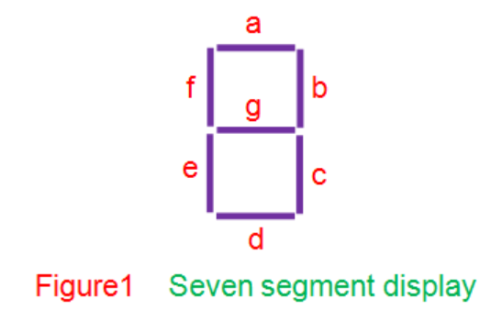
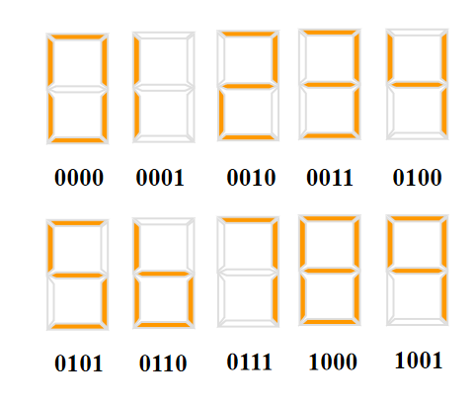
Theoretical Basis
Seven segment displays
Seven segment displays comprise of seven individual segments formed by either Light Emitting Diodes (LEDs) or Liquid Crystal Displays (LCDs) arranged in a definite pattern (Figure 1).
For the display to work, these segments are to be driven by the certain logic level at their input. Depending on this, seven segment displays are found to be of two types viz., common cathode type and common anode type.

Slide 6
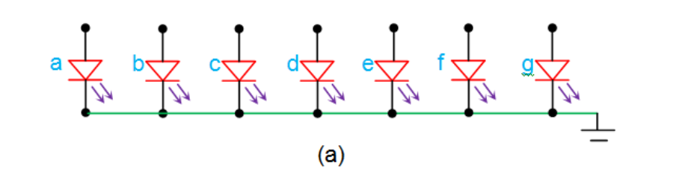
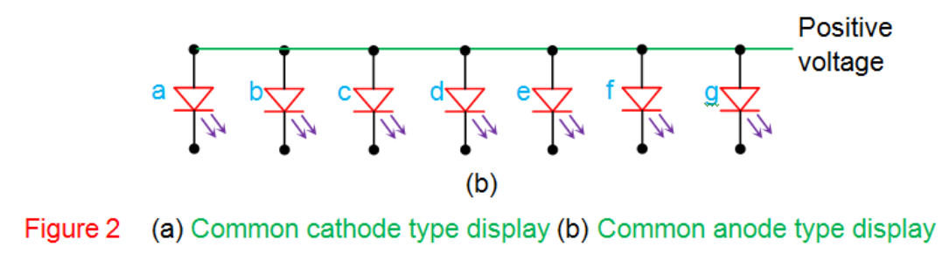
A common cathode display (Figure 2a) has all the cathode terminals of its LED segments tied together (green line).
Further, this is grounded and hence is considered to be at logic 0 state. This means that in order to light up an LED, one needs to drive it high.
On the other hand, Figure 2b has all its anode terminals connected together which is further driven high by connecting it to a positive supply voltage (green line). Hence for this kind of display to work, one has to drive low on the cathode terminals of the individual LED segments.

Slide 7
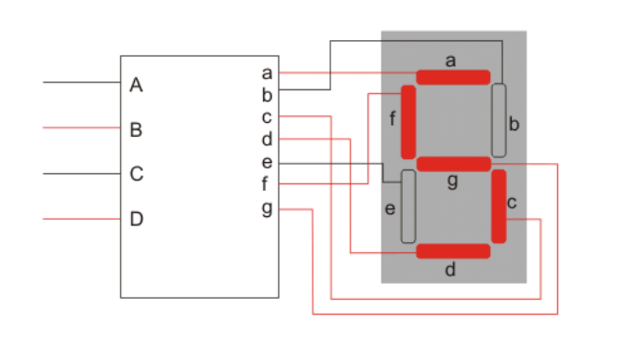
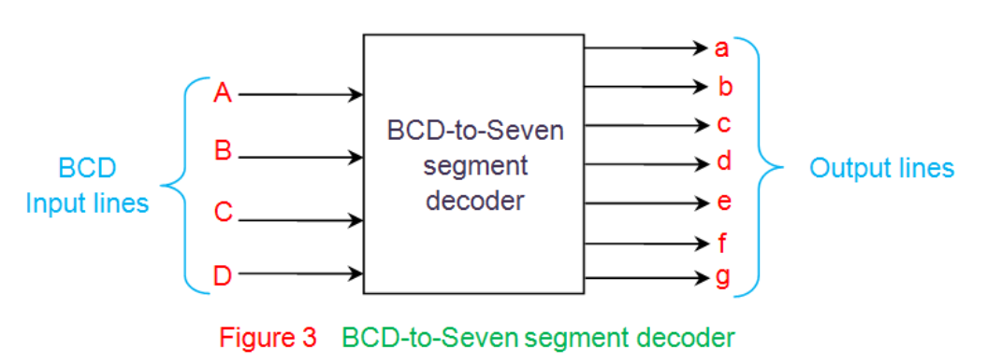
BCD to Seven Segment Decoder
BCD to seven segment decoder is a circuit used to convert the input BCD into a form suitable for the display. It has four input lines (A, B, C and D) and 7 output lines (a, b, c, d, e, f and g) as shown in Figure 3. Considering common cathode type of arrangement, the truth table for the decoder can be given as in Table I.

Slide 8
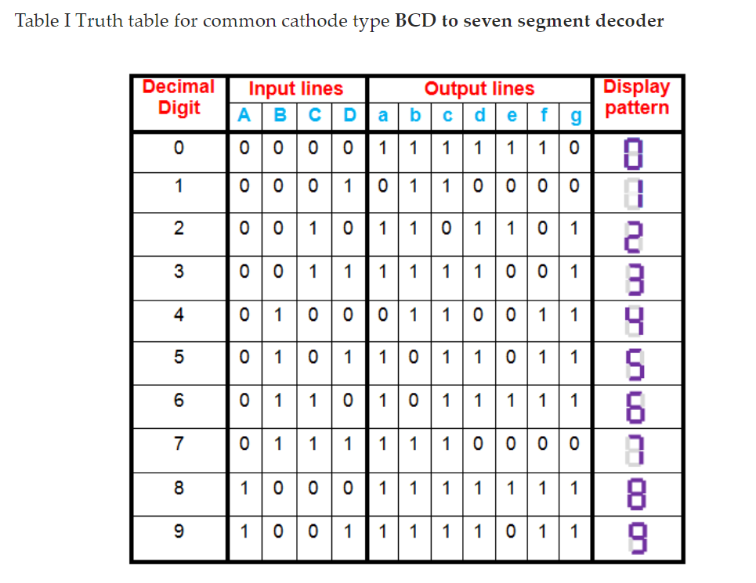
In this case, the segments which are to be driven high to obtain certain decimal digit at the output of the seven segment display. However, it is to be noted that in the case of common anode type, the only change will be to interchange ones and zeros on the table.
This means that from the truth table so obtained one can get to know where low has to be driven so as to obtain the required digit at the output.

Slide 9

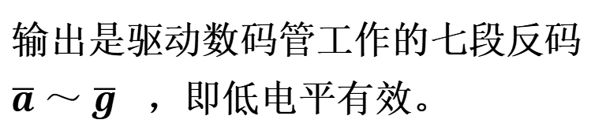
7447/7448
2. BCD－七段译码器
7 1 2 6 3 4 5
A₀
13 12 11 10 9 15 14
(1) BCD七段译码器74LS47/48的符号图
a
A₁
b
输入A₃A₂A₁A₀是四位BCD码
A₂
c
A₃
输出是驱动数码管工作的七段反码 $\overline{a}$ ～ $\overline{g}$ ，即低电平有效。
d
e
LT
f
BI/RBO
g
辅助控制信号输入端:
RBI
$\overline{LT}$—— 试灯输入端，用来测试七段数码管的好坏。
$\overline{BI}$—— 熄灭信号输入端，可控制数码管是否显示。
$\overline{RBO}$—— 灭零信号输出端。
$\overline{RBI}$—— 灭零输入端，用来熄灭不需要显示的0。
Notes:
接下来，我们以74LS47为例，来复习关于显示译码器的工作原理。 这是给出的是输出低电平有效七段显示译码器74LS47的引脚示意图。A3到A0为4位BCD码输入端，a到g为译码输出端。此外还有控制端，包括：LT为试灯输入端，BI和RBO在芯片内部是连在一起的，共用一根管脚，RBI为灭零输入端，控制端均为低电平有效。当 LT =0、BI或RBO=1 时，不论和A₃A₂A₁A₀输入为何，显示数码管的七段全亮，工作时应置LT=1。
当LT =1，RBI=0，且A₃A₂A₁A₀=0000时，数码管不显示，RBO 输出为0。
在多位数显示电路中，在显示数据小数点左边，将高位的 RBO 与相邻低位的 RBI 相连，最高位 RBI 接地；例如显示两位十进制数，在1-9的显示过程中将只显示个位，不会出现为01~09.
引脚4作为输入时，BI起到使能的效果，当BI为低电平有效时，输出全为高，数码管熄灭；

Slide 10
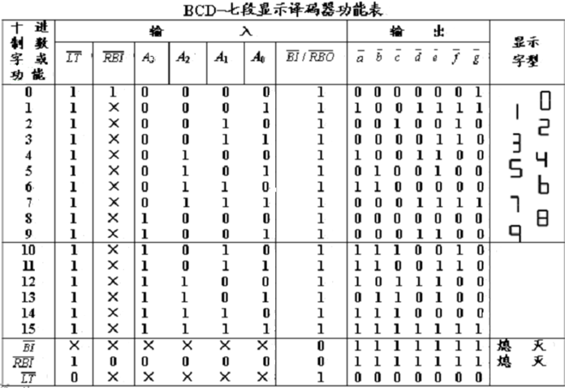
Notes:
这是74LS47的功能表，详细表示了
在多位数显示电路中，在显示数据小数点左边，将高位的 RBO 与相邻低位的 RBI 相连，最高位 RBI 接地；例如显示两位十进制数，在1-9的显示过程中将只显示个位，不会出现为01~09.

Slide 11
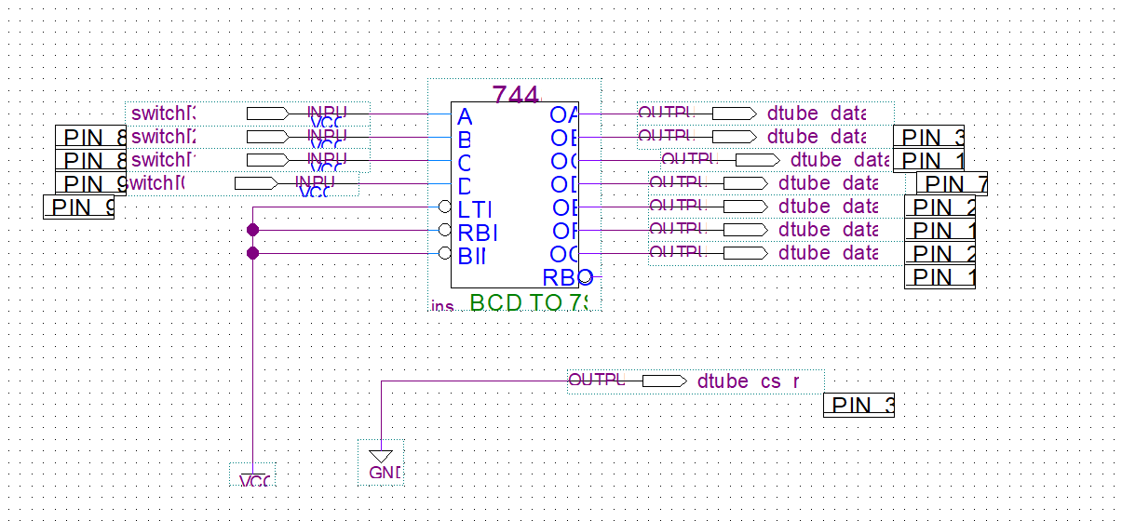

Slide 12
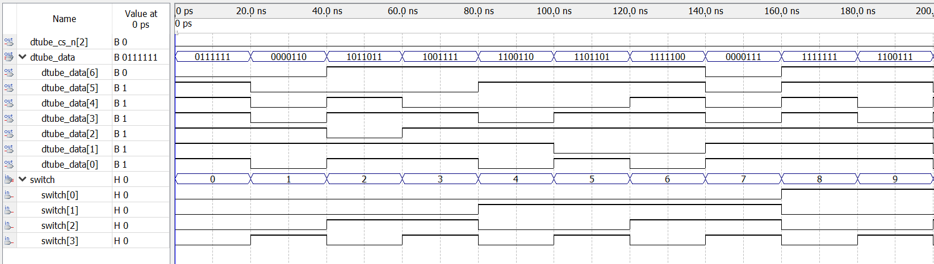
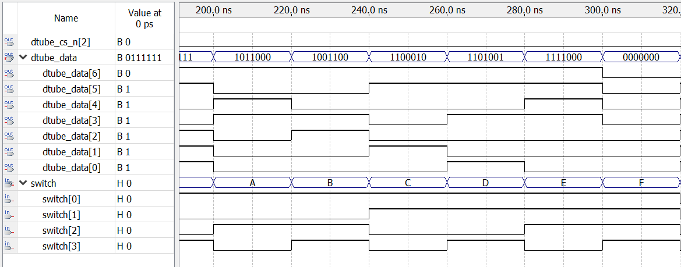

Slide 13
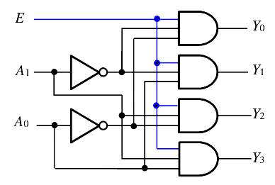








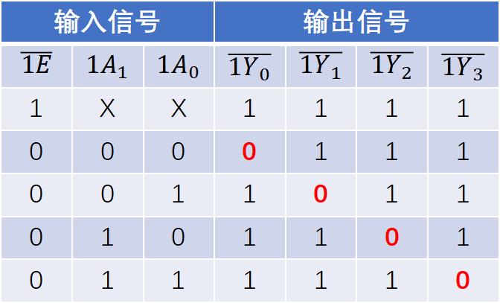
Binary Decoder
Decoder is a combinational circuit with n input lines and 2^{n} output lines. In functionality, a binary decoder converts a definite sequence of input bits into a specific pattern as decided by the user based on the requirement.
Input：0011 Output： 0000 0000 0000 1000
输入信号 |  |  | 输出信号
$$\overline{1E}$$ | $${1A}_{1}$$ | $${1A}_{0}$$ | $$\overline{{1Y}_{0}}$$ | $$\overline{{1Y}_{1}}$$ | $$\overline{{1Y}_{2}}$$ | $$\overline{{1Y}_{3}}$$
1 | X | X | 1 | 1 | 1 | 1
0 | 0 | 0 | 0 | 1 | 1 | 1
0 | 0 | 1 | 1 | 0 | 1 | 1
0 | 1 | 0 | 1 | 1 | 0 | 1
0 | 1 | 1 | 1 | 1 | 1 | 0

Slide 14
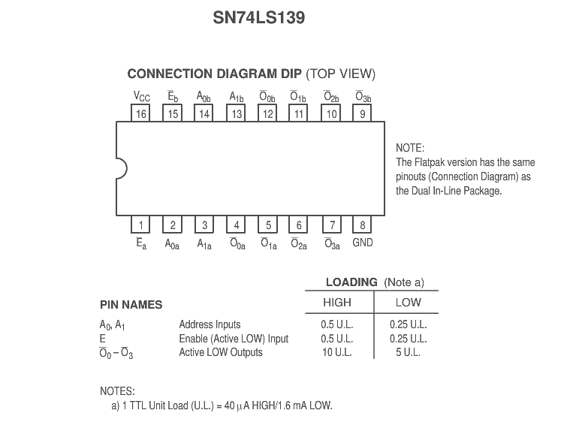

Slide 15
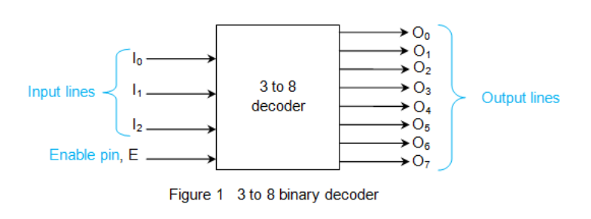
Binary Decoder
Decoder is a combinational circuit with n input lines and 2^{n} output lines. In functionality, a binary decoder converts a definite sequence of input bits into a specific pattern as decided by the user based on the requirement.
Input：0011 Output： 0000 0000 0000 1000
Figure 1 shows a binary decoder with one enable pin and 3 input lines which further results in 8 lines at its output.

Slide 16
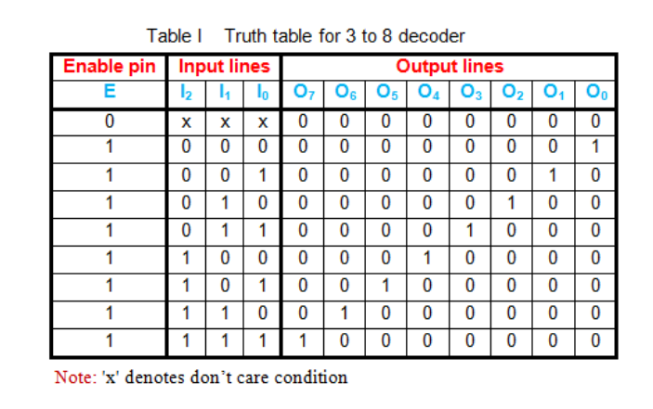
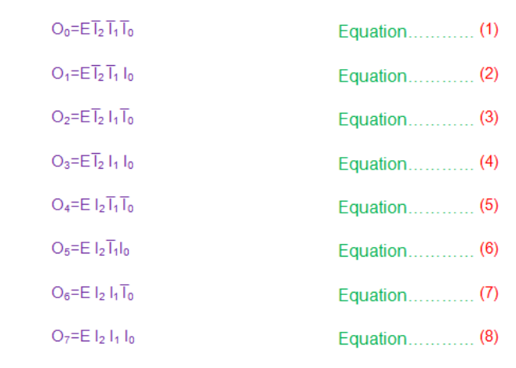
Binary Decoder
when the enable is low, all the output lines are low, no matter what the input sequence be. This indicates the OFF state of the decoder which can also be considered to be its reset state.
Thus one has to drive high on the enable pin to realize the functionality of the decoder.
Thus the Boolean equations for the outputs of the 3 to 8 decoder shown in Figure 1 are given from (1) to (8)

Slide 17
集成电路译码器 —74X138 3线-8线译码器
74LS138是最常用的集成译码器之一，它有三个译码输入端A₂、A₁和A_{0；}八个输出端，低电平有效。因此又称为3线-8线译码器。
输入端
Y0
A0
A1
Y1
A2
Y2
Y3
输出端
Y4
ST_{B}
Y5
使能端
ST_{C}
Y6
ST_{A}
Y7
Notes:
74LS138是最常用的集成译码器之一，它有三个译码输入端A₂、A₁和A_{0；}八个输出端，低电平有效。因此又称为3线-8线译码器。 STA，STB，STC共同构成使能信号。逻辑符号中STB和STC外侧带圈，说明低电平有效，即只有在STA=1，STB和STC都等于0时，译码器才能工作在译码状态。

Slide 18
Binary Decoder
Application: Realize logical function
When E=1, {Qi (i=0,1,2,……,7) } represents the all the minterm that combine of logical variables I₂ I₁and I₀ , so it is possible to realize any logical function with 3 variables by using a 3 to 8 decoder, such as to realized (9), we only need to connect C with I₂, B with I₁, and A with I₀. After that connect Q1, Q2, Q4, and Q7 as the inputs of a 4or gate. Then F is the output of the or gate.

Slide 19
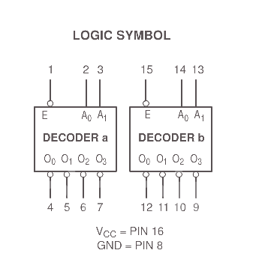
MSI(Medium scale integrated circuit)
74139--- Dual 2-of-4 Decoder.
The device has two independent decoders, each accepting two inputs and providing four mutually exclusive active LOW Outputs.
Each decoder has an active LOW Enable input which can be uses as a data input for a 4-output demultiplexer.
Each half of the 74139 can be used as a function generator providing all four minterms of two variables.

Slide 20
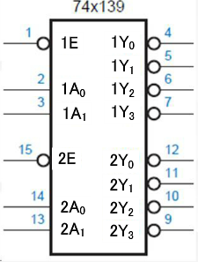










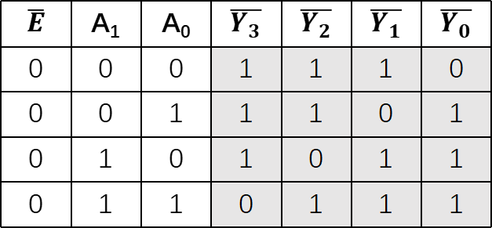














Application: Use the 74139 to realize a 3-of-8 Decoder
$$\text{A}\text{3}$$ | A₁ | A₀ | $$\overline{{2Y}_{3}}$$ | $$\overline{{2Y}_{2}}$$ | $$\overline{{2Y}_{1}}$$ | $$\overline{{2Y}_{0}}$$ | $$\overline{{1Y}_{3}}$$ | $$\overline{{1Y}_{2}}$$ | $$\overline{{1Y}_{1}}$$ | $$\overline{{1Y}_{0}}$$
0 | 0 | 0 | 1 | 1 | 1 | 1 | 1 | 1 | 1 | 0
0 | 0 | 1 | 1 | 1 | 1 | 1 | 1 | 1 | 0 | 1
0 | 1 | 0 | 1 | 1 | 1 | 1 | 1 | 0 | 1 | 1
0 | 1 | 1 | 1 | 1 | 1 | 1 | 0 | 1 | 1 | 1
1 | 0 | 0 | 1 | 1 | 1 | 0 | 1 | 1 | 1 | 1
1 | 0 | 1 | 1 | 1 | 0 | 1 | 1 | 1 | 1 | 1
1 | 1 | 0 | 1 | 0 | 1 | 1 | 1 | 1 | 1 | 1
1 | 1 | 1 | 0 | 1 | 1 | 1 | 1 | 1 | 1 | 1
$$A_{2}$$
$$\overline{{1Y}_{0}}$$
$$\overline{Y_{0}}$$
$$\overline{1E}$$
$$A_{1}$$
$$\overline{{1Y}_{1}}$$
$$\overline{Y_{1}}$$
$$\overline{{1Y}_{2}}$$
$$\overline{Y_{2}}$$
$$\overline{1E}$$
$$\overline{{1Y}_{3}}$$
$$\overline{Y_{3}}$$
$$A_{0}$$
$$\overline{Y_{4}}$$
$$\overline{2E}$$
$$\overline{{2Y}_{0}}$$
$$\overline{{2Y}_{1}}$$
$$\overline{Y_{5}}$$
$$\overline{{2Y}_{2}}$$
$$\overline{Y_{6}}$$
$$\overline{{2Y}_{3}}$$
$$\overline{Y_{7}}$$
$$\overline{2E}$$
$$\overline{E}$$ | A₁ | A₀ | $$\overline{Y_{3}}$$ | $$\overline{Y_{2}}$$ | $$\overline{Y_{1}}$$ | $$\overline{Y_{0}}$$
0 | 0 | 0 | 1 | 1 | 1 | 0
0 | 0 | 1 | 1 | 1 | 0 | 1
0 | 1 | 0 | 1 | 0 | 1 | 1
0 | 1 | 1 | 0 | 1 | 1 | 1

Slide 21
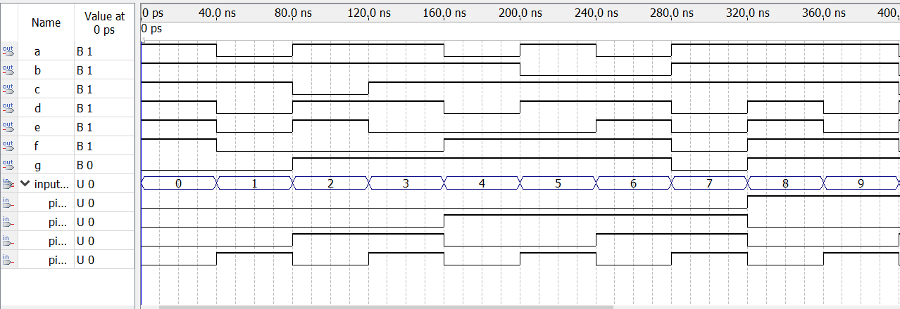
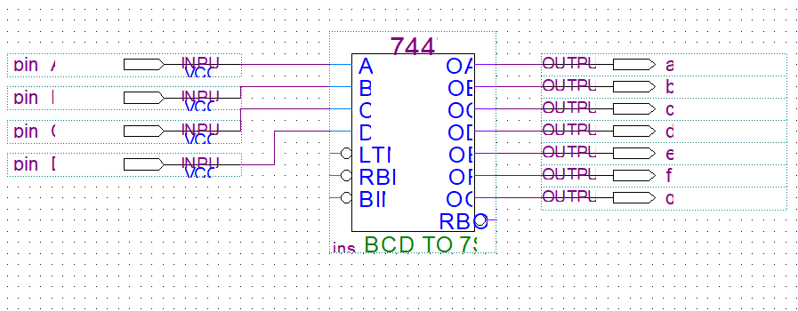
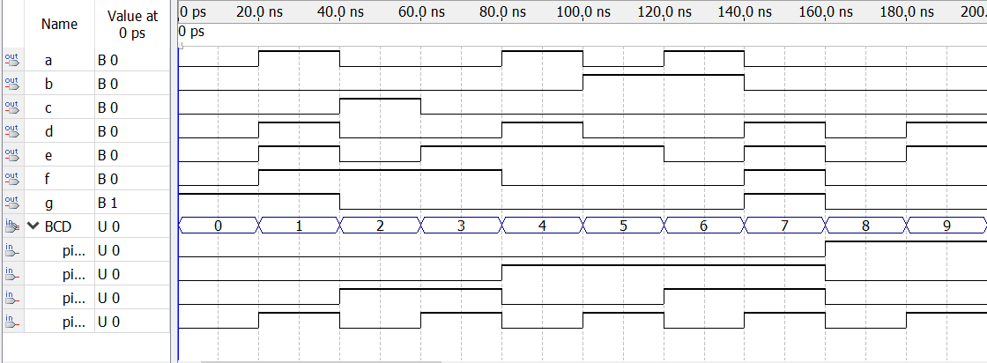
Experimental Contents （1）
1. Test the logical function of BCD to Seven Segment Decoder
Choose BCD to Seven Segment Decoder IC
7447: common anode type display—outputs are low active
7448: common cathode type display—outputs are high active
7448
7447

Slide 22
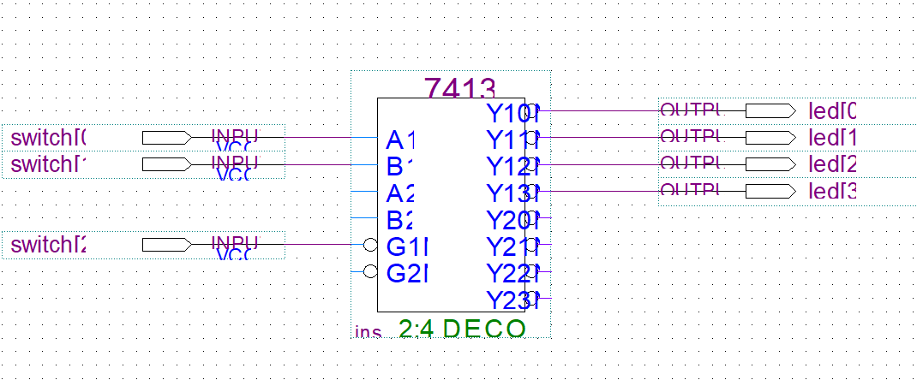
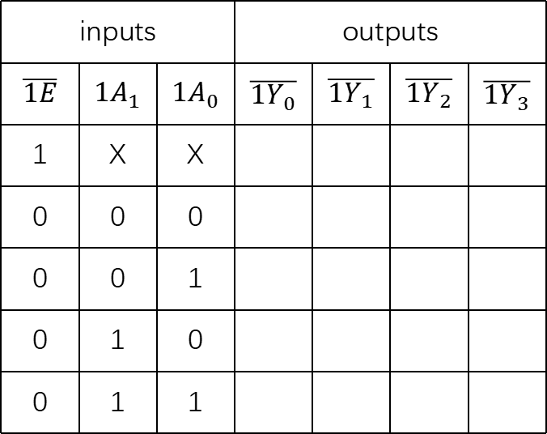
Task 1: function testing of 74139
Experimental Contents （2）
inputs |  |  | outputs
$$\overline{1E}$$ | $${1A}_{1}$$ | $${1A}_{0}$$ | $$\overline{{1Y}_{0}}$$ | $$\overline{{1Y}_{1}}$$ | $$\overline{{1Y}_{2}}$$ | $$\overline{{1Y}_{3}}$$
1 | X | X
0 | 0 | 0
0 | 0 | 1
0 | 1 | 0
0 | 1 | 1
Notes:
实际应用中我们可以采用集成的二进制译码器。常见的有741392-4线译码器，和73138 3-8线译码器。左图是双2-4线译码器74139的逻辑符号。该芯片集成了两个独立的2-4线译码器。这里补芯片逻辑符号说明：符号框外部，如果 输入、输出变量名带一条横线，代表信号低电平有效；这些变量写在符号框外部，表示器件外部的信号。对于符号框内部的信号，表示器件内部输入输出之间的关系，都是高电平有效。图中的的小圆圈就相当于一个反向器。
当使能端有效时，对应于A1A0的每一组输入，只有一个输出端做低电平为有效输出，其余输出端均输出高电平信号。

Slide 23





















Task 2: use the 74139 to realize a 3-of-8 Decoder
Experimental Contents （2）
3-of-8 Decoder
$$A_{2}$$
$$\overline{Y_{0}}$$
$$\overline{1E}$$
$$\overline{{1Y}_{0}}$$
$$\overline{{1Y}_{1}}$$
$$\overline{Y_{1}}$$
$$A_{1}$$
$$\overline{{1Y}_{2}}$$
$$\overline{Y_{2}}$$
$$\overline{{1Y}_{3}}$$
$$\overline{Y_{3}}$$
$$A_{0}$$
$$\overline{2E}$$
$$\overline{{2Y}_{0}}$$
$$\overline{Y_{4}}$$
$$\overline{{2Y}_{1}}$$
$$\overline{Y_{5}}$$
$$\overline{{2Y}_{2}}$$
$$\overline{Y_{6}}$$
$$\overline{{2Y}_{3}}$$
$$\overline{Y_{7}}$$

Slide 24
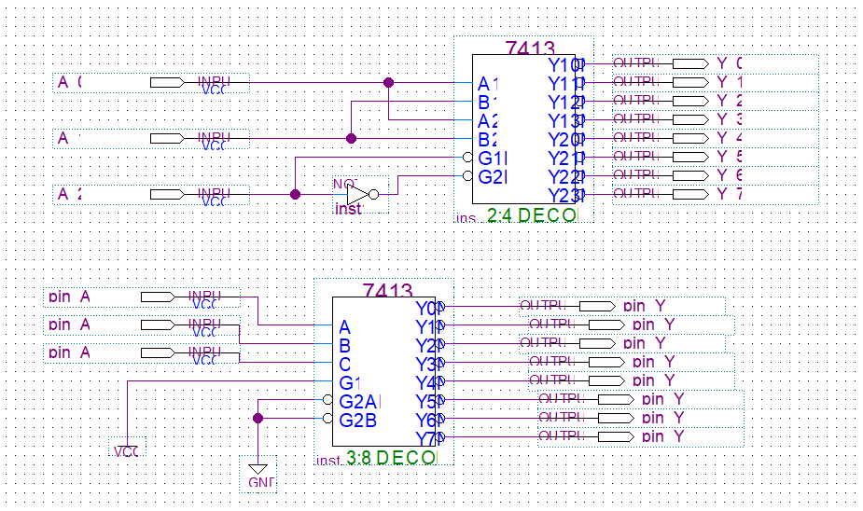
Circuit design

Slide 25
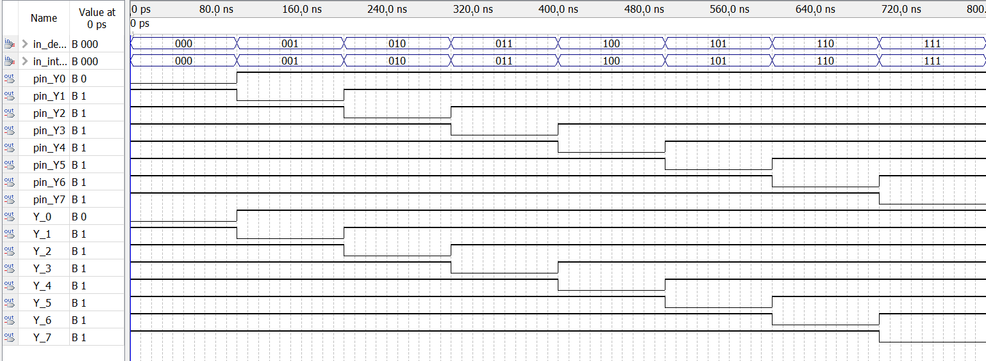
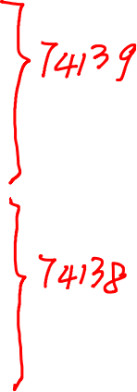
Simulation result

Slide 26
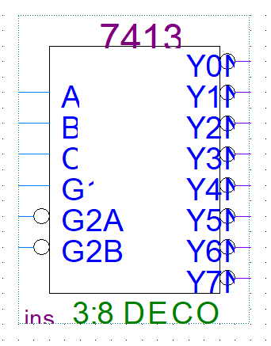
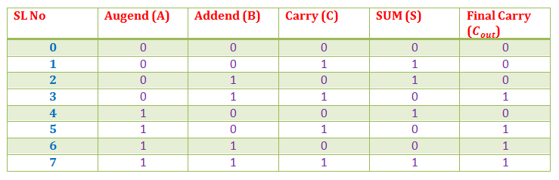
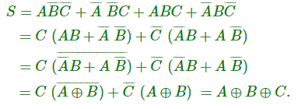
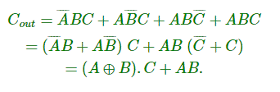
Experimental Contents （2）
Task 3: use a 3-of-8 decoder to realize the Full adder

