Slide 1
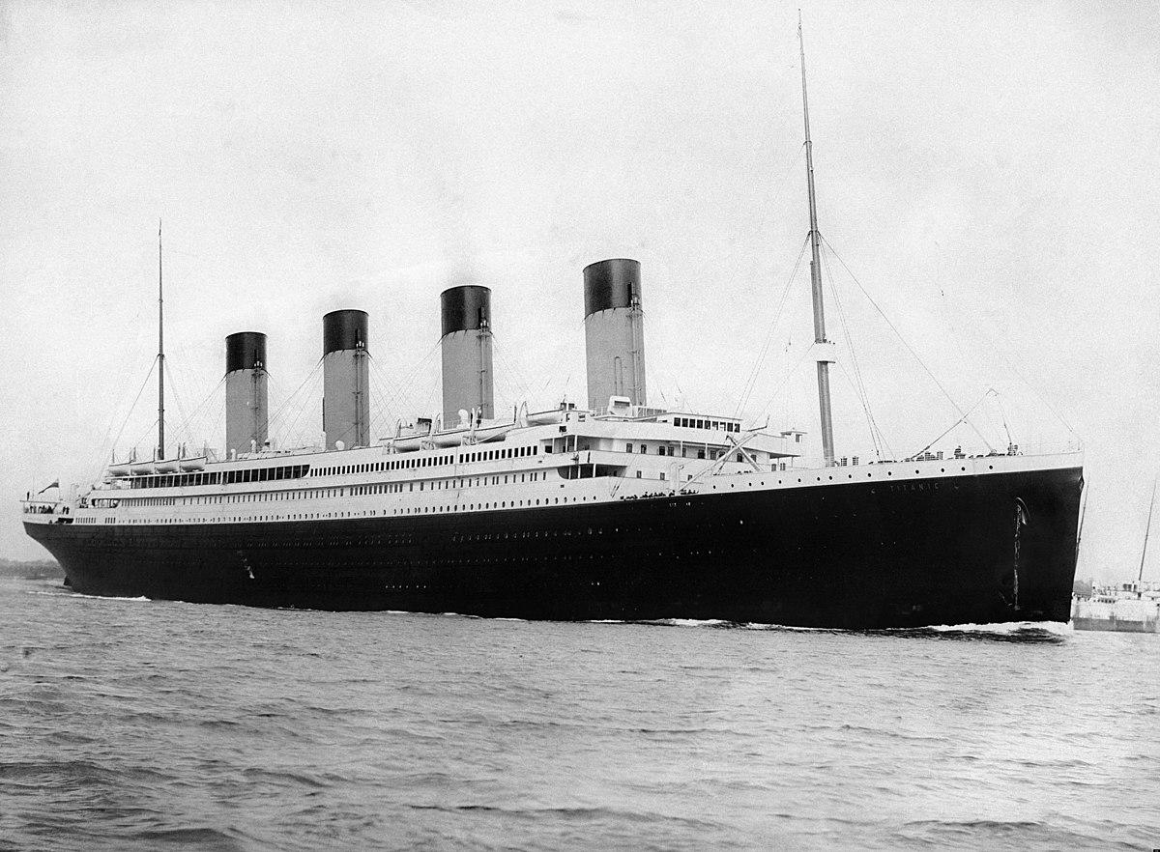
Project

Slide 2
Project
Create a system that will allow you to buy the best ticket for the Titanic ride.
You will receive with the input function the following information. ‘name’, ‘age’, ‘fare’, ‘sex’.
The input function receives its value as a string but you can translate the type with the relevant functions. The name will hold a string, the age will hold a float, the fare will hold a float, and the sex will hold a string.
Find the max fare value that was paid by other passengers and find the minimal value that was paid by other passengers. Make sure that your fare price is for sure between the minimal and the maximal fare prices. If not tell the user that his fare payment is illegal and ask him to pay again.

Slide 3
Project continue
Make sure that the age that you entered is between 0 to 130. Otherwise print a message that will say that your age Is wrong and ask the user to enter his age again until you will receive legal information.
Make sure that the sex value is male or female, if the user chose something else then a message that will say that the sex value is illegal will be printed and the value will be required again.
Clean your name value from spaces in the beginning and in the end of the string.
Find out which class you bought with your fare payment. To find it find the range of fares in each class. For example, the minimum payment for the first class was 100 dollars the maximum payment was 300 dollars.

Slide 4
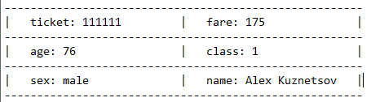
Project continue
The minimal payment for the second class was 50 and the maximum was 200. Let’s say that you paid 175 dollars. In this case, you will be in the first class, the preference will always go up.
Randomize a ticket number of 6 numbers. If the number already exists randomize again until you will receive a new value.
Write your passenger ticket in the following format to a text file.

Slide 5
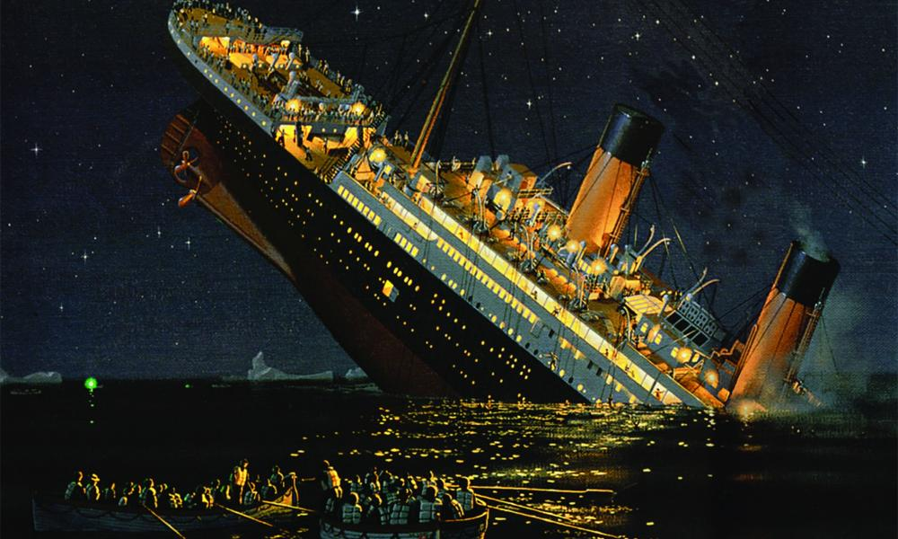
Project continue
Calculate what are the chances of your passenger surviving. Notify your user what are the chances he will survive the trip.
For example:
Dear Alex, your chances to die on our trip are 73.7%.
Enjoy your trip ☺

