Slide 1

1 / 12
JUNIOR COMPUTER & SYSTEMS ENGINEERING
FACULTY OF ENGINEERING – SPECIALIZED PROGRAMS · SPRING 2026
COMPUTER AND SYSTEMS ENGINEERING DEPARTMENT
Contact Management System
CSE333 – Data Structures and Algorithms | Group Project
NAME
STUDENT ID
GI
George Ibrahim Abdo
2300285
GB
Giovanni Boulis Abdo
2300063
AA
Adham Ahmed Hussein Abdelaal
2100725
ME
Mohamed Elsayed Moustafa Hamouda
2200095
AL
Ali Said Abdelhamid Khalil
2300227

Slide 2
I N T R O D U C T I O N
2 / 12
Project Objective
We chose Option 1 — Contact List. The goal is a fully featured contact management system that demonstrates meaningful use of multiple CSE333 data structures, with every design decision justified by its time complexity trade-offs.
Problem Statement
Two Versions Delivered
▸ Store contacts: name, phone, email, address, group
▸ Console version — menu-driven terminal interface
▸ Fast insert, lookup, and delete by name
▸ GUI version (Bonus) — Qt6 desktop app with sidebar, tables, live filter
▸ Secondary search when only phone or email is known
▸ Recovery from accidental deletions (undo)
▸ Both share the same backend headers — zero duplication
Core principle: every data structure was chosen because it is the right tool for a specific operation — not just to satisfy a requirement.

Slide 3
D E S I G N
3 / 12
System Architecture
main_console.cpp
Console UI
MainWindow.cpp
Qt6 GUI
Contact.h
Plain struct: name, phone, email, address, group. Name is the primary key. Provides operator< for sorting and operator== for lookup.
▼
ContactManager.h
Facade / Coordinator
ContactManager.h
Facade that owns one instance of each data structure. All UI layers call only ContactManager — no UI code touches raw data structures directly.
▼
HashTable.h
UndoStack.h
BinarySearch.h
▼
Separation of Concerns
Contact.h — shared data structure
One header per data structure. Adding a feature only requires touching ContactManager and the relevant header.

Slide 4
D A T A S T R U C T U R E 1
4 / 12
Hash Table — Primary Storage
Why a Hash Table?
// djb2 hash — h * 33 + char
int hash(const string& key) const {
unsigned long h = 5381;
for (char ch : key)
h = ((h << 5) + h) + (unsigned char)ch;
return (int)(h % tableSize);
}
// Separate chaining via std::list
vector<list<Contact>> buckets;
// remove() returns the deleted contact
// so it can be pushed onto the undo stack
Contact remove(const string& name) {
int idx = hash(name);
for (auto it = buckets[idx].begin();
it != buckets[idx].end(); ++it) {
if (it->name == name) {
Contact removed = *it;
buckets[idx].erase(it);
return removed;
}
}
throw out_of_range("not found");
}
▸ Name is the natural primary key
▸ Direct O(1) access vs. O(n) list scan
▸ Insert, lookup, delete all average O(1)
Design Choices
▸ 101 buckets (prime) reduces clustering
▸ Separate chaining via std::list<Contact>
▸ djb2 hash — fast, low collision for short strings
Complexities
insert
O(1) avg
search
O(1) avg
remove
O(1) avg
update
O(1) avg

Slide 5
D A T A S T R U C T U R E 2
5 / 12
Stack — Undo Last Delete
Why a Stack?
// UndoStack.h — wrapper over std::stack
class UndoStack {
public:
// Record a deleted contact O(1)
void push(const Contact& c) {
deletedContacts.push(c);
}
// Retrieve most-recently deleted O(1)
bool pop(Contact& out) {
if (deletedContacts.empty())
return false;
out = deletedContacts.top();
deletedContacts.pop();
return true;
}
private:
stack<Contact> deletedContacts;
};
// delete → table.remove() → stack.push()
// undo → stack.pop() → table.insert()
▸ Delete is the only destructive operation
▸ LIFO maps exactly to 'undo most recent deletion'
▸ Both push and pop are O(1)
▸ Wraps std::stack<Contact> — no custom node needed
How It Works
▸ Delete: HashTable.remove() → push onto stack
▸ Undo: pop from stack → HashTable.insert()
▸ Multiple undos restore in reverse deletion order
Complexity
push (on delete)
O(1)
pop (on undo)
O(1)

Slide 6
D A T A S T R U C T U R E 3
6 / 12
Vector + Binary Search — Secondary Lookup
Why Binary Search Here?
// Search by phone — O(n log n + log n)
static Contact* byPhone(
vector<Contact>& contacts,
const string& phone) {
// 1. Sort on the target field
sort(contacts.begin(), contacts.end(),
[](const Contact& a, const Contact& b) {
return a.phone < b.phone;
});
// 2. Classic binary search
int lo = 0, hi = (int)contacts.size() - 1;
while (lo <= hi) {
int mid = lo + (hi - lo) / 2;
if (contacts[mid].phone == phone)
return &contacts[mid];
else if (contacts[mid].phone < phone)
lo = mid + 1;
else
hi = mid - 1;
}
return nullptr;
}
▸ Phone and email are not the hash key — hash table cannot help
▸ Collect all contacts into a vector → sort → binary search
▸ O(log n) search beats O(n) linear scan at scale
▸ Demonstrates divide-and-conquer paradigm
Also Used For
▸ Display All (A–Z) — sortByName() returns sorted copy
▸ Original hash table ordering is never disturbed
Complexity
std::sort
O(n log n)
binary search
O(log n)
total per query
O(n log n)

Slide 7
I M P L E M E N T A T I O N
7 / 12
Implemented Features
1
Add Contact
2
Search by Name
3
Search by Phone
Hash Table insert — O(1) avg
Hash Table lookup — O(1) avg
Sort + Binary Search — O(n log n)
4
Search by Email
5
Update Contact
6
Delete Contact
Sort + Binary Search — O(n log n)
Hash Table in-place update — O(1)
Hash Table remove + Stack push — O(1)
7
Undo Last Delete
8
Display All A–Z
9
Filter by Group
Stack pop + Hash Table insert — O(1)
std::sort on vector — O(n log n)
Linear scan — O(n)
★
GUI Interface — Bonus Feature
Full Qt6 desktop application: sidebar navigation, contact tables, add/update forms, live group filter. Built on top of the same backend headers — no core logic was modified.

Slide 8
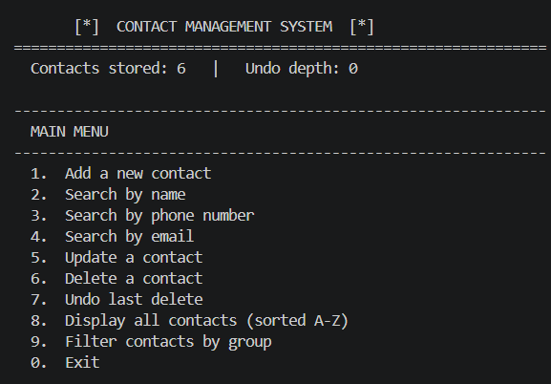
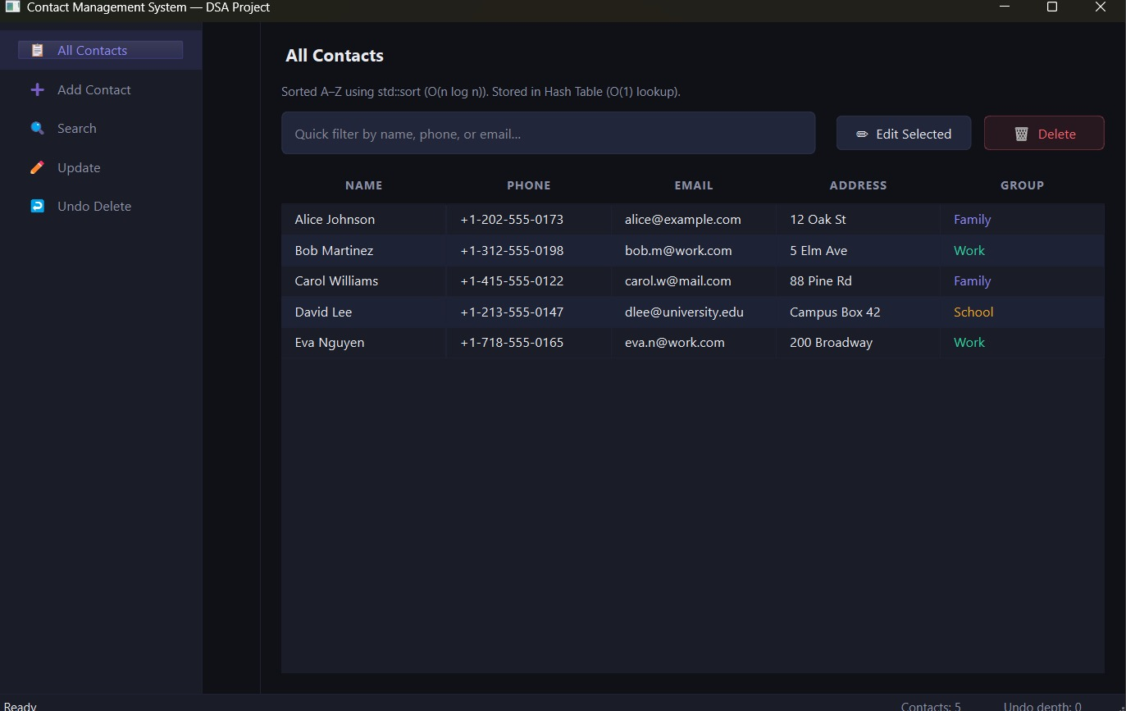
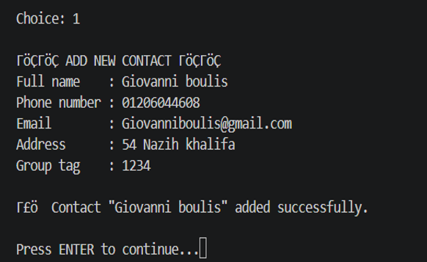
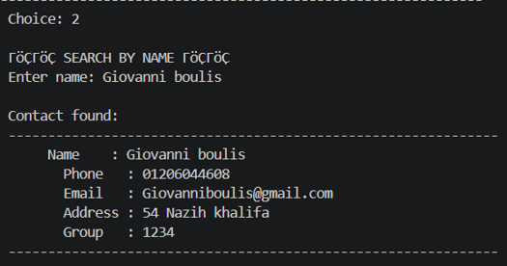
D E M O
8 / 12
System Screenshots
CONSOLE VERSION
QT6 GUI VERSION ★ BONUS

Slide 9
A N A L Y S I S
9 / 12
Time Complexity Summary
Operation
Data Structure Used
Time Complexity
Add contact
Hash Table insert
O(1) average
Search by name
Hash Table lookup
O(1) average
Update contact
Hash Table in-place update
O(1) average
Delete contact
Hash Table remove + Stack push
O(1)
Undo last delete
Stack pop + Hash Table insert
O(1)
Search by phone
std::sort + Binary Search
O(n log n)
Search by email
std::sort + Binary Search
O(n log n)
Display all (A–Z)
std::sort on vector copy
O(n log n)
Filter by group
Linear scan of all contacts
O(n)
All primary operations (add, search by name, update, delete, undo) run in O(1) average time. Secondary-field search is O(n log n) — still far more efficient than a naive O(n) linear scan for large contact lists.

Slide 10
C O M P I L A T I O N & U S A G E
10 / 12
How to Compile and Run
Console Version — requires g++ C++17
GUI Version (Qt6 Bonus)
# Compile
g++ -std=c++17 -o contacts main_console.cpp
# Run (Linux / macOS)
./contacts
# Run (Windows)
contacts.exe
▸ Qt Creator: open ContactManager.pro → Configure → ▶ Run
▸ Linux CLI:
sudo apt install qtbase5-dev qt5-qmake
qmake ContactManager.pro
make
./ContactManager
Project File Structure
Project/
├── Contact.h ← data structure
├── HashTable.h ← primary storage
├── UndoStack.h ← undo feature
├── BinarySearch.h ← secondary search
├── ContactManager.h ← facade
├── main_console.cpp ← console entry
├── MainWindow.h/cpp ← Qt6 GUI
├── main.cpp ← Qt entry point
└── ContactManager.pro ← Qt build file
Requirements
▸ C++17 standard
▸ No external libs for console version
▸ Qt5 or Qt6 for GUI version only

Slide 11
T R A N S P A R E N C Y
11 / 12
AI Usage Declaration
Tool used: Claude (claude.ai) by Anthropic
WHAT AI WAS USED FOR
WHAT WAS MODIFIED OR REJECTED
GUI layer (MainWindow.h / .cpp / Qt main.cpp), code structure advice (one-header-per-struct), debugging a missing method declaration linker error, Qt kit setup on Windows, README writing, and explaining concepts (djb2, separate chaining, binary search trade-offs).
The first GUI suggestion used HTML/JavaScript — rejected in favour of a proper Qt C++ desktop app. Several AI-suggested variable names and layout choices were adjusted to match existing backend naming conventions.
EXAMPLE WHERE AI WAS WRONG
WHAT THE GROUP DID THEMSELVES
Claude declared several private methods in MainWindow.h but omitted buildPageSearch(), buildPageUpdate(), and buildPageUndo() — causing linker errors. The group identified and corrected the missing declarations.
All five backend headers (HashTable, UndoStack, BinarySearch, Contact, ContactManager) and the full console version were written independently. Every design decision — hash table as primary structure, stack for undo, binary search for secondary fields — was made and justified by the group.
Using AI did not reduce our understanding. Every AI-generated component was reviewed, tested, and fully understood before submission.

Slide 12
12 / 12
Thank You
We are ready for the demo and Q&A
Hash Table
Separate Chaining
djb2 Hash Function
Stack — LIFO Undo
Binary Search
Divide & Conquer
Qt6 GUI Bonus
O(1) Primary Operations
CSE333 – Data Structures and Algorithms · Faculty of Engineering – Specialized Programs · Spring 2026

