Slide 1
ENBRIDGE | OIL PRICE FORECAST
Where Is Oil Headed?
A 12-month price outlook through April 2027, built on 23 years of data
Monthly data 2003 – 2026 | Forecast horizon: April 2027

Slide 2
THE BIG PICTURE
The forecast in one slide
Light oil (WTI)
Heavy oil
$61
$57
by April 2027 | per barrel (2025 dollars)
by April 2027 | per barrel (2025 dollars)
Today's prices: Light $89 | Heavy $64. Both prices forecast to settle below current levels by next fiscal year-end.
What this deck shows
● Forecast through April 2027 — 12-month projection for both light and heavy oil, with confidence ranges
● Built on 23 years of monthly data — supply, demand, dollar strength, geopolitical risk, and conflict history since 2003
● Four supporting models behind the forecast — split by oil type (light vs heavy) and conflict length (short vs long); each explains 92–96% of past prices
● Everything is reproducible from raw data — one command refreshes the data, refits the models, and regenerates the forecast
2 / 12

Slide 3
THE APPROACH
How the model works
We split history into four cases
What each model looks at
Light oil (WTI)
Heavy oil (WCS)
INPUTS (8 factors per month)
Short conflict (< 6 mo)
● How much oil the US produced
● How much oil was in storage
● Last month's oil price
● Net exports of oil
● How busy refineries were
● Strength of the US dollar
● Global geopolitical risk score
● Whether the Strait of Hormuz was under threat
Model 1
Model 3
Light | Short
Heavy | Short
Long conflict (6+ mo)
Model 2
Model 4
Light | Long
Heavy | Long
Where the data comes from
● Federal Reserve — oil prices, inflation, US dollar index
● Energy Information Administration — production, storage, refinery activity, exports
● Geopolitical Risk Index — monthly score from a published academic source
● All prices adjusted for inflation — shown in today's dollars (2025 base year)
3 / 12

Slide 4
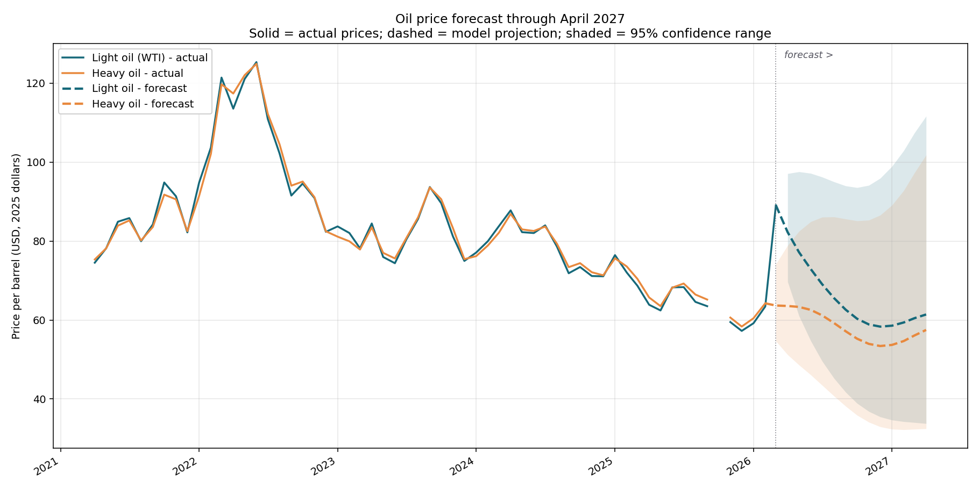
THE FORECAST
12-month forecast through April 2027
April 2027 outlook
LIGHT OIL (WTI)
$61
from $89 today
95% range: $34 – $112
HEAVY OIL
$57
from $64 today
95% range: $32 – $102
Why this story
● Prices currently elevated by ongoing Israel-Iran conflict
● Model expects gradual mean reversion as the spike fades
● Heavy-light gap roughly stable around $5–6
● Confidence range widens with horizon — longer = less certain
Method: long-conflict regression with supply/demand inputs held at latest values; seasonality recomputed each month.
4 / 12

Slide 5
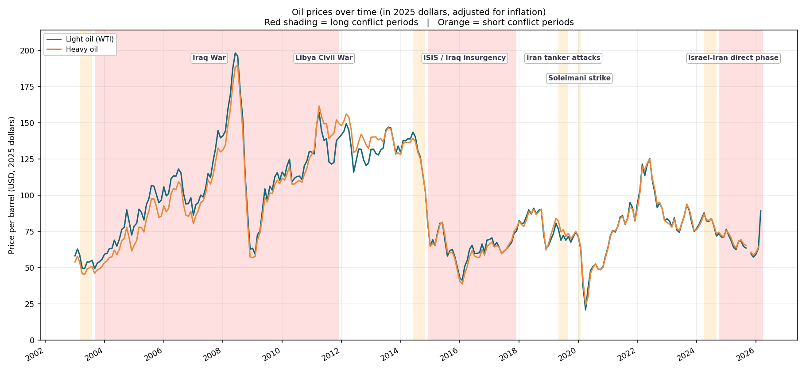
CHART 1 OF 5
Oil prices through major Middle East conflicts
Interpretation
● 2008 spike near $200 a barrel — global demand was huge while supply was tight
● 2014–2016 crash — US shale boom flooded the market; the ISIS conflict didn't push prices up
● 2020 COVID drop near $25 — demand collapsed when the world stopped moving
● Light and heavy oil track each other — they tend to move together, just at different price levels
● Conflict periods don't always spike prices — supply and demand often matter more than wars
● Big takeaway — the economy moves oil more than geopolitics does
5 / 12

Slide 6
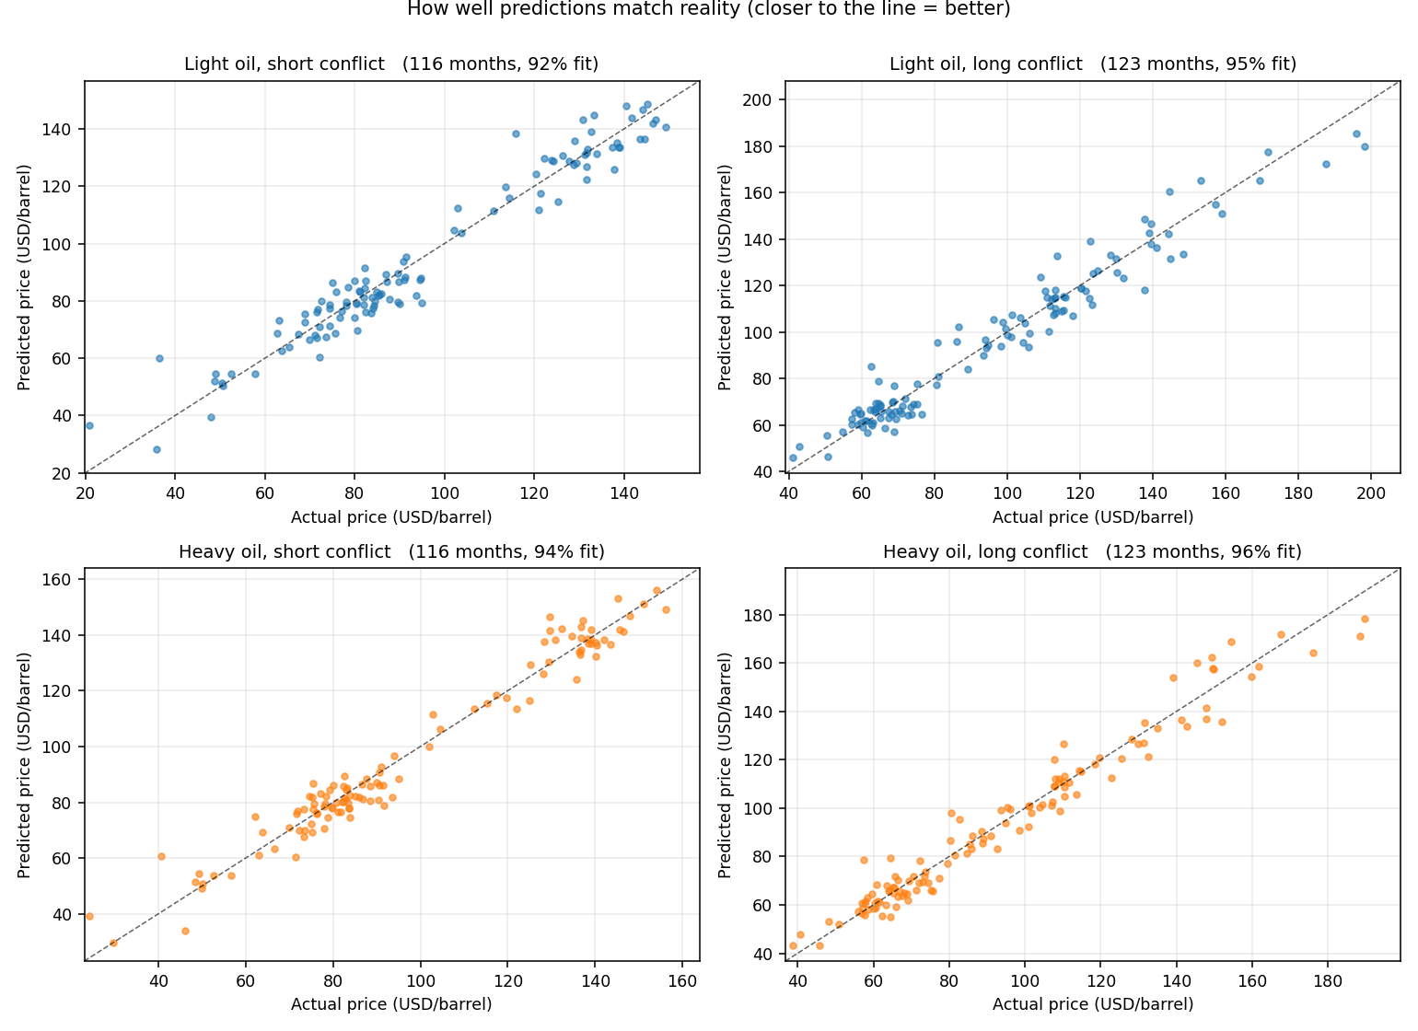
CHART 2 OF 5
How well the model matches reality
Interpretation
● Each dot is one month — the closer to the diagonal line, the better the prediction
● All four models hug the line tightly — the model captures the historic record well
● Heavy oil + long conflicts is the best fit — 96% of price moves explained
● Light oil + short conflicts has the most spread — still a strong 92% fit
● Important caveat — matching the past is easier than predicting the future
6 / 12

Slide 7
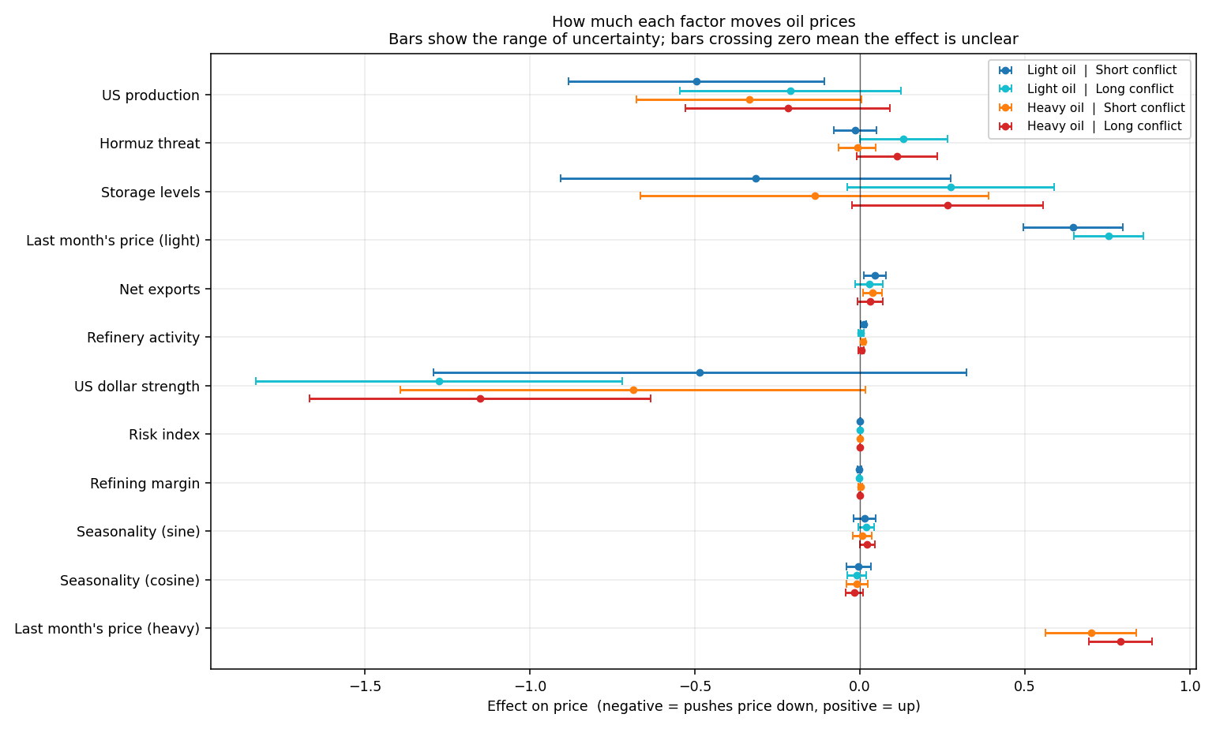
CHART 3 OF 5
Which factors actually matter
Interpretation
● Last month's price has the biggest effect — oil prices have momentum; today builds on yesterday
● US dollar strength: strong negative impact — when the dollar rises, oil priced in dollars tends to fall
● More US production = lower prices — as expected; basic supply and demand
● Storage levels behave differently in long conflicts — people build buffer stocks during sustained tensions
● Hormuz threats and risk index: surprisingly small — their effect on prices is too small to measure reliably
● Bars show the range of uncertainty — bars crossing zero mean the effect could go either way
7 / 12

Slide 8
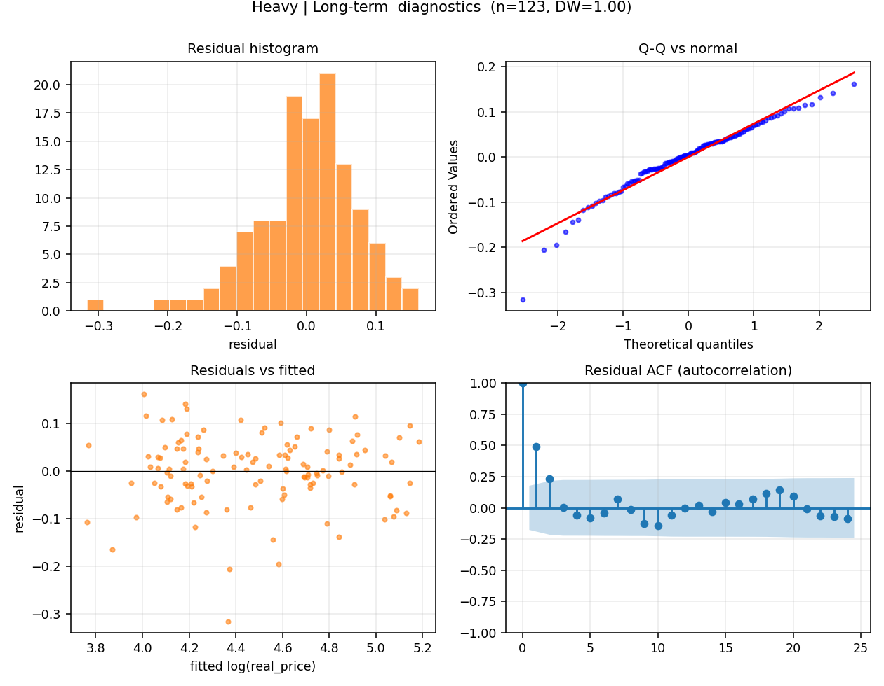
CHART 4 OF 5
Quality check on the best model
Interpretation
● These four panels test whether the model is well-behaved — they look at the leftover errors after each prediction
● Top-left and top-right: errors are roughly symmetric — no systematic bias in either direction
● Bottom-left: errors look randomly scattered — the model isn't missing an obvious pattern
● Bottom-right: a small lingering issue — this month's error nudges next month's, slightly
● Practical impact — predictions are accurate, but our confidence ranges are slightly too tight
● Easy fix exists — switch to a more robust statistical method (one-line code change)
8 / 12

Slide 9
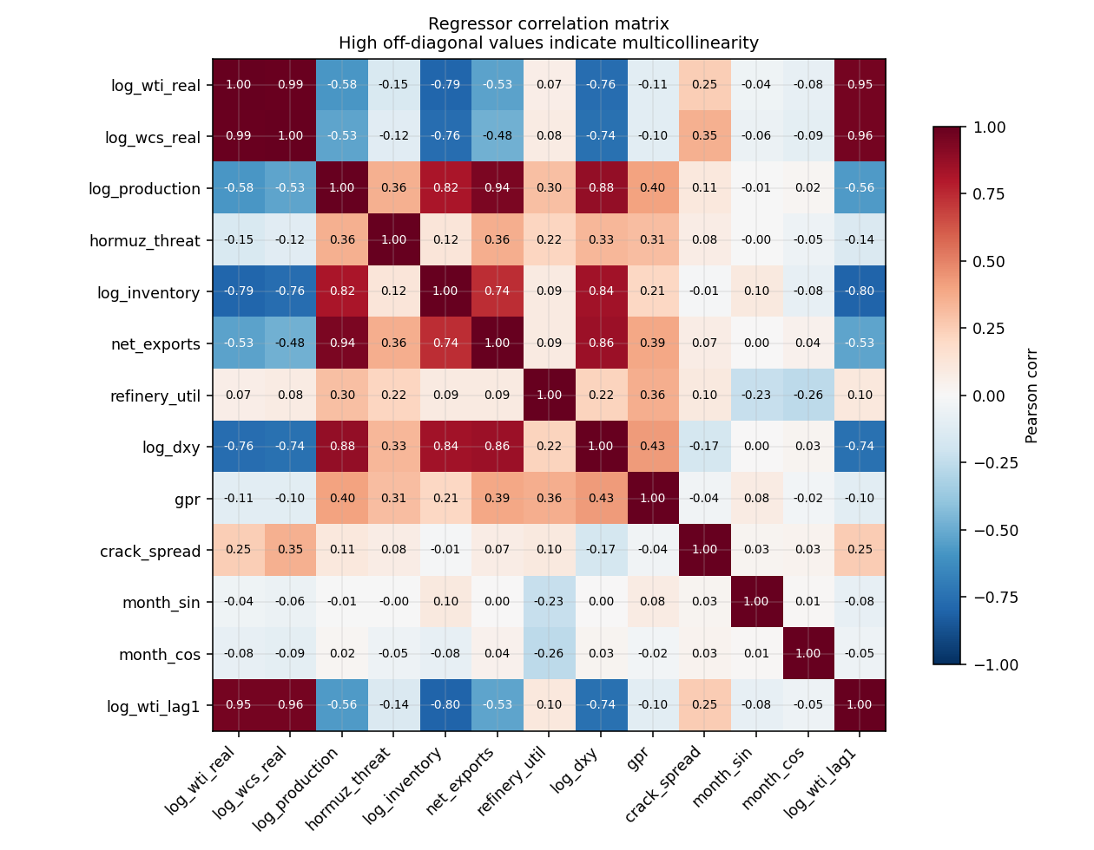
CHART 5 OF 5
Which factors overlap with each other
Interpretation
● This chart shows which factors move together — deep red = move in lockstep, deep blue = move opposite
● Light and heavy oil prices: nearly identical movement — that's why we split them into separate models
● Production and storage rose together (2010s shale era) — they share some information but not enough to cause trouble
● Dollar strength is mostly independent — good — its effect on oil is clean and easy to pinpoint
● Risk index doesn't track other factors — explains why its impact on price is hard to nail down
● Big takeaway — no harmful overlap — each factor brings its own information
9 / 12

Slide 10
HONEST LIMITS
What to keep in mind
Data
Model & forecast
● Heavy oil price uses a stand-in — we used a heavy oil blend that's similar to WCS, since clean WCS history is hard to source
● Reliable data only goes back to about 2006 — some sources started later; we use what's complete
● Hormuz threat status is a judgment call — the strait has never actually closed, so we flagged periods of credible threat
● Risk index relies on an outside source — if the source is offline, we fall back to a neutral value
● Forecast assumes today's conditions hold — supply, demand, dollar, and conflict are held at latest values; a regime shift would change things
● Confidence range widens with horizon — by April 2027 the 95% range spans roughly $30–$110; near-term months are tighter
● Last month's price drives a lot of prediction — realistic for oil, but means a sudden shock would push the whole forecast
● Some factors couldn't be measured cleanly — Hormuz, geopolitics, refining margins — too rare or too small to detect
The honest take
The forecast is a baseline, not a guarantee. It says: if today's geopolitics, supply, and dollar levels persist, prices drift back toward the model's long-conflict average. A new shock — escalation, a production cut, a recession — would shift the picture meaningfully.
10 / 12

Slide 11
PATH FORWARD
What to do next
1
Tighten the confidence ranges
A small statistical adjustment will give us more reliable error bars without changing the predictions themselves.
2
Get real Western Canadian Select price history
We're using a similar heavy-oil blend as a stand-in. Real WCS data would sharpen the heavy-oil models.
3
Drop factors that don't measurably affect prices
Hormuz, geopolitical risk, and refining margins didn't move the needle. Removing them simplifies the story.
4
Test the model on data it hasn't seen
Re-fit on 2003–2023 and check how well it predicts 2024–2026. This is the real test of forecasting power.
5
Try a time-series model for long-conflict periods
Because last month's price has so much weight, a model designed for time series may be a better fit.
11 / 12

Slide 12
Questions?
Everything in this deck is reproducible from raw public data
WHAT YOU CAN EXPLORE
● A 12-month forecast table with prediction and confidence range per month
● A spreadsheet with all four model results and statistical details
● The seven charts shown in this deck, as image files
● The complete monthly dataset and the settings file used to build the forecast

