Slide 1
AAPL — Apple Inc. — Fundamental Analysis Report (Annual 2025)
2026-03-23 12:53:10Z

Slide 2
Executive Summary
Moderate cash conversion (CF/NI = 1.00), gap likely driven by working capital movements.
Profitability - ROE 151.9% | ROA 31.2% | Net margin 26.9%
Liquidity - Current ratio 0.89 | Cash ratio 0.33
Leverage - D/E 1.34 | Net debt $43.96B
Free cash flow: $98.77B (real, after $12.71B capex)
DCF Valuation: Intrinsic value $98.30/share vs current $247.99 (overvalued by 60.4%)

Slide 3
Key Metrics
Metric | Value
GrossProfit | $195.20B
GrossMargin | 46.9%
NetMargin | 26.9%
ROA | 31.2%
ROE | 151.9%
CurrentRatio | 0.89
DebtToEquity | 1.34
NetDebt | $43.96B
CashRatio | 0.33
FCF | $98.77B
CashflowReliability | 1.00
PE | 32.5×
EV_EBITDA | 25.5×
NetDebt_EBITDA | 0.30

Slide 4
DCF Valuation
Metric | Value
WACC | 0.10
IntrinsicValue | $98.30
Upside | -60.4%

Slide 5
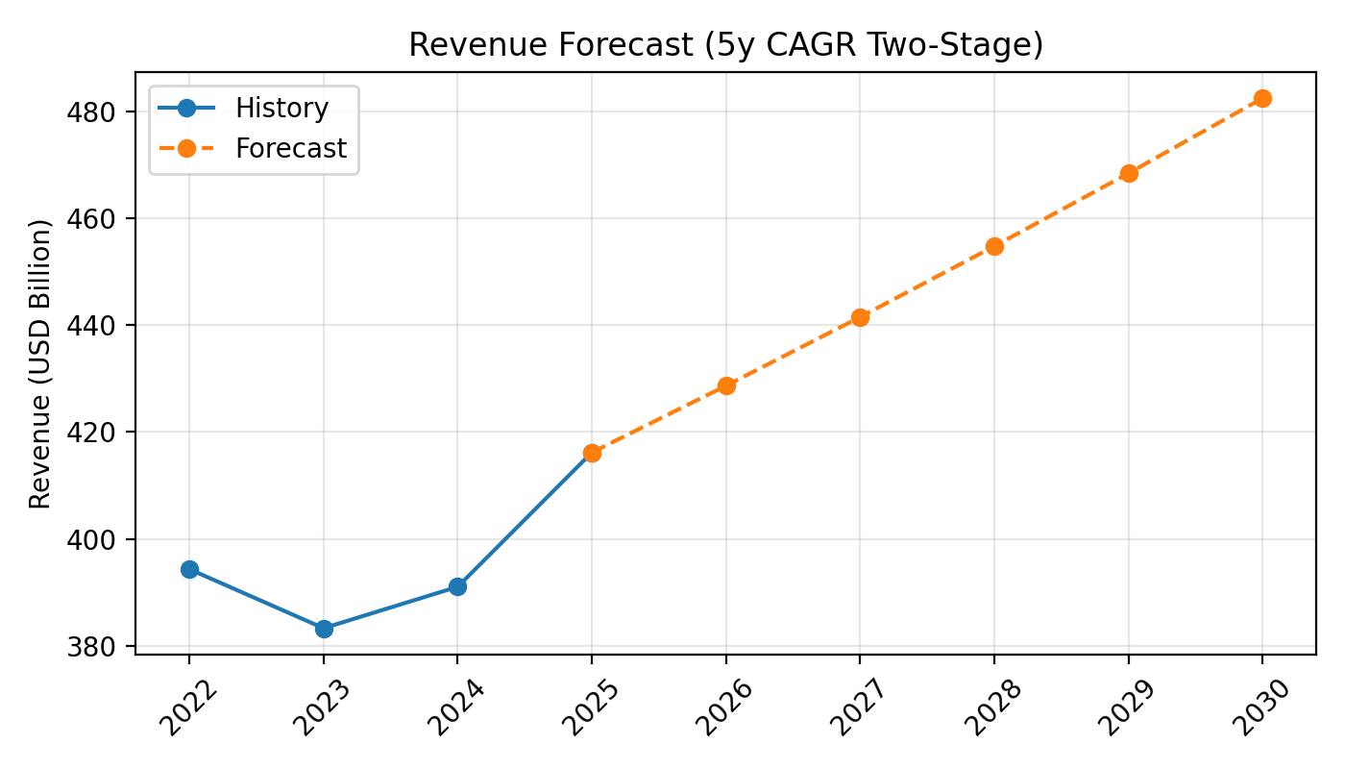
Revenue Forecast

Slide 6
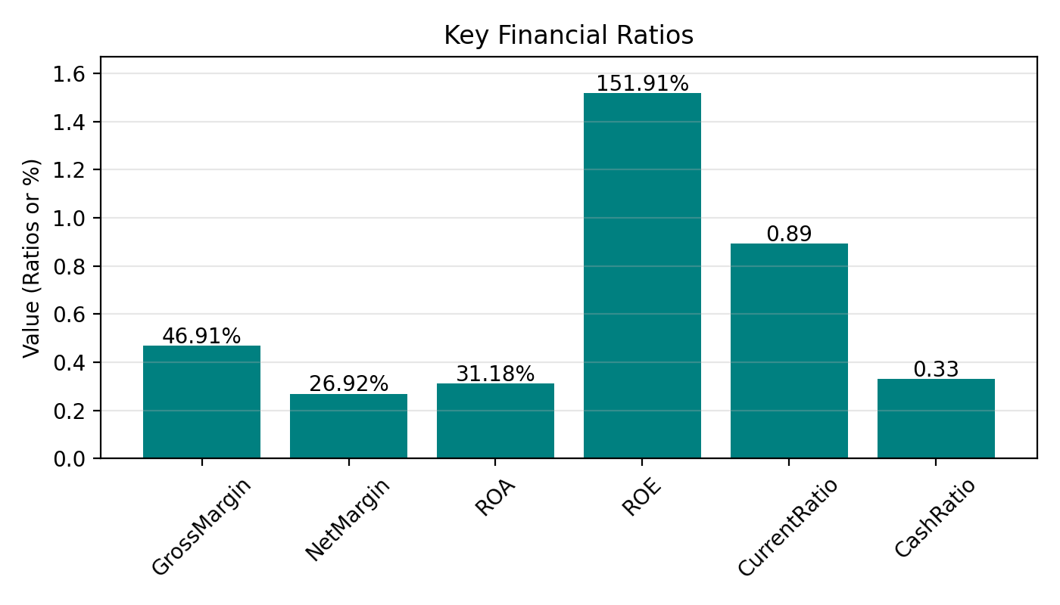
Key Ratios

Slide 7
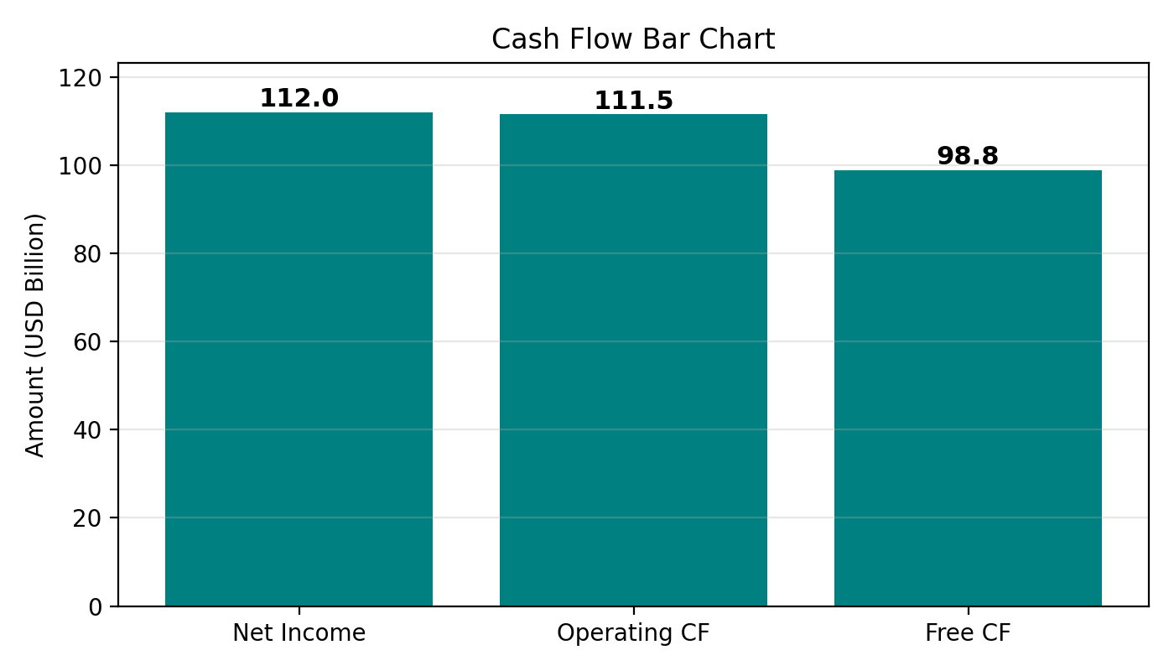
Cash Flow

