Slide 1
SAP.DE — SAP SE — Fundamental Analysis Report (TTM 2025)
2026-03-23 12:16:09Z

Slide 2
Executive Summary
OCF exceeds net income (1.28×).
Profitability - ROE 16.1% | ROA 10.2% | Net margin 19.5%
Liquidity - Current ratio 1.16 | Cash ratio 0.56
Leverage - D/E 0.17 | Net debt -$2.65B
Free cash flow: $9.73B (real, after $854.34M capex)
DCF Valuation: Intrinsic value $235.78/share vs current $179.65 (undervalued by 31.2%)

Slide 3
Key Metrics
Metric | Value
GrossProfit | $31.00B
GrossMargin | 72.9%
NetMargin | 19.5%
ROA | 10.2%
ROE | 16.1%
CurrentRatio | 1.16
DebtToEquity | 0.17
NetDebt | -$2.65B
CashRatio | 0.56
FCF | $9.73B
CashflowReliability | 1.28
PE | 25.3×
EV_EBITDA | 14.8×
NetDebt_EBITDA | -0.19

Slide 4
DCF Valuation
Metric | Value
WACC | 0.08
IntrinsicValue | $235.78
Upside | 31.2%

Slide 5
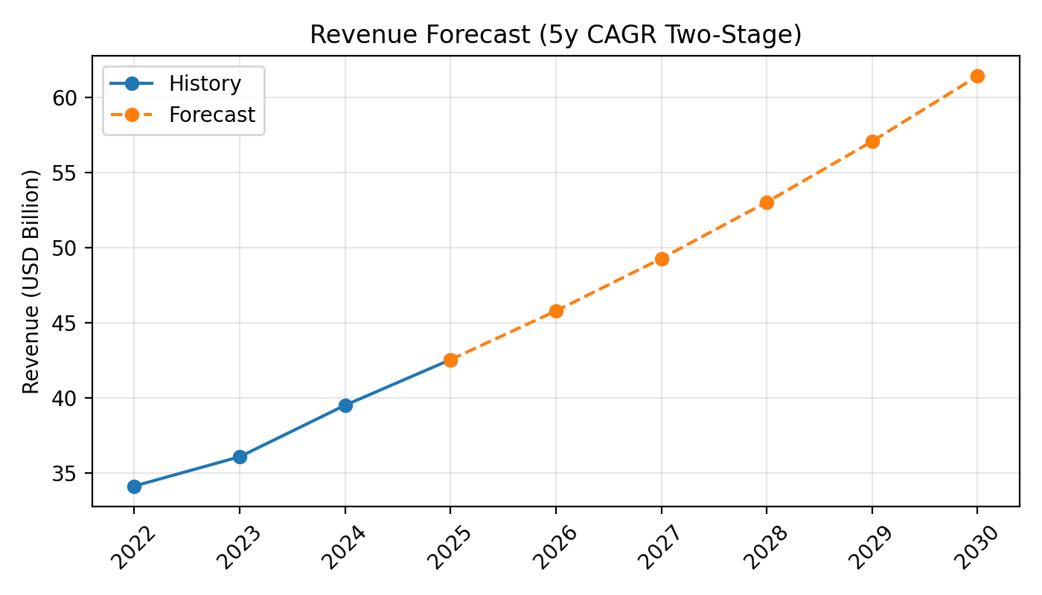
Revenue Forecast

Slide 6
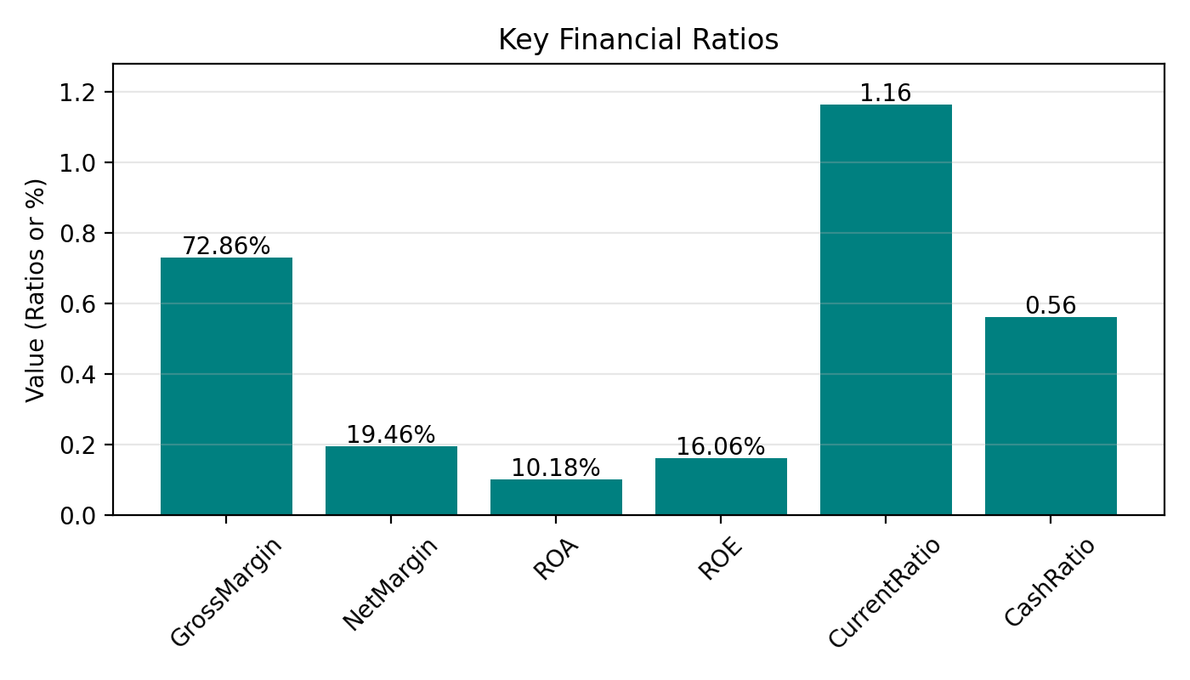
Key Ratios

Slide 7
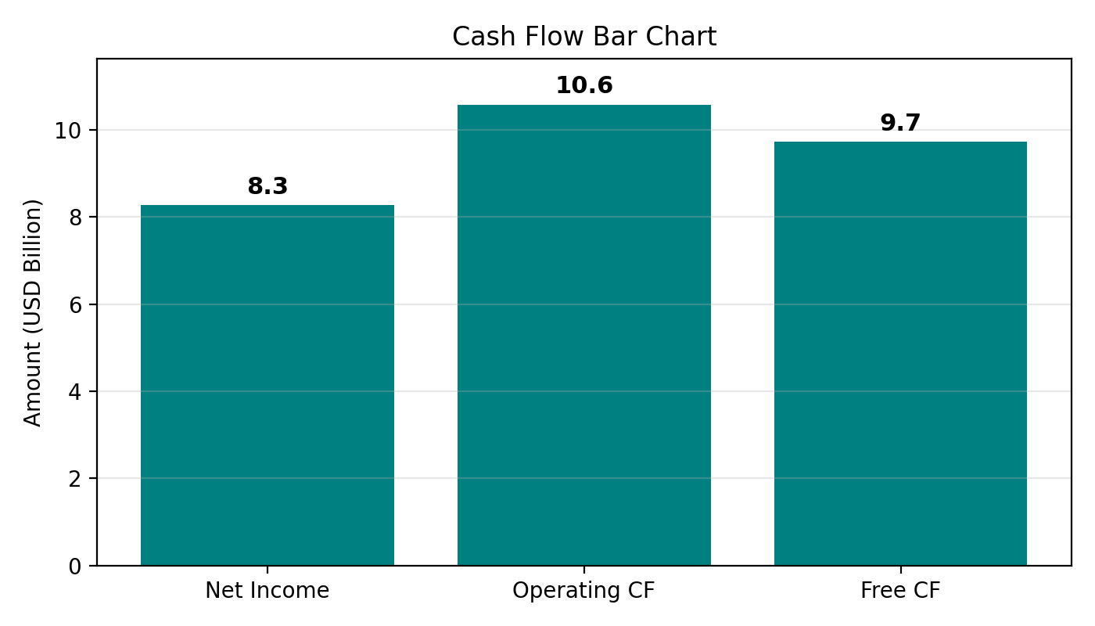
Cash Flow

