Slide 1
TSLA — Tesla, Inc. — Fundamental Analysis Report (TTM 2025)
2026-03-23 11:33:57Z

Slide 2
Executive Summary
Strong cash conversion: OCF is 3.89× net income.
Profitability - ROE 4.6% | ROA 2.8% | Net margin 4.0%
Liquidity - Current ratio 2.16 | Cash ratio 1.39
Leverage - D/E 0.18 | Net debt -$29.34B
Free cash flow: $6.22B (real, after $8.53B capex)
DCF Valuation: Intrinsic value $24.85/share vs current $367.96 (overvalued by 93.2%)

Slide 3
Key Metrics
Metric | Value
GrossProfit | $17.09B
GrossMargin | 18.0%
NetMargin | 4.0%
ROA | 2.8%
ROE | 4.6%
CurrentRatio | 2.16
DebtToEquity | 0.18
NetDebt | -$29.34B
CashRatio | 1.39
FCF | $6.22B
CashflowReliability | 3.89
PE | 363.9×
EV_EBITDA | 114.9×
NetDebt_EBITDA | -2.49

Slide 4
DCF Valuation
Metric | Value
WACC | 0.14
IntrinsicValue | $24.85
Upside | -93.2%

Slide 5
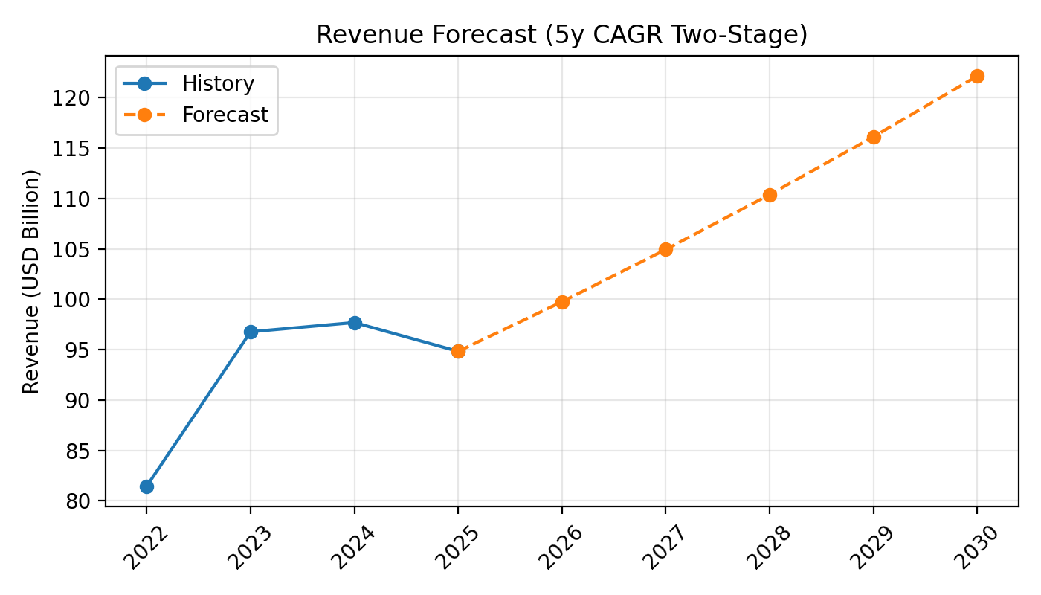
Revenue Forecast

Slide 6
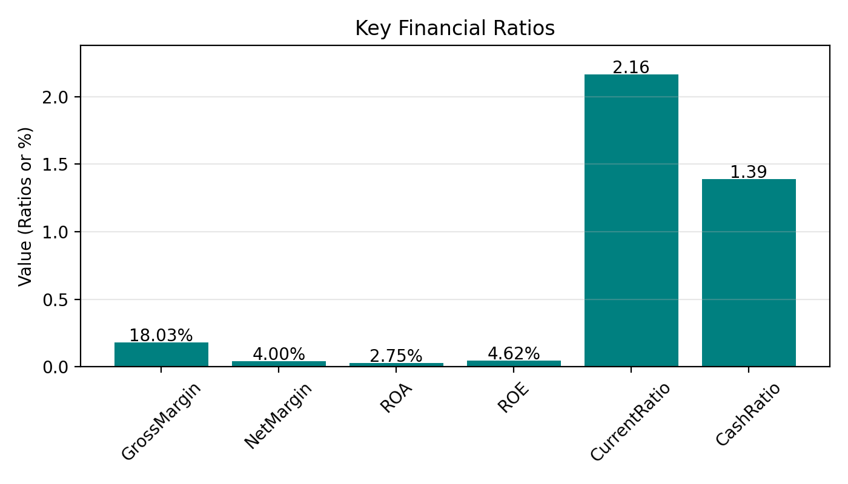
Key Ratios

Slide 7
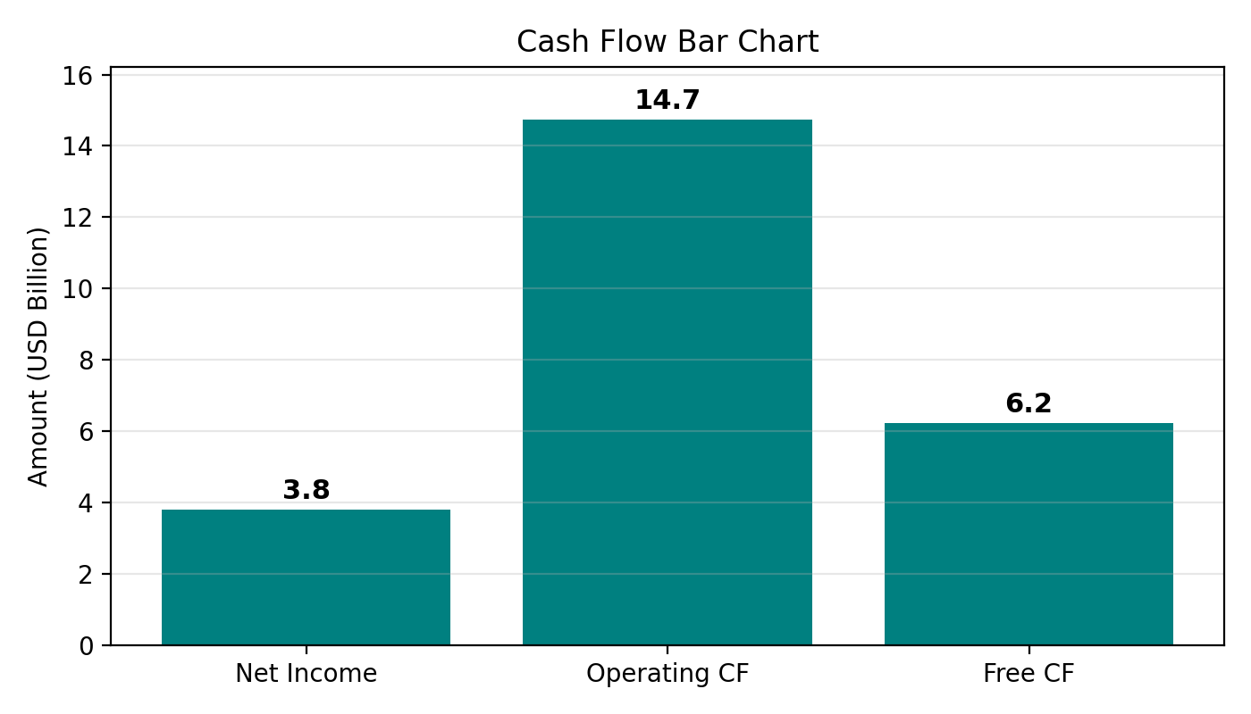
Cash Flow

