Slide 1
000333.SZ — Midea Group Co., Ltd. — Fundamental Analysis Report (Annual 2024)
2026-03-23 12:53:18Z

Slide 2
Executive Summary
Strong cash conversion: OCF is 1.57× net income.
Profitability - ROE 17.8% | ROA 6.4% | Net margin 9.4%
Liquidity - Current ratio 1.11 | Cash ratio 0.42
Leverage - D/E 0.40 | Net debt -$8.87B
Free cash flow: $7.64B (real, after $1.14B capex)
DCF Valuation: Intrinsic value $28.31/share vs current $10.65 (undervalued by 165.8%)

Slide 3
Key Metrics
Metric | Value
GrossProfit | $15.89B
GrossMargin | 26.8%
NetMargin | 9.4%
ROA | 6.4%
ROE | 17.8%
CurrentRatio | 1.11
DebtToEquity | 0.40
NetDebt | -$8.87B
CashRatio | 0.42
FCF | $7.64B
CashflowReliability | 1.57
PE | 14.5×
EV_EBITDA | 8.7×
NetDebt_EBITDA | -1.07

Slide 4
DCF Valuation
Metric | Value
WACC | 0.08
IntrinsicValue | $28.31
Upside | 165.8%

Slide 5
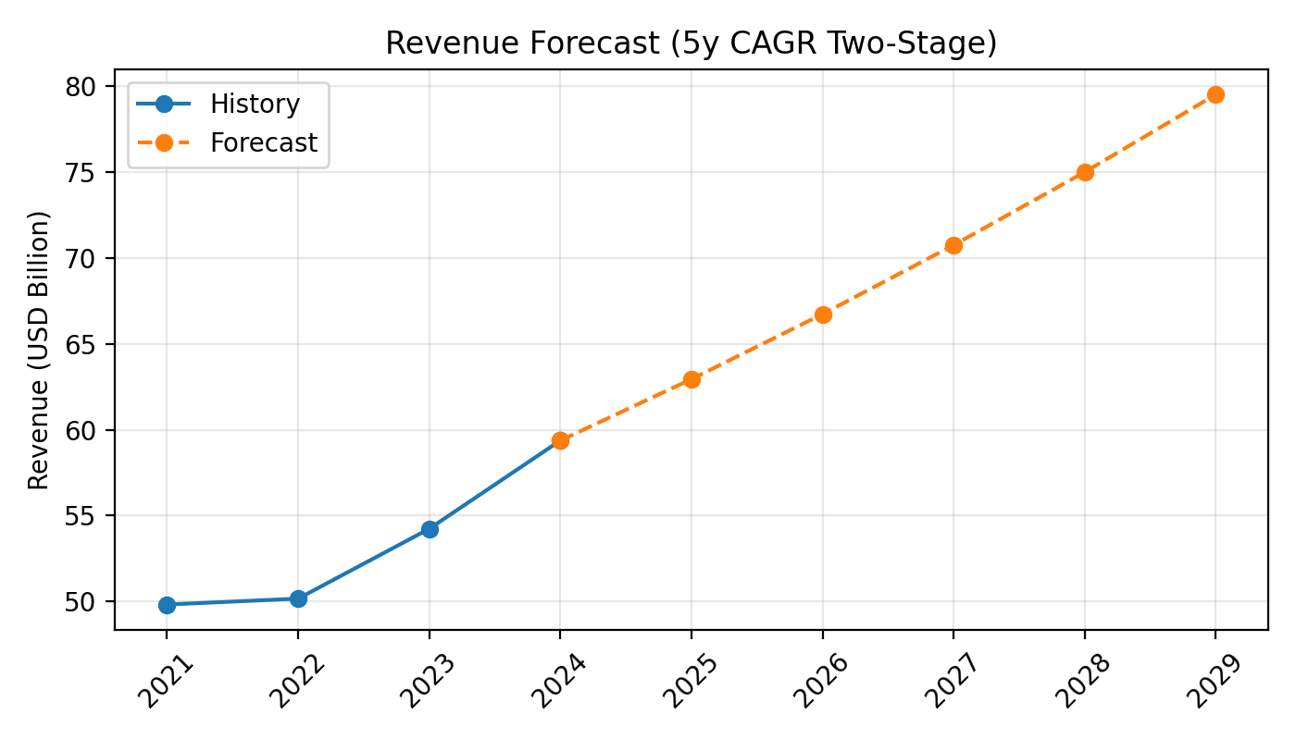
Revenue Forecast

Slide 6
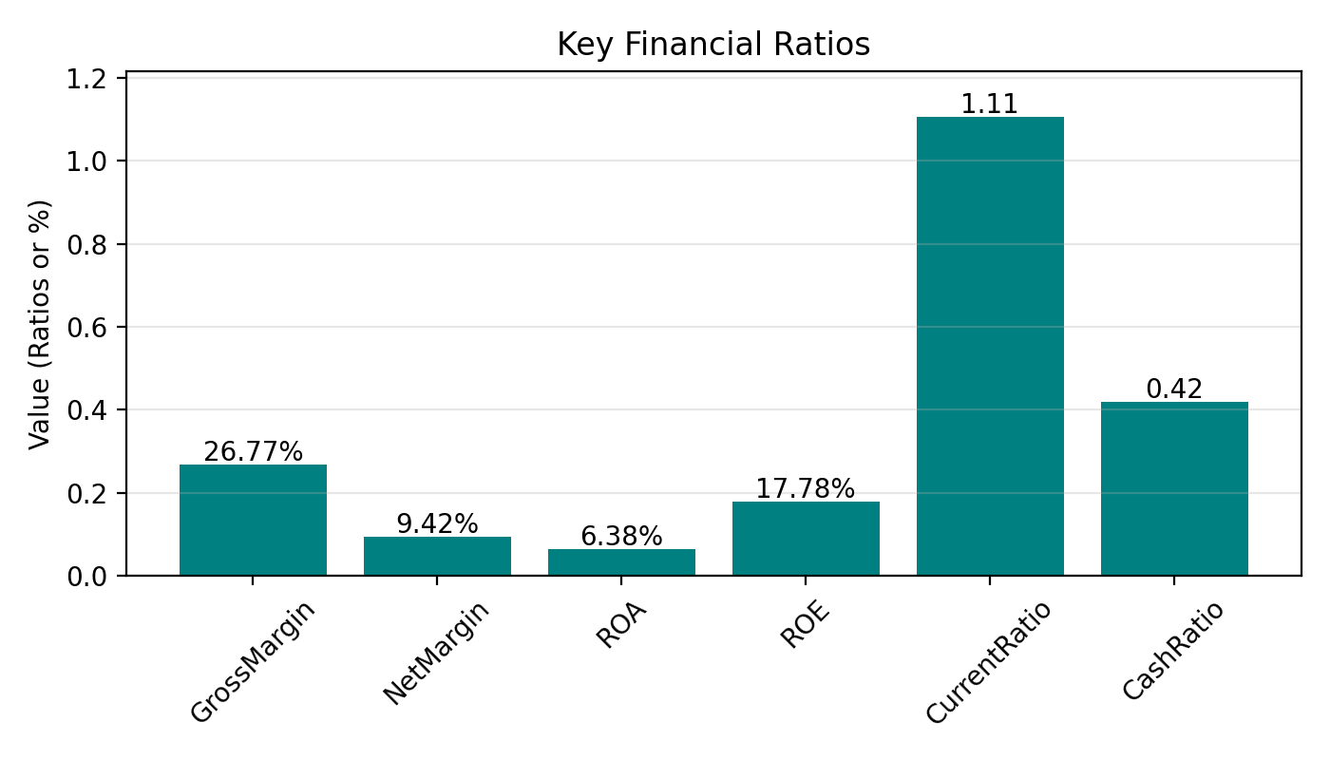
Key Ratios

Slide 7
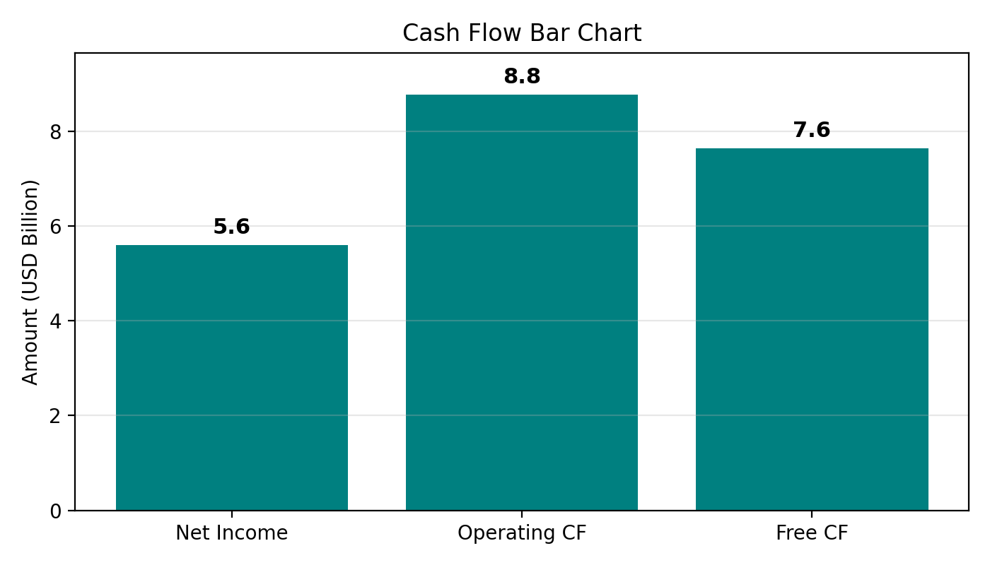
Cash Flow

