Slide 1
6301.T — Komatsu Ltd. — Fundamental Analysis Report (Annual 2025)
2026-03-23 12:53:14Z

Slide 2
Executive Summary
OCF exceeds net income (1.18×).
Profitability - ROE 13.9% | ROA 7.6% | Net margin 10.7%
Liquidity - Current ratio 2.00 | Cash ratio 0.23
Leverage - D/E 0.38 | Net debt $5.27B
Free cash flow: $1.96B (real, after $1.30B capex)
DCF Valuation: Intrinsic value $60.11/share vs current $37.51 (undervalued by 60.2%)

Slide 3
Key Metrics
Metric | Value
GrossProfit | $8.34B
GrossMargin | 32.2%
NetMargin | 10.7%
ROA | 7.6%
ROE | 13.9%
CurrentRatio | 2.00
DebtToEquity | 0.38
NetDebt | $5.27B
CashRatio | 0.23
FCF | $1.96B
CashflowReliability | 1.18
PE | 12.2×
EV_EBITDA | 7.5×
NetDebt_EBITDA | 1.01

Slide 4
DCF Valuation
Metric | Value
WACC | 0.08
IntrinsicValue | $60.11
Upside | 60.2%

Slide 5
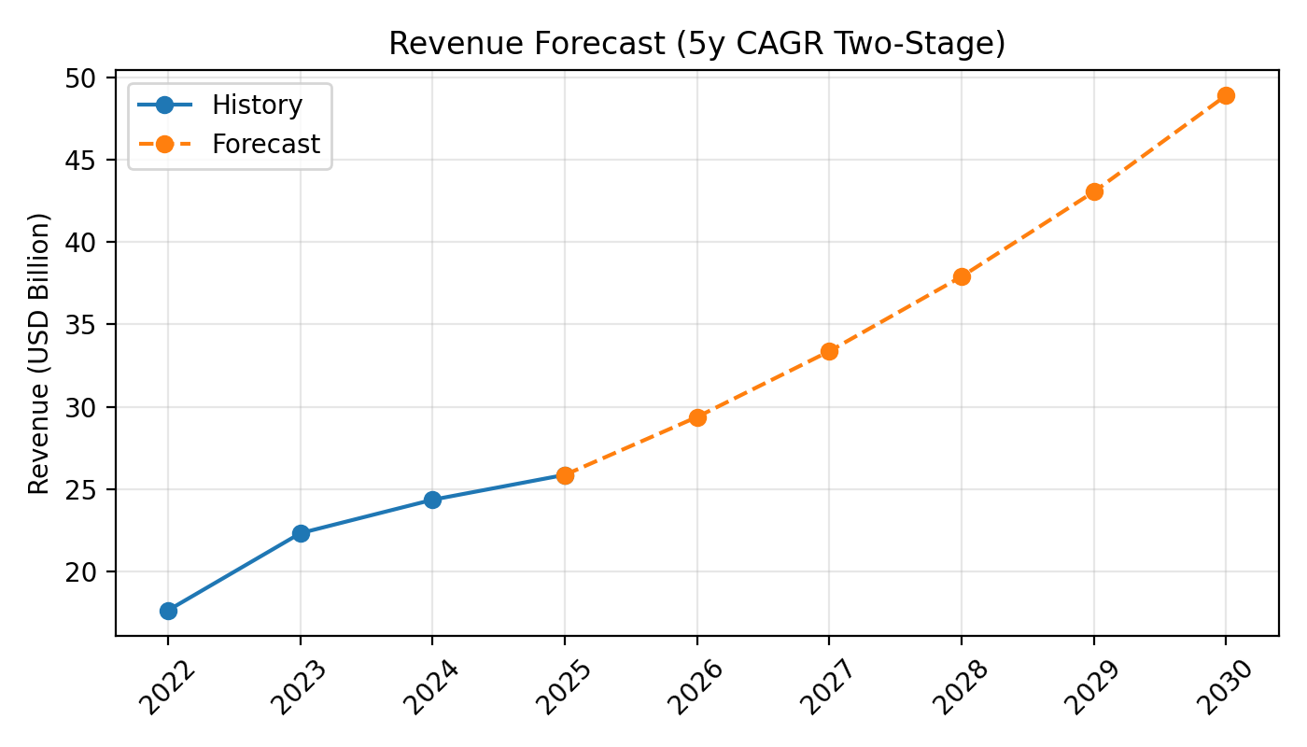
Revenue Forecast

Slide 6
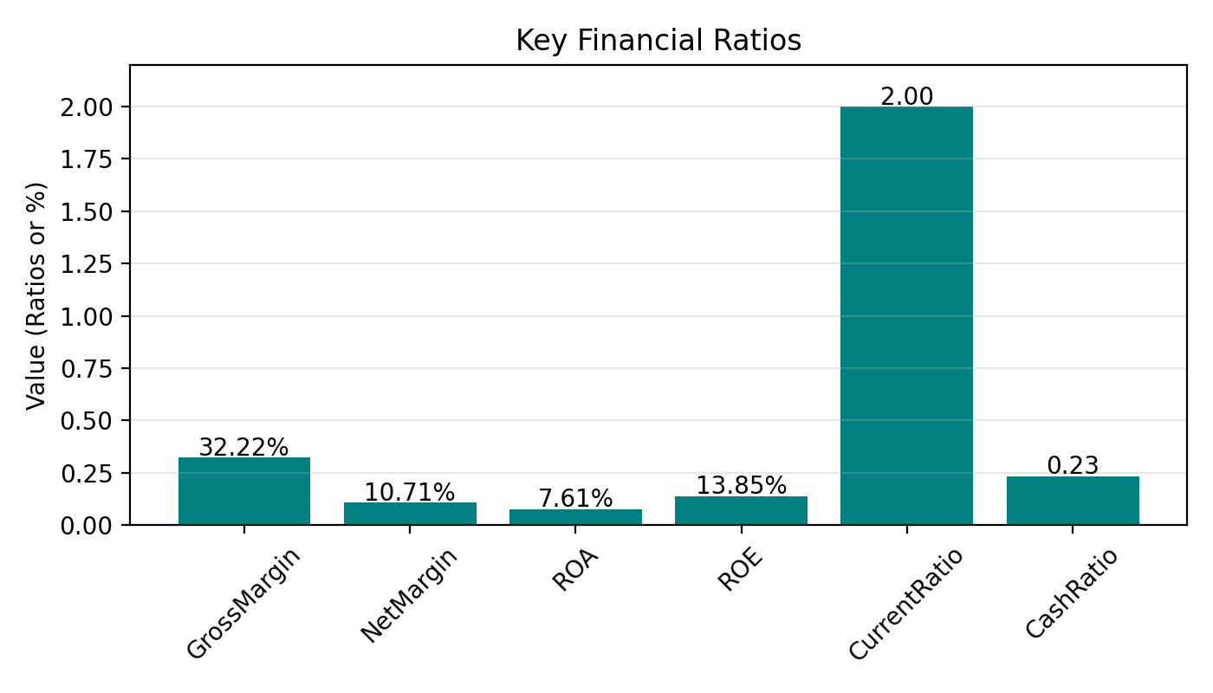
Key Ratios

Slide 7
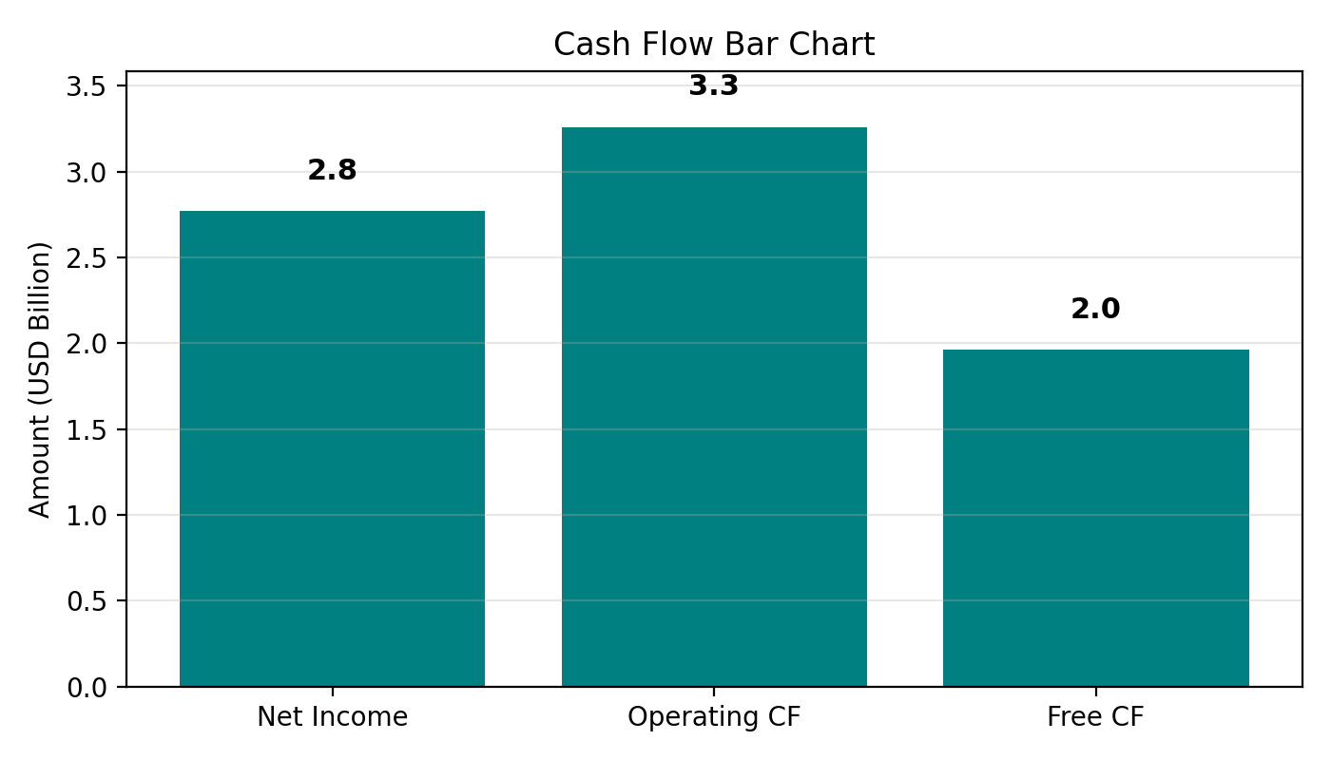
Cash Flow

