Slide 1
NVDA — NVIDIA Corporation — Fundamental Analysis Report (TTM 2026)
2026-03-23 13:51:29Z

Slide 2
Executive Summary
Moderate cash conversion (CF/NI = 0.86), gap likely driven by working capital movements.
Profitability - ROE 76.3% | ROA 58.1% | Net margin 55.6%
Liquidity - Current ratio 3.91 | Cash ratio 1.94
Leverage - D/E 0.07 | Net debt -$51.52B
Free cash flow: $96.68B (real, after $6.04B capex)
DCF Valuation: Intrinsic value $50.63/share vs current $177.23 (overvalued by 71.4%)

Slide 3
Key Metrics
Metric | Value
GrossProfit | $153.46B
GrossMargin | 71.1%
NetMargin | 55.6%
ROA | 58.1%
ROE | 76.3%
CurrentRatio | 3.91
DebtToEquity | 0.07
NetDebt | -$51.52B
CashRatio | 1.94
FCF | $96.68B
CashflowReliability | 0.86
PE | 35.9×
EV_EBITDA | 29.4×
NetDebt_EBITDA | -0.36

Slide 4
DCF Valuation
Metric | Value
WACC | 0.16
IntrinsicValue | $50.63
Upside | -71.4%

Slide 5
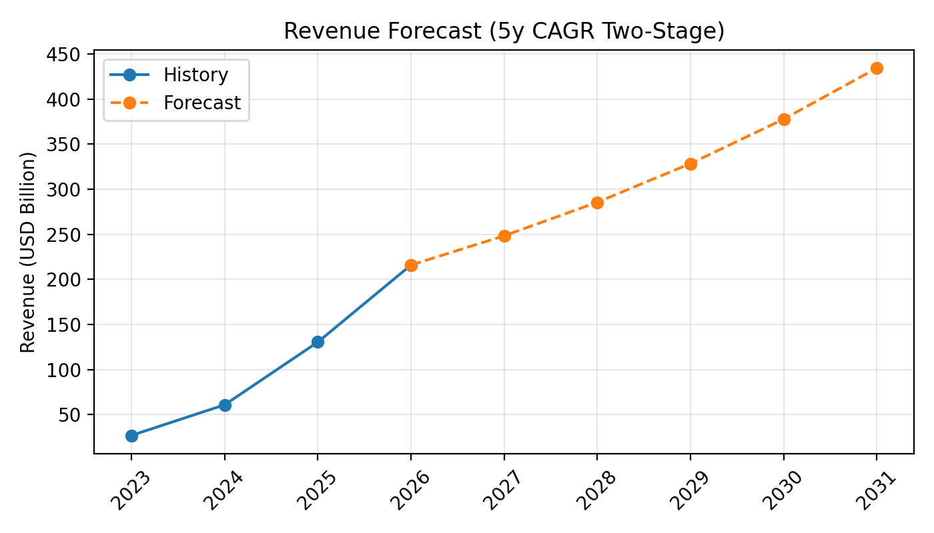
Revenue Forecast

Slide 6
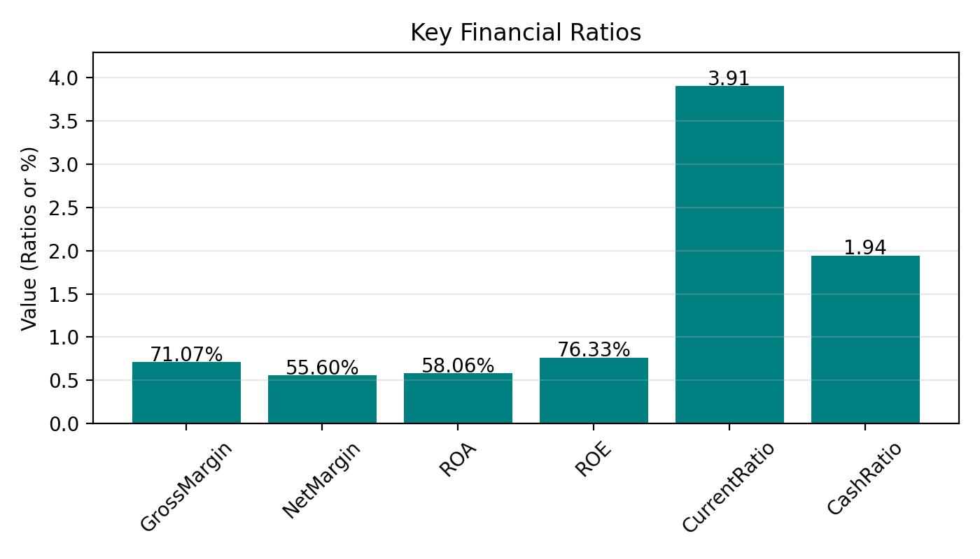
Key Ratios

Slide 7
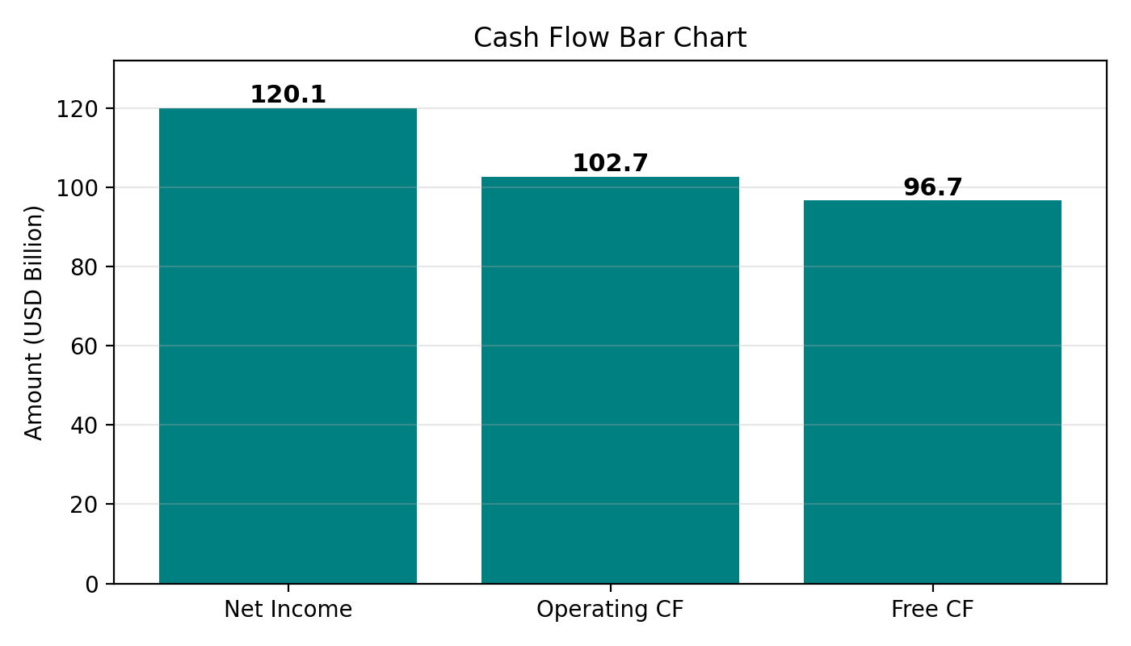
Cash Flow

