Slide 1
Midterm Study Guide
Boolean Logic
Below are sample questions only.
The exam can contain any topic from Chapter 11.
Review/read Chapter 11 and labs 1-3.
Lecture 5 Dr. B. Kovalerchuk, cs 312

Slide 2
Show the difference between AND and the other Boolean operators
AND , e.g., 1and 0=0 1or 0=1
OR
NOT
XOR
NAND
NOR
Lecture 5 Dr. B. Kovalerchuk, cs 312

Slide 3
Describe and transform
commutative law
distributive law
identity law
inverse law
associative law
DeMorgan’s theorem
  not(A*B)=?
  not(A+B)=?
A NOR B =?
A NAND B=?
Lecture 5 Dr. B. Kovalerchuk, cs 312

Slide 4
Simplify
(A+B)*notA
(A+notB)(notA+B)
ABC+notABC+BC+AC+notBC
Lecture 5 Dr. B. Kovalerchuk, cs 312

Slide 5
Give examples of DNF/SOP, CNF/POS for Boolean functions
y1=F1(x1,x2,x3,x4)=x₁x₂x₃+(notx₁)x₄ DNF/SOP
y2=F2(x1,x2,x3,x4)=x1(x3+x4)
CNF/POS
y3=F3(x1,x2,x3,x4)=(notx1)x2(notx3)+
+(notx1)x2x3+ (notx1)(notx2)x4
DNF/SOP
Lecture 5 Dr. B. Kovalerchuk, cs 312

Slide 6
Realize a formula as DNF/ SOP or CNF/POS
x1(x3+x4) CNF/POS
x1x3+x1x4 DNF/SOP
Draw gate presentation for both forms
x3
x4
x1
+
*
y2
x3
x1
x4
*
+
y2
*
Lecture 5 Dr. B. Kovalerchuk, cs 312

Slide 7
Realize the formula with 2 OR and 3 NOT
x₁(x₃+x₄) =
=(not(notx₁))(not(not(x₃+x₄))
(not A)(notB)=not(A +B) De Morgan
=not(notx₁+not(x₃+x₄))
Lecture 5 Dr. B. Kovalerchuk, cs 312

Slide 8
Get DNF (SOP)
CD
00 01 11 10
00
01
11
10
1
1
1
notABnotCD+
ABnotCD+
ABCD+
AnotBCD=
AB
1
B(notC)D+AD(B+C) not DNF
B(notC)D+ACD=
B(notC)D+ACD+ABD=
B(notC)D+ABD+ AnotBCD
Lecture 5 Dr. B. Kovalerchuk, cs 312

Slide 9
What is the maximum number of variable acceptable for Karnaugh map?
Karnaugh map
  6 var
Lecture 5 Dr. B. Kovalerchuk, cs 312

Slide 10
Formulate NAND and NOR implementation theorem for Boolean Functions
Theorem
  Any Boolean function can be implemented using only
    NOR
    or
    NAND
Lecture 5 Dr. B. Kovalerchuk, cs 312

Slide 11
NAND
DeMorgan’s theorem not(A*B)=notA+notB not(A+B)=(notA)*(notB)
A NOR B =notA * notB A NAND B=notA OR not B
B(notA+notC)=B(notA)+B(notC)
not(not[B(notA) + B(notC)])= (DeMorgan)
=not[not{B(notA)}]*not{B(notC)}]
we have three NAND form
notA
B
B
notC
NAND
NAND
NAND
Lecture 5 Dr. B. Kovalerchuk, cs 312

Slide 12
Draw Multiplexer
S2 S1
not
not
D0
D1
D2
D3
AND
AND
OR
AND
AND
Lecture 5 Dr. B. Kovalerchuk, cs 312

Slide 13
Draw decoder
A0
….
A7
RAM
RAM
RAM
RAM
enable enable enable enable
(control signal)
A8
A9
Lecture 5 Dr. B. Kovalerchuk, cs 312

Slide 14
Define and justify programmable logic array (PLA)
problem of practical realization of Boolean functions (manufacturing problem)
SSI (<10) standard minimization
printed-circuit board to implement logic function
layout of gates and interconnections on the chip must be designed.
expensive design without PLA
Lecture 5 Dr. B. Kovalerchuk, cs 312

Slide 15
Solution
General purpose chip -programmable logic array (PLA)
SOP-DNF: not, and, or
Inputs
  available x as well as (not x)
  output of each AND is available for each OR
  output of each OR is a chip output
Lab. device
Lecture 5 Dr. B. Kovalerchuk, cs 312

Slide 16
Draw an example of
programmable logic array
S2 S1
not
not
D0
D1
D2
D3
AND
AND
OR
AND
AND
made appropriate connections
Lecture 5 Dr. B. Kovalerchuk, cs 312

Slide 17
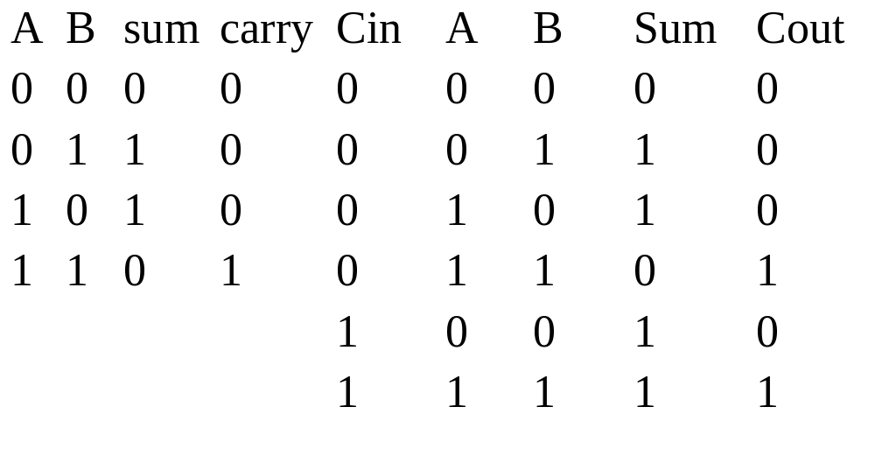
Draw the truth table for binary Adder
Lecture 5 Dr. B. Kovalerchuk, cs 312

Slide 18
Draw 4-bit adder
A3 B3 A2 B2 A1 B1 A0 B0
OVERFLOW
SIGNAL
0
C3 Cin C2 Cin C1 Cin Co Cin
S3 S2 S1 S0
Lecture 5 Dr. B. Kovalerchuk, cs 312

Slide 19
Define Adder as a DNF and draw Adder
Sum=(notA)(notB)C+(notA)B(notC)+
+A(notB)(notC)+ABC
Carry=AB+AC+BC
Lecture 5 Dr. B. Kovalerchuk, cs 312

Slide 20
Describe difference
Sequential circuits
output depends on
  Input, and
  current state of the circuit
  Examples Flip-Flops
Combinational circuits
output depends on
  Input only
Lecture 5 Dr. B. Kovalerchuk, cs 312

Slide 21
Draw D Flip-Flop
(D-data or delay)
reset
1
OR
Q
AND
Clock
OR
notQ
AND
D
0
set
S-R flip-flop R=1 and S=1 must be avoided
D -input Data (0,1) storage one bit of data
Delays a 0 or 1 applied to its input for a single clock pulse
Lecture 5 Dr. B. Kovalerchuk, cs 312

Slide 22
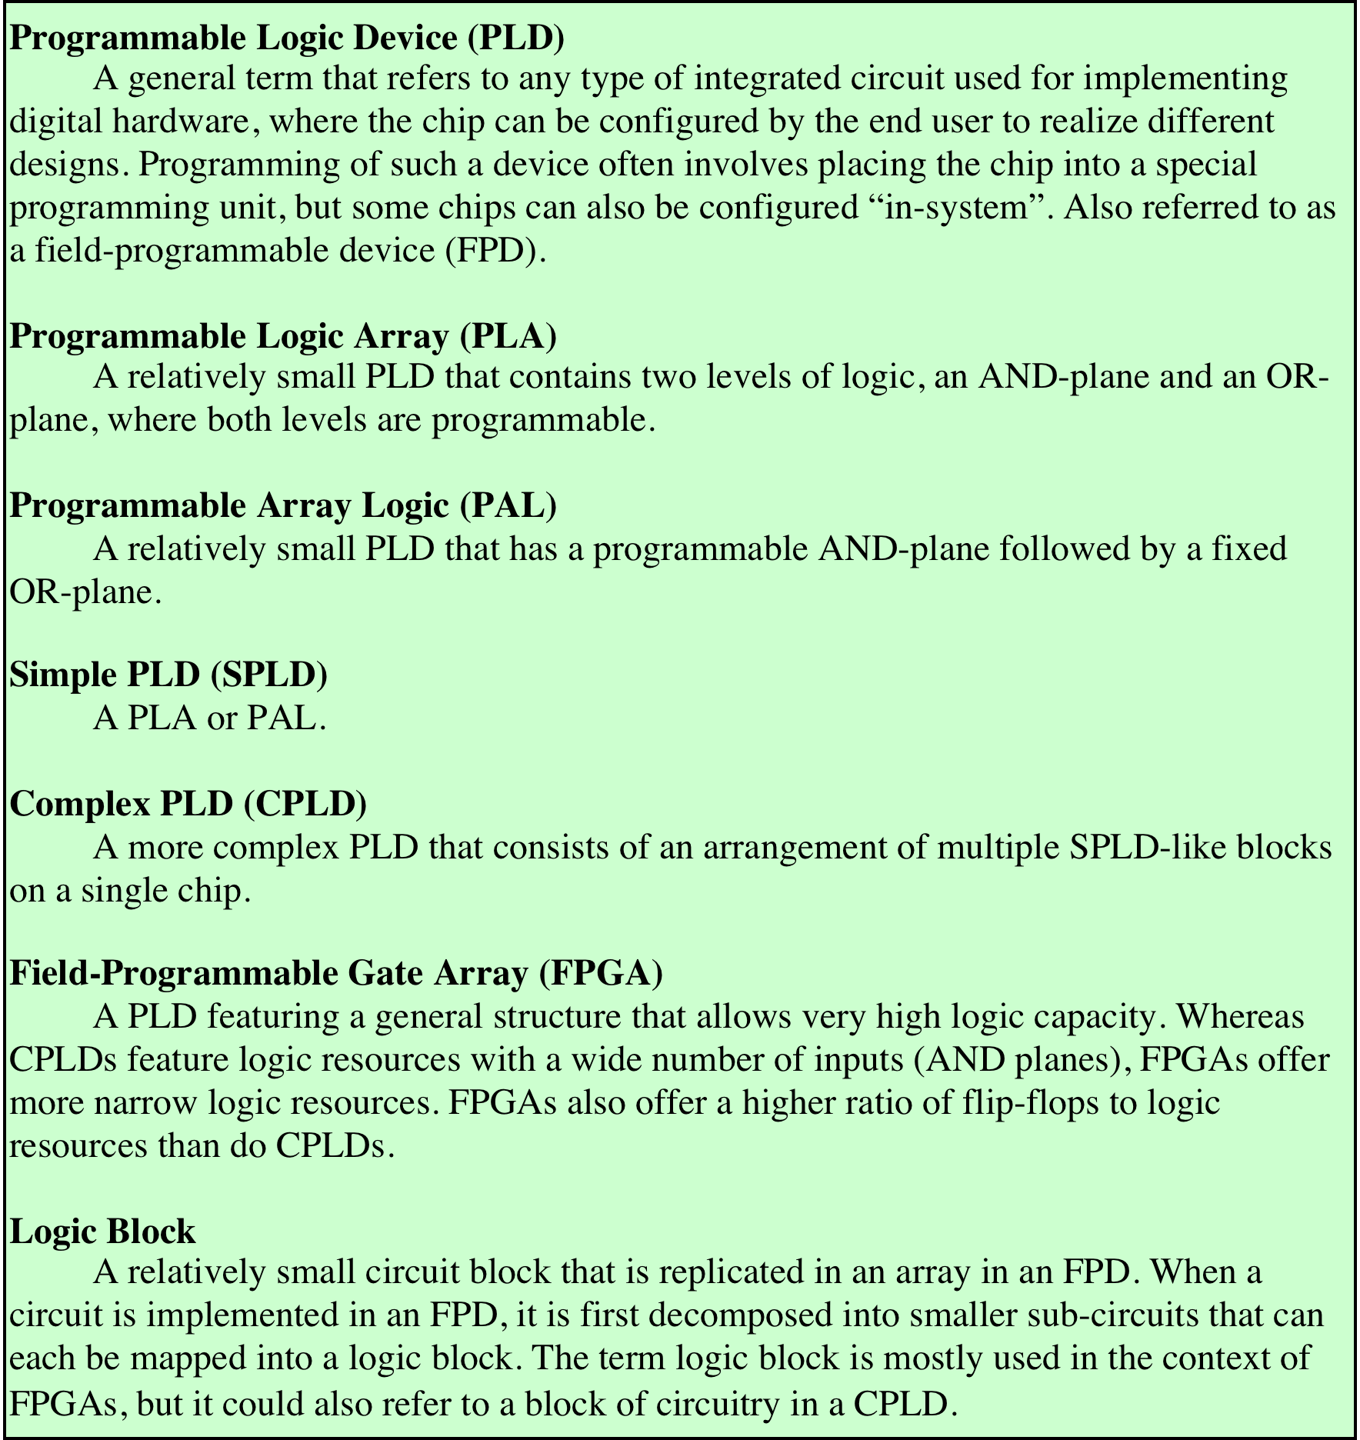
Programmable
Logic
Devices (PLD)
Terminology
Define PLD,
PLA,
FPGA
Notes:
As the level of integration provided by integrated circuits increases, other considerations apply. Early integrated circuits, using small-scale integration (SSI), provided from one to ten gates on a chip. Each gate is treated independently, in the building-block approach described so far. To construct a logic function, a number of these chips are laid out on a printed circuit board and the appropriate pin interconnections are made.
Increasing levels of integration made it possible to put more gates on a chip and to make gate interconnections on the chip as well. This yields the advantages of decreased cost, decreased size, and increased speed (because on-chip delays are of shorter duration than off-chip delays). A design problem arises, however. For each particular logic function or set of functions, the layout of gates and interconnections on the chip must be designed. The cost and time involved in such custom chip design is high. Thus, it becomes attractive to develop a general-purpose chip that can be readily adapted to specific purposes. This is the intent of the programmable logic device (PLD).
There are a number of different types of PLDs in commercial use. Table 11.11 lists some of the key terms and defines some of the most important types. In this section, we first look at one of the simplest such devices, the programmable logic array (PLA) and then introduce perhaps the most important and widely used type of PLD, the field-programmable gate array (FPGA).

Slide 23
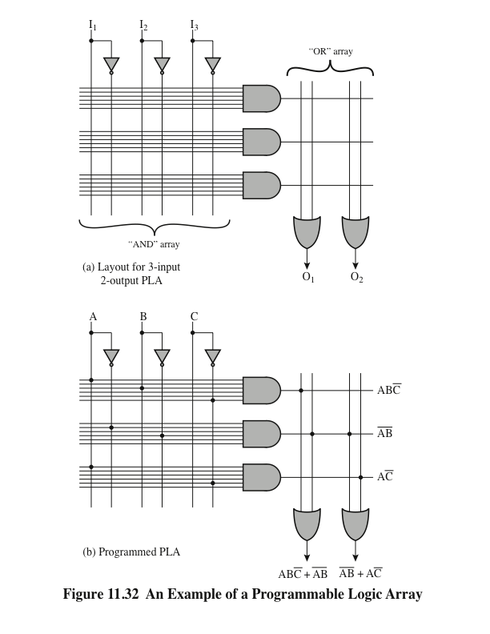
Draw a sample of Programmable Logic Array (PLA)
Notes:
The PLA is based on the fact that any Boolean function (truth table) can be expressed in a sum-of-products (SOP) form, as we have seen. The PLA consists of a regular arrangement of NOT, AND, and OR gates on a chip. Each chip input is passed through a NOT gate so that each input and its complement are available to each AND gate. The output of each AND gate is available to each OR gate, and the output of each OR gate is a chip output. By making the appropriate connections, arbitrary SOP expressions can be implemented.
Figure 11.32a shows a PLA with three inputs, eight gates, and two outputs. On the left is a programmable AND array. The AND array is programmed by establishing a connection between any PLA input or its negation and any AND gate input by connecting the corresponding lines at their point of intersection. On the
right is a programmable OR array, which involves connecting AND gate outputs to OR gate inputs. Most larger PLAs contain several hundred gates, 15 to 25 inputs, and 5 to 15 outputs. The connections from the inputs to the AND gates, and from the AND gates to the OR gates, are not specified until programming time.
PLAs are manufactured in two different ways to allow easy programming (making of connections). In the first, every possible connection is made through a fuse at every intersection point. The undesired connections can then be later removed by blowing the fuses. This type of PLA is referred to as a field-programmable logic array. Alternatively, the proper connections can be made during chip fabrication by using an appropriate mask supplied for a particular interconnection pattern. In either case, the PLA provides a flexible, inexpensive way of implementing digital logic functions.
Figure 11.32b shows a programmed PLA that realizes two Boolean expressions.

Slide 24
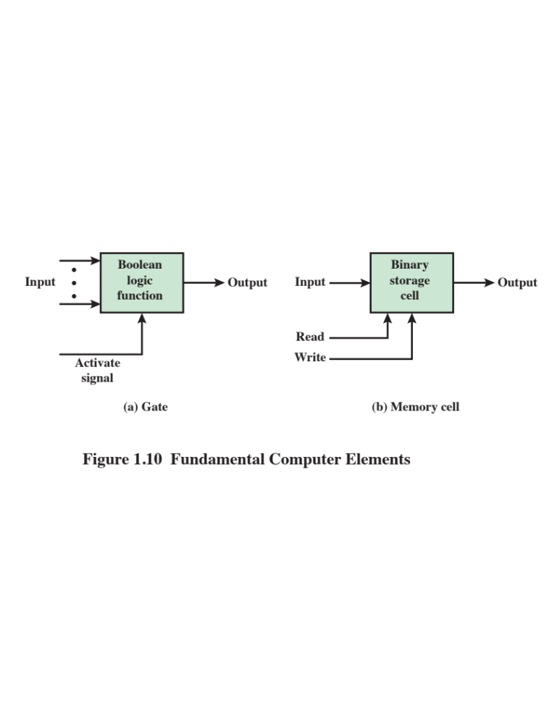
Notes:
Microelectronics means, literally, “small electronics.” Since
the beginnings of digital electronics and the computer industry, there has been a
persistent and consistent trend toward the reduction in size of digital electronic
circuits. Before examining the implications and benefits of this trend, we need to
say something about the nature of digital electronics. A more detailed discussion is
found in Chapter 11.
The basic elements of a digital computer, as we know, must perform storage,
movement, processing, and control functions. Only two fundamental types of components
are required (Figure 1.10): gates and memory cells. A gate is a device that
implements a simple Boolean or logical function, such as IF A AND B ARE TRUE
THEN C IS TRUE (AND gate). Such devices are called gates because they control
data flow in much the same way that canal gates control the flow of water. The
memory cell is a device that can store one bit of data; that is, the device can be in
one of two stable states at any time. By interconnecting large numbers of these
fundamental devices, we can construct a computer.
© 2016 Pearson Education, Inc., Hoboken, NJ. All rights reserved.

