Slide 1

Automation Server
2/19/17

Slide 2


We will talk about..
What is Automation
What are we looking for
How it works
DOT Example
Project Goals
Questions & Suggestions
2

Slide 3
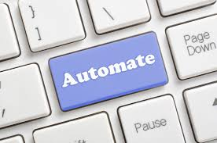
What is Automation…?
Transforming long, repetitive manual tasks into a single click operation,
minimizing human intervention to maximize productivity and enable scalability.
For Example…
ChangeMe node
TeamyInstall
Rosbag_play
3

Slide 4





Why Do We Need It?
Internal Error Detection
Integration and Synchronization error detection
Code degradation prevention
Thresholds optimization
Benchmarking

Slide 5
How It Works?
Obtaining a large set of successful bag records
Optimizing the test environment to stabilize results
Generate 'GroundTruth' data output
Generate 'TrialCode' data output
Analyze results and export to a well organized excel file
RQT reconfigure benchmarking and analytics
5

Slide 6
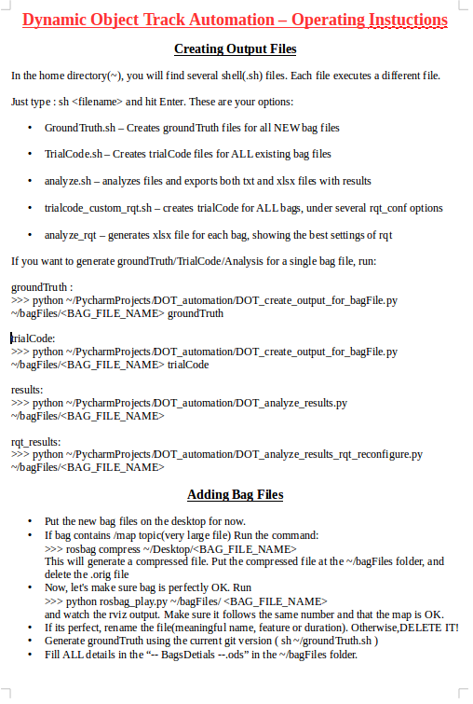
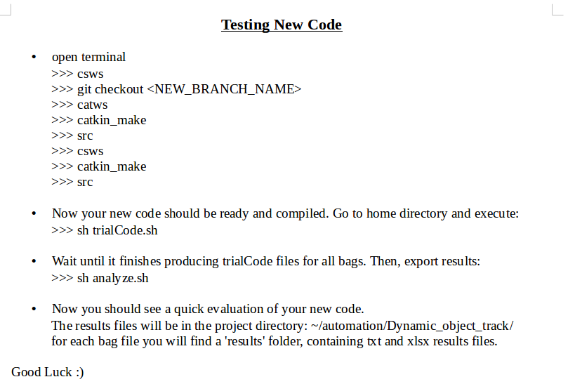
DOT Example – Instructions
6

Slide 7
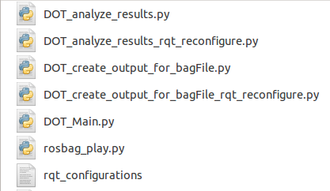
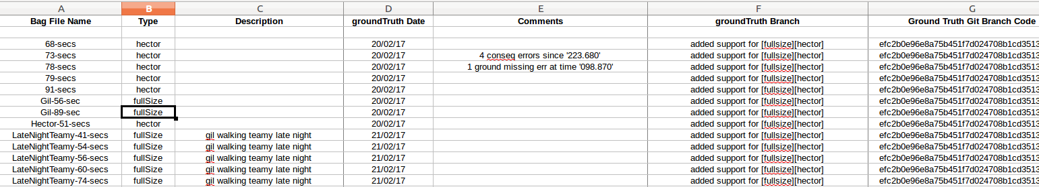
DOT Example – Files

Slide 8
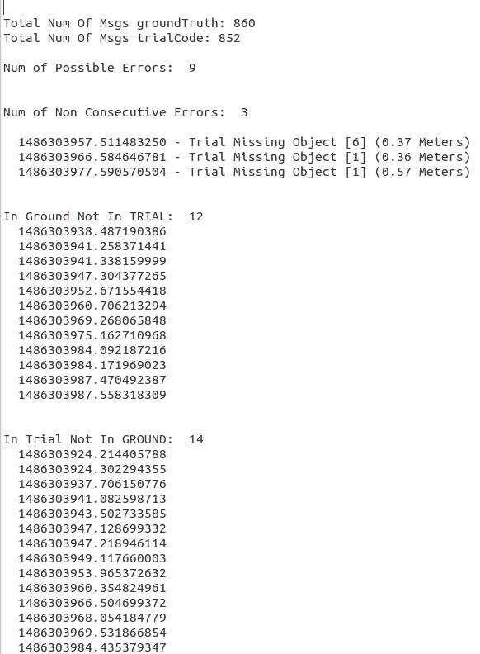
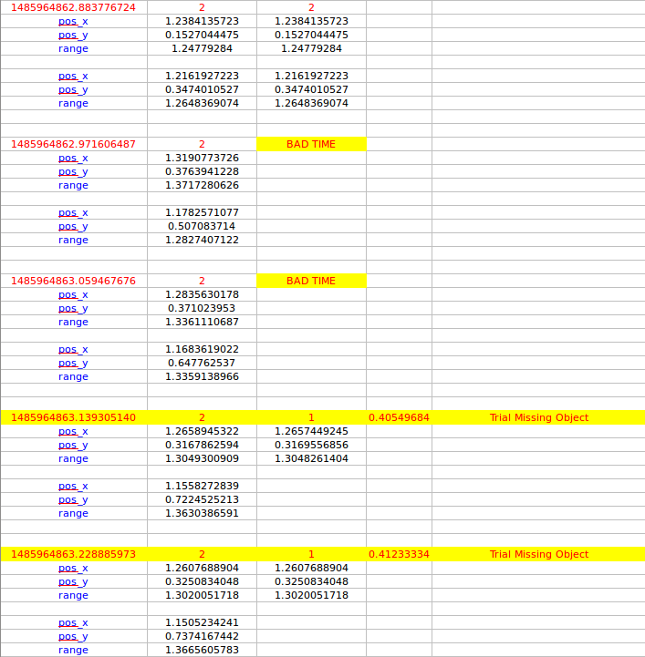
DOT Example – Results files

Slide 9
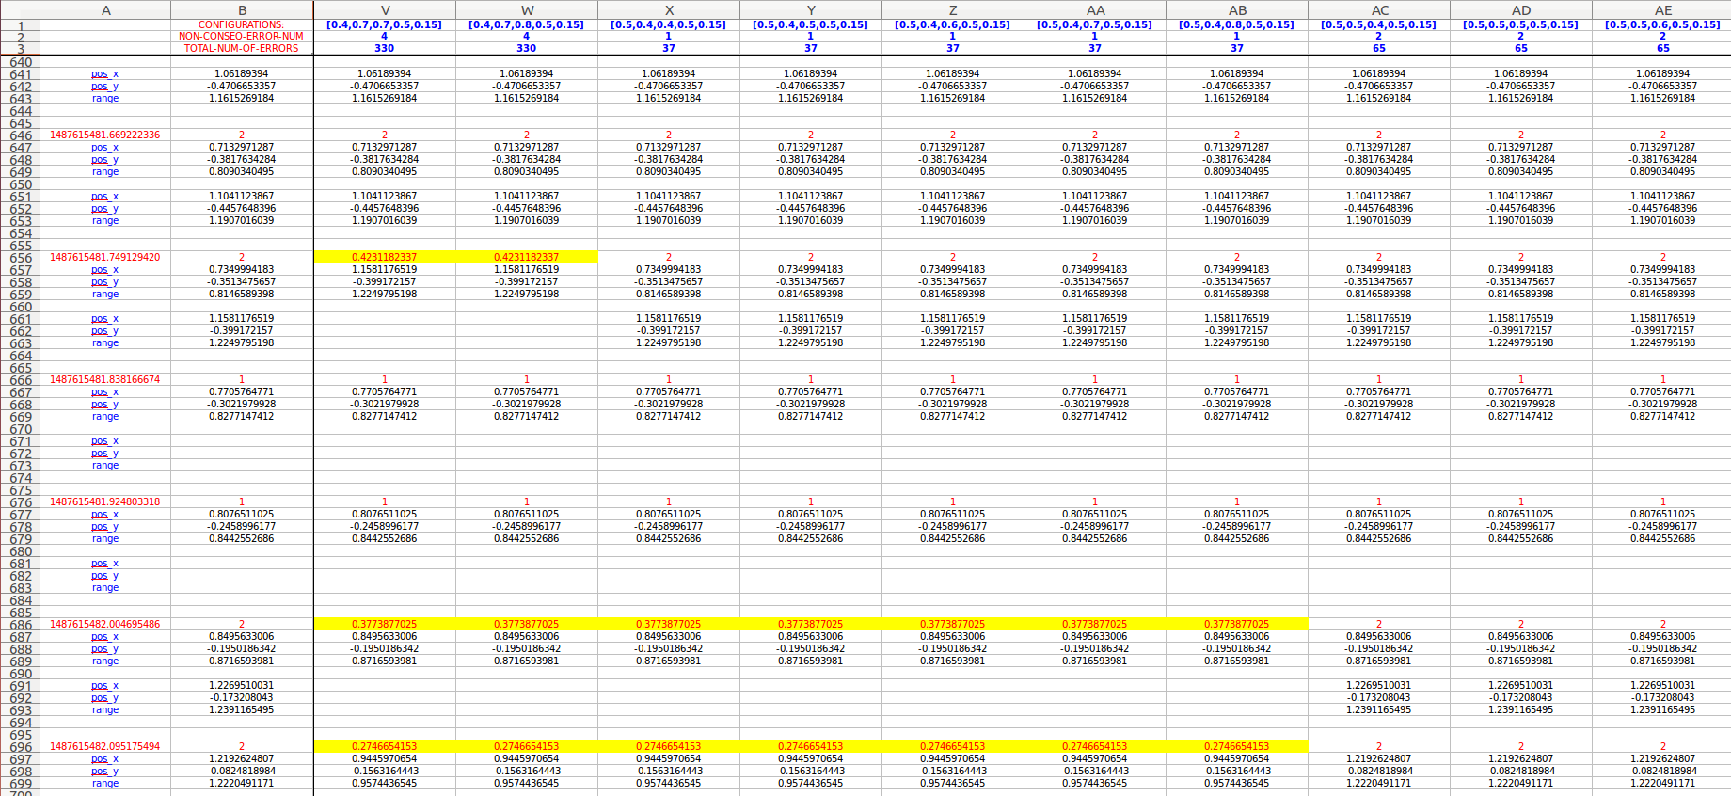
DOT Example – RQT parameters comparison

Slide 10
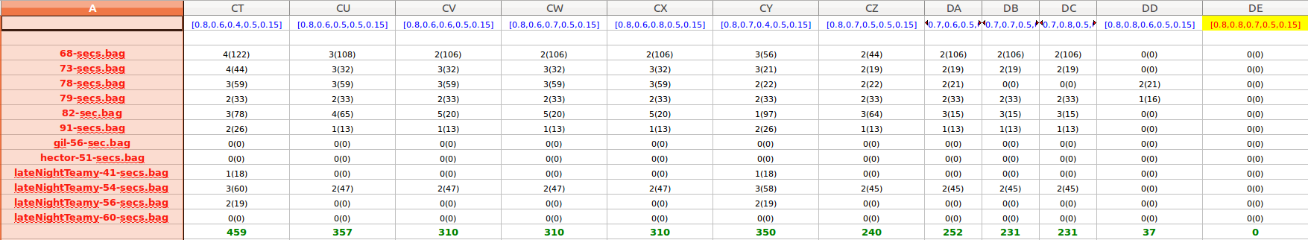

DOT Example – RQT Final Results File

Slide 11

Project Goals
Create a stable, scalable and user friendly platform for testing new code
Create a large, well-organized database of recordings to increase tests accuracy and efficiency
Develop test environments for all ongoing algorithms
Inherit a deep understanding of the whole system to locate origin upon rising errors
Develop a parallel multi-computer testing environment to decrease runtime and increase testcases.

Slide 12


Questions and Suggestion…?

Slide 13
THANK YOU ☺

