Slide 1

Team Members:
Badrinath Rohith Varma Datla
George Chempumthara
Gokulakrishnan R
Yakgna Venkatesh Ramasamy

Slide 2
Our Mission
Our mission is to democratize healthcare access by providing free online doctor appointments and a platform for healthcare events. We aim to remove financial barriers and create a convenient, efficient, and compassionate space for individuals to connect with healthcare professionals at no cost.

Slide 3
Features
User Registration
Donation
Vaccination Management
Appointment Bookings
Medical History Maintenance
Healthcare events

Slide 4















Tech Stack
Frontend | Backend | Third-party APIs

Slide 5
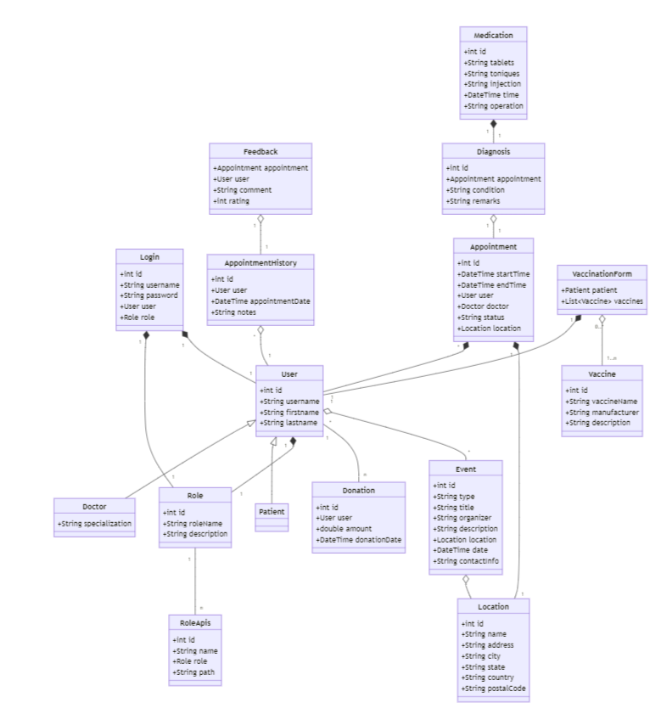
Object Model

Slide 6
Thank You!!!
Stay Healthy

