Slide 1
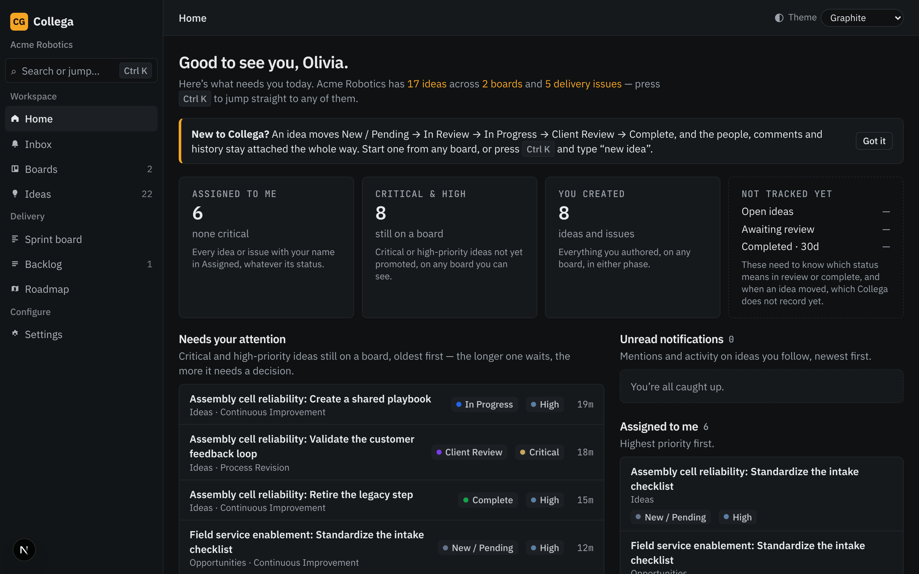
Collega
Every idea, from first spark to shipped.
Capture it, rank it, deliver it — in one place.
Acme Robotics demo workspace · Sales deck

Slide 2
Great ideas die in the gaps
Where good work goes to disappear today
Scattered
Unranked
Disconnected
Ideas live in chat, email, slide decks and spreadsheets. Nobody sees the whole picture.
No shared way to vote, prioritise or decide — loudest voice wins.
The idea that was approved is not the ticket being built. Context is lost at hand-off.

Slide 3
One workspace, idea to delivery
Collega keeps the people, comments and history attached the whole way
New / Pending
In Review
In Progress
Client Review
Complete
Capture ideas on boards, vote and prioritise, then promote the winners into delivery issues on a sprint.
Every status change, assignee and comment travels with the idea — nothing to re-explain at hand-off.

Slide 4
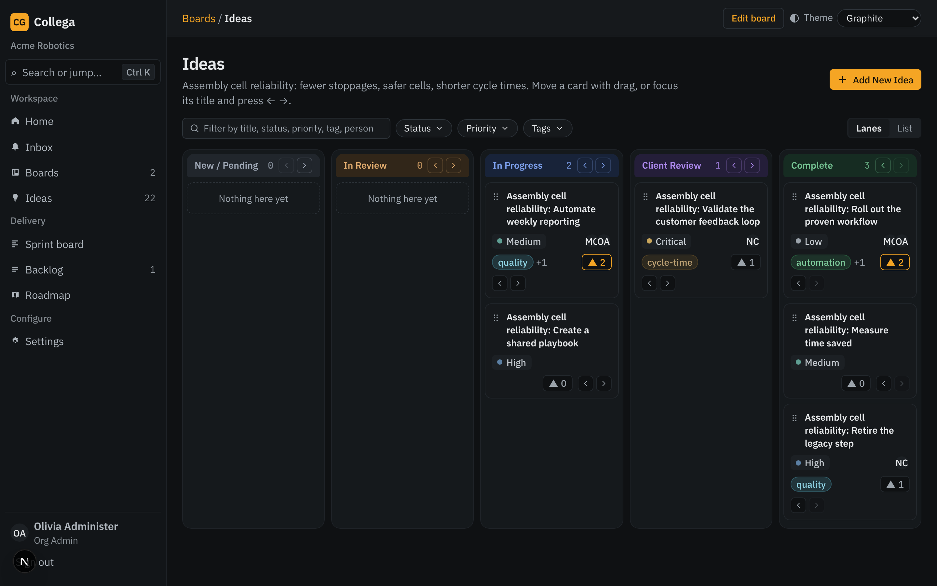
Boards that match how teams think
Lanes by status, drag a card to move it
Kanban lanes from New to Complete
Priority, assignees, tags and votes on every card
Keyboard-friendly: focus a title, press ← →
Multiple boards per organization — one per team or theme

Slide 5
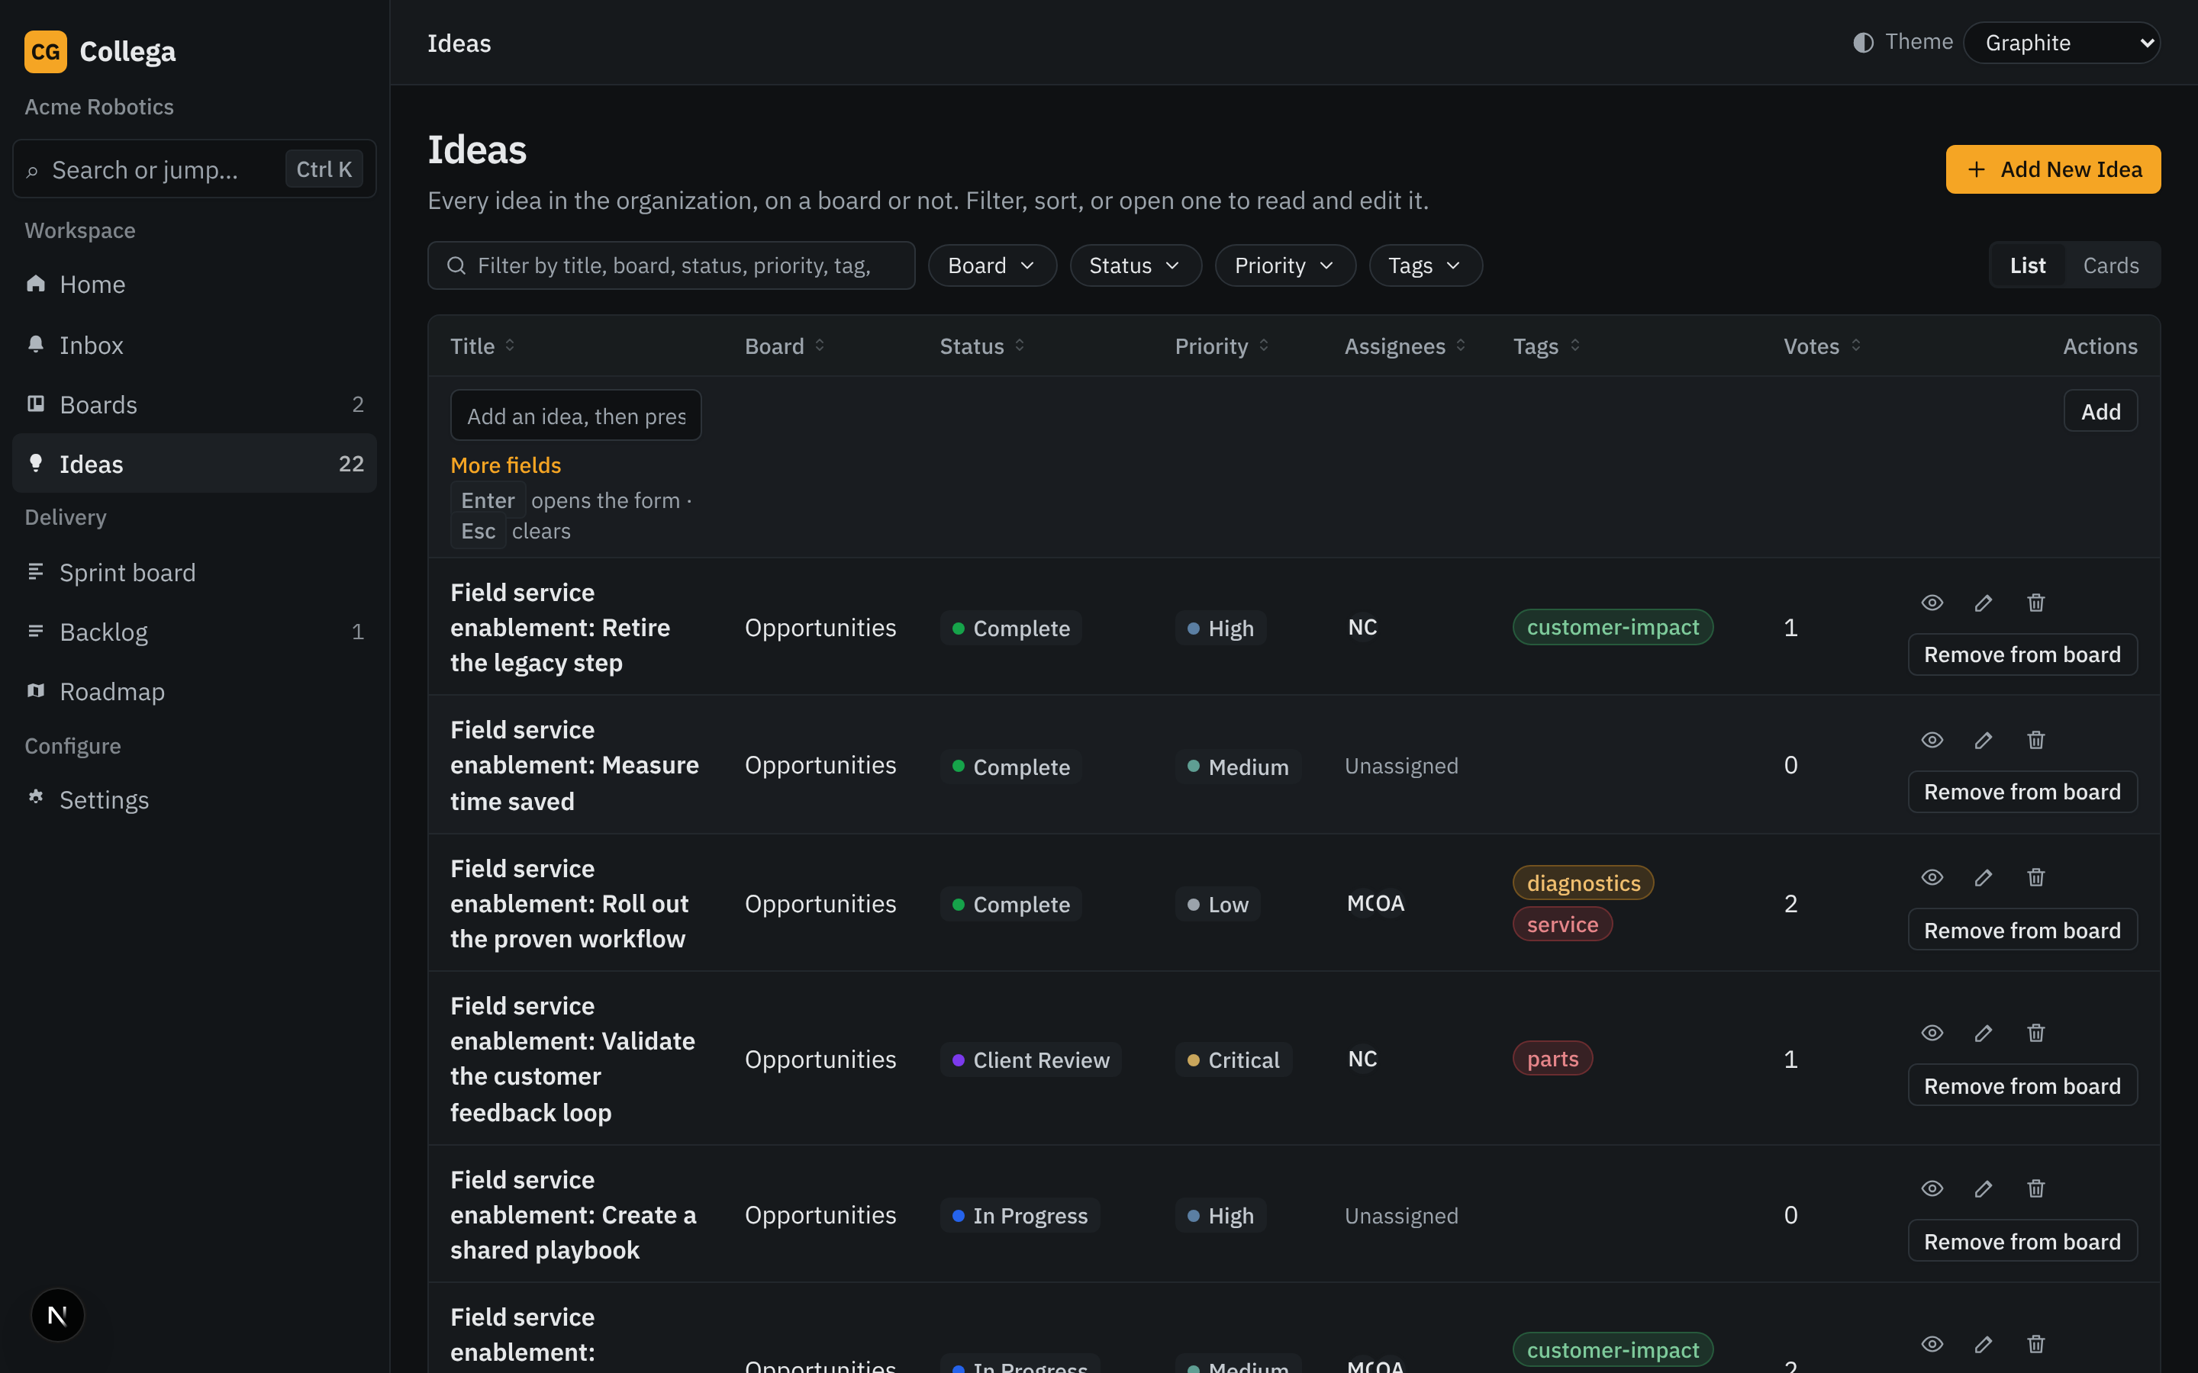
See every idea in one list
Filter, sort and open any idea to read and edit
Filter by board, status, priority and tags
List or card view
Upvotes surface what the team actually wants
Add an idea in a keystroke

Slide 6
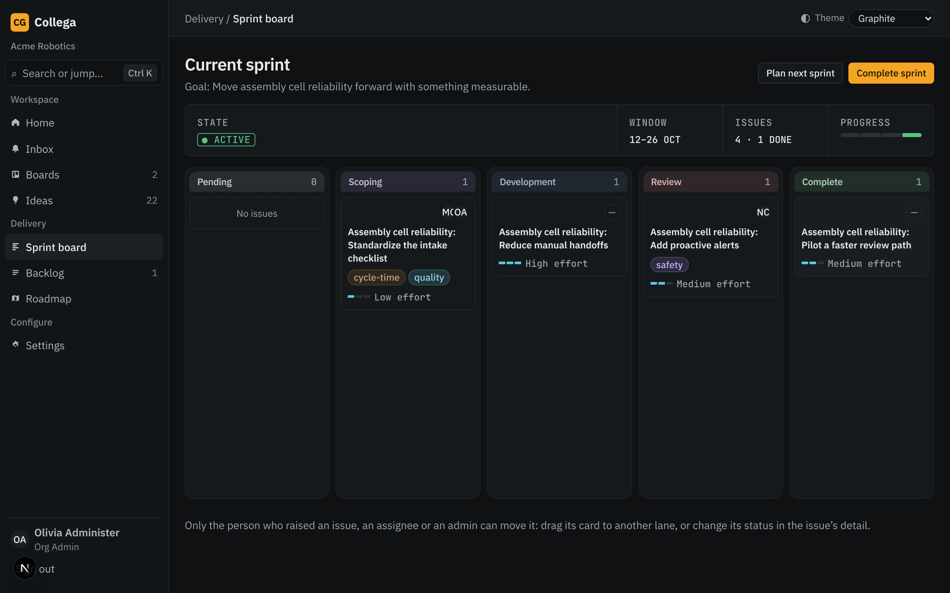
From approved idea to delivered work
Sprint board, backlog and roadmap
Sprint board with lanes from Pending to Complete
Effort sizing on every issue
Only the owner, an assignee or an admin can move an issue
Backlog to plan the next sprint

Slide 7
Start the day knowing what needs you
A personal home built around your work
Assigned to me, critical & high priority, created by you
Needs-your-attention list, oldest first
Ctrl K to jump to anything — or type "new idea"

Slide 8
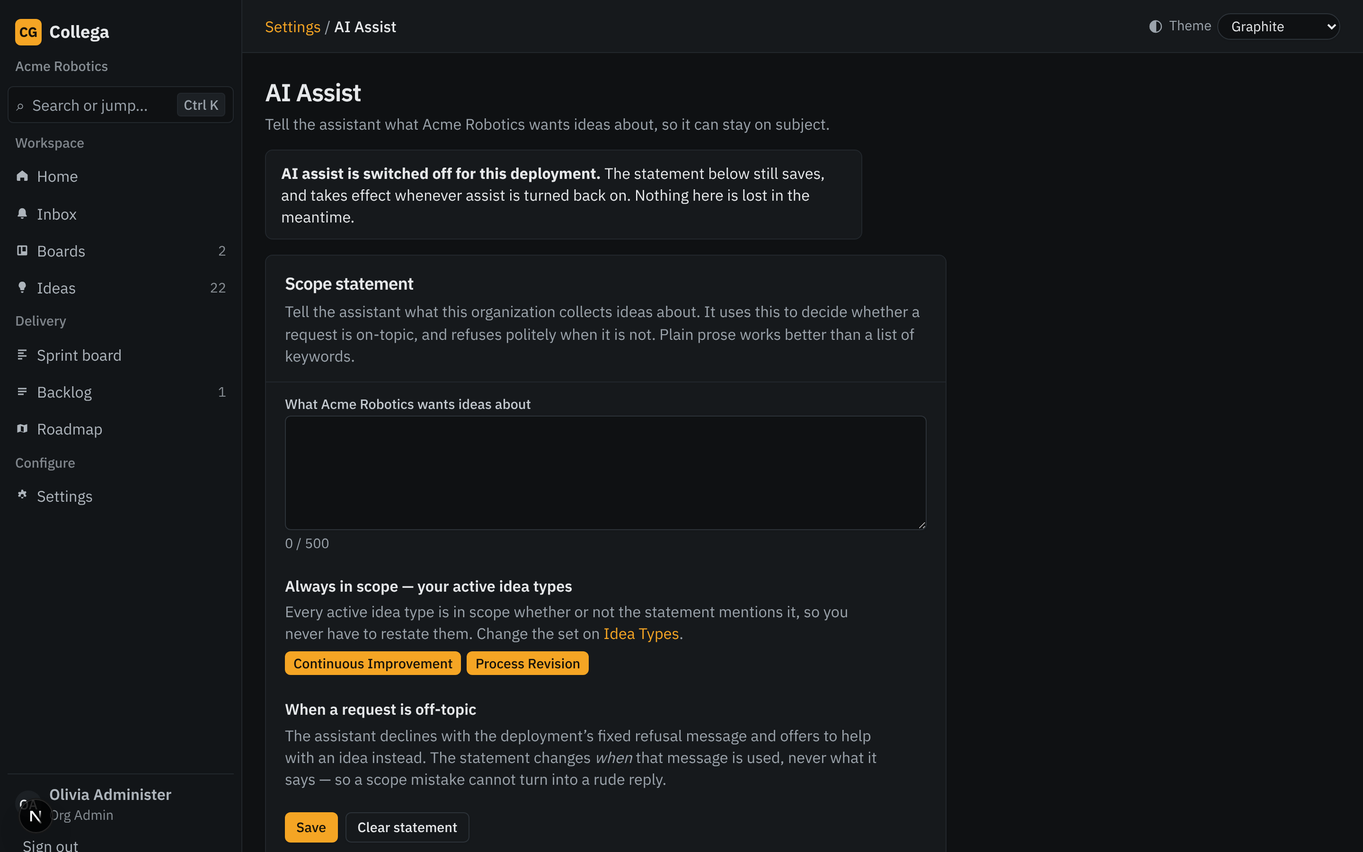
AI-assisted idea authoring
Turn a rough thought into a clear, complete idea
Assist helps draft and sharpen idea descriptions
Admins control the AI settings and prompt
Usage is visible to administrators

Slide 9
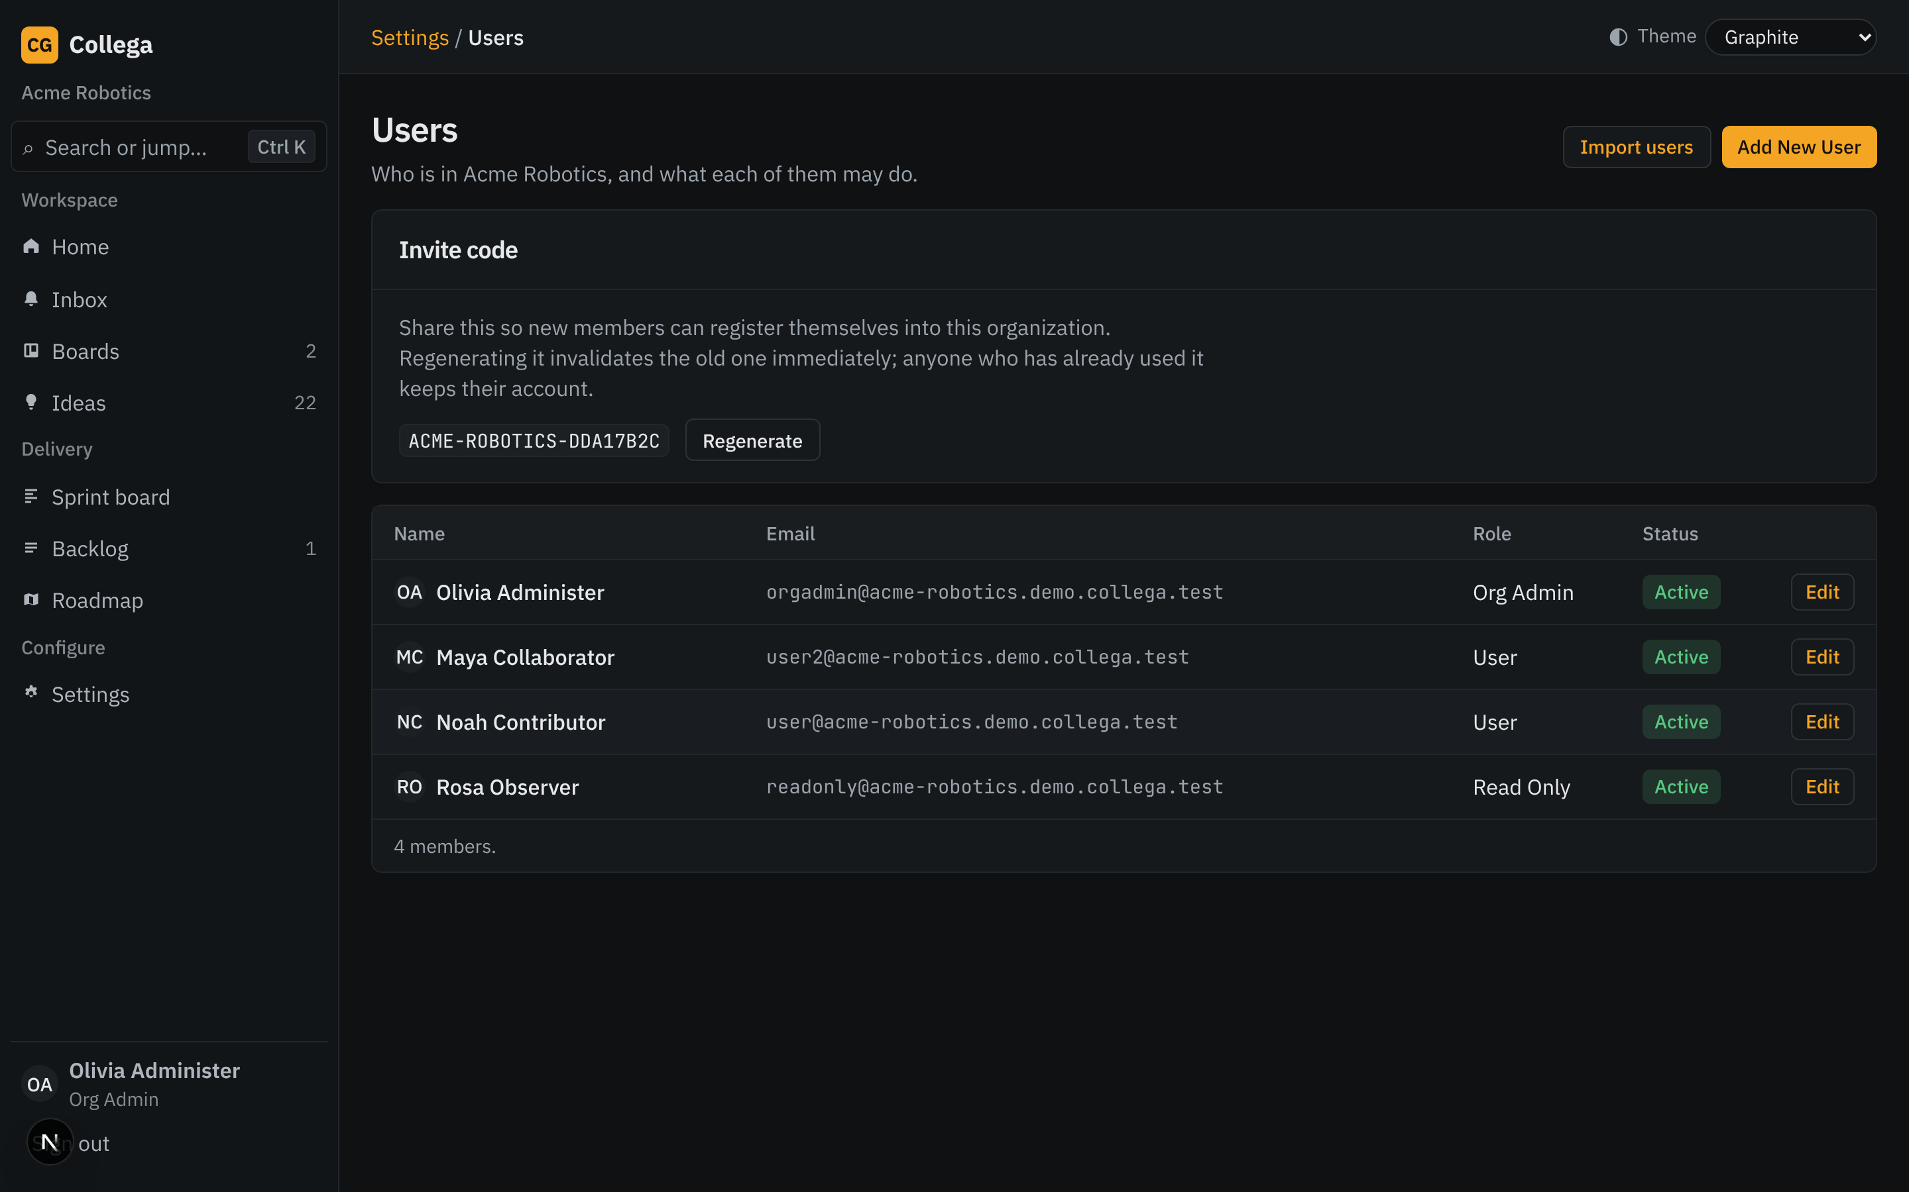
Built for admins, comfortable for everyone
Roles, custom fields and your own look
Org Admins, members and read-only roles
Custom fields, field sets and idea types
Five themes — Graphite dark by default, Terrazzo light
User management and bulk import

Slide 10
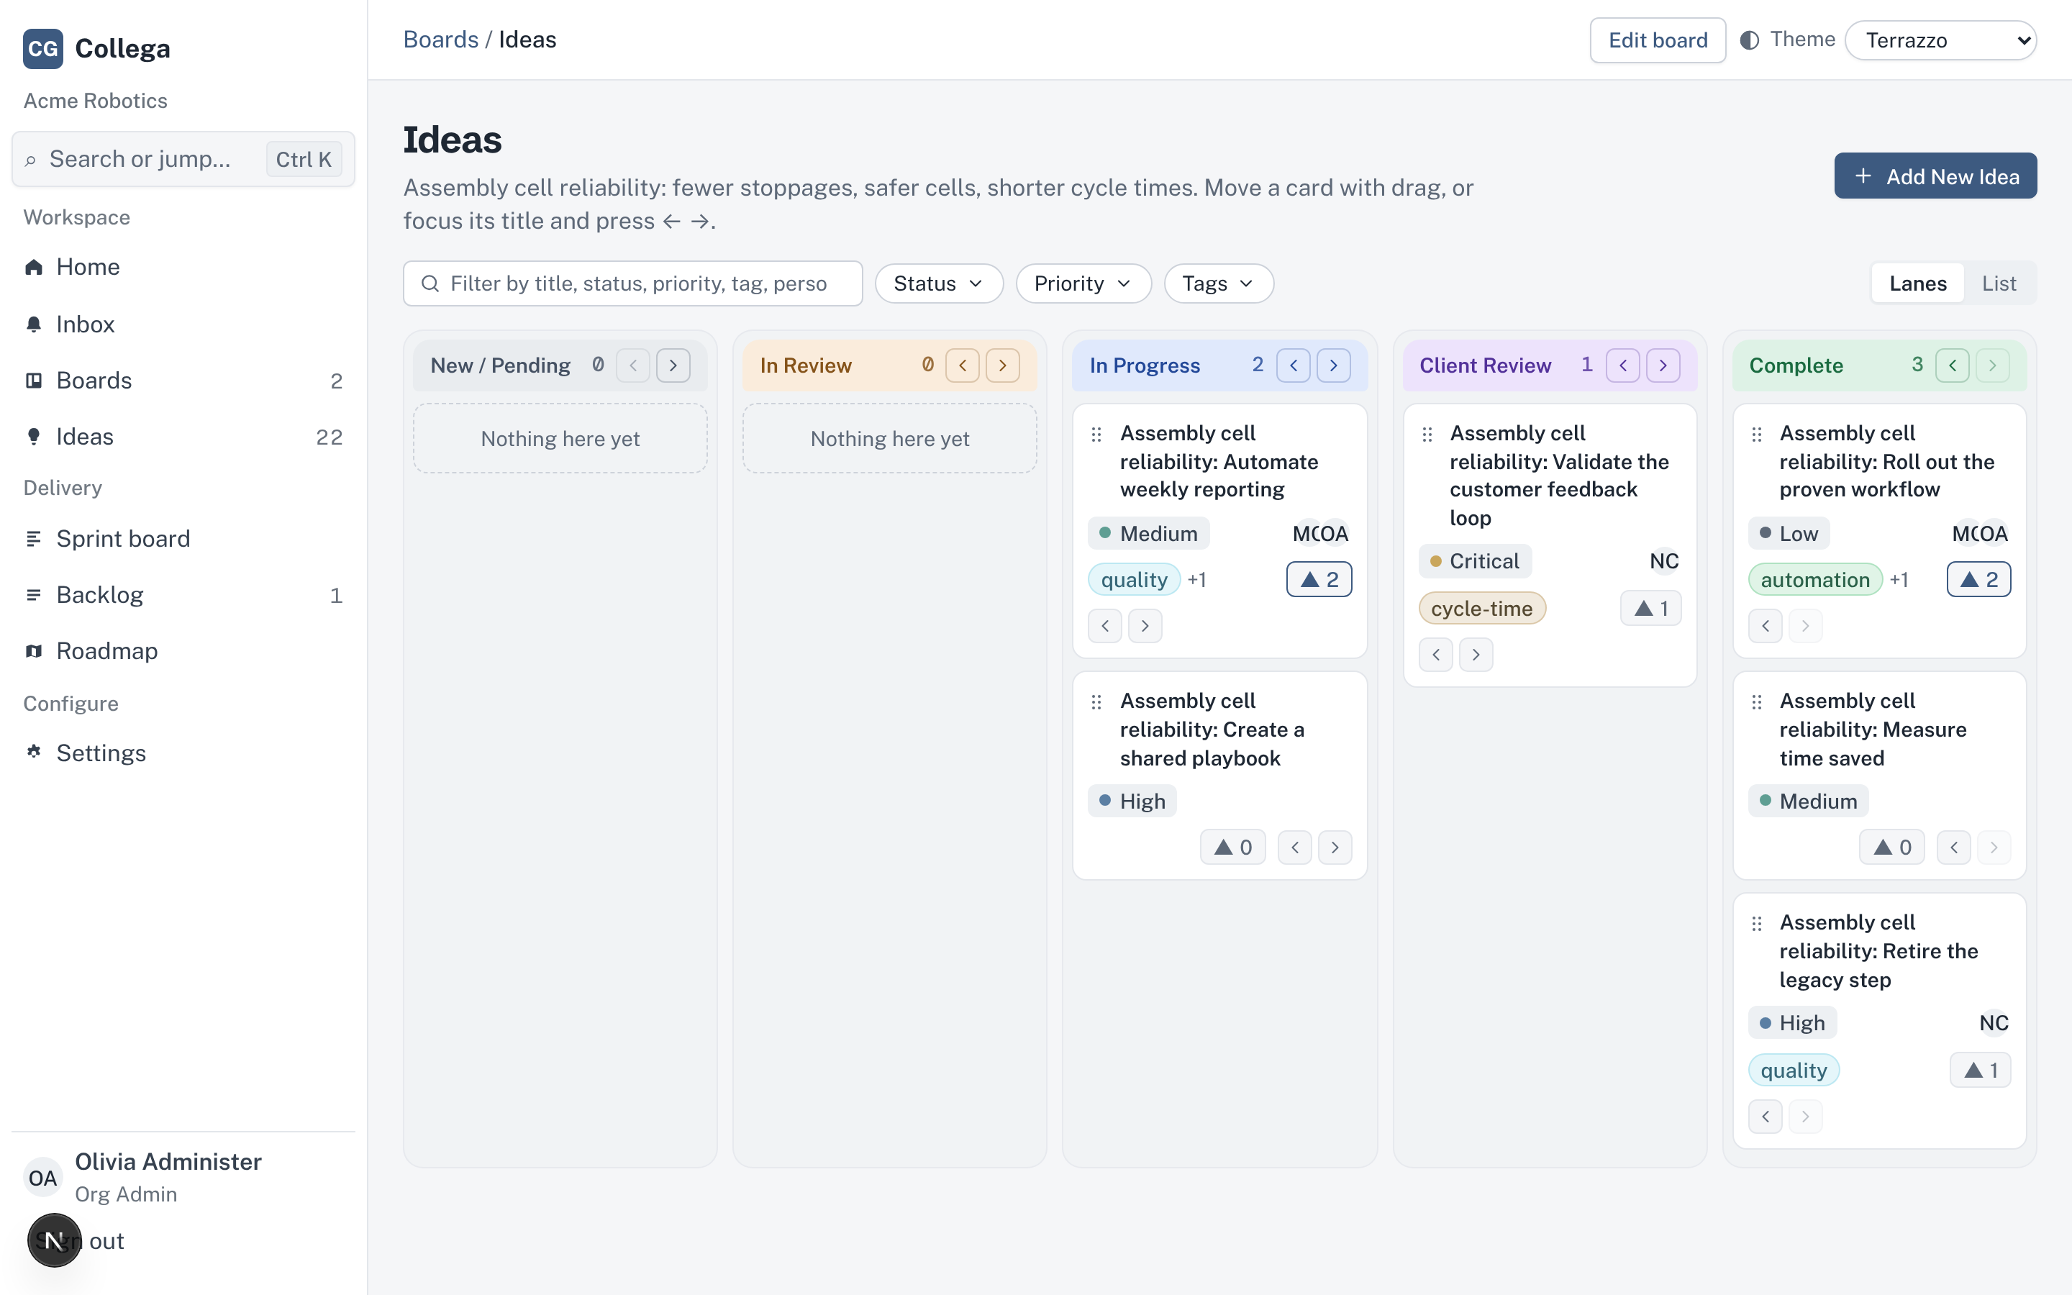
Light or dark — your call
Five themes, remembered per browser

Slide 11
See Collega on your own ideas.
Book a 30-minute walkthrough · Pilot with one team · Scale to the organization
collega · idea management with delivery built in

