Slide 1
Multi-Task Learning Using Uncertainty to Weigh Losses for Scene Geometry and Semantics
Alex Kendall, Yarin Gal, and Roberto Cipolla
CS 722 - Machine Learning
Presented by: George Marché
Spring 2022 - Paper Algorithm

Slide 2
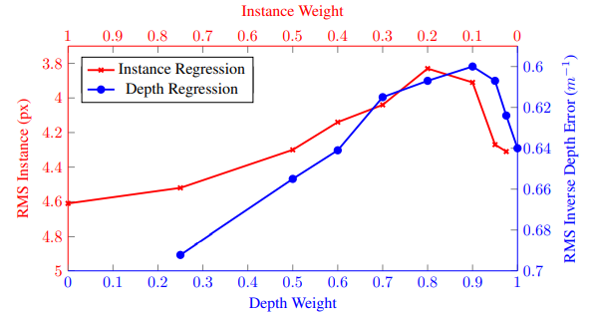
Overview
Multi-task learning is gaining popularity as a way to find relative weights between tasks in a shared representation
E.g. stock market, voice recognition, computer vision, etc.
Most proposed multi-task learning models don’t consider homoscedastic uncertainty
Differences in noise
Scale/measurement

Slide 3
Initial Attempts - Computer Vision
I tried implementing the experiment from the paper
Trouble with configuration and adjusting code
Some encoder-decoder programs had outdated code/modules
Each attempt to compile and run the GitHub methods led to errors
Of course, a lot of this came down to time
I did not devote enough time to research
I assumed that integrating DeepLabV3 wouldn’t be challenging
I assumed that instance segmentation and depth regression algorithms would not be that difficult to find
In retrospect, devoting enough time, I could have accomplished this

Slide 4
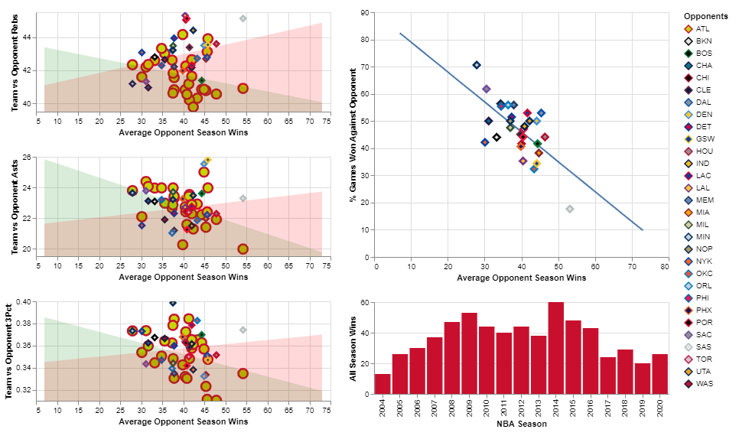
New Dataset
NBA Games Dataset
25,000+ rows of data (2004 - today)
Preseason, regular season, and finals
Home & away team stats
FG%, FT%, 3PT%, etc.
NBA games data | Kaggle
Used this dataset Visualization Dashboard
CS 725/825, Spr21 - Visualization Project
In this program, user is prompted for team and location

Slide 5

The Objective
Produce a multi-task learning model
Predict (3 models):
“Season” of the game
“Part” of the season
Points difference (- = lost, + = won)
Using:
The stats: Pts, FG %, FT %, 3PT %, Asts, Rebs

Slide 6
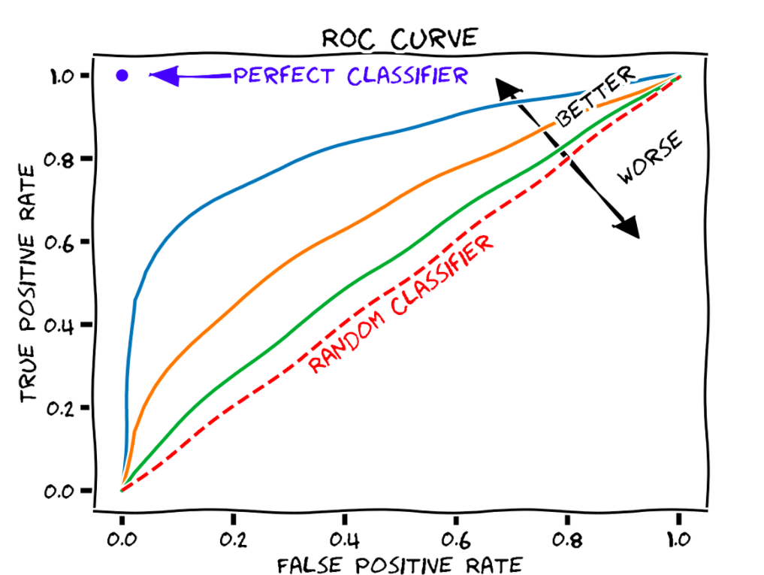
The Program
Programmed in Python (Idle)
Pandas for data structuring
Numpy for matrix manipulation
Matmul, transpose, asmatrix, etc.
Matplotlib.pyplot (plt) for visualization
Math module for exp, log, and isnan
Train/Test split was 75/25
Optimized weights with gradient descent function
Created ROC curve for classification model validation

Slide 7
Gradient Descent & Program Mechanics
Split the data into the proper model target space
Save the target and feature data into Numpy matrices
Prompt the user for:
Initial model weights
Feature data and (multiple) target data
2 weight alpha step sizes (for regression and for classification)
Initial multi-task sigmas
Sigma alpha step size
Execute gradient descent algorithm
Both per individual model and altogether
Validate using test data
ROC Curve

Slide 8
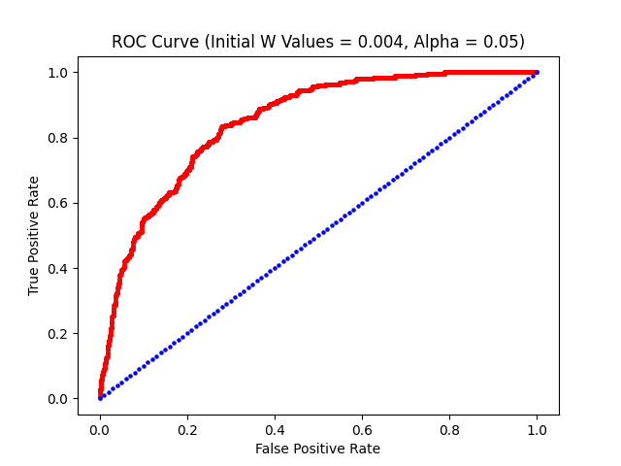
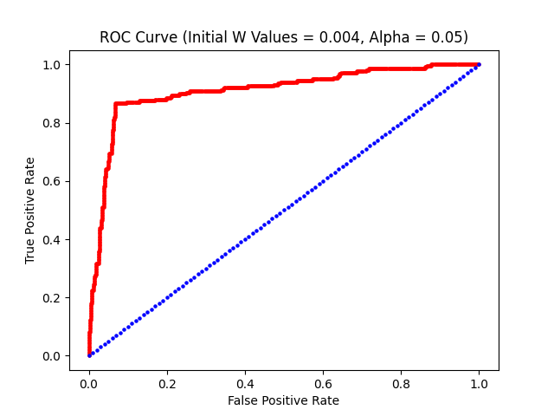
ROC Curves & Loss
MSE for Pts Diff: ~16.96 (WAS, Away, w₀ = .004, α_{w} = .005, σ₀ = .08, α_{σ} = .0002)
ROC Curves:
Game Season Season Part

Slide 9
Results & Conclusion
Did I implement the algorithm properly?
I optimized the task weights and sigmas after each row
Is this correct? What effect does it have on the models?
The model did well in predictions
Decent in predicting points difference and season phase
However, it didn’t do as well in predicting which season
For the future
Add a more variable step size implementation?
Revisit the Multi-Task Learning algorithm and improve my results?
Add some prior knowledge? More data?

