Slide 1
Analysis of NLP Feature Correlation in Economic Tweets
George Marché
CS 795 - Natural Language Processing

Slide 2
Tweet/Social Media Analysis
Today, we’ve seen massive developments in NLP
However, NLP of informal text (e.g., social media posts) is difficult
Emojis, over-capitalization, varying accuracy in punctuation
Analysis of economic posts on social media
What NLP features are more common when an economic system is mentioned?
Word size? Parts of speech? Number of emojis, punctuation, etc.?
Positive versus negative views?
Public opinion of each economic system
We can find correlation normalized for economic opinion
More emojis = less punctuation?
Positive/negative post deviation

Slide 3

The Data
3,441 Tweets (and rising)
Collected by scraping Twitter using the TwitterSearch Python library
Difficult to collect data - Twitter limits number of Tweets each 15 minutes
Scraping process is still in progress
Search for Tweets that contain one of fifteen various terms for economic systems
Ex: ‘communism’, ‘conservative’, ‘liberal’, ‘fascist’, etc.
No Re-Tweets, English text only, URLs removed
Initial cleaning
Remove mentions (“@...”)
Remove hashtags (but keep record of them)
For word count, filter separate instance of ‘split’ Tweet

Slide 4
Data Parsing & Cleaning
Counts
Punctuation: . , ! ? - : ; ( ) \ ‘
Emojis: “if char in emoji.UNICODE_EMOJI[“en”]:”
Hashtags, capital letters, percents, numbers
Word size
Column for each word size (E.g. “Together” = 8-letter word)
Part of speech
nltk.pos_tag(tokens)
Polarity (Sentiment Analysis)
from nltk.sentiment.vader import SentimentIntensityAnalyzer
Positive, neutral, or negative? Compound sentiment value (-1 to 1)?

Slide 5
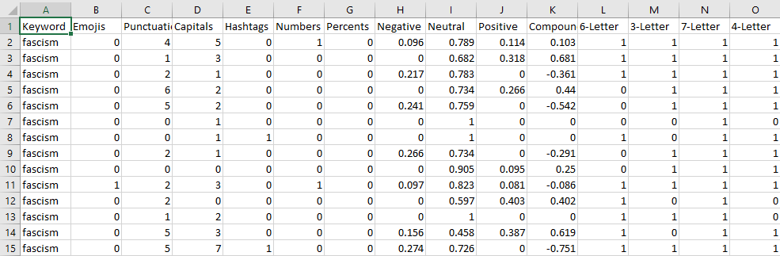
The Datasets
Raw Tweet Dataset:
Contains each Tweet with initial cleaning and the economic term contained
Polarity Dataset:
How positive, neutral, or negative were Tweets for each term?
Word Dataset:
Count of each word grouped by Tweets for each term
Tweet Feature Dataset:
Count of words by size
Count of each part of speech
Polarity
Punctuation, emojis, etc.

Slide 6
Implementation
Python
NLTK for NLP methods
Saved datasets as CSVs
Pyplot and Seaborn for visualizations
Numpy for data manipulation
File Setup
3 Python files, 4 CSVs of data
Folder (“DataVis”) to store 16 visualizations

Slide 7
Notable Results
Words
‘characteristics’: 5 times in Tweets on centrism, 6 times in Tweets on capitalism
‘hahahahaha’: 3 times in Tweets on socialism and communism
Current observation: too little Tweet data for individual word count
Non-word quantitative analysis
Tweets with ‘liberal’ and ‘communist’ had highest avg # of punctuations (2.61 & 2.25)
Tweets with ‘socialism’ had lowest (1.59)
Tweets with ‘liberal’ and ‘fascist’ had highest avg # of capital letters (2.32 & 2.4)
Tweets with ‘socialism’ and ‘anarchism’ had lowest (1.57 & 1.41)
Tweets with ‘liberal’ and ‘conservative’ had the most adjectives on avg (1.63 & 2.02)
Tweets with ‘capitalism’, ‘capitalist’, ‘communism’, and ‘socialism’ had the most singular nouns on avg (2.87, 2.85 ,2.94, & 2.9)

Slide 8
More Notable Results
(Word Size)
Word size and POS Correlation
Notable + correlation: 12-letter & adjectives (0.25), 10-letter & singular nouns (0.26), 8-letter & plural nouns (0.15), 5-letter & present participles (0.17)
Some high correlations aren’t interesting (‘I’ is a common 1-letter determiner)
- correlation: 12-letter & singular nouns (-0.07), 15-letter & personal pronouns (-0.06)
Word size and Tweet Details
Correlation between # of capital letters and 6-letter words (0.12)
correlation between # of hashtags and 16-letter words (0.14) (#blacklivesmatter?)
Negative correlation between number of emojis and 9-letter words

Slide 9

Even More Notable Results
(Sentiment Analysis)
Tweet Details - Unexpectedly Low Correlations
Negative: emojis (0.04), punctuations (0.035), hashtags (0.03)
Neutral: emojis (-0.04), capitals (-0.035), numbers (0.03)
Positive: capitals (0.028), hashtags (-0.03), percents (-0.025)
Parts of Speech
Negative: singular nouns (0.07)
Neutral: adjectives (-0.15), superlative adjectives (-0.1), interjections (-0.09)
Positive: adjectives (0.15), superlative adjectives (0.08), interjections (0.12)
Word Size
Negative: 9-letter (-0.06), 10-letter (0.06)
Neutral: 4-letter (-0.11), 6-letter (-0.08), 11-letter (-0.07)
Positive: 4-letter (0.09), 6-letter (0.08), 11-letter (0.09)

Slide 10
Sentiment Analysis by Economic Term
What was done
Group data by sentiment (+ or -), then by economic term
Which features are more associated with (+ or -) sentiment towards a term
Notable results
Negative:
libertarian & punctuation (1.14), fascism, fascist, anarchist & capitals (1,1, 1.12, 1.3)
fascist, conservative & determiners (0.72, 0.67), adjectives (0.66, 0.65)
fascism, communist, communism, capitalist & singular nouns (1.14, 1.22, 1.17, 1.34)
fascist & 4-letter (0.4), 7-letter (0.45), anarchist & 9-letter words (0.4)
Positive:
socialism & punctuation (1.16), centrist, socialism & capitals (1.06, 1.05)
conservative, socialist & adjectives (0.83, 0.85), socialism & singular nouns (1.4)
socialism & 2-letter (0.46), 3-letter (0.43), 4-letter (0.47), 9-letter (0.43)
socialist & 2-letter (0.4), 3-letter (0.45)
libertarian & 11-letter(0.3), conservative & 12-letter (0.32)

Slide 11
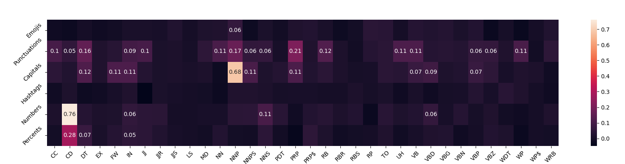
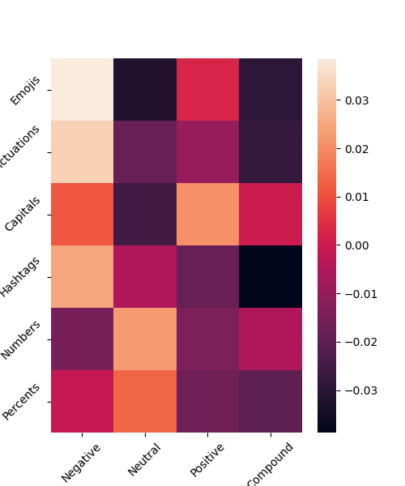
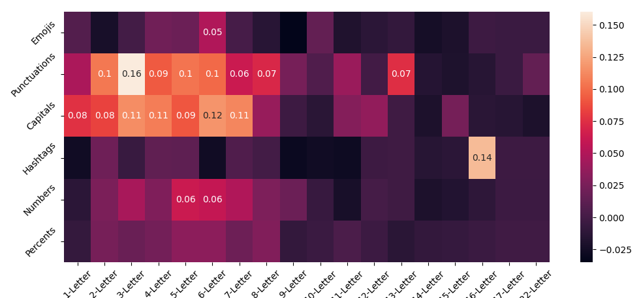
Correlation Visualizations

Slide 12
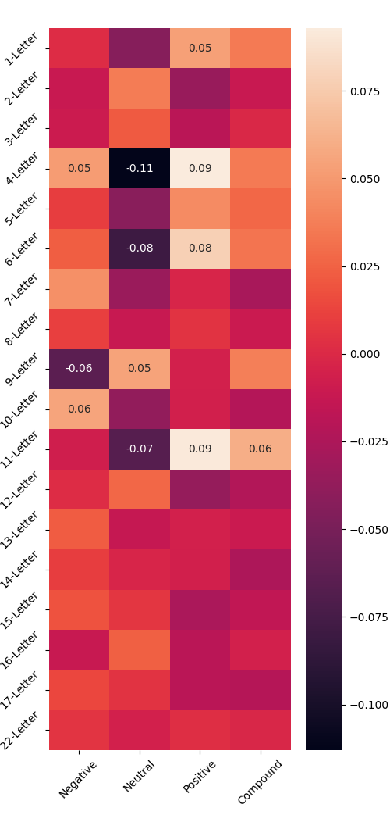
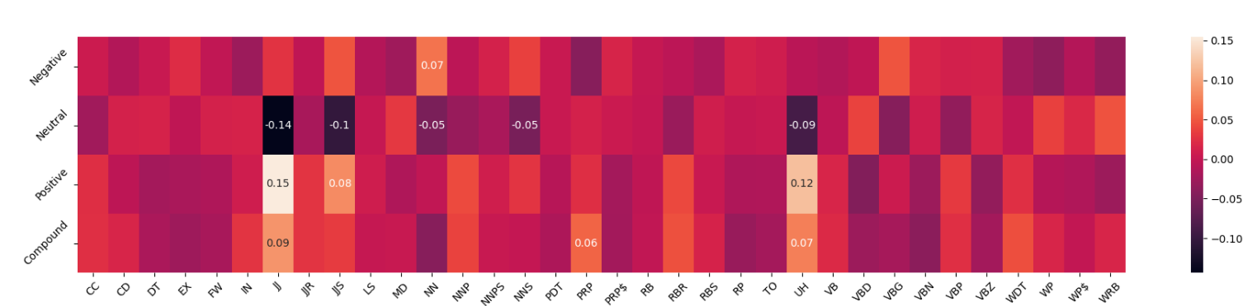
Correlation Visualizations

Slide 13
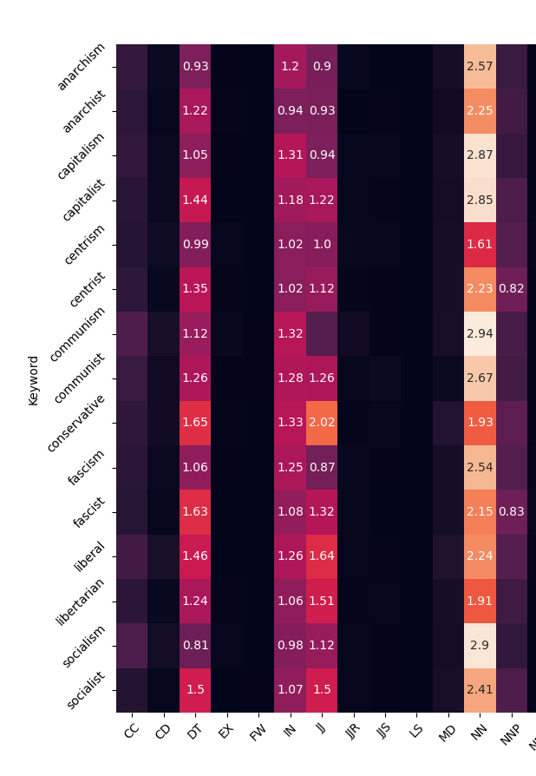
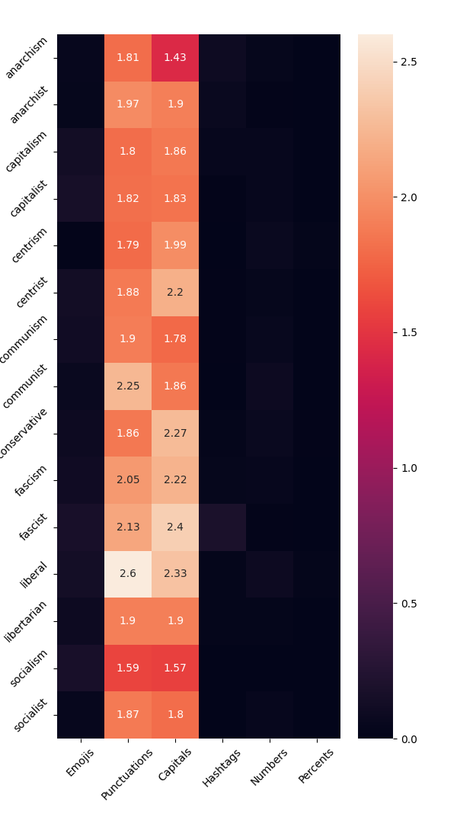
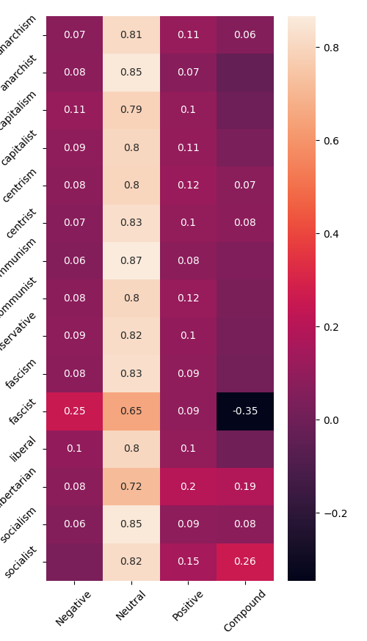
Average By Term Visualizations

Slide 14
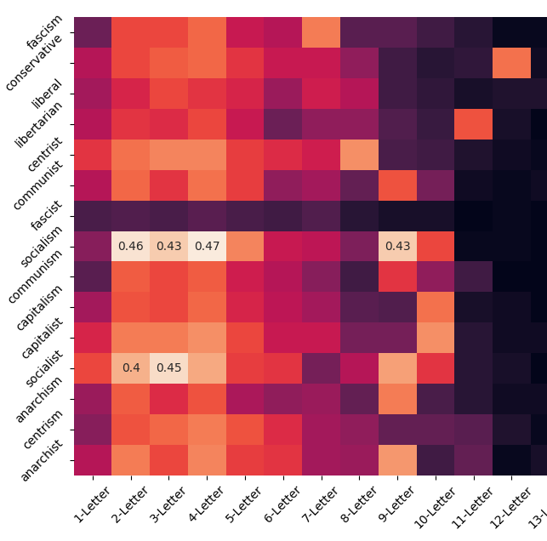
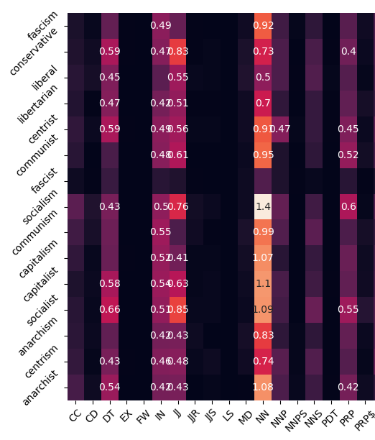
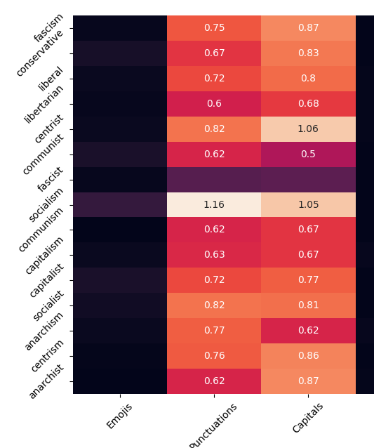
Sentimental Impact Visualization
(Positive)

Slide 15
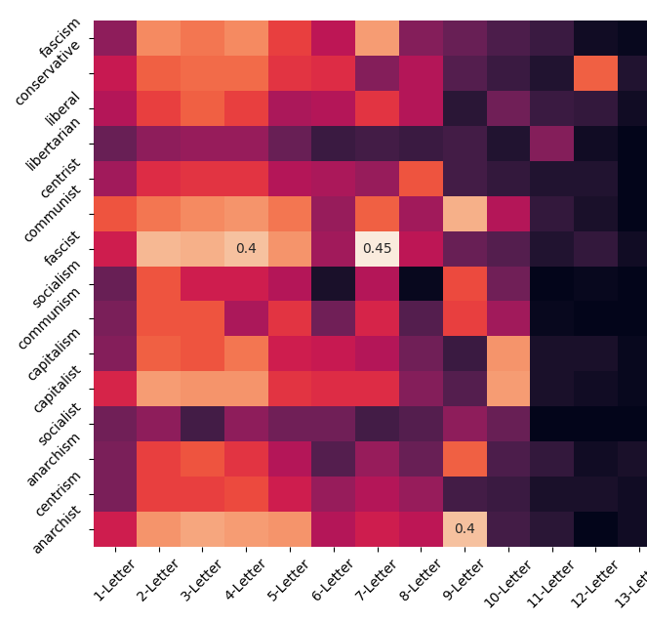
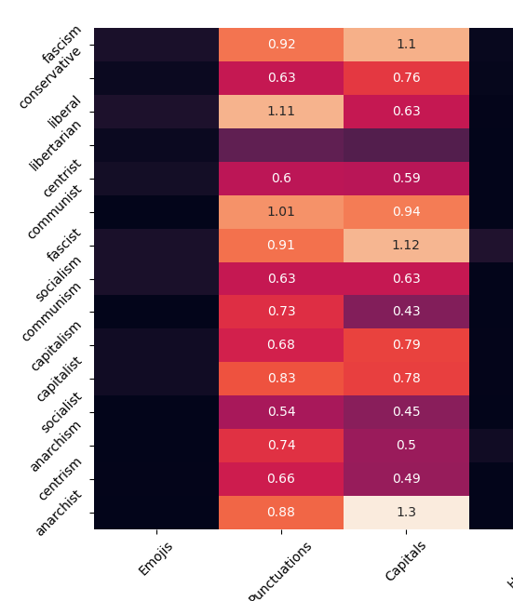
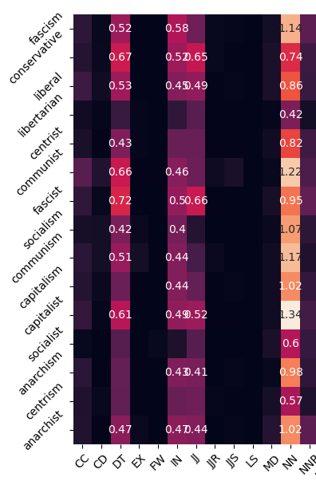
Sentimental Impact Visualization
(Negative)

Slide 16
Conclusion (so far)
Adjectives and interjections appear in positive, not negative tweets
Terms for economic systems (‘capitalism’, ‘socialism’, ‘communism’, etc.) tend to have more adjectives and singular nouns
Similarities between ‘socialism’ & ‘communism’ values (incorrectly used as synonyms?)
Smaller words are used more often for tweets with ‘socialism’
Sentiment for each term
Only solid negative compound is ‘fascist’ at -0.35 (thankfully)
Positive compound for ‘libertarian’ (0.19), ‘socialist’ (0.26), and ‘socialism’ (0.08)
Can we claim that libertarianism and socialism are gaining popularity?
Ultimately too little data and results are far from conclusive
More words, clearer correlations, etc.
Possibly find other relations? Build a model? Apply an algorithm?

Slide 17
Questions?

