Slide 1
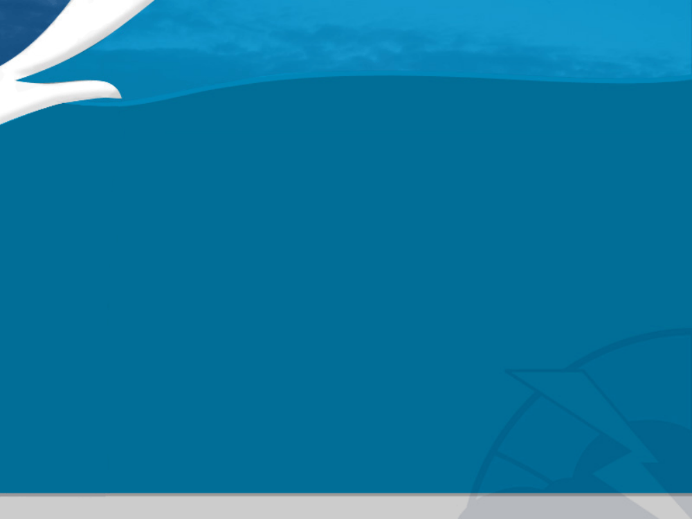
VTEC Primer
Your Guide to Interpreting VTEC
Notes:
Hi, I’m Art Kraus, a Dissemination Services Meteorologist with the Office of Climate, Water and Weather Services at Weather Service Headquarters. Over the next half hour, this session will familiarize you with the Valid Time Event Code, or VTEC, which will soon be introduced in many event-driven National Weather Service (NWS) products.

Slide 2
Outline
Why VTEC?
Impact on Operations
What Products?
The Code
Reading VTEC in a product
Notes:
This training will cover
- the reasons behind VTEC,
- its impact on NWS forecast operations,
- the suite of VTEC products at Initial Implementation,
- the makeup of the P-VTEC code string, and
- how to read VTEC when it’s included in products.
For more in-depth information on VTEC rules, coding, and interpretation, you’re encouraged to review the VTEC directive NWSI 10-1703, which is available on the NWS Directives website (http://www.nws.noaa.gov/directives). References to specific sections of the VTEC directive are included in these notes.

Slide 3
Why VTEC?
Customers needed an easy-to-decode, uniform way to receive Watch/Warning/Advisory (W/W/A) information
Allows start to finish tracking of W/W/As
Allows for quicker dissemination of W/W/A information in conjunction with UGC header
Helps to standardize our products for both internal and external use (webpages, TV crawls)
Notes:
VTEC has been in the works for several years, to provide our Customers with a standard method to receive Watch/Warning/Advisory (or W/W/A) information from NWS products.
VTEC will allow customers to track specific W/W/As from start to finish, by using an Event Tracking Number (or ETN).
VTEC works together with the Universal Geographic Code (UGC). UGC tells where the product or product segment is valid, while VTEC indicates the specific event type included in the segment, the action occurring with this issuance, and when the event begins and ends.

Slide 4
Impact on Operations
VTEC is generated automatically by NWS software
Mandates use of VTEC-generating software
  WarnGen for Feb. 8 products
Necessitates a strict adherence to NWS policy
  Mandatory ways to correct inadvertent mistakes
  Headline standardization
    Especially critical with delay to long-fused products
Notes:
VTEC by itself shouldn’t make extra work for NWS forecast staff. The code is generated automatically by the baseline NWS software applications - WarnGen for short duration convective warnings and followup statements and Watch, Warning, Advisory (WWA) application for all other event driven products included at VTEC initial implementation (a k a VTEC operational turnkey).
However, because of event tracking included in VTEC, new headline standardization, and office backup requirements, all of which necessitate a strict adherence to NWS policy, offices will be required to use these baseline software applications to prepare all event-driven products that contain VTEC. So, if you aren’t familiar with the WarnGen and WWA programs, you will need to become familiar with them.

Slide 5
Initial VTEC Products
Initial Implementation on February 8, 2005
All non-hydrologic convective warnings and follow-up statements
  Tornado Warnings (TOR)
  Severe Thunderstorm Warnings (SVR)
  Special Marine Warnings (SMW)
  Severe Weather Statements (SVS)
  Marine Weather Statements (MWS)
    Only as SMW follow-up
SPC Products
  Watch Outline Update (WOU)
    Only initial and final issuances
Notes:
This slide lists the Weather Forecast Office (WFO) products which will contain VTEC.
- all WFO non-hydro convective watch, warning, and followup products, including the new Watch County Notification (WCN) product,
- all Winter Storm Watches, Warnings, and Advisories (WSWs),
- all Non-Precipitation Watches, Warnings, and Advisories (NPWs),
- all Coastal and Lakeshore flood products and High Surf Advisories (CFWs),
- all Fire Weather Watches and Red Flag Warnings (RFWs).
In addition, the Watch Outline Update (WOU) product issued by the Storm Prediction Center includes VTEC.
Hydrology products such as the FFW and FFS along with River flood warnings will add VTEC later in 2005. Also expected to include VTEC in the next year or two will be other products such as Routine Marine forecasts and a new Tropical Cyclone Product from TPC.

Slide 6
Eventual VTEC Products
Watch County Notification (WCN)
Intermediate Watch Outline Updates (WOU)
All winter weather watches, warnings and advisories (WSW)
All non-precip watches, warnings and advisories (NPW)
Coastal and Lakeshore Flood watches, warnings and statements and High Surf advisories (CFW)
Fire weather watches and Red flag warnings (RFW)
All Hydrologic Products
  FFW, FFS, FFA, FLW, FLS
Routine Marine Products (CWF, NSH, GLF, OFF)
NCEP Tropical Hazard Products

Slide 7
Definition of a VTEC Event
An event is a specific combination of phenomenon (e.g., Heavy Snow, Tornado, Wind) and level of significance (e.g., Watch, Warning, or Advisory).
Common examples of events include:
Phenomenon Level of Significance
Heavy Snow Warning HS W
Winter Storm Warning WS W
Tornado Watch TO A
Wind Advisory WI Y
Each event given an Event Tracking Number (ETN), a four-digit number which stays with the event through its lifetime - from first issuance until upgrade, downgrade, cancellation or expiration.
Notes:
Let’s spend a minute talking about VTEC events.
An event in VTEC is defined as a specific combination of phenomenon and level of significance.
The phenomenon code identifies the specific type of weather or non-weather occurrence. This includes different types of precipitation and flooding, and marine or fire weather phenomena, and even such things as heat, cold, or volcano. There were 53 different phenomena codes defined in the first issuance of the VTEC directive (See NWSI 10-1703 Appendix A), and a few more may be added before the February 2005 Operational Turnkey.
The significance code identifies the level of importance of the weather or non-weather occurrence. There are seven possible significance levels defined in the VTEC directive (See NWSI 10-1703 Appendix A), but currently, only four are used: Warning, Watch, Advisory, and Statement. The Statement significance level currently is used only in a few informational Coastal and Marine products.
Normally, when a follow-up statement is issued to update, cancel, or announce expiration of a previously issued event, the event phenomenon and significance codes used in the follow-up will be the same as what was used in the original product, even if the product was issued under a different communications identifier. For example, the initial issuance of a Tornado Warning in a TOR product will have a TO phenomenon code and a W significance level. If the TOR is followed up with an Severe Weather Statement in an SVS product, the same TO phenomenon code and W significance level is used.
A complete list of valid VTEC events, as well as a complete list of VTEC events to be included in the February 2005 Operational Turnkey, will be produced in the coming weeks. Both lists will be posted on the NWS Headquarters VTEC web page (http://weather.gov/os/vtec).
Each VTEC event is given an Event Tracking Number, or ETN. The ETN allows our Partners and Customers to follow an event through its lifetime. The four-digit ETN stays with the event from its first issuance until it is cancelled, expired, or in some cases downgraded (as from a warning to an advisory) or upgraded (as from a watch to a warning).
Upgrades are valid only where watches are replaced by warnings, and downgrades aren’t valid for such things as severe weather. By their nature, convective and hydrologic watches are not upgradeable to warnings, since these watches can remain in effect as the corresponding convective and hydrologic warnings are issued.

Slide 8
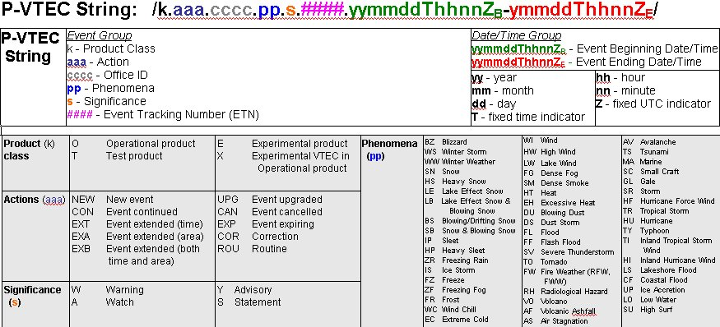
VTEC Explained
Notes:
There are two types of VTEC, the P- (Primary) VTEC, and an H- (Hydrologic) VTEC.
We will look at the P-VTEC string, which is included every time that VTEC is used. The H-VTEC, which is included in Flood and Flash Flood products only, will be operationally implemented later in 2005. Since there may be changes made to the H-VTEC format in the coming months, it will be left for a later training session.
The P-VTEC string is made up of a number of different codes, which can be lumped into two groups. The event group gives the parameters of the VTEC event, along with the action being performed with this product issuance. The date/time group gives the beginning and ending times of the event, that is, when the actual phenomenon is expected to begin and end. (See NWSI 10-1703 Section 2)
Starting from left to right:
After the initial forward slash, the first code is the k-code, or product class. (See NWSI 10-1703 Section 2.2.1) This single character tells whether the product is test, experimental, or operational, and, if it is operational, whether the VTEC code included is operational or experimental.
There are four different letters used.
The ‘T’ code (for test) is used for operational products issued for non-real events, for example - Test Severe Thunderstorm Warnings issued during a Severe Weather Awareness Week.
The ‘E’ code (for experimental) is used in new non-operational products which are being evaluated.
The ‘X’ code (for experimental VTEC) was used in the VTEC Operational Test and Evaluation (also called the OT&E) from late August through early October 2004, in otherwise operational products where just the VTEC code is being tested.
And finally, the ‘O’ code (for operational) implies operational VTEC in an operational product. The ‘O’ code will be used after official implementation of VTEC in 2005.
The second code is the Action code. (See NWSI 10-1703, Section 2.2.2) This three character code describes the action being taken with this product issuance. The first time any VTEC event is included, it starts as a NEW. The other action codes are used in followup products, except for the last one in the list, ROU (for routine).
A few words about each of the Action Codes: (I’ll run through a product example of most of these a bit later)
NEW (NEW) is used for an initial issuance of an event. It is also used for an event that has replaced another event for the same area, as when an event is upgraded or downgraded (see the UPG and CAN action terms below). Whenever the NEW action code is used, the ETN increments from the last one used for that particular event.
CON (CONTINUED) is used when providing updates to an existing event, where no changes were made to the area, valid time period, or Significance category.
EXT (EXTENDED IN TIME) is used when the valid time period of an existing event has been made longer or shorter by changing either or both the Event Beginning or Event Ending Date/Time Group, with no changes to the area or Significance category. EXT is not used in short duration warning products (Severe Thunderstorm Warning [SVR], Tornado Warning [TOR], and Special Marine Warning [SMW]). Instead, a new warning is issued with the NEW action code and a new ETN.
EXA (EXTENDED IN AREA) is used when the valid area of an existing event has been expanded from its previous issuance, with no changes made to the valid time period or significance category. EXA is not used in short duration warning products. Instead, a new warning is issued as with the EXT.
EXB (EXTENDED IN BOTH AREA AND TIME) is used when the valid time period of an existing event has been changed (made longer or shorter) and the valid area has been expanded, while no changes were made to the Significance category. EXB is not used in short duration warning products. Instead, as with EXT and EXA, a new warning is issued.
UPG (UPGRADED) is used when an existing event is upgraded for the same UGC to a higher significance level (with either the same phenomena or an environmentally related phenomena), for example, from a watch to an advisory or warning, or from an advisory to a warning. Two P-VTEC strings are used: The UPG is used in the first P-VTEC string to show the event being upgraded from (for instance, an advisory) and the NEW is used in the second P-VTEC string to show the event upgraded to (a warning).
CAN (CANCELED) is used in one of three ways: (1) the primary usage is to cancel a still-active event immediately upon issuance of the CAN, using a single P-VTEC string with the CAN action code; (2) after an event has been canceled (before its scheduled expiration time), a final or follow-up statement may be issued referring back to the canceled event, using a single P-VTEC string with the CAN action code, and finally (3) for non-convective and non-hydrologic events, CAN is also used to identify when an event has been downgraded to a lower significance level (for instance, from a warning to an advisory), or (for non-marine products) replaced by another event at the same significance level (for example, from an ice storm warning to a winter storm warning). In this case, two P-VTEC strings are used, the CAN is used in the first P-VTEC string to show the event being downgraded from (for instance, a warning) and NEW is used in the second P-VTEC string to show the event downgraded to ( an advisory). In all cases, the event ending date/time in the P-VTEC string with the CAN action code remains the same as in the previous product issuance of that event.
EXP (EXPIRED) is primarily used in a concluding message, while the event is still active, to notify users that an event will be allowed to expire at the scheduled event ending time, It can also be used just after event expiration, to pass along final wrap-up information about the event.
COR (CORRECTION) is used when correcting any non-VTEC or non-UGC error or omission in the previous product, that is, for a typographical or grammatical error or omission which is not related to the VTEC or UGC coded elements.
ROU (ROUTINE) will not be used in the initial VTEC product suite. It is designed for use in Routine Marine forecasts when no watch, warning, or advisory is in effect.
The third code is the four-character office ID. (See NWSI 10-1703, Section 2.2.3)
The fourth code is the Phenomenon code. (See NWSI 10-1703, Section 2.2.4) This two character group describes the specific meteorological or hydrologic phenomenon included in the product or product segment. As you can see, there is a large list of phenomena codes, and as needs arise additional ones will be added to the list.
The fifth code is the Significance code. (See NWSI 10-1703, Section 2.2.5) This single character, when combined with the phenomenon code, describes a specific VTEC event. For example, a Winter Storm Watch would have a Phenomenon code of WS and a Significance code of A, while a Winter Storm Warning would have a Phenomenon code of WS and a Significance code of W.
The sixth code is the Event Tracking Number or ETN. (See NWSI 10-1703, Section 2.2.6) For each specific VTEC event issued by a WFO, this four digit number is assigned in sequence, for example, there is one set of ETNs at each WFO for Winter Storm Watches, and another set at each WFO for Dense Fog Advisories. A specific ETN stays with a particular event from beginning to end, and makes it easier for our customers to keep track of each event. All ETNs are reset back to 0001 at 00Z on January 1st each year, including those ETNs for winter weather.
The ETN does not always reflect a count of the number of each event that has occurred so far in the year at a WFO. It may be true for non-segmented products like Severe Thunderstorm Warnings, although test warnings will be included in the same numbering list as operational warnings. But for some segmented products like Winter Storm Warnings, an office may issue multiple Warning segments for a given storm, with different beginning or ending times or for different accumulations. Each new segment would be given a different ETN. Likewise, in Flood Warnings for specific forecast points, each forecast point is considered a separate VTEC event, and even though they may appear in the same FLW product, each will be assigned a different ETN.
Since every office has its own unique ETNs for each VTEC event, events that span multiple WFOs (like large winter storms) will probably be represented by different ETNs from each affected WFO - even though they all issue the same phenomenon and significance codes.
The last two P-VTEC codes are the beginning and ending event times, separated by a dash. (See NWSI 10-1703, Section 2.2.7) The capital T and capital Z (without the subscript) appear in the two times, along with the year, month, date, hour, and minute. The times tell when the VTEC event is expected to begin and expected to end. For example, in a NEW Snow Advisory, they would give the times that the accumulating snow is expected to start falling and is expected to stop falling.
For most long-duration products, the VTEC event ending time will be different than the product purge or expiration time found in the UGC line. The UGC time tells when the product will expire, and when, if applicable, the next followup product can be expected. For most short-duration products, such as tornado warnings, the VTEC event ending time will be the same as the UGC product expiration time.
There are a few special coding rules which I’ll briefly mention:
- Once an event actually begins, the event beginning time is encoded as all zeroes in subsequent statements.
- If an ongoing event is cancelled before its scheduled event ending time, the event ending time is not changed to reflect that. The event ending time remains the same as it was in the previous product issuance.
- For events that are in effect “until further notice”, for example, flood warnings that are expected to continue beyond the run of the hydrologic model forecasts, or tropical watches and warnings which are open-ended, the event ending time will be encoded as all zeroes. For “until further notice” floods, once a specific ending time for the flood can be determined, that time will be encoded into the event ending time and the EXT action code will be used to reflect the change.

Slide 9
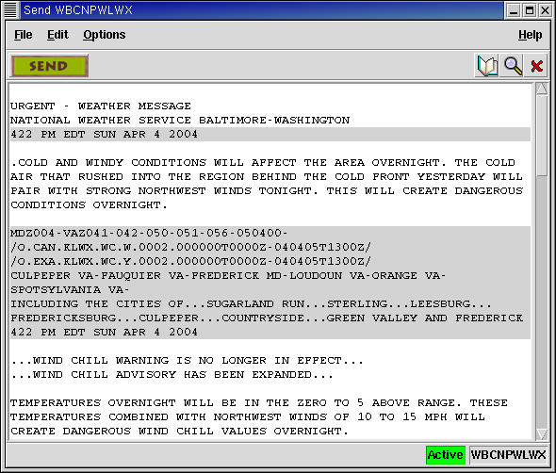
VTEC Examples
Notes:
Let’s look at some VTEC examples.
When included, VTEC will always appear immediately after the UGC. This slide shows VTEC in a segmented product. If this product has multiple segments, each segment will have its own VTEC string(s) immediately after the UGC line for the segment. In non-segmented products, the VTEC still appears right after the UGC, but both would be near the top of the product, before the Mass News Disseminator group.
Now let’s look at some examples of VTEC in products. Note that many of these examples will not be meteorologically realistic. However, they’re included to let you become more familiar with VTEC coding and its rules.

Slide 10
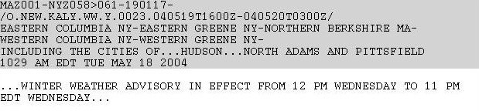
New Hazard
O – Operational VTEC
NEW – New hazard (first issuance)
KALY – Albany, NY WFO
WW – Winter Weather
Y – Advisory
0023 – 23rd Winter Weather Advisory issued this year
040519T1600Z – Hazard begins at 16Z on 5/19/04
040520T0300Z – Hazard ends at 03Z on 5/20/04
Notes:
Looking at the P-VTEC string:
This is the 23rd time in 2004 (#### = 0023) that a Winter Weather Advisory event (pp.s = WW.Y) has been issued by WFO Albany NY (cccc = KALY). This new event (aaa = NEW) is an operational VTEC code in an operational product (k = O). The winter weather is expected to begin at 1600Z on May 19th 2004 (yymmddThhnnZ_{B} = 040519T1600Z) and end at 0300Z on May 20th 2004 (yymmddThhnnZ_{E} = 040520T0300Z).
From the UGC line at the top, this advisory is valid for Northern Berkshire County in Massachusetts, and Columbia and Greene Counties in New York (MAZ001-NYZ058>061) and the product expires at 0117Z on the 19th (190117), which is well before the winter weather advisory is expected to begin.
If the NEW event was to begin immediately upon product issuance, its event beginning time would be encoded with the current (that is, product issuance) time. If the NEW event has already begun (that is, if you were a little late issuing the advisory), its event beginning time in the P-VTEC string will still be encoded with the current time.
The Headline shown is an example of the new standardized format which will begin appearing in W/W/A products.

Slide 11
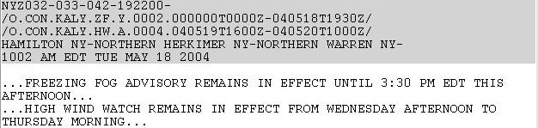
Continuing Hazard(s)
O – Operational VTEC
CON – Continued hazard (followup)
KALY – Albany, NY WFO
ZF – Freezing Fog HW – High Wind
Y – Advisory A - Watch
0002 – 2nd Fz. fog adv. 0004 – 4th High wind watch
000000T0000Z – Hazard already in effect
040518T1930Z - Hazard ends at 1930Z on 5/18/04
040519T1600Z – Hazard begins at 16Z on 5/19/04
040520T1000Z – Hazard ends at 10Z on 5/20/04
Notes:
This example shows 2 different VTEC events in a single product segment, both of which are follow-ups from a previous product. From the UGC at the top, both are valid for Hamilton, Northern Herkimer and Northern Warren Counties in New York (NYZ032-033-042) until 2200Z on the 19th (192200). Note that the 19th in the UGC is a typo – it should actually be the 18th. We didn’t catch it until after the slide was made and the show was put together. But that’s not important. What is important here is the VTEC.
Looking at the first P-VTEC string:
This is the 2nd time in 2004 (#### = 0002) that a Freezing Fog Advisory (pp.s = ZF.Y) has been issued by WFO Albany NY (cccc = KALY). This continued event (aaa = CON) is an operational VTEC code in an operational product (k = O). The freezing fog began sometime before this product was issued (yymmddThhnnZ_{B} = 000000T0000Z) and is forecast to end at 1930Z on May 18th 2004 (yymmddThhnnZ_{E} = 040518T1930Z).
Now look at the second P-VTEC string:
This is the 4nd time in 2004 (#### = 0004) that a High Wind Watch (pp.s = HW.A) has been issued by WFO Albany NY (cccc = KALY). This continued event (aaa = CON) is an operational VTEC code in an operational product (k = O), and the threat of damaging winds is forecast to begin at 1600Z on May 19th (yymmddThhnnZ_{B} = 040519T1600Z) and end at 1000Z on May 20th 2004 (yymmddThhnnZ_{E} = 040520T1000Z).
Again, note the standardized headlines.

Slide 12
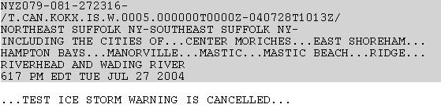
Cancelled/Cleared Hazard
T – Test product
CAN – Cancelled hazard
KOKX – Upton, NY WFO
IS – Ice Storm
W – Warning
0005 – 5th Ice Storm Warning issued this year
000000T0000Z – Hazard ongoing
040728T1013Z – Hazard originally ended at 1013Z on 7/28/04
Notes:
This example shows a Cancelled event, specifically a Test (k = T) Ice Storm Warning (pp.s = IS.W) issued by WFO Upton NY (cccc = KOKX). Since the event beginning time is all zeroes (yymmddThhnnZ_{B} = 000000T0000Z) the event has already begun. The Cancelled action code (sss = CAN) takes effect immediately upon issuance, even though the coded event ending time remains unchanged from the previous product issuance (yymmddThhnnZ_{E} = 040728T1013Z). If for some reason this warning was mistakenly cancelled (that is, it was intended to remain in effect), the warning would have to be reissued as NEW with a new ETN.

Slide 13
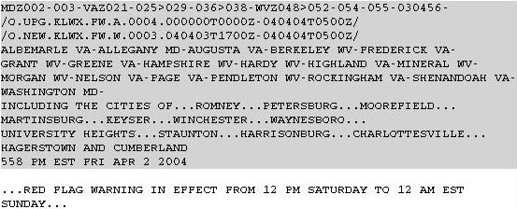
Upgraded Hazard
O – Operational VTEC
UPG – Upgraded hazard NEW – New Hazard
KALY – Albany, NY WFO
FW – Fire Weather/Red Flag
A – Watch W - Warning
0004 – 4th Fire Wx Watch 0003 – 3rd Red Flag Warning
000000T0000Z – Hazard already in effect
040404T0500Z – Hazard would have ended at 05Z on 4/4/04
040403T1700Z – Hazard begins at 17Z on 4/3/04
040404T0500Z – Hazard ends at 05Z on 4/4/04
Notes:
This slide shows an Upgraded event, specifically from a Fire Weather Watch (pp.s = FW.A) to a Red Flag Warning (pp.s = FW.W), issued by WFO Sterling VA (cccc = KLWX) for a number of counties in Maryland, Virginia, and West Virginia. This is the standard format for an upgraded VTEC event - there will always be two P-VTEC strings. The first P-VTEC string shows the event being upgraded (sss = UPG), while the second P-VTEC string shows the new upgraded event (sss = NEW).
Note that the UPG action code is not used for convective and hydrologic events, since those Watches and Warnings are issued in separate products with different product ID’s.
In this case, the Fire Weather Watch was already in effect (yymmddThhnnZ_{B} = 000000T0000Z), while the Red Flag Warning conditions are not expected to begin until 17Z on April 3rd (yymmddThhnnZ_{B} = 040403T1700Z). Both the upgraded watch and the warning have the same event ending time (yymmddThhnnZ_{E} = 040404T0500Z).

Slide 14
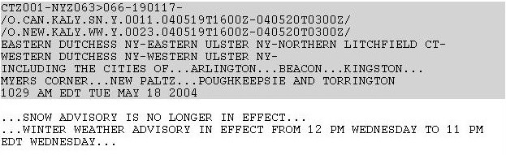
Downgraded/Replaced Hazard
O – Operational VTEC
CAN – Cancelled NEW – New hazard (1st issuance)
KALY – Albany, NY WFO
SN – Snow WW – Winter weather
Y – Advisory
0011 – 11th Snow Adv. 0023 – 23rd Winter Wx Adv.
040519T1600Z – Hazard begins at 16Z on 5/19/04
040520T0300Z – Hazard ends at 03Z on 5/20/04
Notes:
A downgraded or replaced VTEC event also contains two P-VTEC strings, the first showing the event being downgraded or replaced (in this case, a Snow Advisory [pp.s = SN.Y]) using the cancel action code (aaa = CAN) and the second showing the event it is being downgraded to or replaced by (in this case, a Winter Weather Advisory [pp.s = WW.Y] using the new action code (aaa = NEW).
Also note the ETNs. This is the 11th (#### = 0011) Snow Advisory of the year issued by Albany, and their 23rd (#### = 0023) Winter Weather Advisory of the year.
In this example, both the replaced event and the new event are still in the future. If the downgraded or replaced event had already begun, its event beginning time would have been encoded as all zeroes. Likewise, if the replacement (or new) event was to begin immediately upon product issuance, its event beginning time would be encoded with the current (that is, issuance) time.

Slide 15

Expiring Hazard
X – Experimental VTEC in an Operational product
EXP – Expiring hazard (last issuance of this hazard)
KLWX – Sterling, VA WFO
SV – Severe Thunderstorm
W – Warning
0056 – 56th Severe thunderstorm warning this year
000000T0000Z – Hazard ongoing
040727T1615Z – Hazard ends at 1615Z on 7/27/04
Notes:
This example shows an Operational Severe Thunderstorm Warning (pp.s = SV.W) which includes Experimental VTEC (k = X) issued by WFO Sterling VA (cccc = KLWX). Although the issuance date-time line is not shown, it is presumably shortly before the scheduled event ending time of 1615Z on July 27th 2004 (yymmddThhnnZ_{E} = 040727T1615Z), based on the wording in the headline and the use of the EXP action code.

Slide 16
Corrected Hazard
O – Operational VTEC
COR – Corrected hazard
KOKX – Upton, NY WFO
BZ – Blizzard
A – Watch
0010 – 10th Blizzard Watch issued this year
040713T2232Z – Hazard begins at 2232Z on 7/13/04
040714T2232Z – Hazard ends at 2232Z on 7/14/04
Notes:
As stated before, the VTEC Correction action code (aaa = COR) is used when correcting any non-VTEC or non-UGC error or omission in the previous product, that is, for a typographical or grammatical error or omission which is not related to the VTEC or UGC coded elements.
With the exception of short-duration warning products, corrections related to errors or omissions in VTEC or UGC coding will be made through the use of the appropriate P-VTEC action codes. For example, if a product is corrected to extend the valid time, the EXT action code would be used. In short duration warning products, the COR action code may be used in corrections involving format or dissemination code errors, or for counties (or marine zones) either omitted or erroneously added to a warning. This is done in order to clear communications systems of incorrect warning text. Follow-up statements may also be issued to formally cancel a warning for any erroneous counties, using the CAN action code.

Slide 17


Questions/Comments
Contact:
Art Kraus arthur.kraus@noaa.gov
or
Shannon White shannon.white@noaa.gov
Notes:
If you have questions or comments about this training, please contact either myself or Shannon White.
There are many VTEC nuances and rules which have not been covered here. However, for more information on VTEC, as well as an additional 75 or so VTEC product examples with explanations, check out the VTEC Directive, NWSI 10-1703, which is available on the NWS Directives website (http://www.nws.noaa.gov/directives).
You can also find the VTEC Directive and much more VTEC information on the NWS Headquarters VTEC website. (http://weather.gov/os/vtec).

