Slide 1
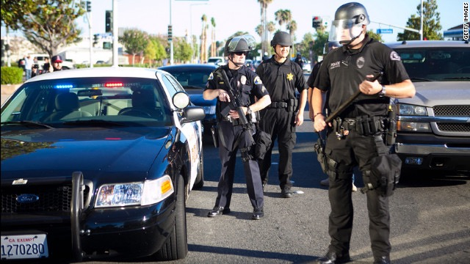
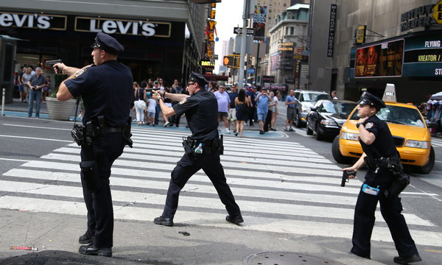
Datafying Police Violence in America
George McIntire
Metis Student and journalist

Slide 2
Issue & Background
1150 deaths per year in the US.
Since August 2014, the issue of police officer-involved deaths has come under a national spotlight.
Spurred a new push to use data to better understand and tackle issue
White House Police Data Initiative partners with local PDs to generate clean data on police activities.

Slide 3
Objective
The goal of this project is to identify relevant demographical factors and quantify their influence on the issue.
Use those traits to find probability of incident occurring on a zip code level and identify zip codes with the highest risk.

Slide 4
Data Preparation
Fatal Encounters data
Census data
Table of zip codes
Census data with demographic features
Census features and corresponding zip codes

Slide 5
Data Analysis
In the 19 months since Sept 1, 2014, there have been 2010 incidents and in the 19 months before that there were 2035 incidents.
Half of all incidents in the last three years have occurred in 11 counties.

Slide 6
Results
For every standard deviation increase in the value of white share, the odds of an incident halved. Most influential feature.
Cities | White | <HS | Income | Poverty | Unemployment | Probability
Wheatley Heights, New York | 17% | 11.7% | $73800 | 11.3% | 9.8% | 87%
Nottawa, Michigan | 89% | 56% | $19500 | 35% | 57% | 43%

Slide 7
Contact
@georgemcint
geo.mcintire@gmail.com
www.linkedin.com/in/georgemcintire
www.github.com/georgemcintire

