Slide 1

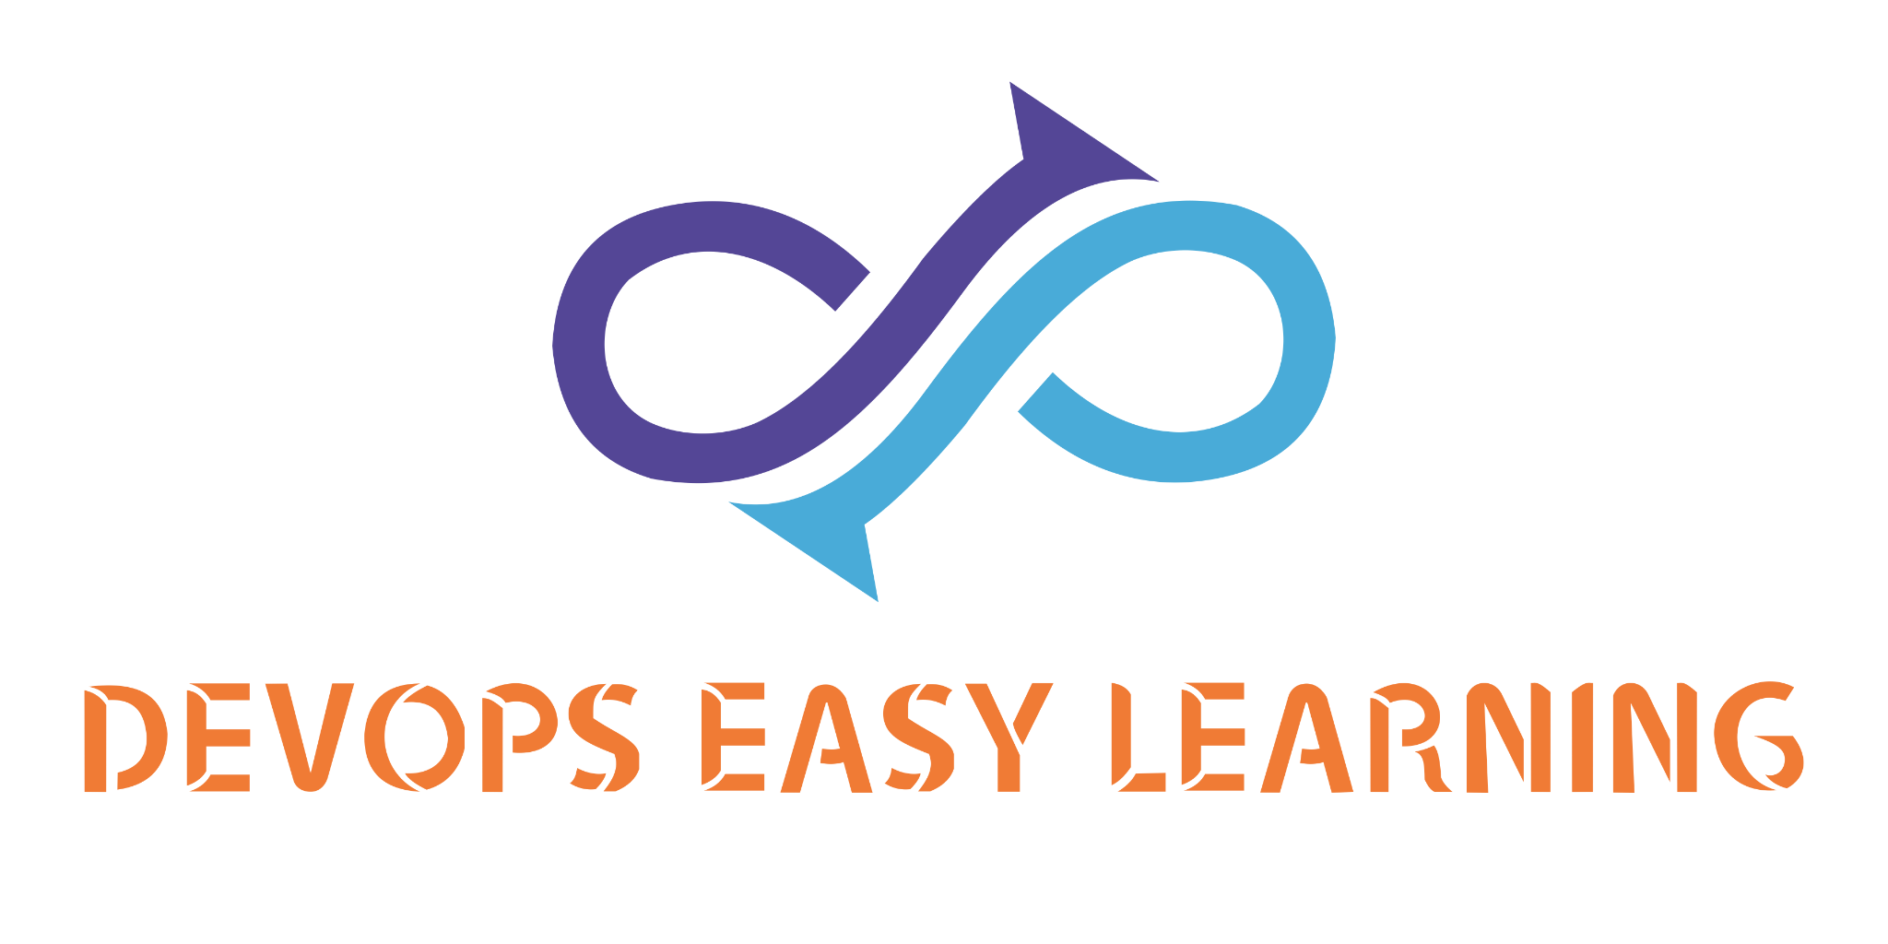
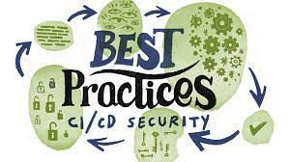
CI/CD
SECURITY
BEST
PRACTISES

Slide 2
INFO
ONE the big challenge DevOps engineer and companies face to is to make the application and infrastructure as secure as possible, and the best way to secure an application is to enable security from the beginning of the chain meaning from the time the application is being giving life.

Slide 3
INFO
Many enterprises step up from DevOps to DevSecOps by adding continuous security validation into their CI/CD pipelines. A shift-left model builds security into applications from the beginning to greatly reduce the chances that production releases contain exploitable flaws and vulnerabilities. This compares with a process flow in which security testing occurs at the end of the development lifecycle.
However, the CI/CD pipeline itself is a target of compromise and abuse. Its access to proprietary code, databases, credentials, secrets, and development and production environments make it a rich prize for hackers. To many DevOps-driven organizations, this is a growing concern. This is especially true in the wake of the SolarWinds attacks and the Codecov breach, which compromised the software supply chains for thousands of organizations.

Slide 4
INFO
DevOps is at a crossroads when it comes to securing containers and Kubernetes. You must meet security and compliance requirements before you can deploy new apps—but containers introduce new security challenges that existing DevOps tools and processes simply don’t address.
So, how can you secure what you cannot see and further, how can you get the scale and data depth you need to secure your DevOps workflows effectively?

Slide 5
INFO
CI/CD security means fortifying everything that flows through your software pipeline with securing elements -- but the pipeline itself can be a target. Lock it down with these CI/CD protective steps.

Slide 6

Security from code:
Integrated Development Environment (IDE)
Since the Development (DEV) is in charge of writing the entire application code the first CI/CD security layer start from them, from best practices the DEV team need to integrated in their IDE (vscode,NetBeans, Eclipse, IntelliJ) a tool such as Sonarlint which will scan and detect security hotspot on the code on their IDE before they commit the code to the repository (gitlab, github, bitbucket)

Slide 7

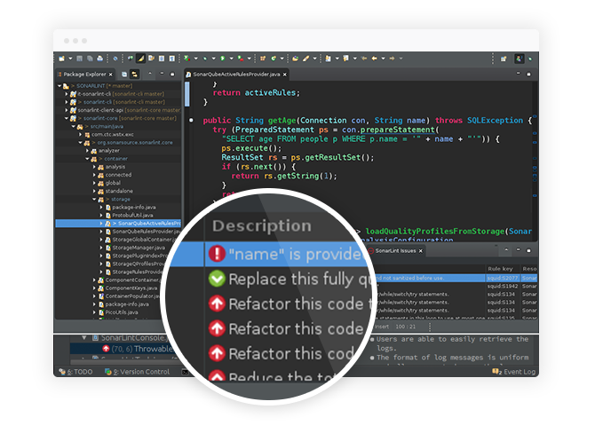
Security from code:
Integrated Development Environment (IDE)
Developer is typing code on vscode
Sonarlint scan the code as the developer type for security hotspot
Sonarlint detect an issue

Slide 8
Security from code:
Continuous Integration (CI)
The DevOps team should always make sure that the Development team write clean light and secure code, therefore by best practise the DevOps team should always do continue inspection on the Development code at each commit my mean of tool such as Gitlab and/or jenkins as continuous integration tool then SonarQube as Continue inspection tool.
Sonarqube need to be integrates and program with Gitlab and/or jenkins such ways that in case of security issue the build should be mark as fails and a report available or sonarqube UI

Slide 9


Security:Continuous Integration (CI)
Sonarqube UI
EKTECH sonarqube UI
or
Continue code inspection with Sonar scanner
Github
Jenkins
Gitlab
Gitlab
Bitbucket

Slide 10
Security from code:
Dockerfile
The DevOps team should always make sure they follow best security practises while write Dockerfile
Click here to learn more here

Slide 11
Security: Dockerfile
Make executables owned by root and not writable
It is a Dockerfile best practice for every executable in a container to be owned by the root user, even if it is executed by a non-root user and should not be world-writable.
This will block the executing user from modifying existing binaries or scripts, which could enable different attacks. By following this best practice, you’re effectively enforcing container immutability. Immutable containers do not update their code automatically at runtime and, in this way, you can prevent your running application from being accidentally or maliciously modified.
Always use trusted base images that are certified and secure
Avoid downloading package remotely using wget, curl or ADD instead download them in a secure server get them scan then use COPY to move them into the image
Don’t bind to a specific UID
Run the container as a non-root user, but don’t make that user UID a requirement.
Avoid using root as default user instead create a user and use USER to set him as default user
Make use of multistage building features to have reproducible builds inside containers.
A well crafted multistage build includes only the minimal required binaries and dependencies in the final image, and not build tools or intermediate files. This reduces the attack surface, decreasing vulnerabilities.
You should prefer verified and official images from trusted repositories and providers over images built by unknown users.
When using custom images, check for the image source and the Dockerfile, and build your own base image. There is no guarantee that an image published in a public registry is really built from the given Dockerfile. Neither is assurance that it is kept up to date.

Slide 12
Security: Dockerfile
Use base images that are frequently updated, and rebuild yours on top of them.
As new security vulnerabilities are discovered continuously, it is a general security best practice to stick to the latest security patches.
Every opened port in your container is an open door to your system. Expose only the ports that your application needs and avoid exposing ports like SSH (22).
Never put any secret or credentials in the Dockerfile instructions (environment variables, args, or hard coded into any command).

Slide 13
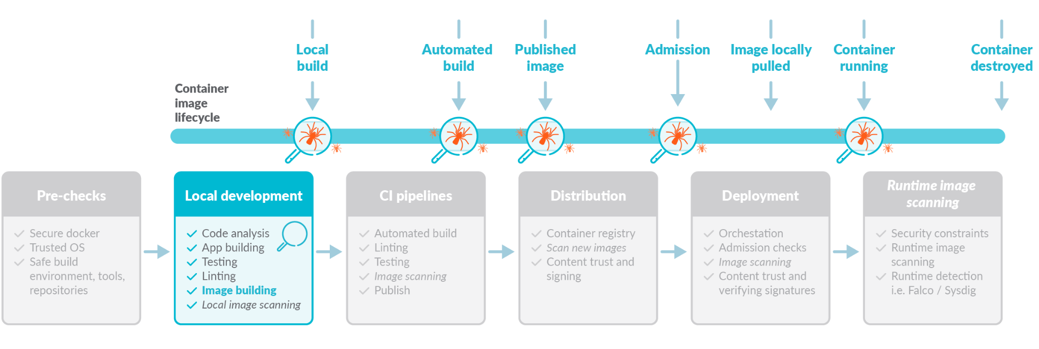
Security: Dockerfile

Slide 14
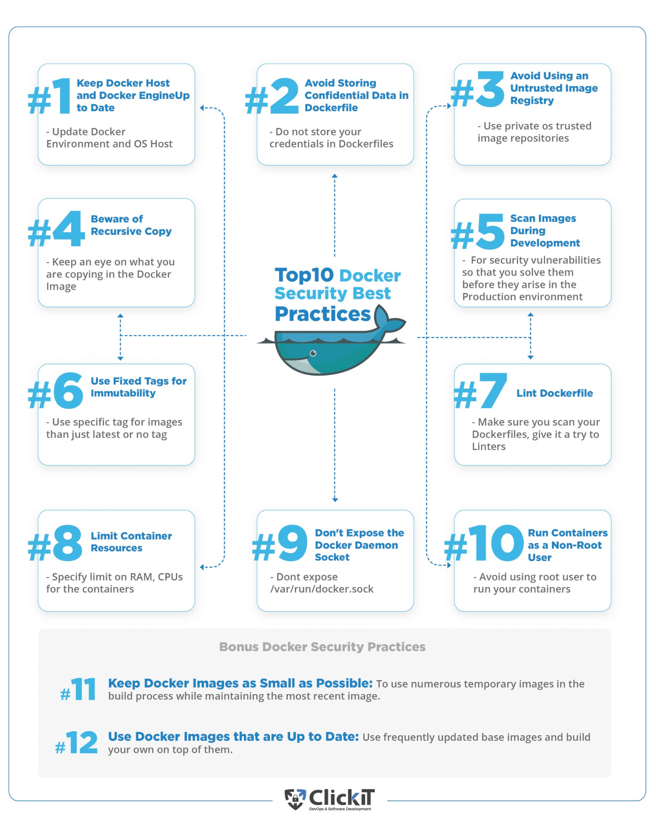
Security: Docker Image

Slide 15
Security: Docker Image
Keep Host and Docker Up to Date
It is essential to patch both Docker Engine and the underlying host operating system running Docker, to prevent a range of known vulnerabilities, many of which can result in container espaces.
Run Docker in Rootless Mode
Docker provides “rootless mode”, which lets you run Docker daemons and containers as non-root users. This is extremely important to mitigate vulnerabilities in daemons and container runtimes, which can grant root access of entire nodes and clusters to an attacker.
Do Not Expose the Docker Daemon Socket
The Docker daemon socket is a Unix network socket that facilitates communication with the Docker API. By default, this socket is owned by the root user. If anyone else obtains access to the socket, they will have permissions equivalent to root access to the host.

Slide 16
Security: Docker Image
Limit Container Resources
When a container is compromised, attackers may try to make use of the underlying host resources to perform malicious activity. Set Docker memory and CPU usage limits to minimize the impact of breaches for resource-intensive containers.
Avoid Privileged Containers
Docker provides a privileged mode, which lets a container run as root on the local machine. Running a container in privileged mode provides the capabilities of that host—including:
Root access to all devices
Ability to tamper with Linux security modules like AppArmor and SELinux
Ability to install a new instance of the Docker platform, using the host's kernel capabilities, and run Docker within Docker.
Privileged containers create a major security risk—enabling attackers to easily escalate privileges if the container is compromised. Therefore, it is not recommended to use privileged containers in a production environment. Best of all, never use them in any environment.
Segregate Container Networks
Docker containers require a network layer to communicate with the outside world through the network interfaces on the host. The default bridge network exists on all Docker hosts—if you do not specify a different network, new containers automatically connect to it.
Improve Container Isolation
Operations teams should create an optimized environment to run containers. Ideally, the operating system on a container host should protect the host kernel from container escapes, and prevent mutual influence between containers.

Slide 17
Security: Docker Image
Set Filesystem and Volumes to Read-only
A simple and effective security trick is to run containers with a read-only filesystem. This can prevent malicious activity such as deploying malware on the container or modifying configuration.
Improve Container Isolation
Operations teams should create an optimized environment to run containers. Ideally, the operating system on a container host should protect the host kernel from container escapes, and prevent mutual influence between containers.
Scan and Verify Container Images
Docker container images must be tested for vulnerabilities before use, especially if they were pulled from public repositories. Remember that a vulnerability in any component of your image will exist in all containers you create from it. If you use a base image to create new images, any vulnerability in the base image will extend to your new images.
Restrict System Calls from Within Containers
In a container, you can choose to allow or deny any system calls. Not all system calls are required to run a container.

Slide 18
Security: Docker Image
Don’t Leak Sensitive Info to Docker Images
Docker images often require sensitive data for their normal operations, such as credentials, tokens, SSH keys, TLS certificates, database names or connection strings. In other cases, applications running in a container may generate or store sensitive data. Sensitive information should never be hardcoded into the Dockerfile—it will be copied to Docker containers, and may be cached in intermediate container layers, even if you attempt to delete them.
Secure Container Registries
Container registries are highly convenient, letting you download container images at the click of a button, or automatically as part of development and testing workflows.
However, together with this convenience comes a security risk. There is no guarantee that the image you are pulling from the registry is trusted. It may unintentionally contain security vulnerabilities, or may have intentionally been replaced with an image compromised by attackers.
Use Fixed Tags for Immutability
Tags are commonly used to manage versions of Docker images. For example, a latest tag is used to indicate that this is the latest version of an image. However, because tags can be changed, it is possible for several images to have a latest tag, causing confusion and inconsistent behavior in automated builds.
Monitor Container Activity
Visibility and monitoring are critical to smooth operation and security of Docker containers. Containerized environments are dynamic, and close monitoring is required to understand what is running in your environment, identify anomalies and respond to them.

Slide 19
Security: Docker Image
Secure Containers at Runtime
At the center of the cloud native stack are workloads, always a prized asset for hackers. The ability to stop an attack in progress is of utmost importance but few organizations are effectively able to stop an attack or zero-day exploit as it happens, or before it happens.
Save Troubleshooting Data Separately from Containers
If your team needs to log into your containers using SSH for every maintenance operation, this creates a security risk. You should design a way to maintain containers without needing to directly access them.
Use Metadata Labels for Images
Container labeling is a common practice, applied to objects like images, deployments, Docker containers, volumes, and networks.

Slide 20

Security: Continuous Scanning on docker-image
By best practise DevOps engineers SHOULD always enable continuous vulnerability scanning on docker-images repositories on their docker-images registry (DockerHub, Nexus, Gitlab-registry etc…)
DockerHub use snyk as vulnerability scanning tools

Slide 21
Security: Continuous Scanning on docker-image
Container Image Scanning Best Practices & Examples
Running containers from publicly available images is convenient, but it’s a good idea to make sure you know what you’re getting.
Because containers created from images inherit all of an image’s characteristics including misconfigurations, malware, and security vulnerabilities, you need to analyze dependencies and packages defined in container images so that you shift security left. This means you can act before threats are deployed to your production pipeline.

Slide 22
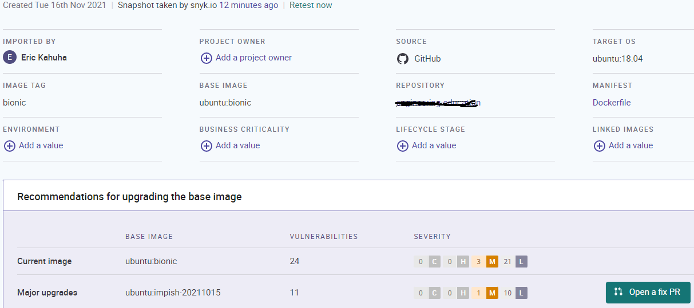
Security: Continuous Scanning on docker-image
The following is an example Snyk scan report showing three vulnerabilities with medium severity and twenty-one with low severity.

Slide 23
Security: Continuous Scanning on docker-image
Integrate/Automate Scanning Using a CI Pipeline
Developers often notice security vulnerabilities in their build when it’s too late. To avoid this, you need to embed scanning into your CI/CD pipeline to address the problem early and ensure a cleaner operating environment.
Scanning early and reporting a failed build directly in the pipeline will help you know why your build failed and how to rectify it.
Ideally, you should integrate security scans into every possible segment of your pipeline. You can automate the process by using a CI pipeline that will help you continuously analyze images that you build.
Use the CLI First to Scan Locally
Security scanning using the docker scan command is part of your Docker tooling. You can scan images by running the scan command using the image ID or name.
Scan Base Images
New container images are typically built off an existing base image. It takes a significant amount of time and resources to scan for vulnerabilities in base images without introducing new susceptibilities.
For this reason, you should focus on base images from third parties. The trustworthiness of the source of your base image and host is important. Look for images from open-source groups and known companies as well as those hosted on reputable registries. In addition, look for the availability of the source code and Dockerfile for all components.

Slide 24
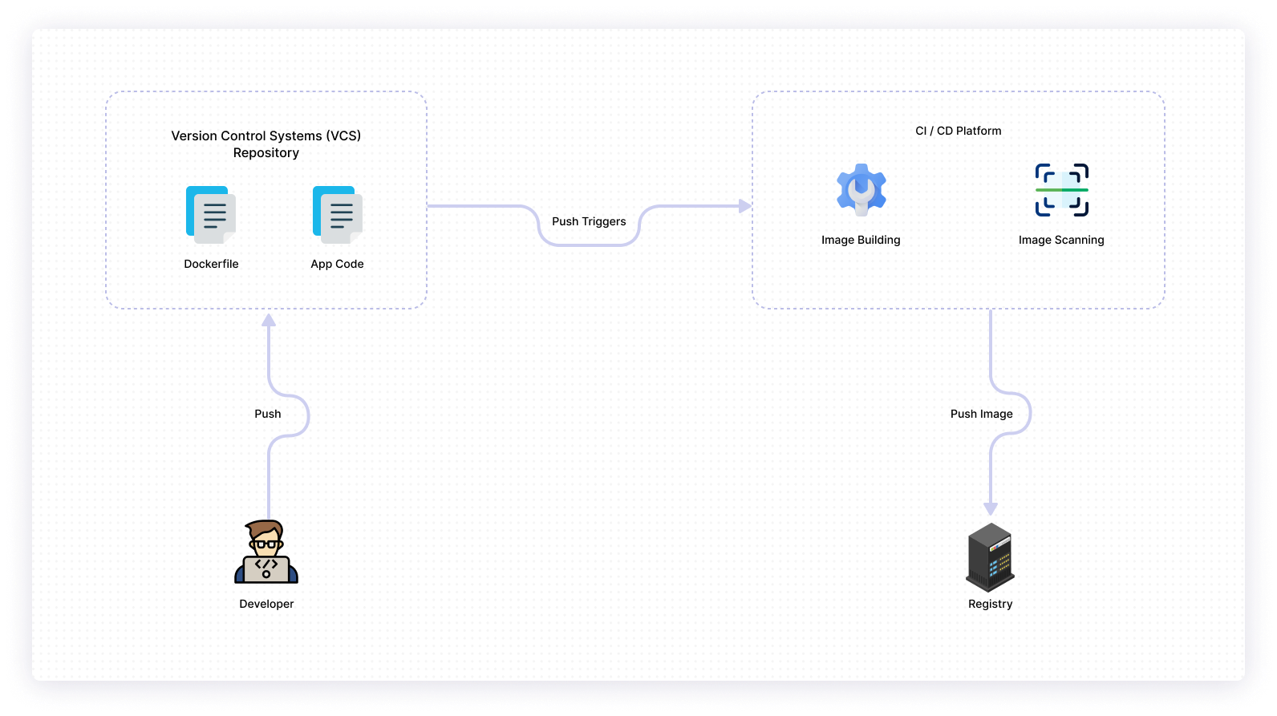
Security: Continuous Scanning on docker-image

Slide 25
Security: Continuous Scanning on docker-image
Choose the Right-Sized Base Image
You need to limit what you include in your runtime container to the essentials. Choosing the right size for your base image is your starting point.
Images that are smaller in size and share layers have fewer dependencies and a small attack surface. That is to say, the security surface is reduced, and you require a smaller footprint for your most relevant libraries and dependencies.
Use Docker Hub’s Native Scanning
If you’re already hosting images on Docker, you’ll be able to scan images on the specific repositories of your choice.
Scan for Secrets
Using a Docker image build is convenient, since it allows you to include essential items such as secrets, password, username, private key, etc., as text in files. However, you may forget to remove these secrets before deploying the image in a production system.
Scan for OS Vulnerabilities
A container image consists of a complete operating system, an application, and a runtime. Updated software may be incompatible with the operating system and OSs are updated frequently to prevent this incompatibility. If an image’s OS is breached, there is a high probability that the resulting application will also be breached.
Vulnerability scanning tools should always be used to review the state of your OS. If you identify any issues during the scan, fix them, and your deployment will be more secure.
Update Frequently
New image updates respond to pertinent security vulnerability disclosures. Older versions of images are susceptible to vulnerabilities and can ultimately make your container app more prone to malicious attacks. It’s vital to use specific tags when making updates.
Confirm That the Image Is Signed
Before using a container image, check that it comes from a trusted source. You can do this by confirming that the image is signed.
While image signing differs for each container platform, a digital signature is standard. As an image builder, you can use a private key to check for the image’s authenticity and verify that the image has not been tampered with.

Slide 26
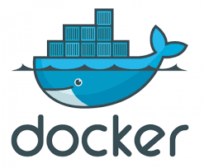
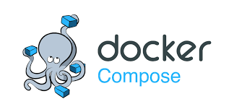
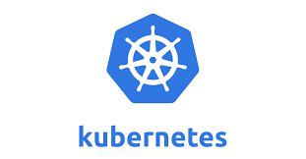
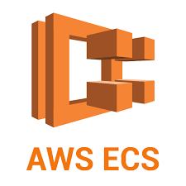
Security: Continuous Scanning on docker-image
or
Github
Jenkins
Deployment areas
Gitlab
Gitlab
Bitbucket

Slide 27
Security: General Practises
Map threats and secure connections
First, you must understand what potential security threats exist and which vulnerable points within the entire build and deployment process need additional protection. Conduct a threat modeling exercise to map threats to the pipeline.
Every connection to the CI/CD pipeline is a potential point of compromise. Regularly patch and scan all devices that connect to the pipeline, and block the devices if they fail to meet security policy requirements. All connections should be made over Transport Layer Security. Configurations for repositories and build servers should be locked down and any scripted builds scanned for vulnerabilities.
Tighten access control
Establish access control lists and rules to control all access to the CI/CD pipeline -- it should be easily and instantly clear who has access to what, when and how. Log, monitor and manage access to every component and resource of the pipeline, whether it's role-based, time-based or task-based. Conduct regular audits to ensure redundant machine or service accounts and ex-employees are closed or have permissions revoked. Require strong authentication for all users, and regularly rotate passwords. Machine identity and authentication are vital to secure nonhuman access in containers.

Slide 28
Security: General Practises
Separate duties and enforce permissions
Development environments tend to be permissive when it comes to implementing least privilege because permissions can slow down or interfere with testing. Nevertheless, it's important to establish enforceable permissions for everyone who accesses the pipeline to control who can commit code changes to the repositories, create containers and deploy code to different environments. Least privilege also applies to applications, systems and connected devices within the pipeline that require privileges or permissions to perform essential tasks.
Keep secrets safe
Secrets are authentication credentials, such as usernames and passwords, API tokens, SSH keys and encryption keys, that allow access to applications and services. They are literally the keys to a project's data and resources. If these credentials are improperly secured and used, they can open the doors to a serious data breach or intellectual property theft.
Control where you locate secrets and who has access to these credentials with a dedicated key management service. This encrypts, stores and injects secrets at runtime only when they are required. So, they are not exposed during the application's build or deployment, and they never appear in the actual source code.

Slide 29
Security: General Practises
Lock up your code repository
Businesses that self-host a Git-based code repository roll the dice against the high risk that a misconfiguration could create a vulnerability and expose the pipeline to attack -- Nissan's North America division recently learned this the hard way. However, even a hosted version control service must ensure secure access to the repository. Implement two-factor authentication and signed commits to prove the identity of the author, and preferably two people, to perform a commit. Define access roles on a per-repository basis to ensure only developers with valid access credentials can interact with individual repositories.
Stay informed and have a plan
You can compromise third-party resources and services in a pipeline at any time. IT teams must closely monitor the security feeds and notices of vendors whose products and services they use to immediately discover and act on any breaking news. Establish an incident response plan to handle such an event and help minimize any impact on the pipeline.
Diligently monitor and clean up
A continuous software delivery pipeline, by definition, is a flow of constantly moving parts and processes for builds and deployments, but don't let the cadence distract you from proper security maintenance chores. Always monitor the CI/CD environment as it runs, and terminate any temporary resources such as containers and VMs after you complete tasks. To reduce the attack surface of containers and VMs, remove any unnecessary tools and utilities -- netcat is one example -- and launch containers in read-only mode if possible.

Slide 30

Security: Password rotation

Slide 31
Security: Encryption

Slide 32
Security: Tools involved in the pipeline

Slide 33
Security: Permission and Access

