Slide 1
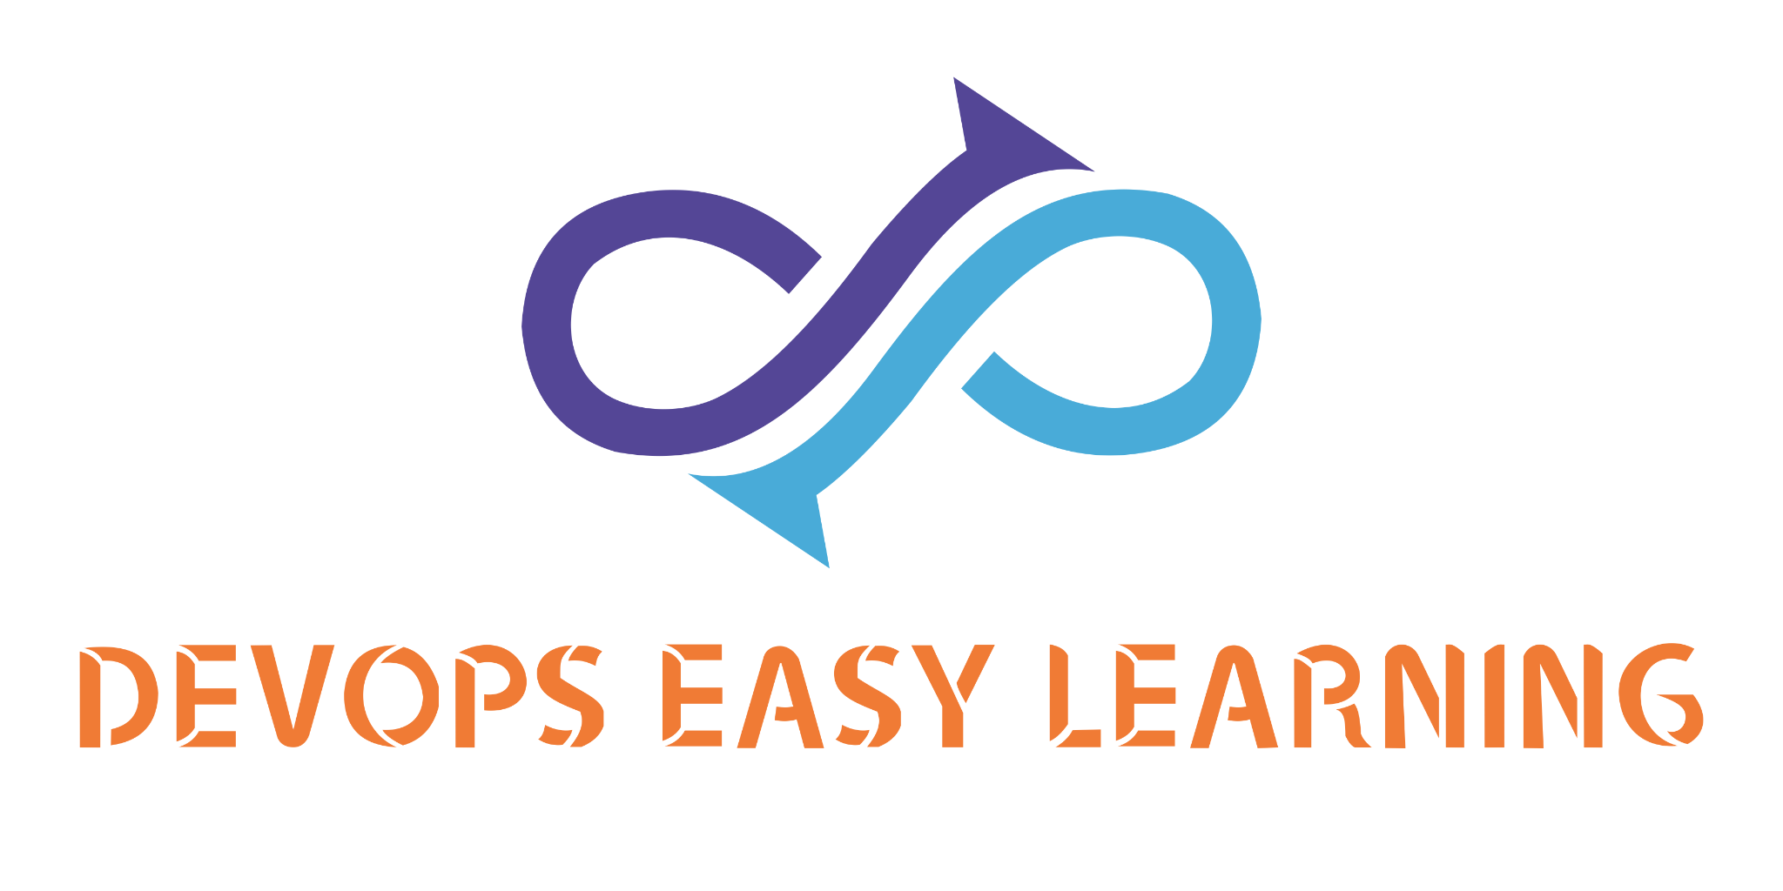
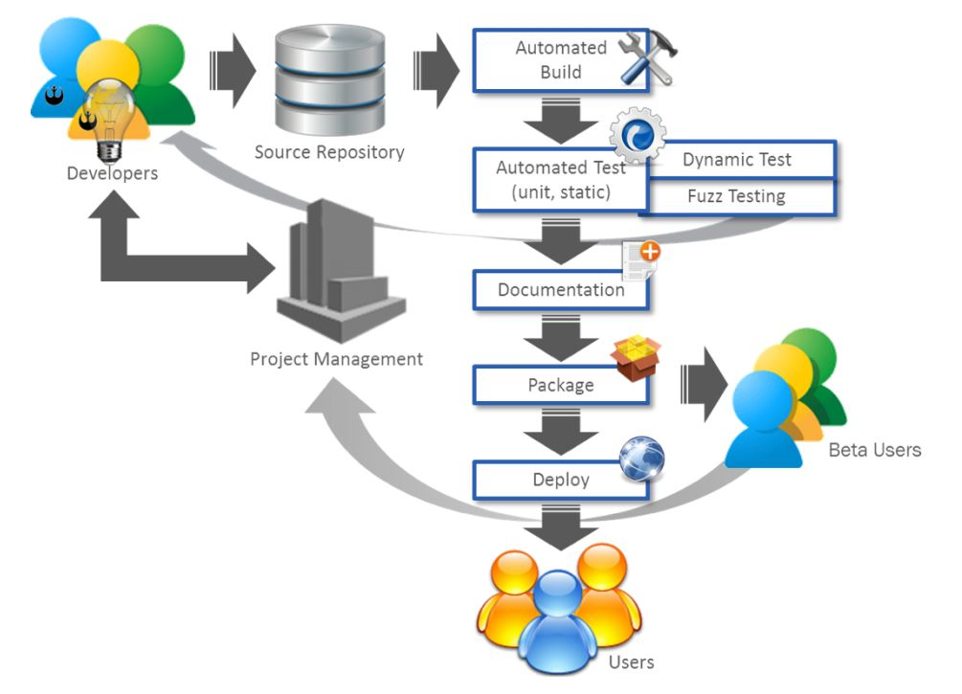

The Software factory
At
EK TECH SOFTWARE SOLUTION
Core areas

Slide 2
Introduction
At EK TECH SOFTWARE SOLUTION The Software Factory is made of 05 core areas
1- Development team
2- Testing team
3- Security team
4- Access management team
5- DevOps teams

Slide 3
PROVISION
Testing team:
Test the image made
out of the code from the development team.
Development team:
Develop the application
code so that an image
can be built out of it
Security team:
Secure the entire infrastructure and application.
DevOps team:
Provide and manage tools on the entire software factory. Deploy applications.
Why id the devops in the middle? well because the devops provide and maintain all the tools used by others team
Access management team:
Manage access to the infrastructure.

Slide 4
CORE AREAS
DevOps
Development (DEV)
TESTING
(QA)
Pre-production
(PREPROD)
Production
(PROD)
Security
(DEVSECOPS)
Access management (AMT)

Slide 5
APP FLOW
DevOps
Development (DEV)
Code to Image
TESTING
(QA)
Test the images
Pre-production
(PREPROD)
Image to Application
Pre-production area is same as production area the only difference is that the customer does not have access to the application running in pre-production but does have access to the application running in production
Production
(PROD)
Image to Application

Slide 6
Development area
Development (DEV)
Code to Image
The docker build fail
Therefore the code is sent
back to development team to fix it
Developper notify testing team
A developper raise a pull or merge request on develop branch
Gitlab scan the code using Sonarqube
Developper confirm image ready for testing
Docker build images
The code pass docker build stage
The code fail sonarqube stage
therefore will be sent back to
development team for the cycle
to start over
The code pass sonarqube stage
Developper tag the image
Docker push images to Docker Hub
Deployment
On k8s failed
Deploy on dev cluster
Deployment
On k8s passed
Development check the application on dev eare UI

Slide 7
Testing area
TESTING
(QA)
Test the images
The image
fail synk scan
Notify dev team an stop all further testing
Received ok to test from
Development team
Pull image tag provided by dev team from
docker Hub
Scan image using:
Synk for security vulnerability
Scan image using:
Synk for security vulnerability
Synk test pass
Certify the
image tag
Ready for production
Perform following test:
- end to end test
- server test
- user test
- load test
- Environment test
- penetration test
All tests pass
Deploy application on testing cluster using
Image tag provided
Notify DevOps team
At least one test fail
Notify dev team an stop all further testing

Slide 8
Devops area: Pre-production
DevOps
Set a blocker and notify dev team
Received ok from testing team
Pull image tag provided by testing team from
docker Hub
Deploy application on Preprod cluster using
Image tag provided
Observe the application behavior for 72h
The app does not behave correctly
Deployment
Looks ok
Invite dev and testing team for last visual check up on UI only
Certify images ready for production
Schedule production upgrade and Notify customer
Deployment
Looks ok
The app does not behave correctly according to dev and/or testing team
Set a blocker and notify dev team

Slide 9
Devops area: production
DevOps
Stop deployment rollback if necessary and notify de team
Pull same images running on preprod cluster
Deploy application on Prod cluster
Deployment
fail
Notify the entire team and fill out deployment paperwork
Deployment
Looks ok

