Slide 1

Value-Quality-Momentum Strategy
George Moschovis & Florent Yigbe
G_5 Gamma Gurus
Hedge Fund Club - Universität Mannheim & Prime Capital
20.11.2025

Slide 2
SUMMARY
CORE IDEA
UNIVERSE & DATA
SIGNAL DISIGN (Alpha)
PORTOFOLIO CONSTRUCTION
POTENTIAL RISKS
RISK MANAGEMENT
BACKTESTING & PERFORMANCE
PERFORMANCE METRICS

Slide 3
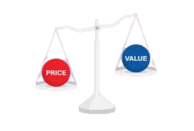


CORE IDEA
What’s the core investment hypothesis ?
Identify undervalued stocks with strong fundamentals and positive momentum outperform over 1–3 years
Why does this opportunity exist ?
Investors often overlook high-quality undervalued companies, creating mispricing opportunities
Asset universe
Top 300 S&P 500 companies

Slide 4
UNIVERSE & DATA
Universe
Data (from yfinance)
Daily/weekly prices
Fundamentals: P/E, P/B, EV/EBITDA, ROE, Debt/Equity
Frequency
Quarterly fundamentals, daily prices
S&P 500
Market cap > $5B
Average daily volume > 500k

Slide 5

SIGNAL DISIGN (Alpha)
Momentum filter: Only select stocks with positive 3 and 12-month price momentum.
Value factors: Low P/E, low EV/EBITDA, low P/B
Quality factors: High ROE, low debt/equity
Composite Score to rank the stocks

Slide 6
PORTOFOLIO CONSTRUCTION
Long top 20 ranked stocks.
5% to each position (Equal weight)
5% per stock
Rebalance semi-annually and when a stock is no more part of the S&P 500 we replace it according to our strategy .

Slide 7

POTENTIAL RISKS
Momentum Crashes
Sudden Regime Change
Sector Concentration
Survivorship Bias
Limited Hedging

Slide 8

RISK MANAGEMENT
Stop-loss: deterioration in fundamentals.
Max 30% exposure per sector.
Track: max drawdown, Sharpe ratio, VaR, CVaR

Slide 9
BACKTESTING & PERFORMANCE
Period: Last 20 years
Benchmark: S&P 500
Metrics: Annualized return, Annualized Volatility, Sharpe ratio, Max Drawdown, VaR, CVaR
Stress test during market crises (2008, 2020).

Slide 10


LET‘S DIVE INTO THE CODE

Slide 11
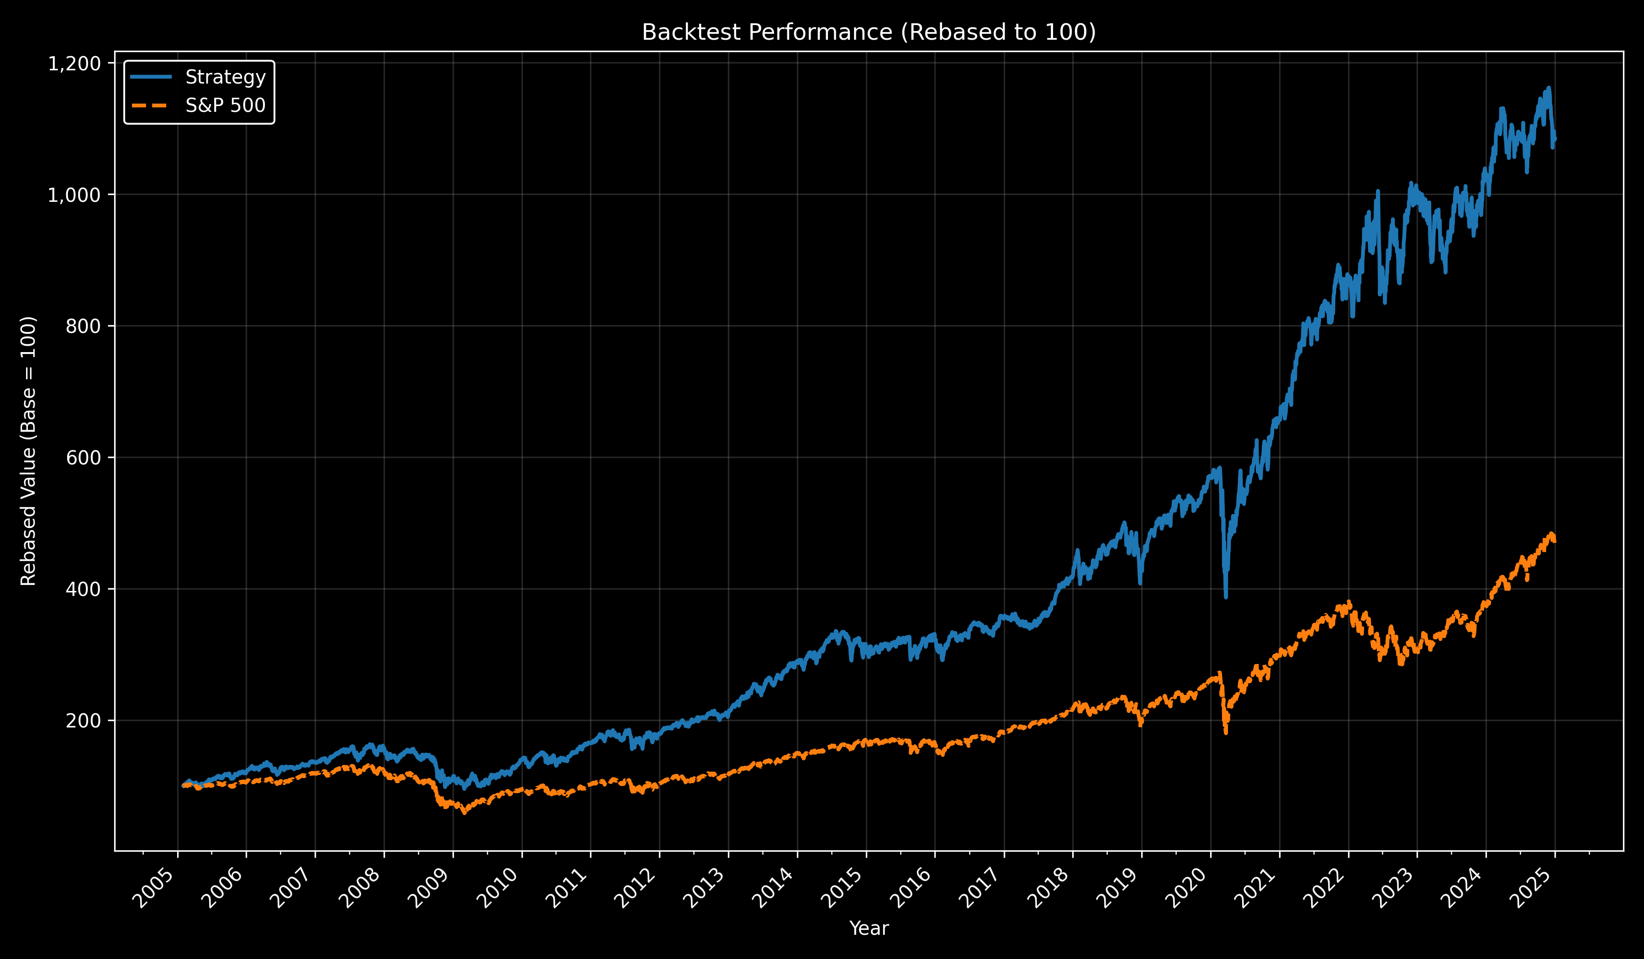

Slide 12
PERFORMANCE METRICS
Annual Return: 12.67% | Benchmark: 8.10%
Annual Vol: 18.96% | Benchmark: 19.20%
Sharpe Ratio: 0.67 | Benchmark: 0.42
Max Drawdown: -41.67% | Benchmark: -56.75%
95% VaR (daily): -1.84% | Benchmark: -1.81%
95% CVaR (Expected daily Shortfall): -2.87% | Benchmark: -2.98%

Slide 13
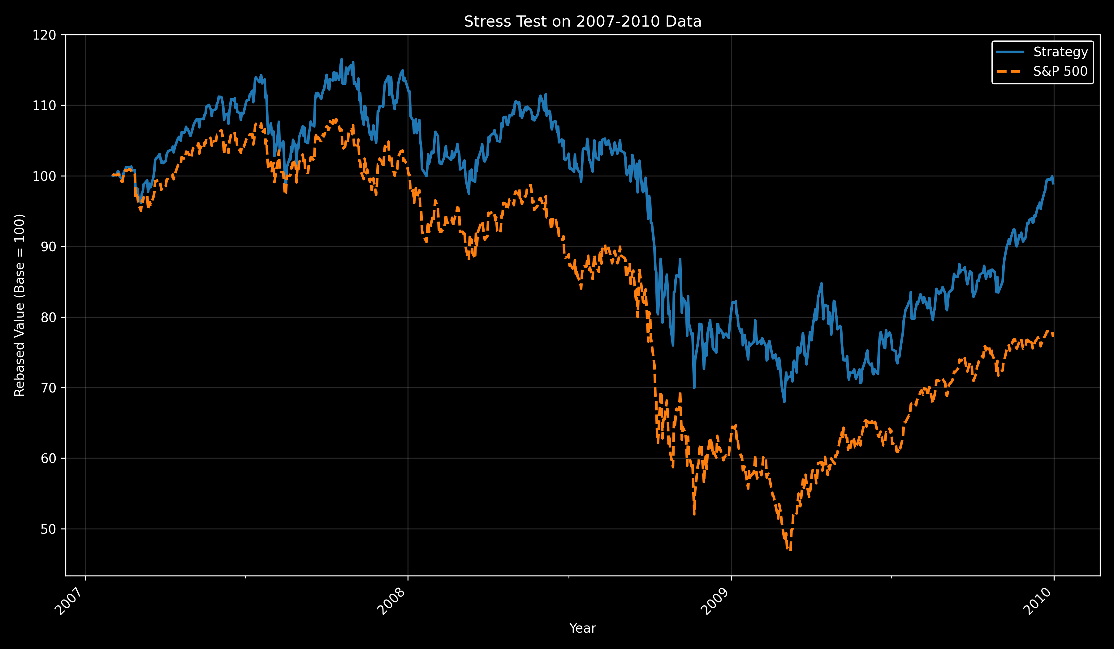

Slide 14
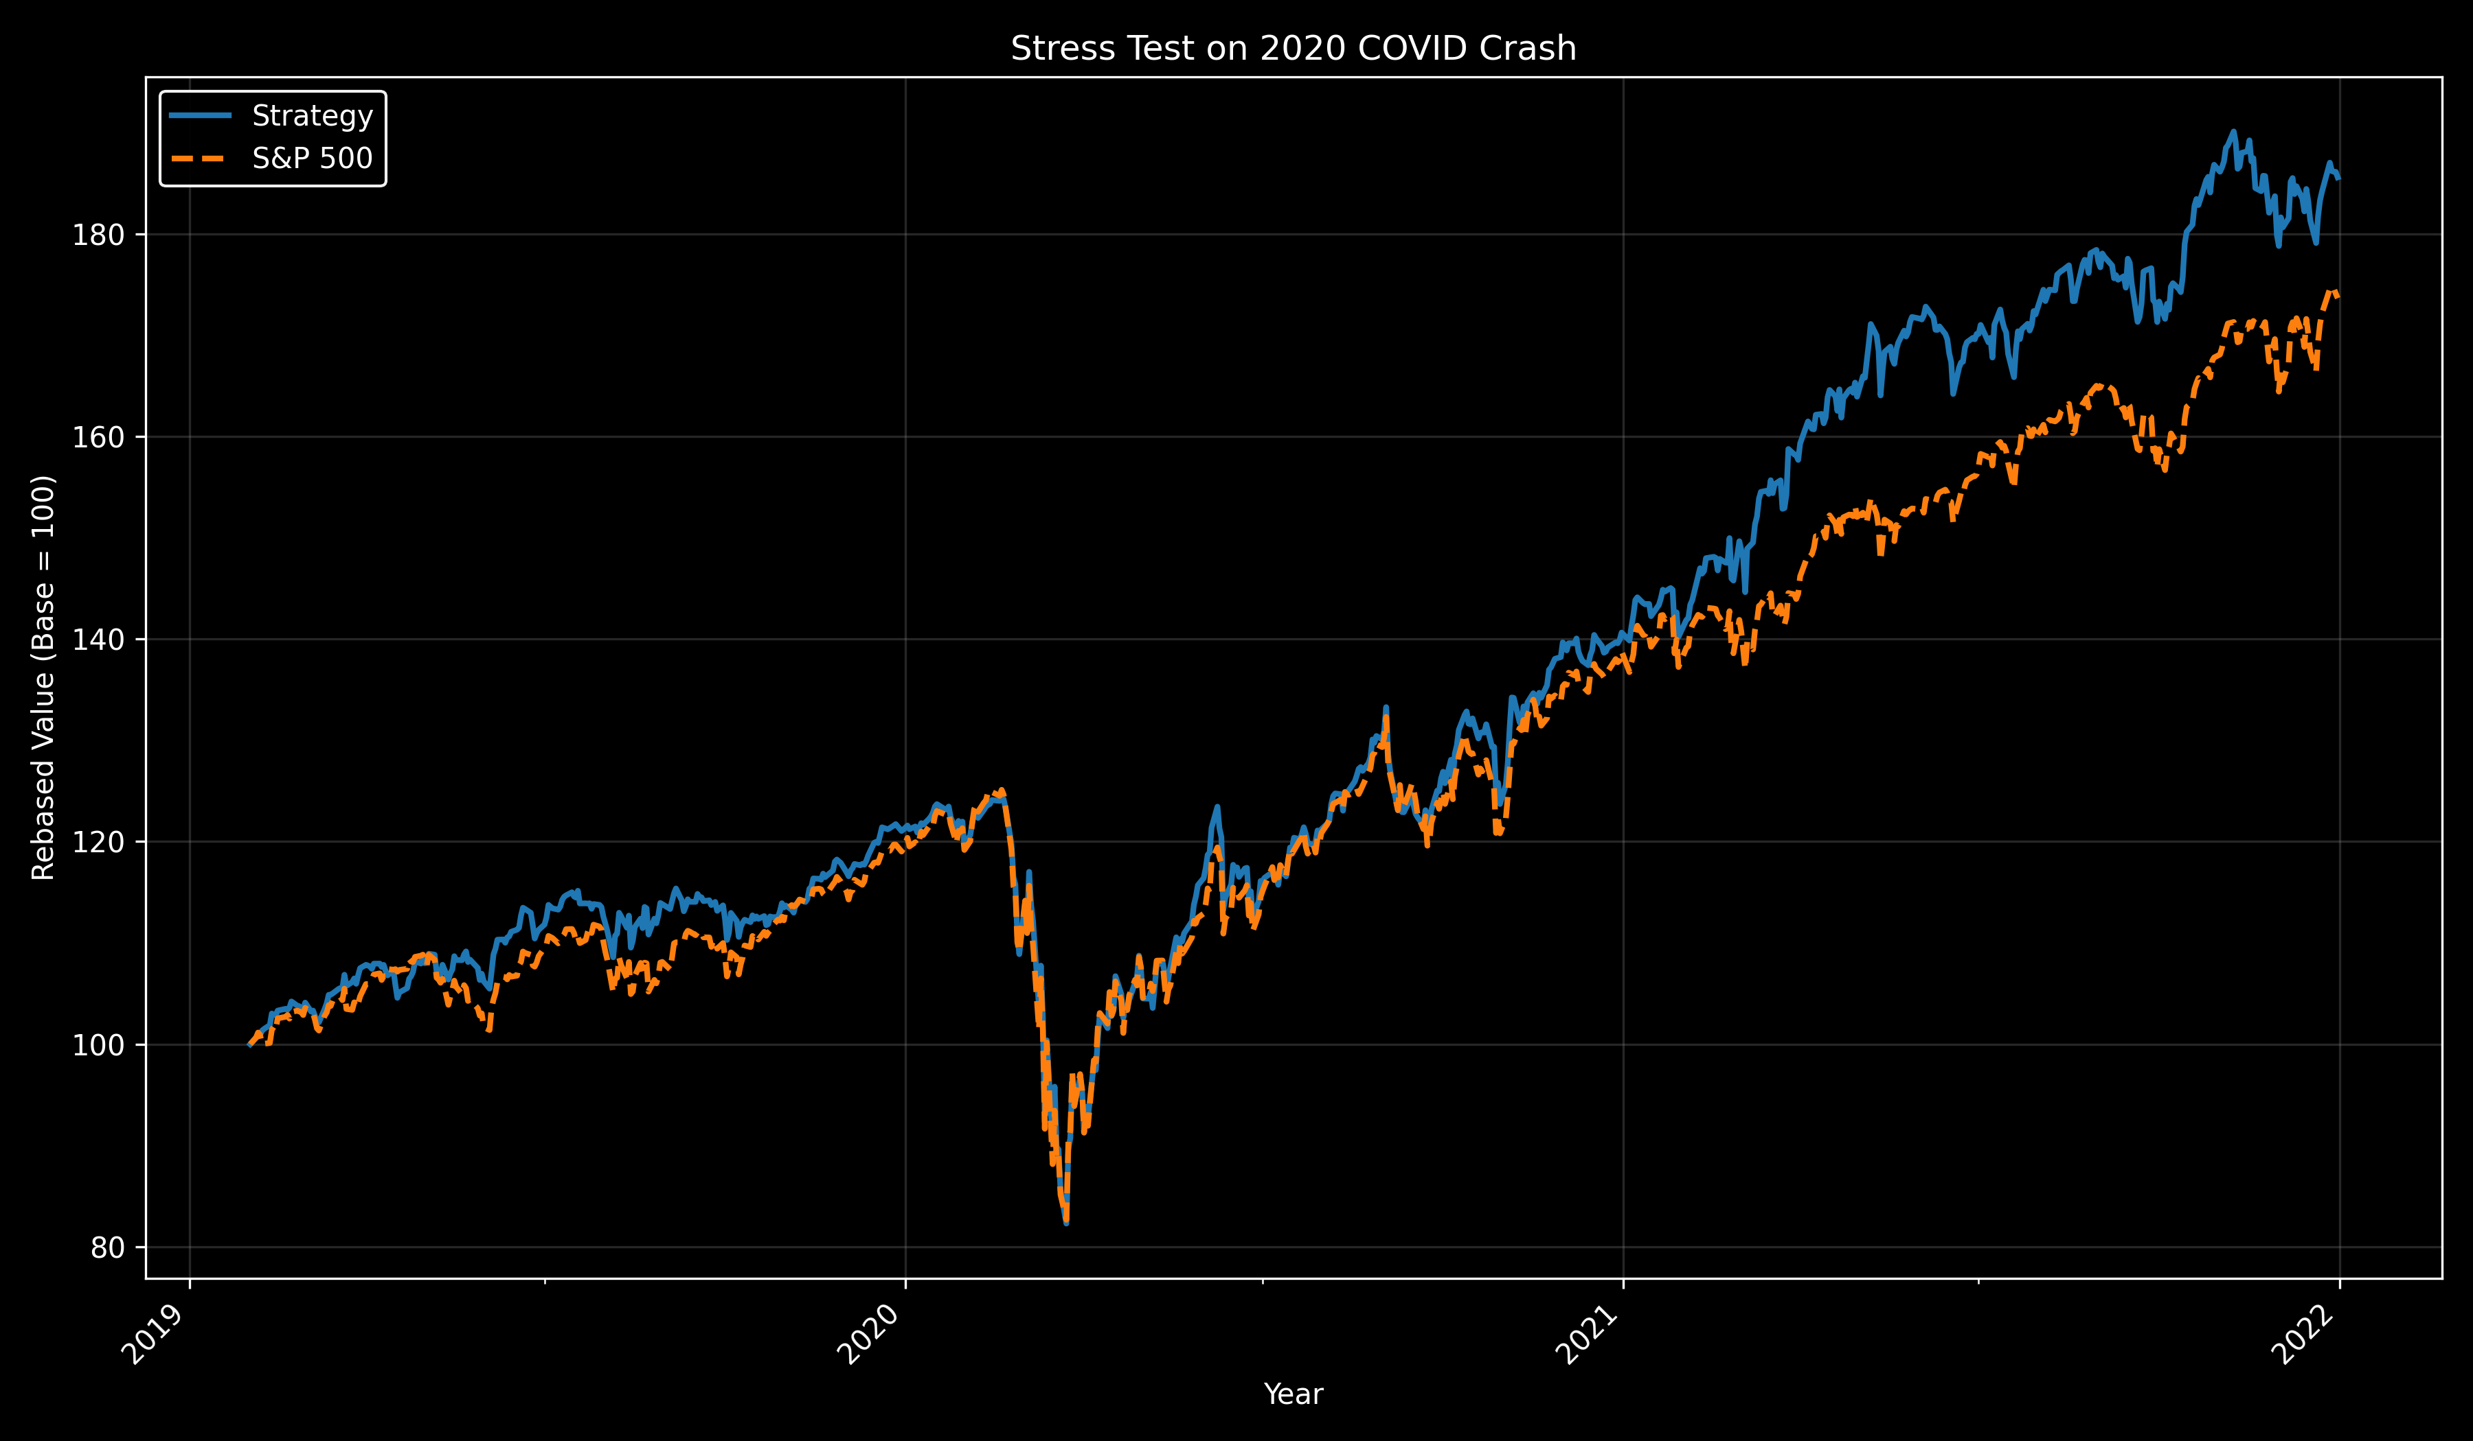

Slide 15
?
How realistic is it

Slide 16
REAL WORLD
Liquidity (S&P 500 Stocks)
Academically Proven Anomalies (Fama & French (1992), Asness et al. (2013) (2019))
Minimal Trading Commisions (Semi-Annual Rebalancing)

Slide 17

THANK YOU FOR YOUR ATTENTION !
All the updated code can be found at:
https://github.com/GeorgeMoschovis/Value-Quality-Momentum-Strategy
George Moschovis & Florent Yigbe
G_5 Gamma Gurus

