Slide 1
Learnt Equality Saturation as a Database Query Engine
George-Octavian Bărbulescu

Slide 2
Query Optimisation
Goal: Identify the query plan with the lowest cost to be executed against the database system
Query Rewrite: Rewire database queries into equivalent queries with minimal execution time

Slide 3
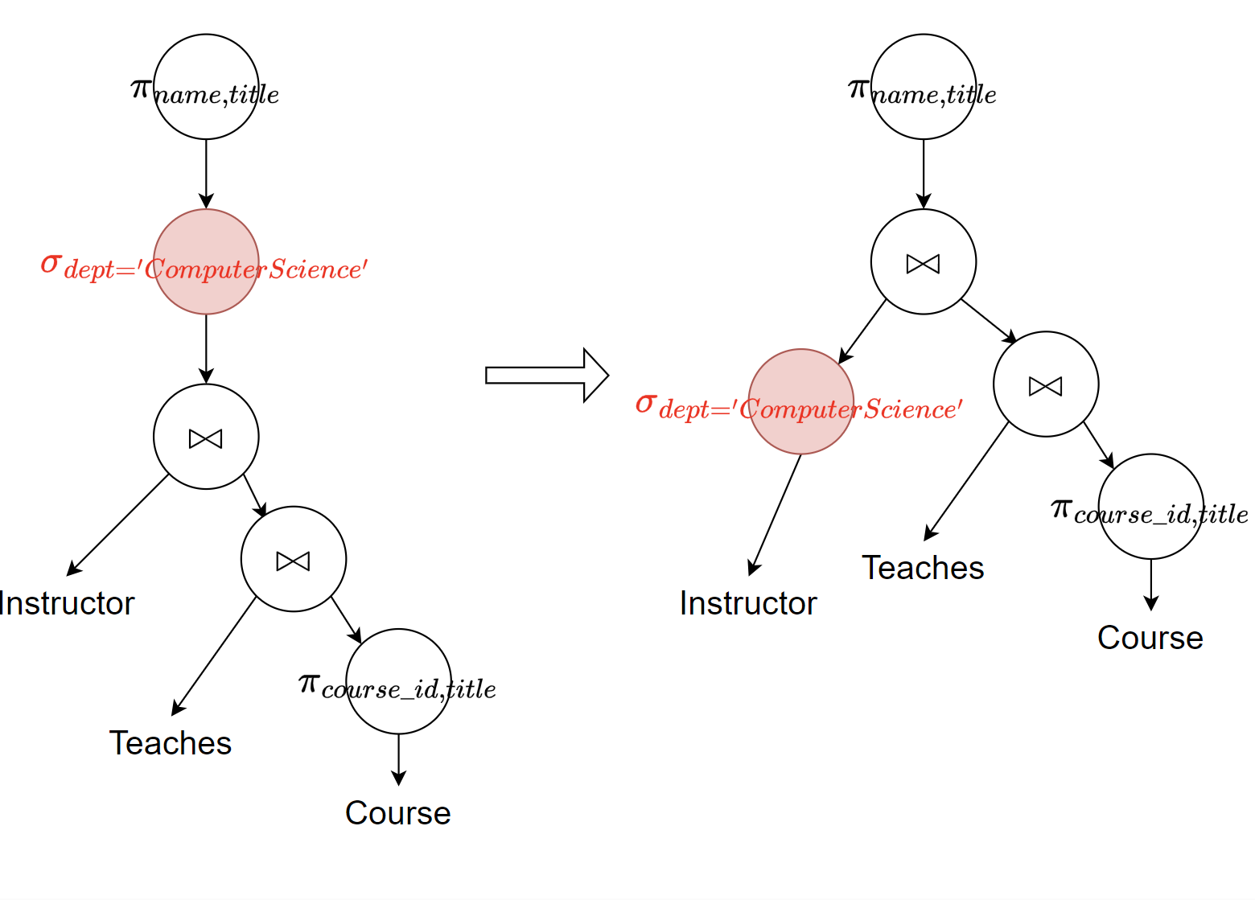
Query Rewrite Example
Query: Identify the names and the courses taught by the instructors in the Computer Science department
Filter the ‘Instructor’ table early in the plan. Intuitively, the subsequent operations (e.g., join) are performed on less data
Question? What is the optimal order of applying the rewrite rules? NP-hard
Example based on Abraham Silberschatz et al. 2011

Slide 4
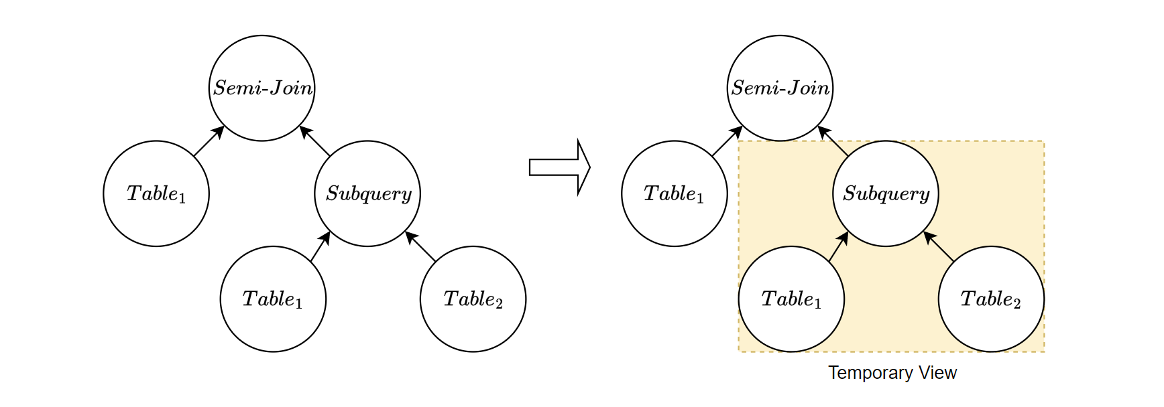
Top-down Query Rewrite
Query Template: Select _ from T1 with condition over (select _ from T1, T2 …
Mainstream engines optimize queries based on predefined equivalence rules in a heuristic fashion. For instance, PostgreSQL uses a top-down approach.
Observation! A top-down approach runs into local optima. In the example, the nested query is replaced with a temporary table. The correlation between the nested query and the outer query is ignored

Slide 5
Motivation (Part I)
Challenges:
Finding the optimal order of rewrite rules is proven NP-hard;
How to efficiently represent many rewrite orders?
Idea: Use non-destructive graph rewriting. Equality Saturation is a popular method from compilation systems
Notes:
10 rules => 30.000

Slide 6
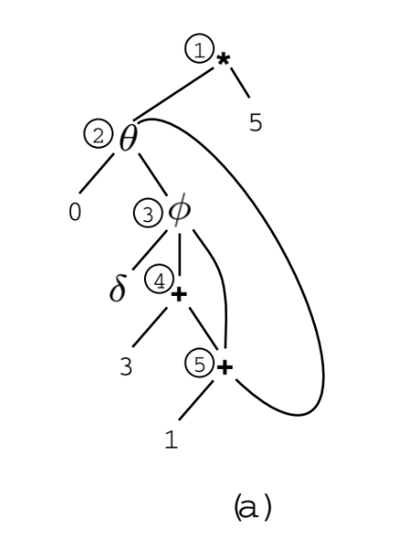
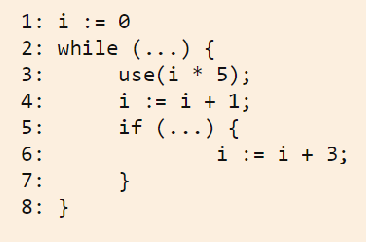
Program Expression Graph

Slide 7
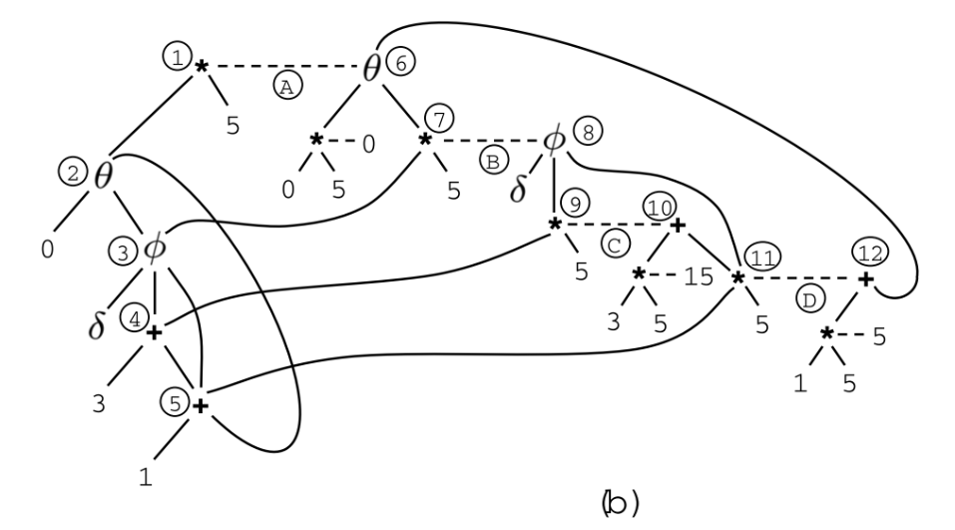
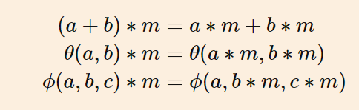
From PEGs to E-PEGs

Slide 8
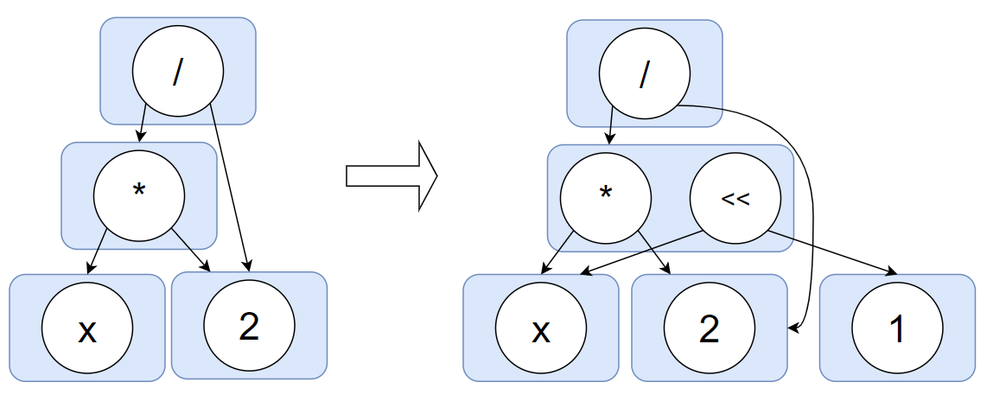
Succinctly: Equality Saturation
Goal: Apply rewrite rules non-destructively until saturation.
Saturation: All the possible versions of a program (or query) are encoded. Infinitely many plans can be represented in equality graphs (e-graphs).
Equality Graphs: Data structure comprised of e-classes and e-nodes. An e-class is an equivalence class over e-nodes in a program.
Observation!: If saturation is achievable, then the plan extracted at the end is the global optima.
$$x∗2 →x≪1$$

Slide 9
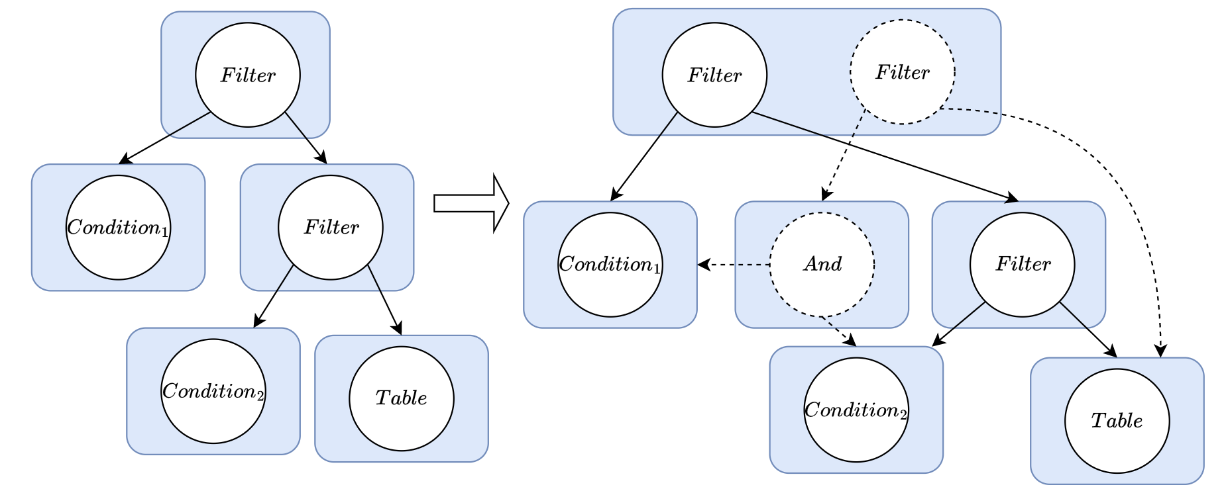
Equality Saturation for Query Optimisation
Query: Select _ from (Select _ from Table where Condition 2) where Condition1
Equality Saturation is applied over the query. The e-graph is expanded with the rule:
filter(c1, filter(c2, table)) → filter(c1∧ c2, table)

Slide 10
Motivation (Part II)
Recall:
Finding the optimal order of rewrite rules is proven NP-hard;
How to efficiently represent many rewrite orders?
Idea: Use non-destructive graph rewriting. Equality Saturation is a popular method from compilation systems
New Challenges:
E-graphs can exceed the available memory;
The rewrite latency is included in the total overhead
Notes:
10 rules => 30.000 versions

Slide 11
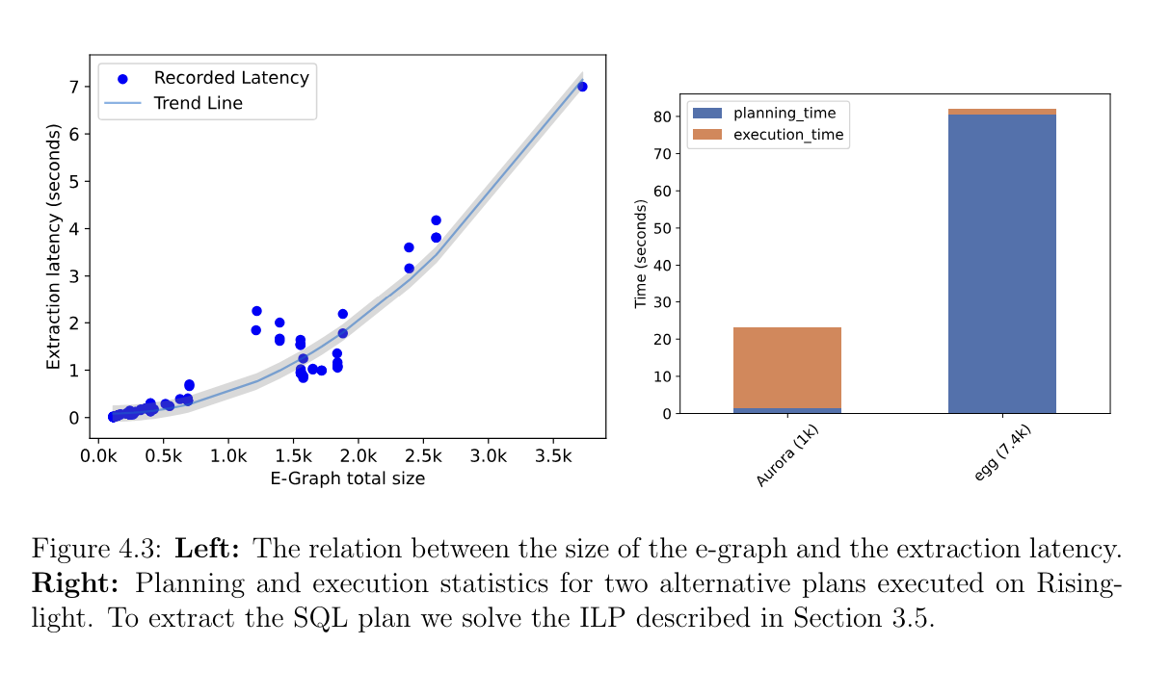
Motivation (Part II)
Notes:
10 rules => 30.000 versions

Slide 12
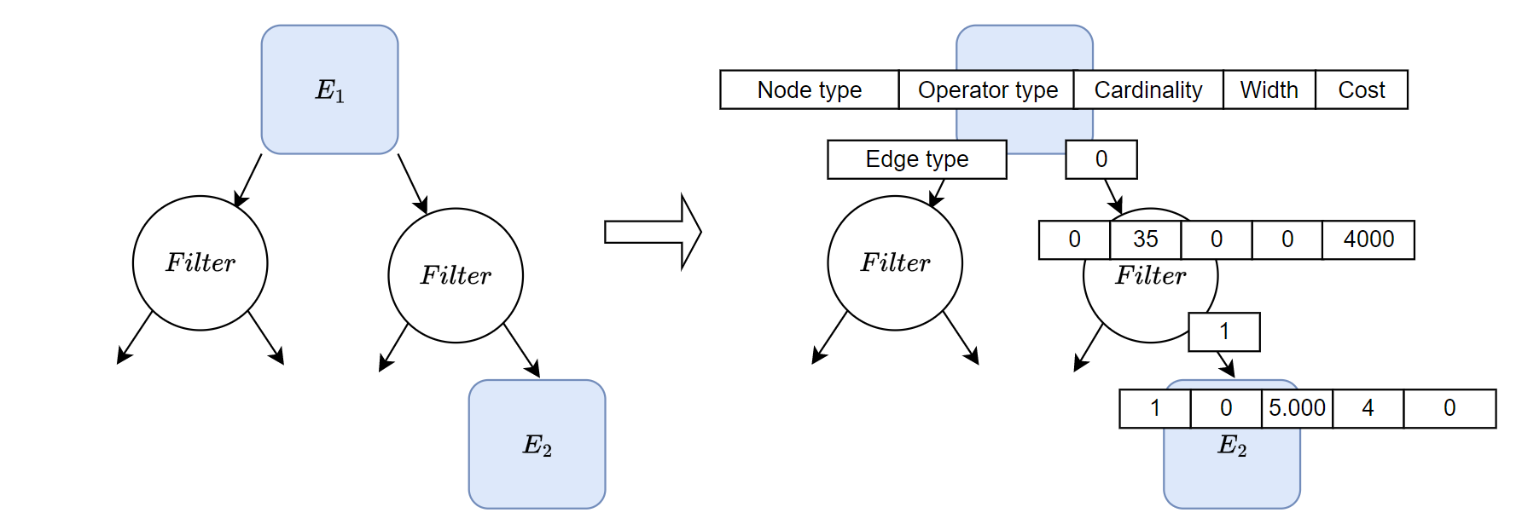
Use Reinforcement Learning to guide Equality Saturation
Idea: Store statistics from the database (e.g., cardinality) in e-classes
This is the state encoding in the RL recipe!

Slide 13
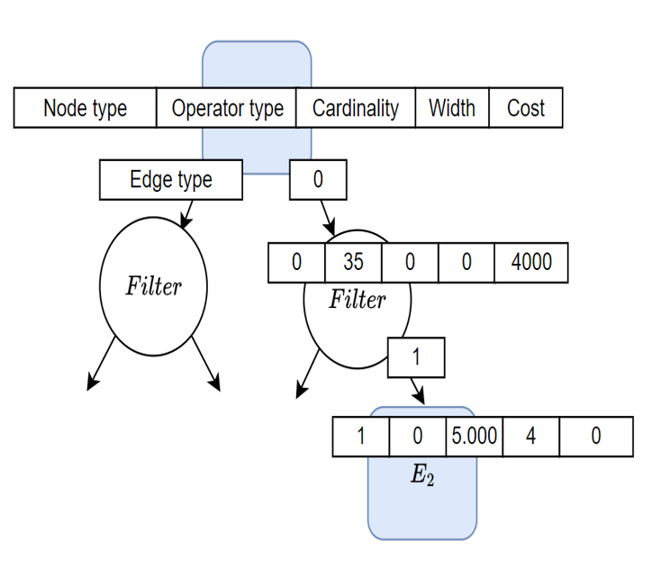
Equality Saturation as a Markov Decision Process
Embedding
Action

Slide 14
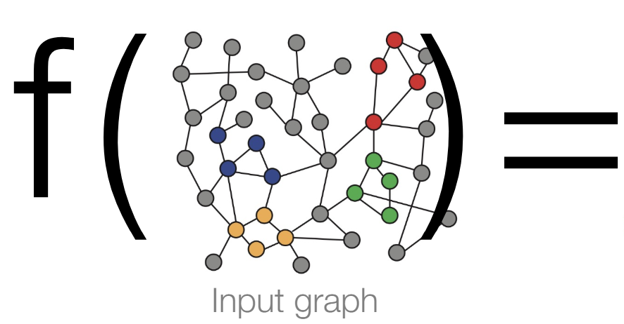
Concretely, we want…

Slide 15
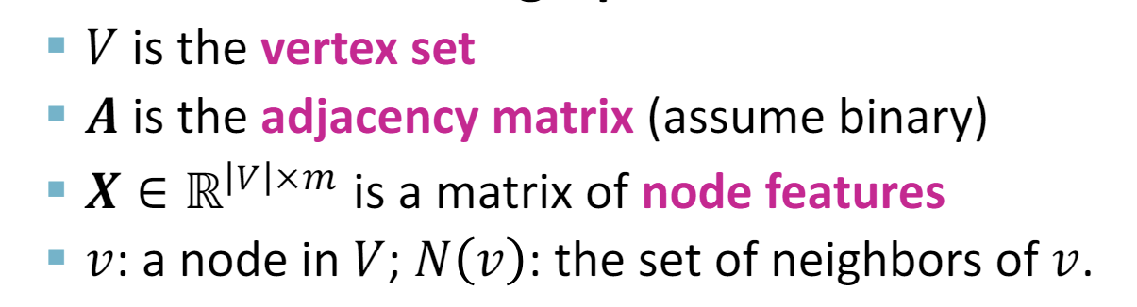
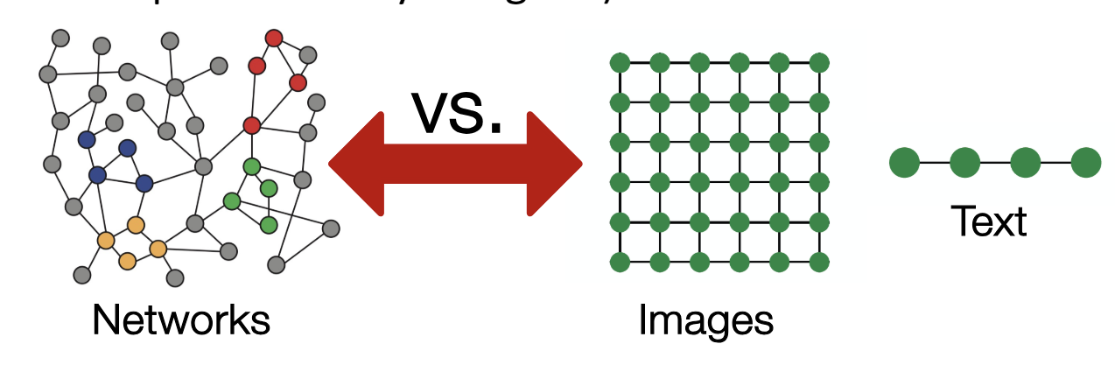
Embeddings for Graph Data
Properties of a graph:
Topological structure
No ordering or start point
Arbitrary size

Slide 16
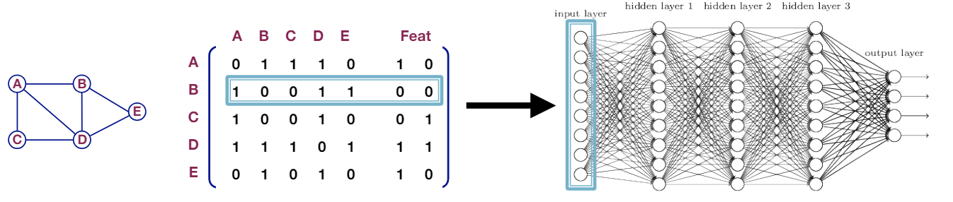
Implications for Machine Learning
Problems:
O(|V|) number of parameters
Fixed input size
Not generalisable – Why?

Slide 17
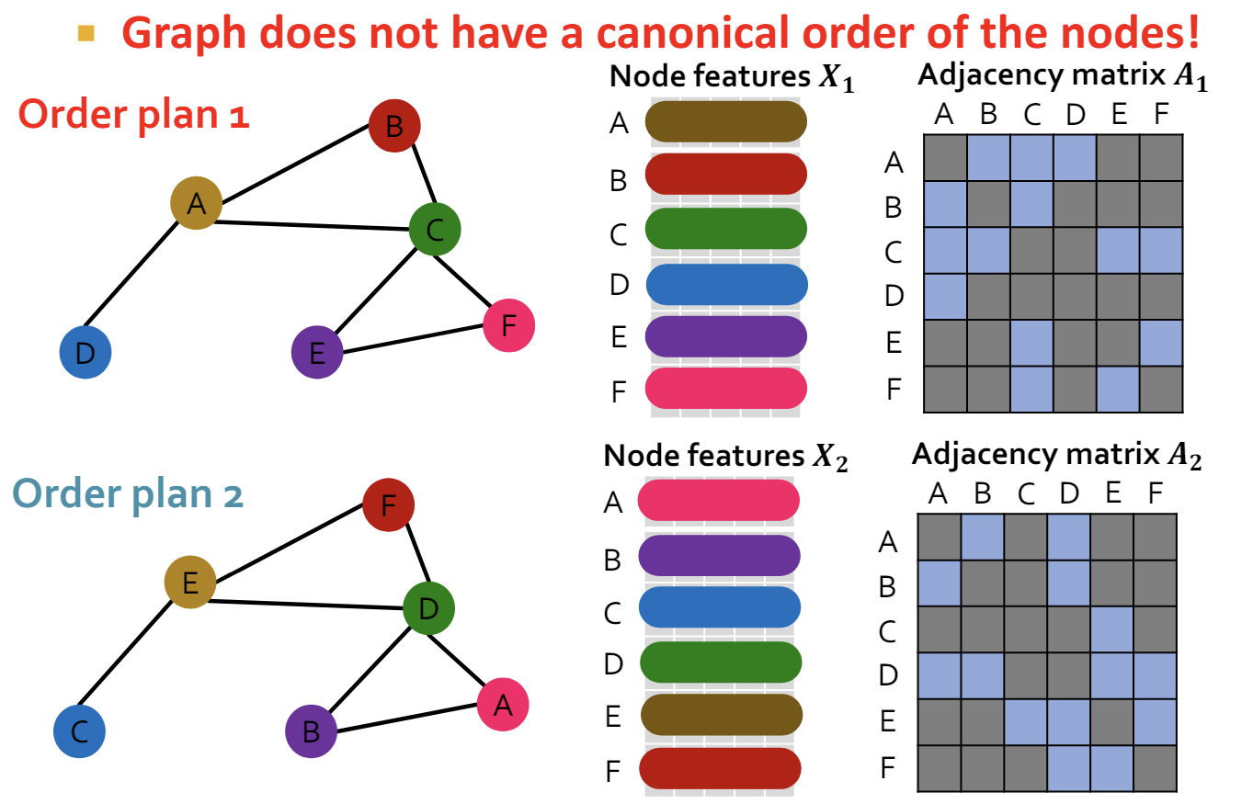
Implications for Machine Learning
Not generalisable:
The input changes, depending on how we order the nodes.
The embedding should be the same in this case!

Slide 18
Concretely, the following happens…

Slide 19
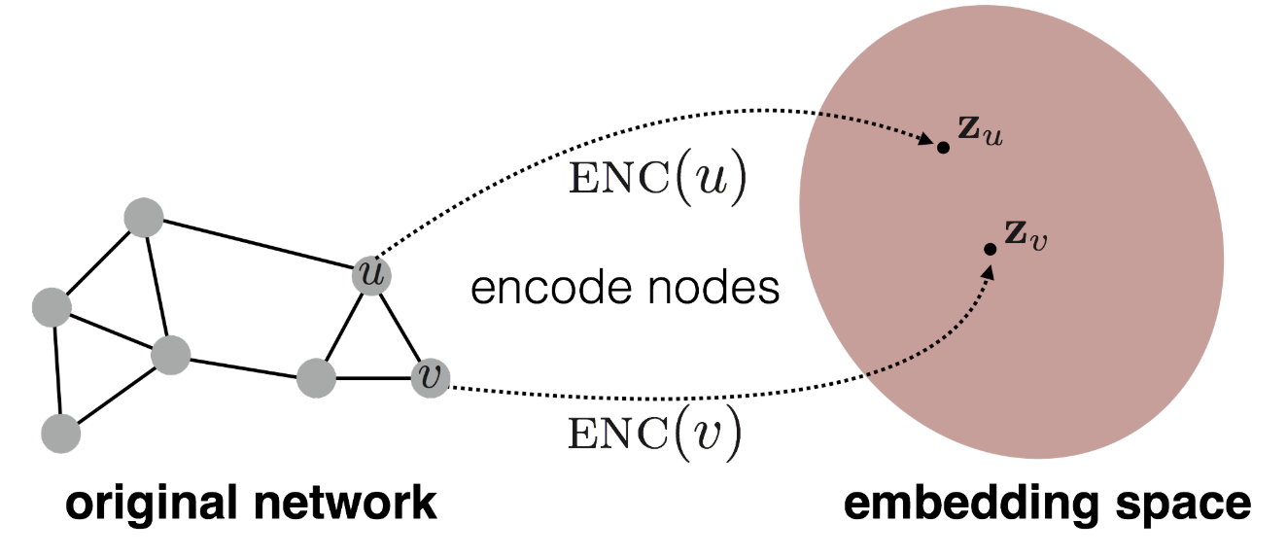
Reducing the Problem to finding Node-level embeddings
The functions applied over the graph have to be:
Permutation invariant
Permutation equivariant

Slide 20

Permutation Invariance
Permute the input, output does not permute (graph to vector)

Slide 21
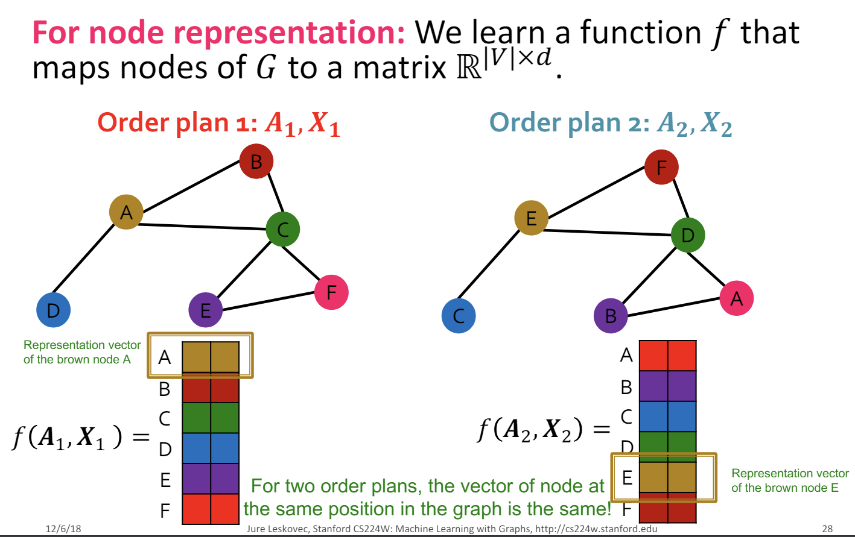
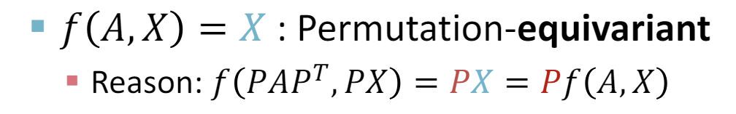
Permutation Equivariance
Permute the input, output permutes too (graph to matrix)

Slide 22
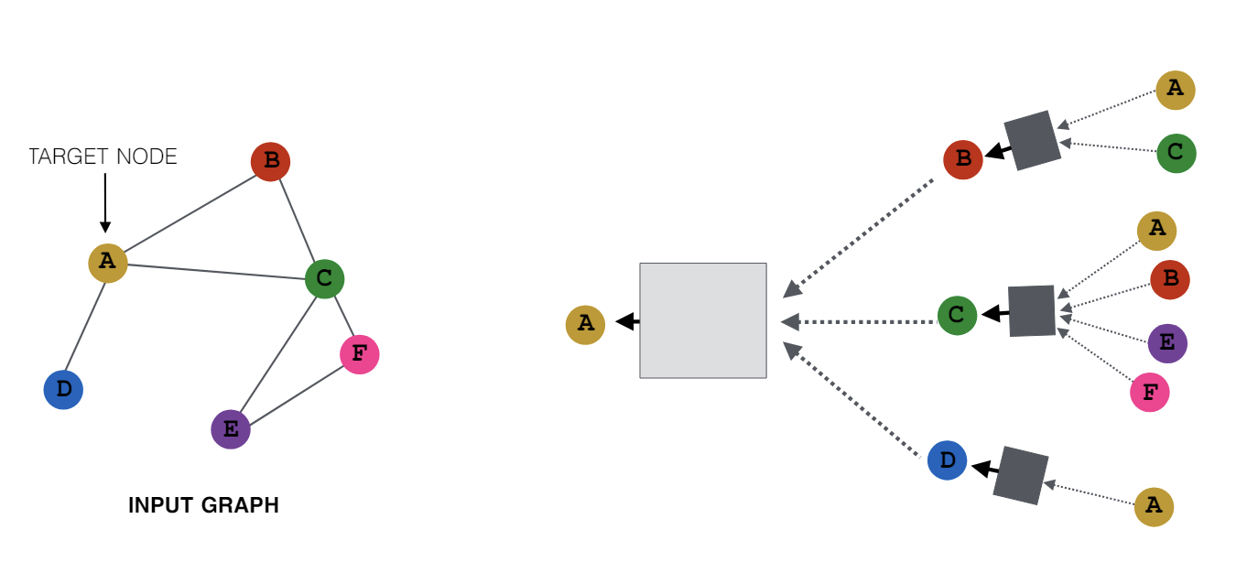
Embedding for Node ‘A’ with equivariant/invariant functions

Slide 23
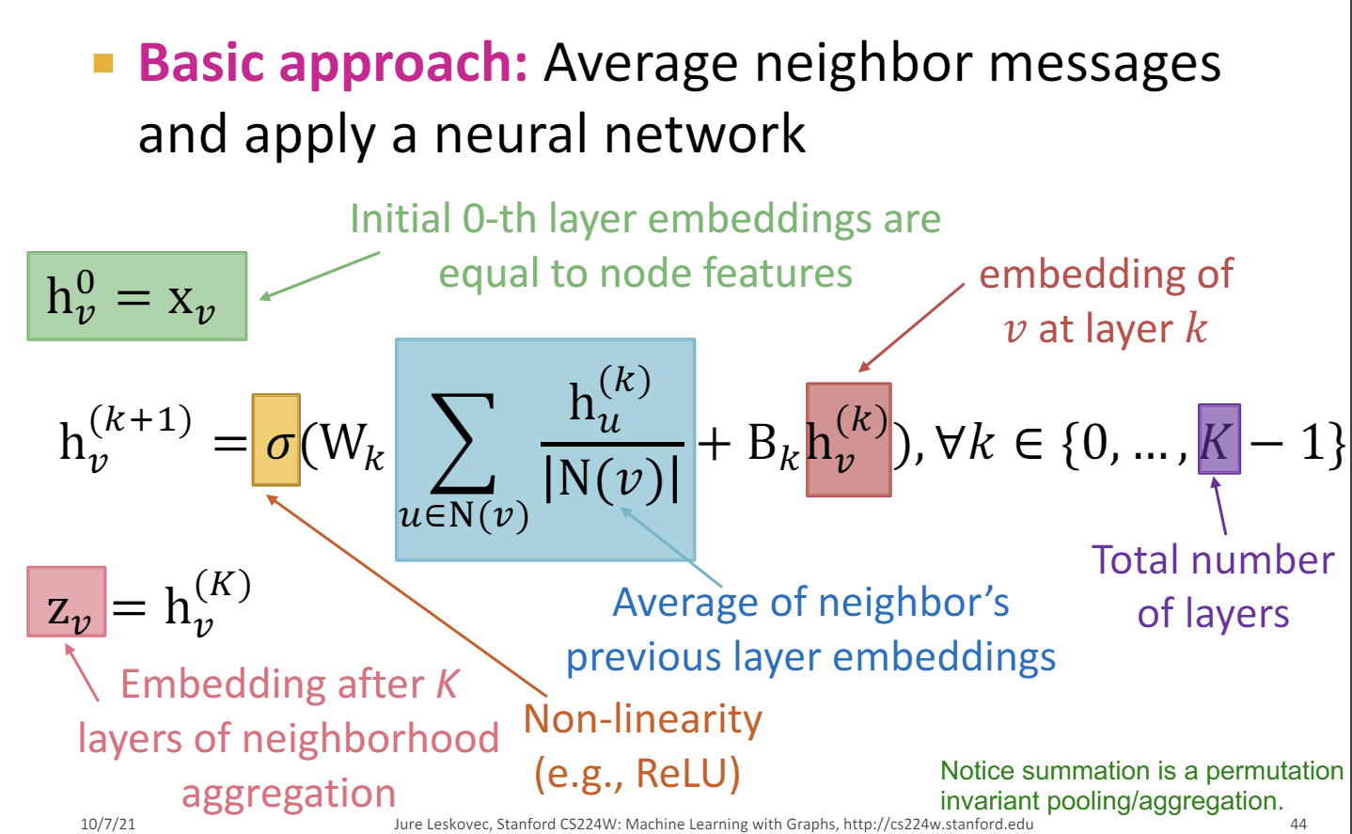
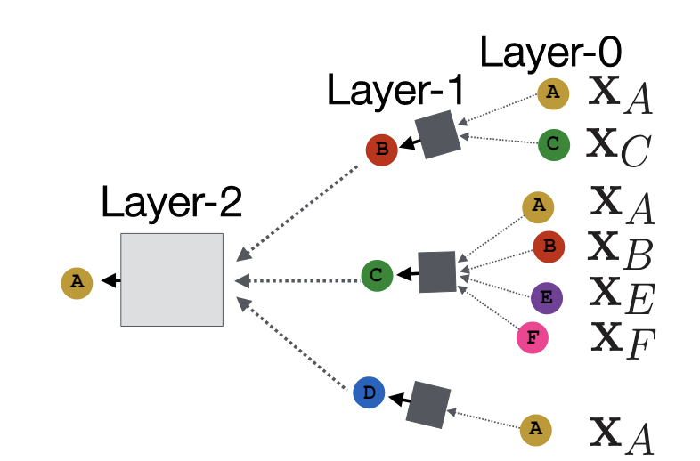
Embedding for Node ‘v’
Reduces to a chain of aggregation and shared neural network parameters

Slide 24
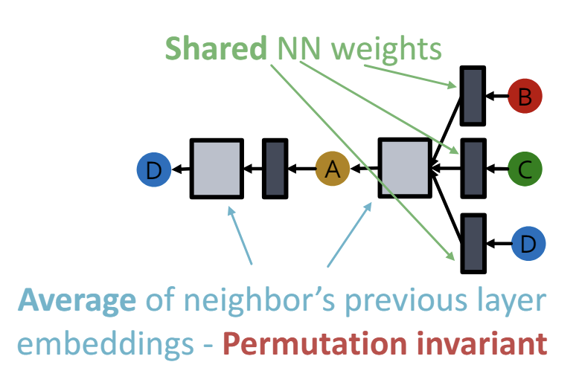
Embedding for Node ‘v’
What about equivariance?
We have established computing a node embedding is invariant -> see right figure
At graph level, a permutation over the input changes the position of a node (and its original representation). But the final representation for that location will be the same -> see right again!

Slide 25

Have we solved the problem?
Embedding
Action

Slide 26
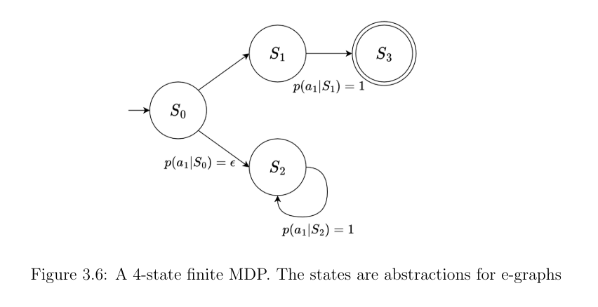


There is still room for improvement…
Problem: the embedding of two states can be very close (due to averaging over graphs of different sizes). Same action leads to regret proportional to the time horizon
S1
S2

Slide 27
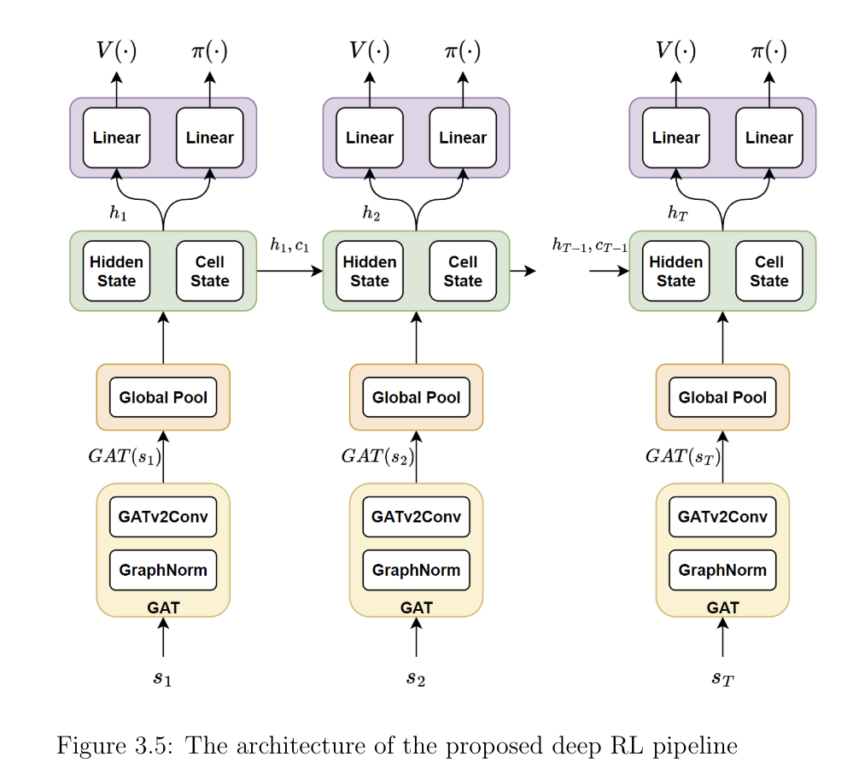
Adding a temporal dependency
Solution: Add a hidden state and a cell state as per Long Short-Term Memory.
There are two gates that control the trade-off between forget and memory in the cell state;
An output gate controls how the information is passed to the next hidden state

Slide 28
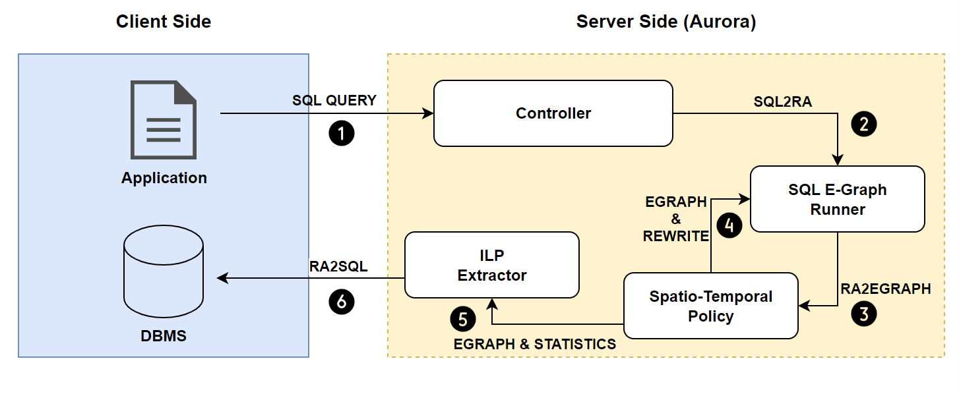
Aurora: RL-based Equality Saturation for Query Optimisation
Guide the expansion of the e-graph with Reinforcement Learning.
Adapt the methodology to the query rewrite problem.
Notes:
10 rules => 30.000

Slide 29
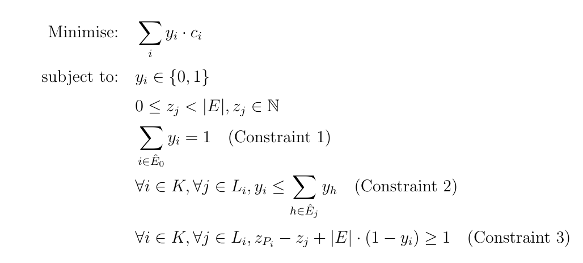
Aurora: Extracting the Learnt Query plan
Notes:
10 rules => 30.000

Slide 30
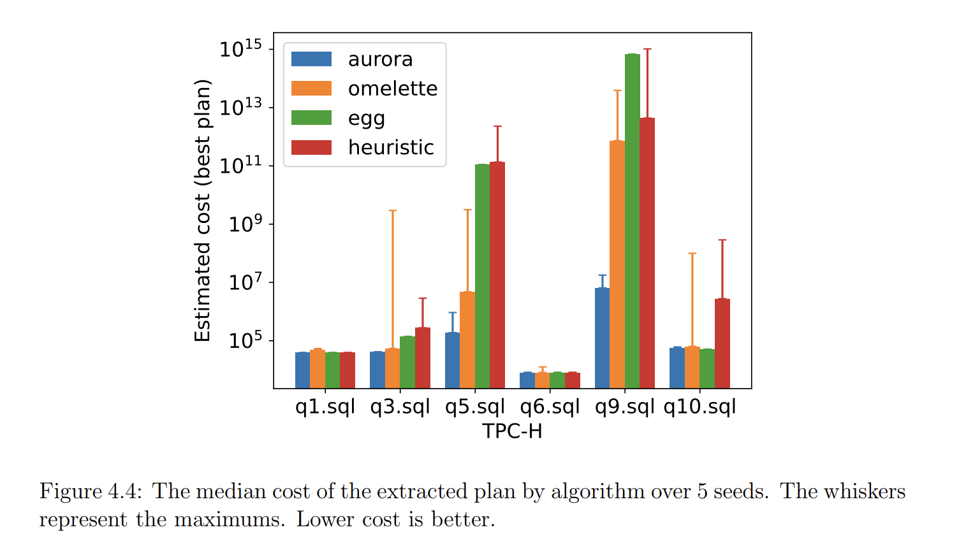
Algorithm Performance
Baselines:
e-good-graphs (egg): sota equality saturation solver (sequential)
Omelette: learned equality saturation solver
Task: Rewrite analytical queries (TPC-H)
Takeaway: Aurora can encode more competitive query plans than existing solvers within the equality graph limit
The median cost of the best plan encoded by each algorithm. The whiskers represent the maximums

Slide 31
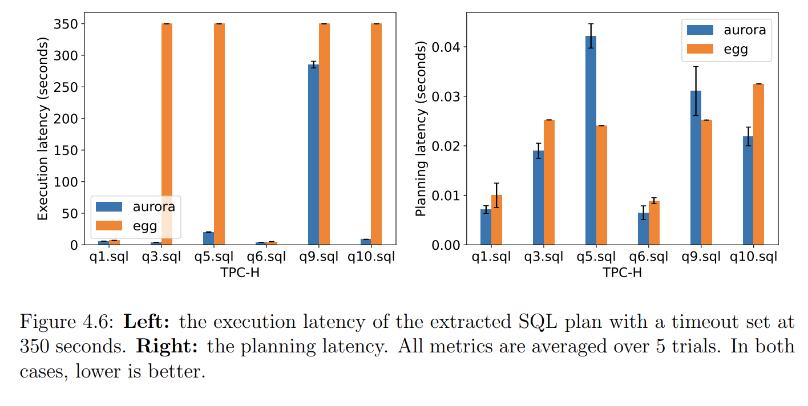
Query Performance
The mean execution latency of the extracted SQL plan (left) and the planning latency (right)

Slide 32
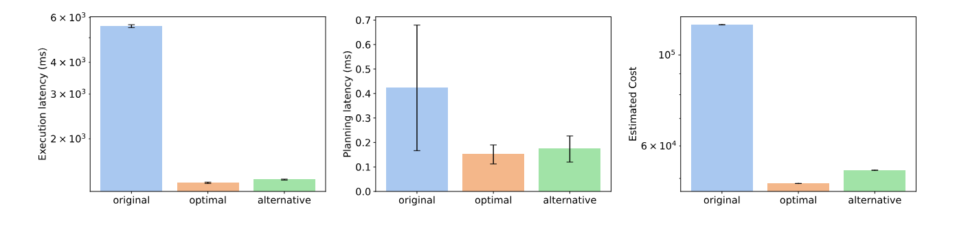
PostgreSQL Performance

Slide 33
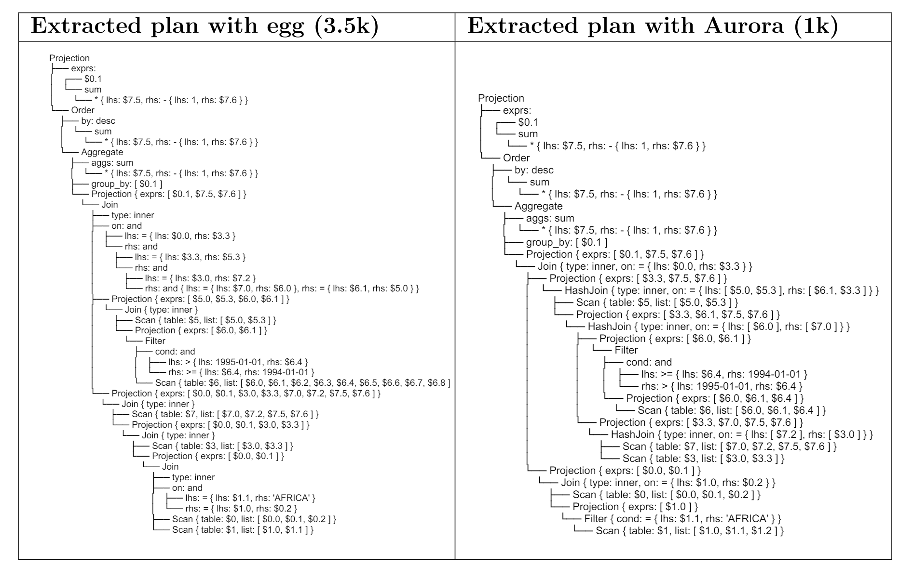
Example Query Plans

Slide 34
Summary
Novel Reinforcement Learning pipeline for equality saturation with GNNs and RNNs
Surpassed the performance of existing equality saturation solvers
The first formulation of the query rewrite problem as an instance of Equality Saturation with RL, to the best of our knowledge
Full paper available at: https://www.cl.cam.ac.uk/~ey204/pubs/MPHIL_P3/2023_George.pdf

Slide 35
Future Work
A comprehensive evaluation against a suite of SOTA query optimizers.
Improving the generalization of the policy.
Use RL for NP combinatorial problems (Problem: how to frame the problem as an ILP?)
My recent PhD work focuses more on Natural Language Processing and Privacy/Machine Unlearning.
https://arxiv.org/abs/2405.03097 (ICML24)

Slide 36
References
Abraham Silberschatz, Henry F Korth, and Shashank Sudarshan. Database system concepts. 2011
Zak Singh. Deep reinforcement learning for equality saturation. https://www.cl.cam.ac.uk/~ey204/pubs/MPHIL_P3/2022_Zak.pdf, 2022
Max Willsey, Chandrakana Nandi, Yisu Remy Wang, Oliver Flatt, Zachary Tatlock, and Pavel Panchekha. Egg: Fast and extensible equality saturation. Proceedings of the ACM on Programming Languages, 5(POPL):1–29, 2021.

