Slide 1
Where a home iron-status test fits: market access and customer-fit analysis
NHANES 2017-2020 · MEPS 2023 · Synthea synthetic EHR | Portfolio case study. Population evidence only: no product performance data is used or implied.

Slide 2
Executive summary
• Real unmet need: 13.5% of non-pregnant US women 20-44 have depleted iron stores (ferritin <15 ng/mL); 55% of them are NOT anemic (3.5M women), so a hemoglobin-first workflow misses them.
• Need concentrates in menstruating (15.3%), lower-income (16.5%) and pregnant women (24.2%, small n); men are near 1%.
• Access friction is real but segment-specific: lower-income women are 27% uninsured; fewer women 18-49 have a usual source of care than adults overall (65% vs 71% of adults).
• Threshold is a strategic choice: flagging ferritin <30 expands the group from 13% to 33% of women 20-44.
• In the synthetic pathway, 97% of target-condition visits are ambulatory or wellness: routine primary care is the natural confirmatory hand-off point.
• Recommendation: launch as a hybrid home-screen → confirmatory-lab product for menstruating women, entering through athletes (equal need, more often non-anemic, most able to pay); treat pregnancy, CKD and heart failure as clinician-supervised follow-on segments.

Slide 3
Question, data and approach
• Business question: which populations need an upstream iron-status test, where does today's pathway create friction, and which channels should be prioritised first?
• NHANES (real, measured labs, n=10,546): prevalence of low ferritin, low ferritin without anemia, and need-vs-access by segment, with design-based 95% CIs.
• MEPS 2023 (real, survey): utilization, insurance, out-of-pocket burden and access barriers for 14,768 adults.
• Synthea (synthetic EHR): code-level patient journey to test where a triage test could sit; workflow logic only.
• The three sources are never joined at person level; findings are combined at segment and workflow level.
• The test is positioned as triage that triggers confirmatory lab testing, never as a replacement for CBC / serum ferritin / clinician evaluation.

Slide 4
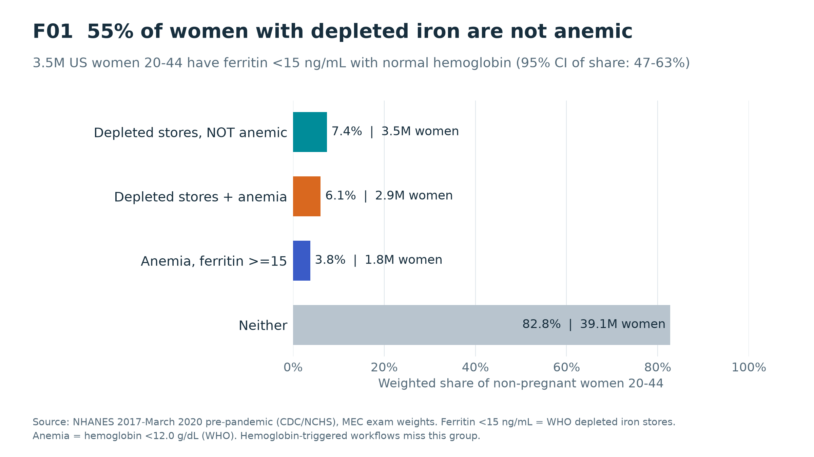
So what
3.5M women 20-44 have depleted iron with normal hemoglobin.
Workflows that start with an abnormal CBC will not find them.
This is the clearest product-market gap and supports Hypothesis 1 (undetected early deficiency).
At ferritin <30 the non-anemic group is 11.9M.

Slide 5
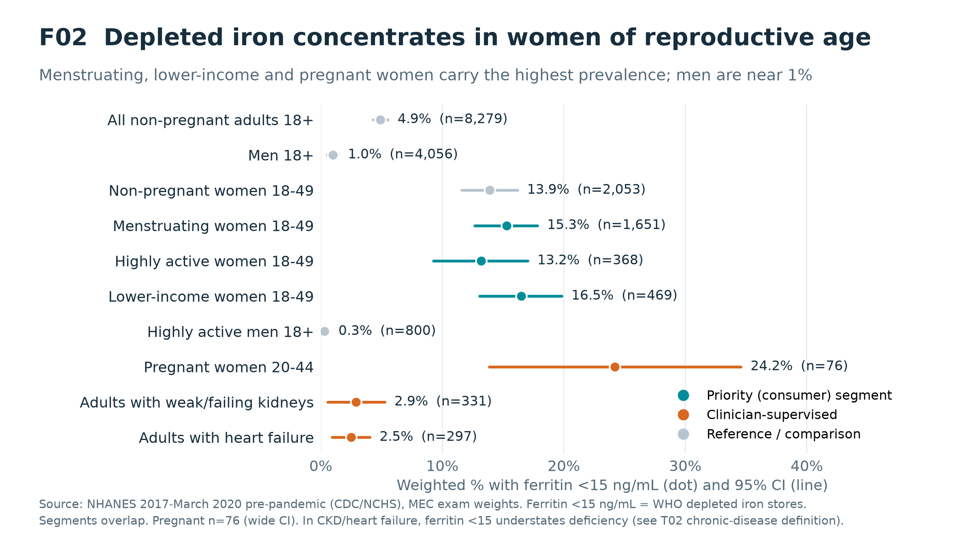
So what
Consumer-ready segments (teal) have 13-17% prevalence, 3x the adult average.
Highly active women have the same prevalence, but 62% of their cases are non-anemic (vs 50%), 44% are high-income and only 9% are uninsured: the best DTC beachhead.
Pregnancy is highest but n=76 and needs clinician oversight.
CKD and heart failure need a different definition (ferritin <100 / TSAT <20%), so they are a future monitoring use case.

Slide 6
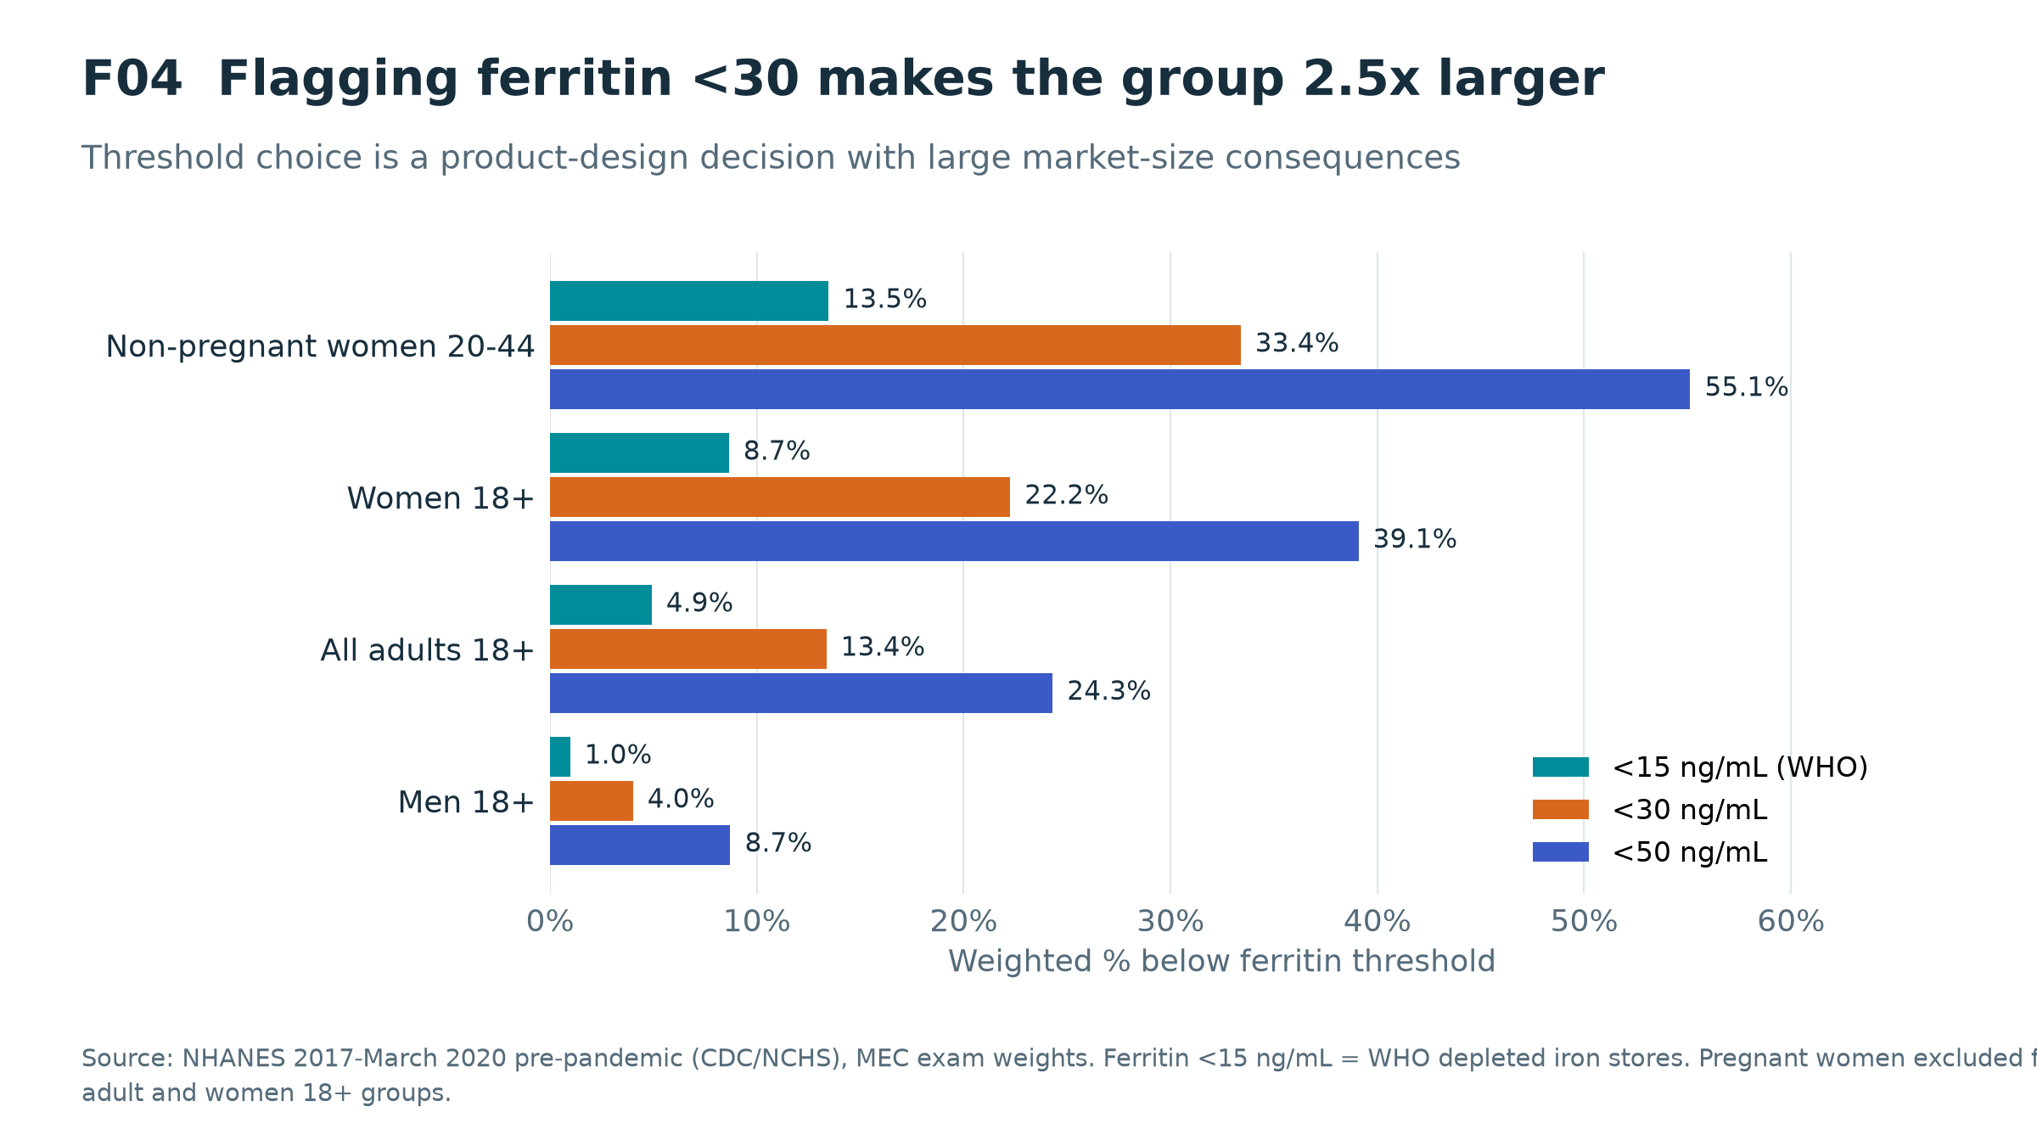
So what
<15 ng/mL: 13.5% of women 20-44; <30: 33.4%; <50: 55.1%.
A higher cutoff grows the market but raises false-positive and confirmatory-testing load.
Cutoff selection must be driven by validated assay performance, not market size.

Slide 7
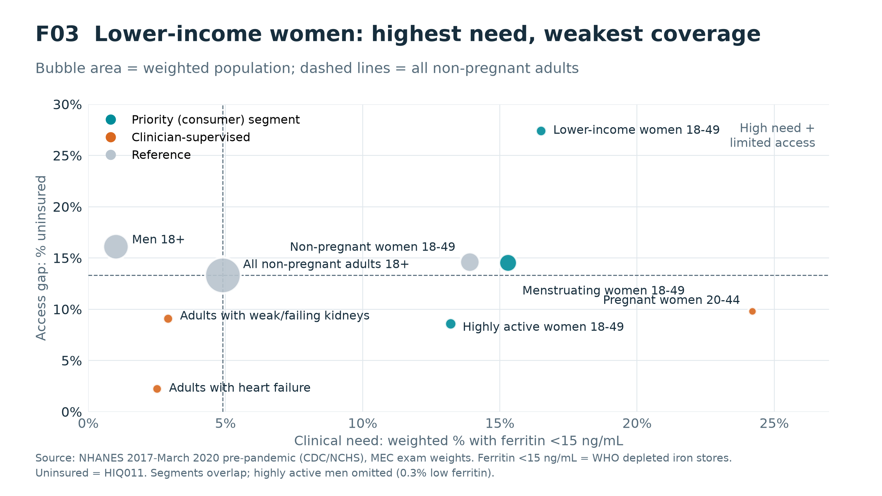
So what
Lower-income women sit alone in the high-need, low-coverage quadrant.
Direct-to-consumer pricing will not reach them; community-health, Medicaid or employer channels are needed (Hypothesis 5).
Highly active women have the best coverage and highest income, and the most to lose from fatigue: a premium DTC beachhead.

Slide 8
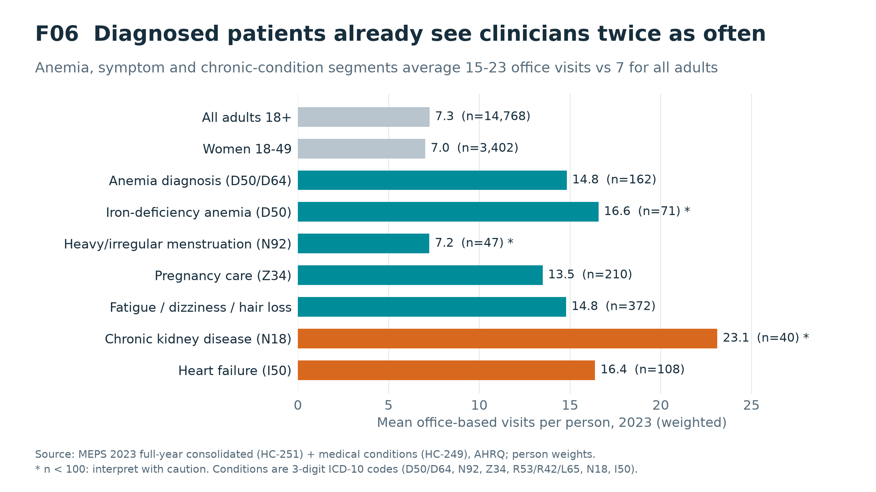
So what
Diagnosed anemia, symptom and chronic segments already average 15-23 office visits a year.
For them the gap is not access to clinicians but the absence of a ferritin trigger: a clinician-recommended channel fits.
Women 18-49 report delayed care at 10% (vs 7% of adults), which supports home convenience.

Slide 9
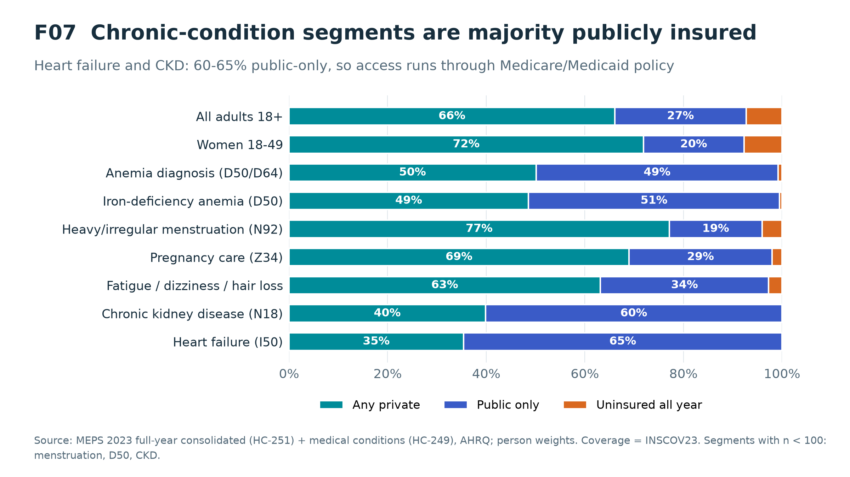
So what
Heart failure: 65% public-only; CKD 60% (n<100).
These segments' reimbursement runs through Medicare/Medicaid evidence standards.
Women with heavy menstruation are 77% privately insured (n<100), which fits an HSA/FSA-eligible or employer-benefit path.

Slide 10
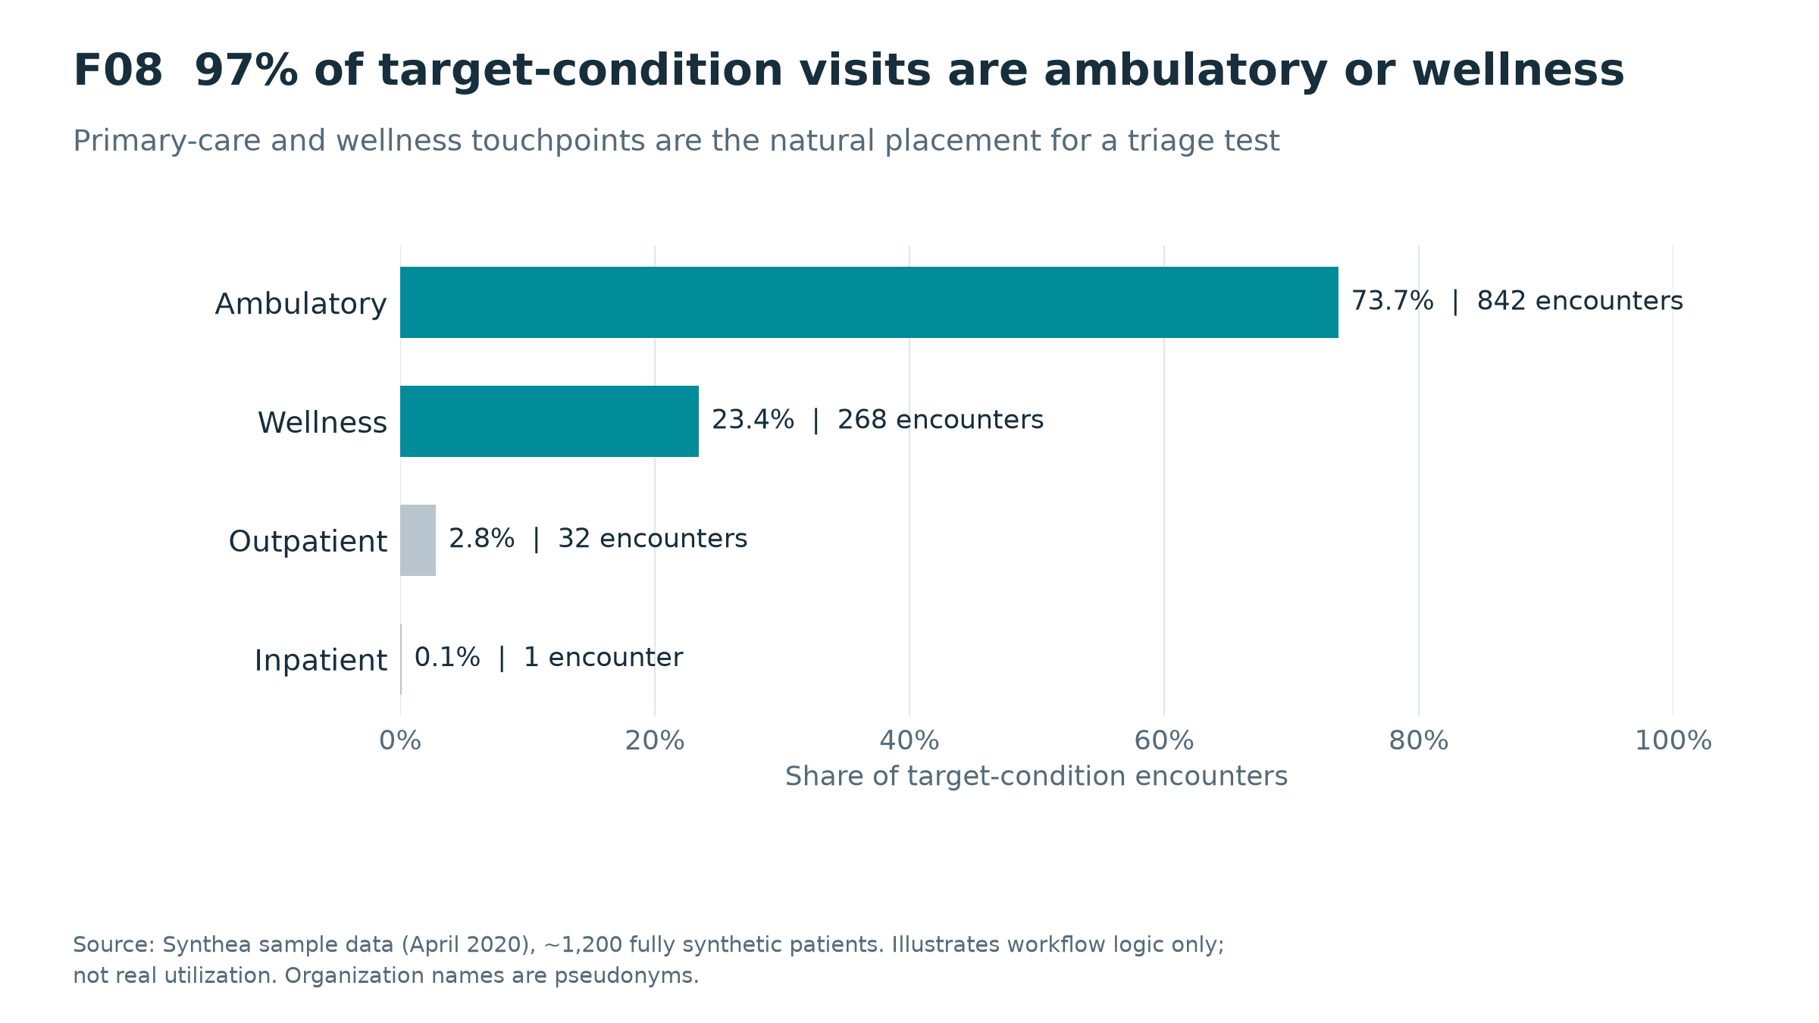
So what
97% of synthetic target-condition encounters are ambulatory or wellness visits.
Only 6% of anemia patients had a CBC in the year before diagnosis, and the export contains no ferritin observations at all.
This illustrates the confirmatory hand-off point, not real-world rates.

Slide 11
Hypothesis scorecard
Hypothesis | Verdict | Evidence
H1 Undetected early deficiency | Supported | F01: 55% of depleted women not anemic (NHANES)
H2 Segment concentration | Supported, refined | Menstruation/income drive prevalence; athletes: equal need, more hidden, more able to pay
H3 Workflow friction | Partially supported | MEPS delayed care / no usual source of care for women 18-49; Synthea is illustrative only
H4 Hybrid adoption | Consistent, not proven | Care is ambulatory-led (F08); needs a willingness-to-pay / pilot study
H5 Channels differ by segment | Supported | F03/F07: coverage and income differ sharply across segments
H6 Value depends on placement | Not testable here | Requires assay performance + outcome data

Slide 12
Recommendations and next actions
Finding | Stakeholder | Recommended action | Evidence required | Owner | Timing | Priority
Depleted iron without anemia is common in women 20-44 | Menstruating women 18-49 | Launch DTC + telehealth confirmatory-lab hand-off | Analytical validation vs serum ferritin at the chosen cutoff | Product / clinical | 0-12 mo | 1
Athletes: equal need, more often non-anemic, most able to pay | Athletes, teams, sports medicine | Beachhead: team / club / performance channels, premium DTC | Willingness-to-pay + usability study | Commercial | 0-12 mo | 1
Lower-income women: highest need, weakest coverage | Community health, Medicaid MCOs | Subsidised / community-health pilots | Cost-per-case-found vs lab-first screening | Market access | 12-24 mo | 2
Threshold drives market size 2.5x | Product team, KOLs | Pick cutoff on assay performance, not size | ROC analysis at 15 / 30 ng/mL | Clinical | 0-6 mo | 1
Chronic segments are publicly insured, high-use | Nephrology, cardiology, Medicare | Defer; monitoring indication later | Performance under inflammation (ferritin <100 / TSAT) | Clinical / regulatory | 24+ mo | 3

Slide 13
Limitations and what this analysis does NOT claim
• No product performance data: nothing here estimates sensitivity, specificity or clinical utility of any test.
• NHANES is cross-sectional: low ferritin today does not prove future anemia. Hemoglobin is not adjusted for smoking/altitude; segment flags are self-reported; pregnant n=76.
• MEPS conditions are self/household-reported, 3-digit ICD-10, and several segments have n<100. Expenditures are all-cause, not iron-testing costs.
• Synthea is synthetic: it demonstrates workflow logic and SQL design, not real utilization, payers or providers. Organization, provider and commercial-payer names are pseudonymised.
• Segments overlap and are not additive; population counts are weighted survey estimates with sampling error.

Slide 14
Appendix: reproducibility and TFL package
• python scripts/download_data.py → python run_pipeline.py → python scripts/build_tfl.py → python scripts/build_deck.py
• 22 SQL steps run against DuckDB; every embedded QA check must return PASS or the build stops (Listing L03).
• 12 tables (T01-T12, CSV + one Excel workbook), 9 figures (F01-F09, PNG + SVG), 3 listings (L01-L03).
• Python survey estimates are asserted against the SQL marts, so the two layers cannot drift.
• outputs/tfl_index.csv catalogues every output with its population and source table.

