Slide 1
Folk the Algorithms: ML and Folk Music
Bob L. Sturm (Tal, Musik och Hörsel)

Slide 2
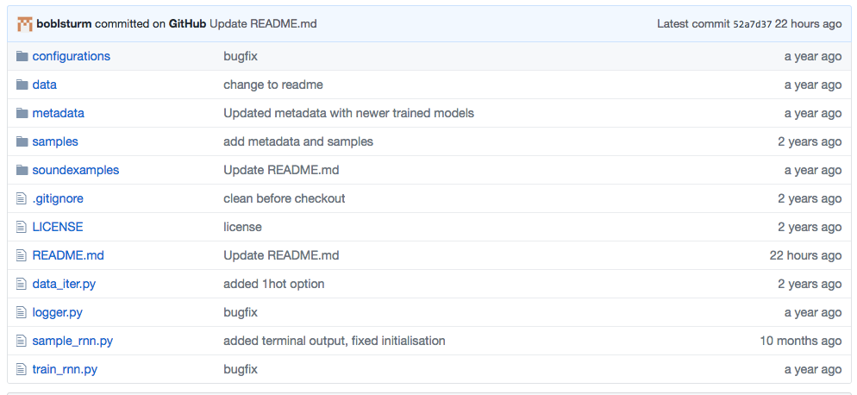
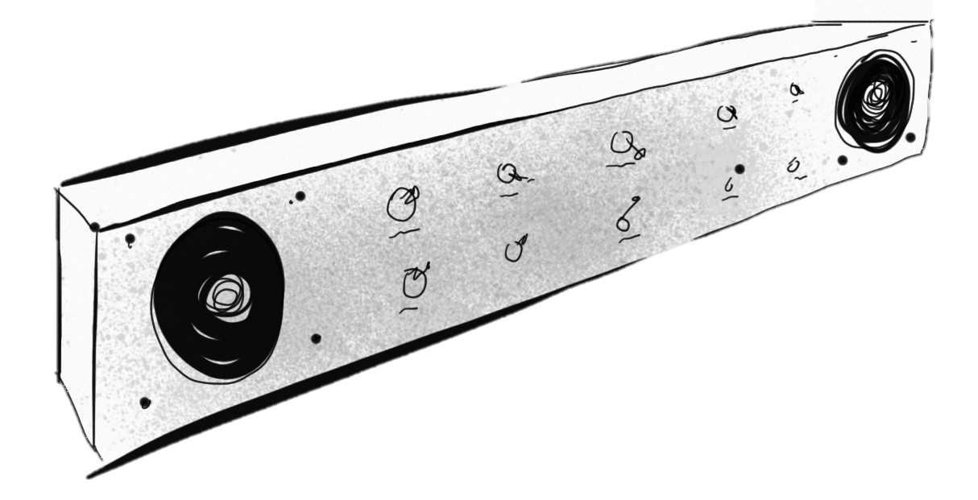
Folk music modeling using LSTMs (2015 –)
https://github.com/IraKorshunova/folk-rnn
folk-rnn
Sturm, Santos, Ben-Tal, and Korshunova, “Music transcription modelling and composition using deep learning,” in Proc. Conf. Computer Simulation of Musical Creativity, (Huddersfield, UK), 2016.

Slide 3

Off-the-shelf LSTM using a specific vocabulary
LSTM Layer 1
~5.6 million parameters
LSTM Layer 2
LSTM Layer 3
Softmax layer
Sample

Slide 4
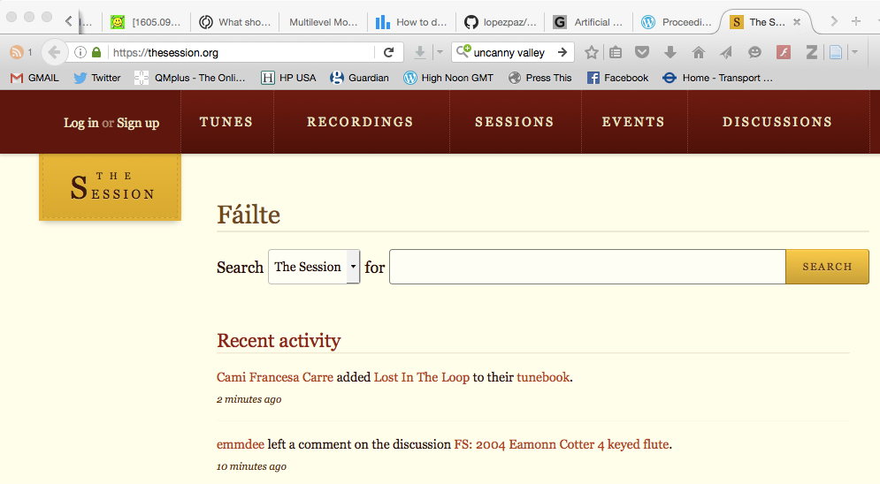
Training data
e.g., https://github.com/IraKorshunova/folk-rnn/blob/master/data/allabcwrepeats_parsed

Slide 5
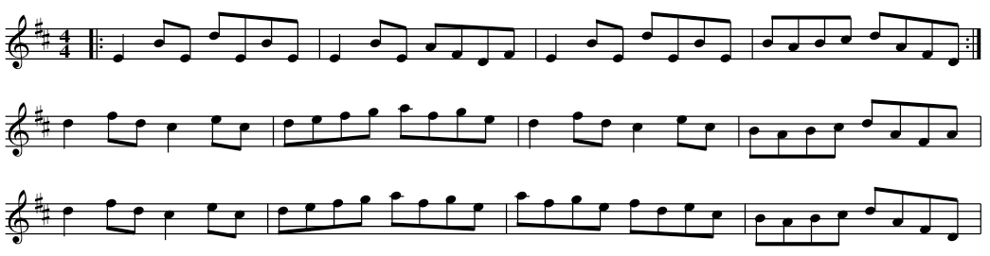
Example transcription from thesession.org
27,27,"Drowsy Maggie","reel","4/4","Edorian","|:E2BE dEBE|E2BE AFDF|E2BE
dEBE|BABc dAFD:| d2fd c2ec|defg afge|d2fd c2ec|BABc dAFA| d2fd c2ec|
defg afge|afge fdec|BABc dAFD|","2001-05-21 03:47:39","Jeremy"

Slide 6
Example transcription from thesession.org
27,27,"Drowsy Maggie","reel","4/4","Edorian","|:E2BE dEBE|E2BE AFDF|E2BE
dEBE|BABc dAFD:| d2fd c2ec|defg afge|d2fd c2ec|BABc dAFA| d2fd c2ec|
defg afge|afge fdec|BABc dAFD|","2001-05-21 03:47:39","Jeremy"
extract, transpose, tokenise

Slide 7
Off-the-shelf LSTM using a specific vocabulary
LSTM Layer 1
~5.6 million parameters
LSTM Layer 2
LSTM Layer 3
Softmax layer
Sample

Slide 8
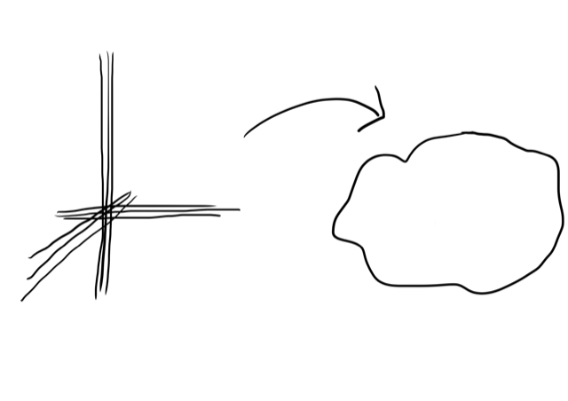
^f
e
K:Cmaj
LSTM i=1
|:
|2
>
4 gates
hidden state

Slide 9
LSTM i=2,3
4 gates
hidden state

Slide 10
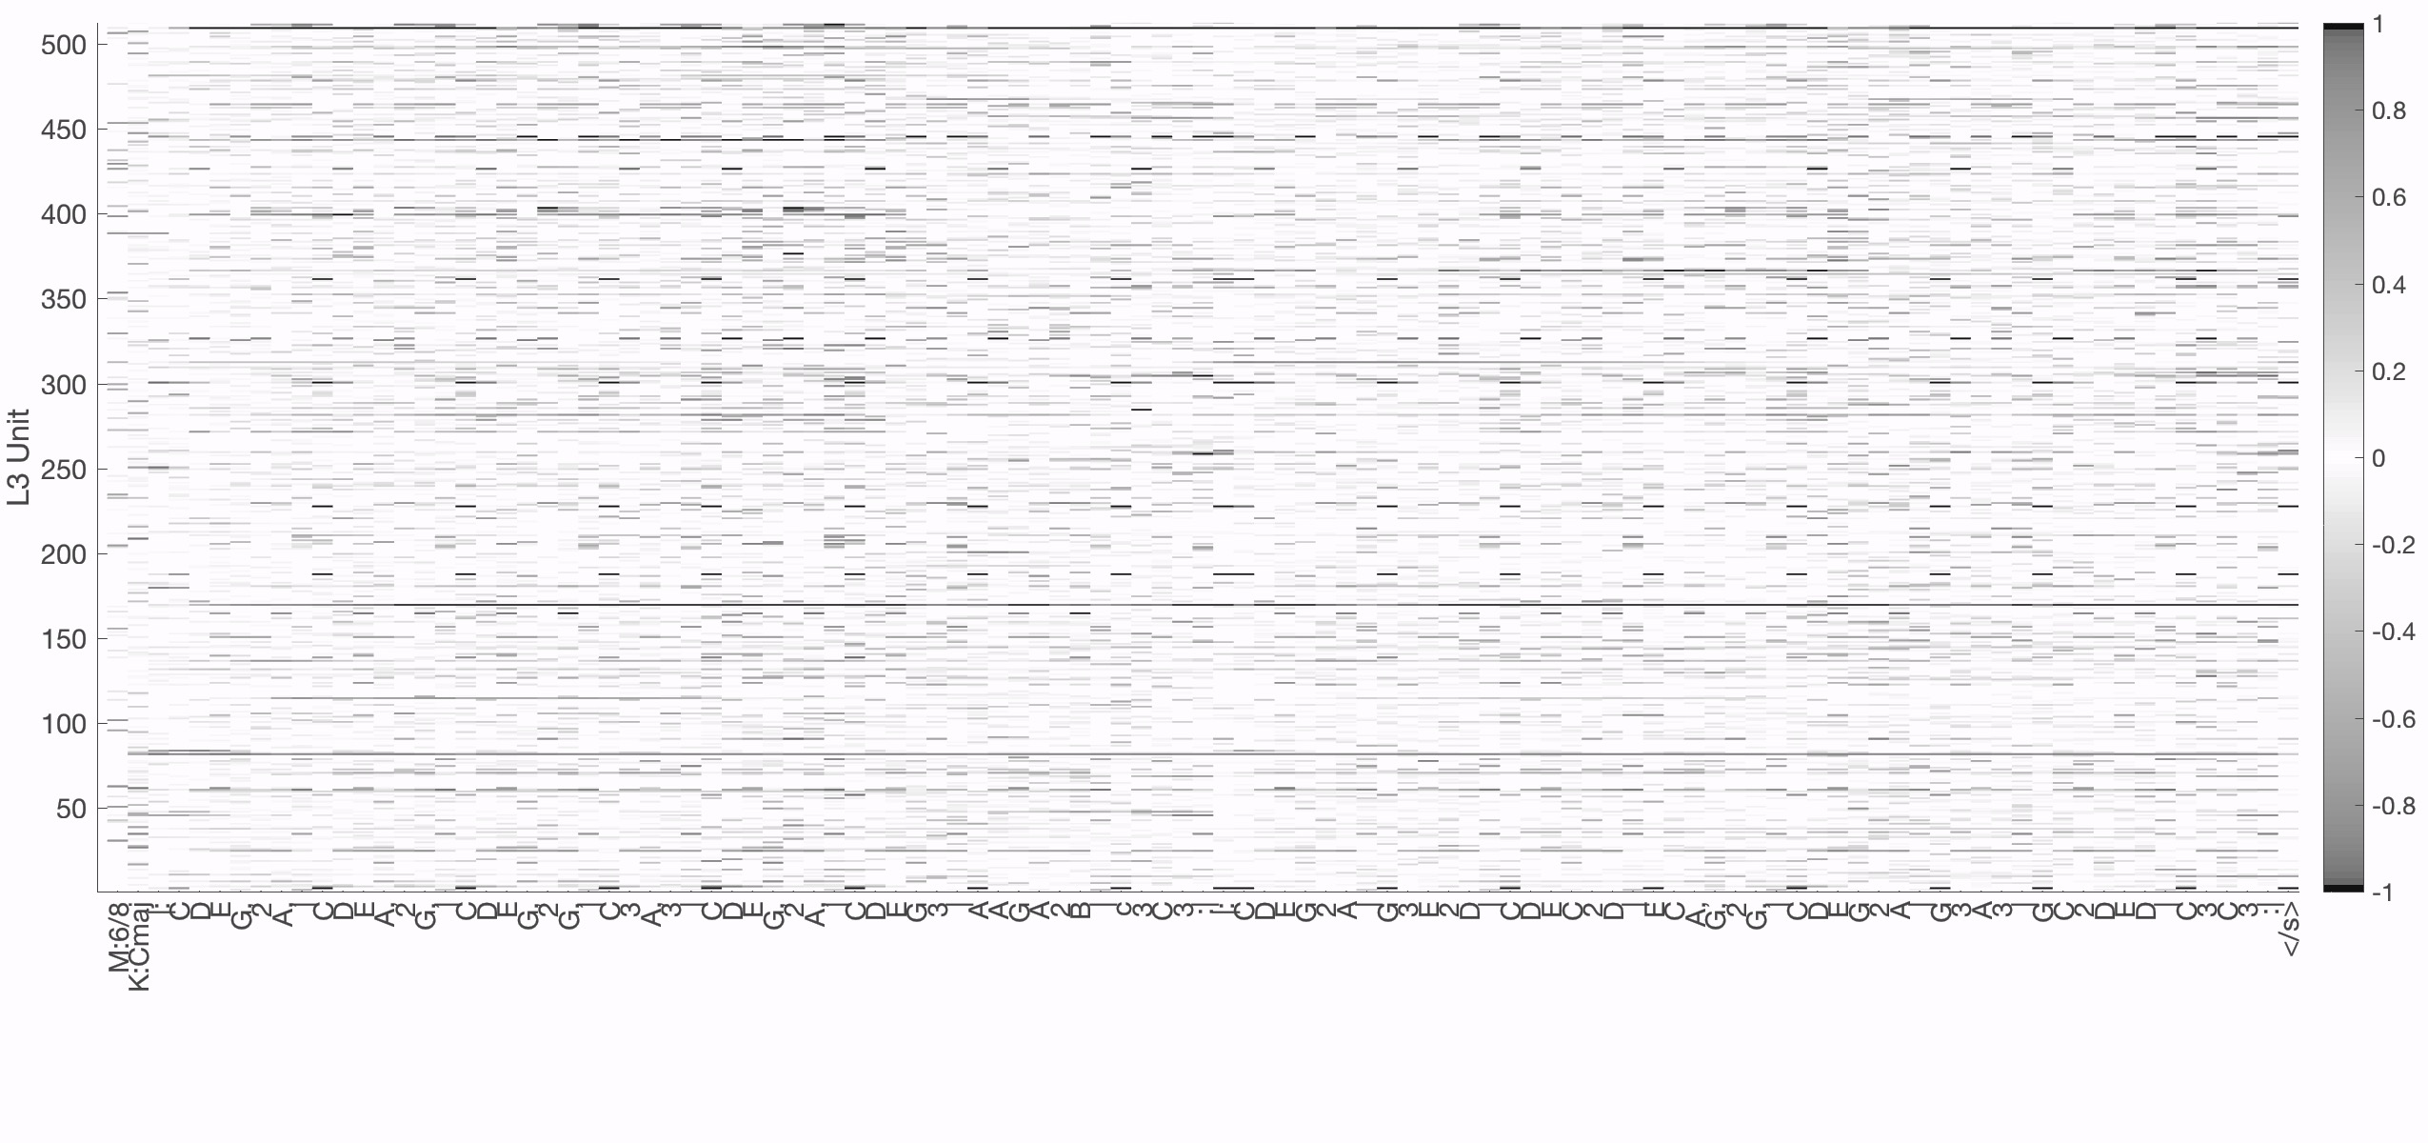
softmax
^f
e
K:Cmaj
1
|:
1
|2
1
>
+
L3 units
step (t)→
→
→
Softmax( )

Slide 11
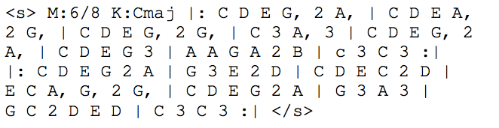
One example generated by folk-rnn (v2)
start
meter
mode
measure
pitch
duration
end

Slide 12
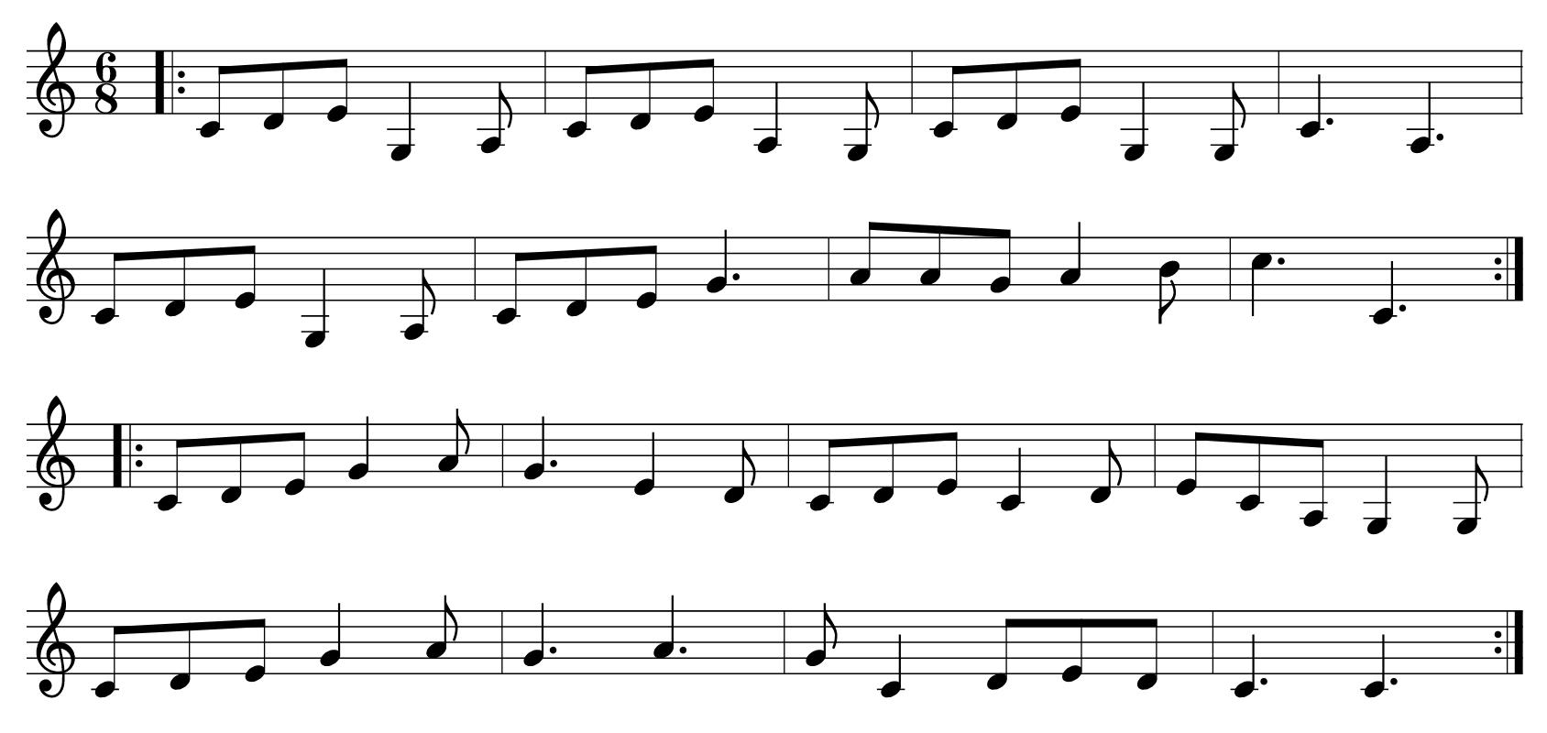
A transcription generated by folk-rnn (v2)
M:6/8
K:Cmaj
|:CDEG,2A,|CDEA,2G,|CDEG,2G,|C3A,3|
CDEG,2A,|CDEG3|AAGA2B|c3C3:|
|: CDEG2A|G3E2D|CDEC2D |ECA,G,2G,|
CDEG2A|G3A3|GC2DED|C3C3:|

Slide 13
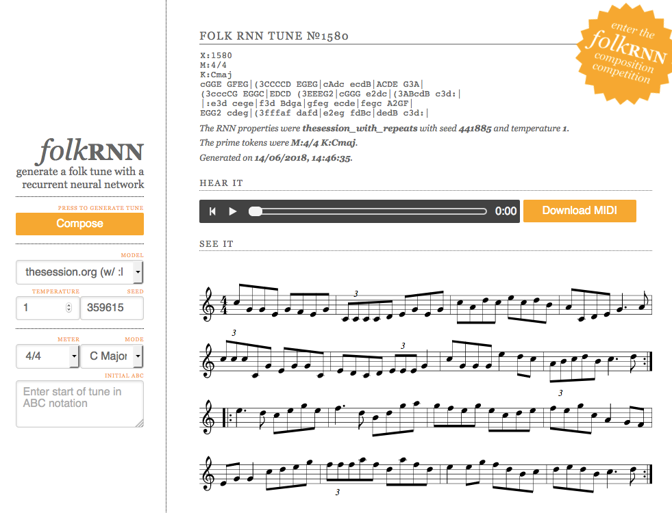
https://folkrnn.org/

Slide 14
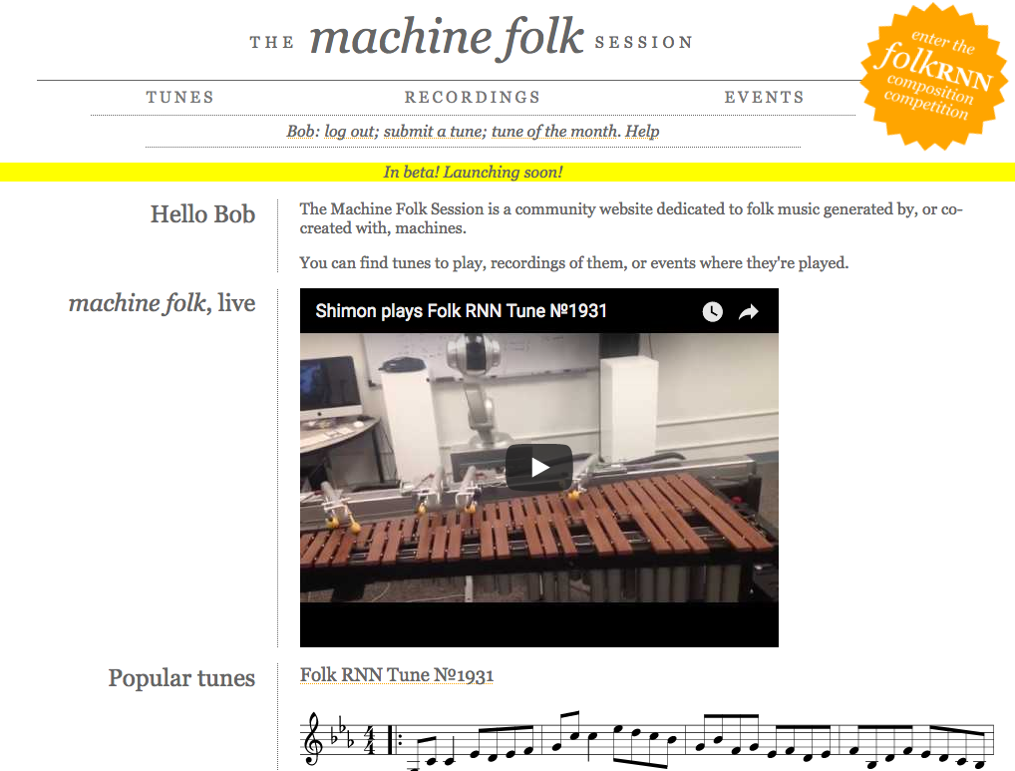
https://themachinefolksession.org/

Slide 15
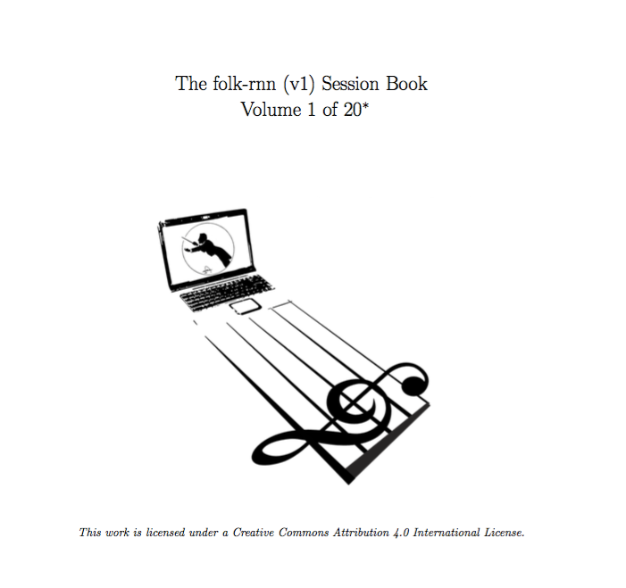
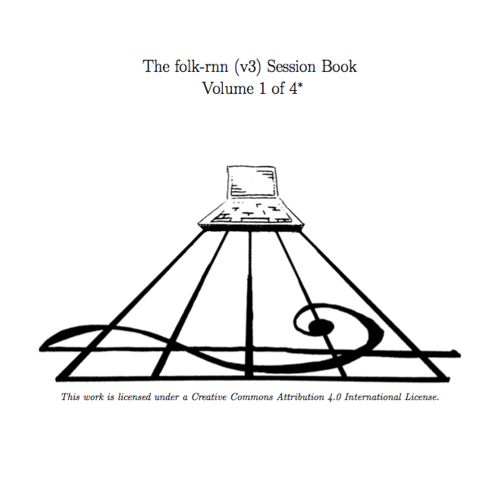
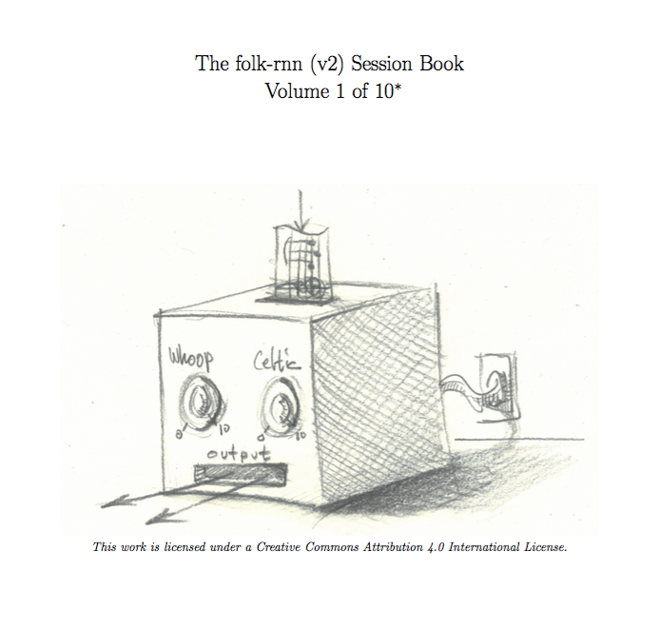
100,000 tunes in 34 volumes!
https://highnoongmt.wordpress.com/2018/01/05/volumes-1-20-of-folk-rnn-v1-transcriptions/

Slide 16
The problem is:
We need scalable methods to go through all this material:
To discover plagiarism
To find occurrences with particular patterns
To discover particular patterns
To roughly determine novelty
To find the strangest ones

Slide 17
Some ideas:
Generated transcription:
Plagiarism: Find the longest verbatim occurrence in the training data
Text comparison with sliding window which grows
Maybe just compare bars of tunes with same meter and mode
Pattern discovery
Find vocabulary of bars and half bars within each meter

Slide 18
Another idea:
Generated transcription:
Compare transcriptions in hidden state vector space:
Put transcriptions through folkrnn model and compare hidden state vectors, maybe using dynamic time warping?

Slide 19
softmax
^f
e
K:Cmaj
1
|:
1
|2
1
>
+
L3 units
step (t)→
→
→
Softmax( )

