Slide 1

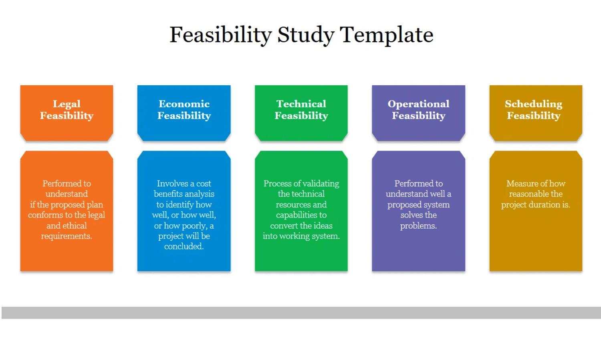
SwiftBite Food Ordering Service
Feasibility Study Presentation
Silicon Hills, Mile 91
Project Two Bitcom Group 1 (Year 3)
George B Sama (2024023)
Michael G.W.A.J Bangura (2024337)
Mariama Bendu (2024029)
Roland Lansana (2024273)
Arnold Ibrahim Lapo Koroma (2024106)
Ali Kalie Kamara (2024027)
Moriba Sahr Kondeh (2024104)
Mohamed I Bangura (2024123)

Slide 2

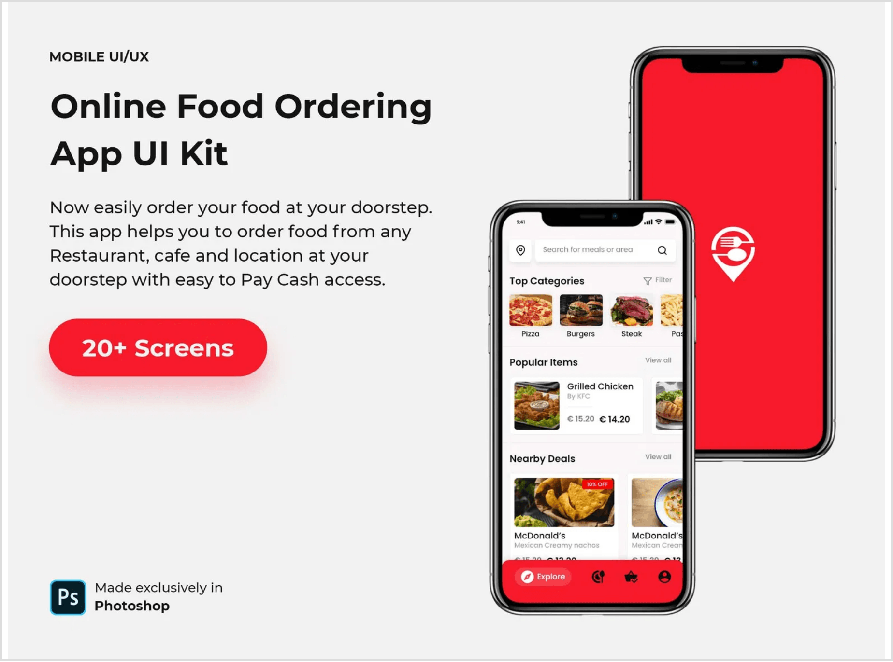
Introduction & Background
The Digital Shift
Modern food services are rapidly transitioning from manual to digital platforms to meet urban demands and efficiency standards.
SwiftBite Concept
A web-based full-stack food ordering and delivery system designed for speed, accuracy, and transparency.
Academic Alignment
Applying Year 3 BIT and Computer Science theoretical knowledge to solve real-world logistical challenges.

Slide 3

Project Concept
SwiftBite is a centralized web platform where users browse menus, place orders, and track deliveries in real-time, bridging the gap between hunger and fulfillment.
Customers
Vendors
Administrators
Seamless browsing of diverse menus, easy order placement, and real-time delivery tracking.
Efficient management of food items, real-time order processing, and sales performance tracking.
Full oversight of system health, user management, and platform-wide service quality control.

Slide 4

Problem Identification
01
02
Manual Inefficiencies
Communication Gaps
Traditional food service setups suffer from long waiting times and disorganized order management, leading to operational bottlenecks.
The lack of digital tracking systems results in frequent order errors, lost requests, and significant customer dissatisfaction.
03
04
Accessibility Issues
Data Management
Students and urban residents face difficulties in finding and ordering food conveniently amidst busy schedules.
Manual record-keeping is prone to data loss, hindering accurate performance analysis and inventory tracking.

Slide 5

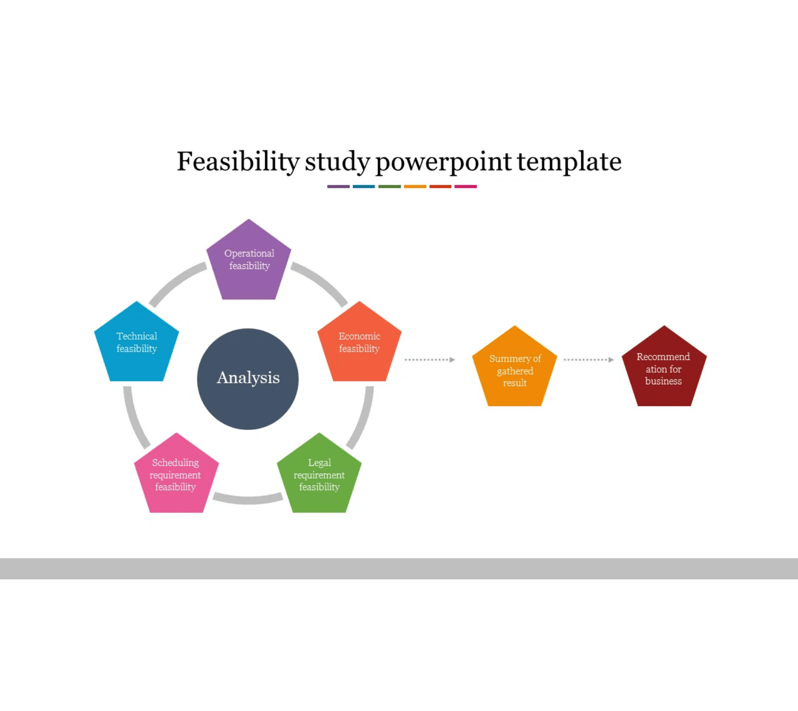
Study Objectives
01
Assess Overall Viability
Determine if the SwiftBite system is realistic and achievable within current academic and practical constraints.
02
Technical Evaluation
Verify if the proposed tech stack (React, Node.js, PostgreSQL) is suitable for achieving the project's functional goals.
03
Financial & Operational Analysis
Ensure sustainability with minimal costs and evaluate how effectively the system functions in a real-world environment.

Slide 6

Justification & Rationale
01
Service Improvement
02
Digital Transformation
Transitioning to SwiftBite will significantly improve service speed, accuracy, and transparency, addressing the core failures of manual systems.
The project directly addresses the lack of digital infrastructure in local food vendor operations, bringing them into the modern digital economy.
03
Resource Optimization
04
User Satisfaction
By eliminating paper records and manual processing errors, the system reduces operational costs and optimizes staff productivity.
SwiftBite provides a modern, convenient solution tailored to the primary needs of students and busy urban residents.

Slide 7

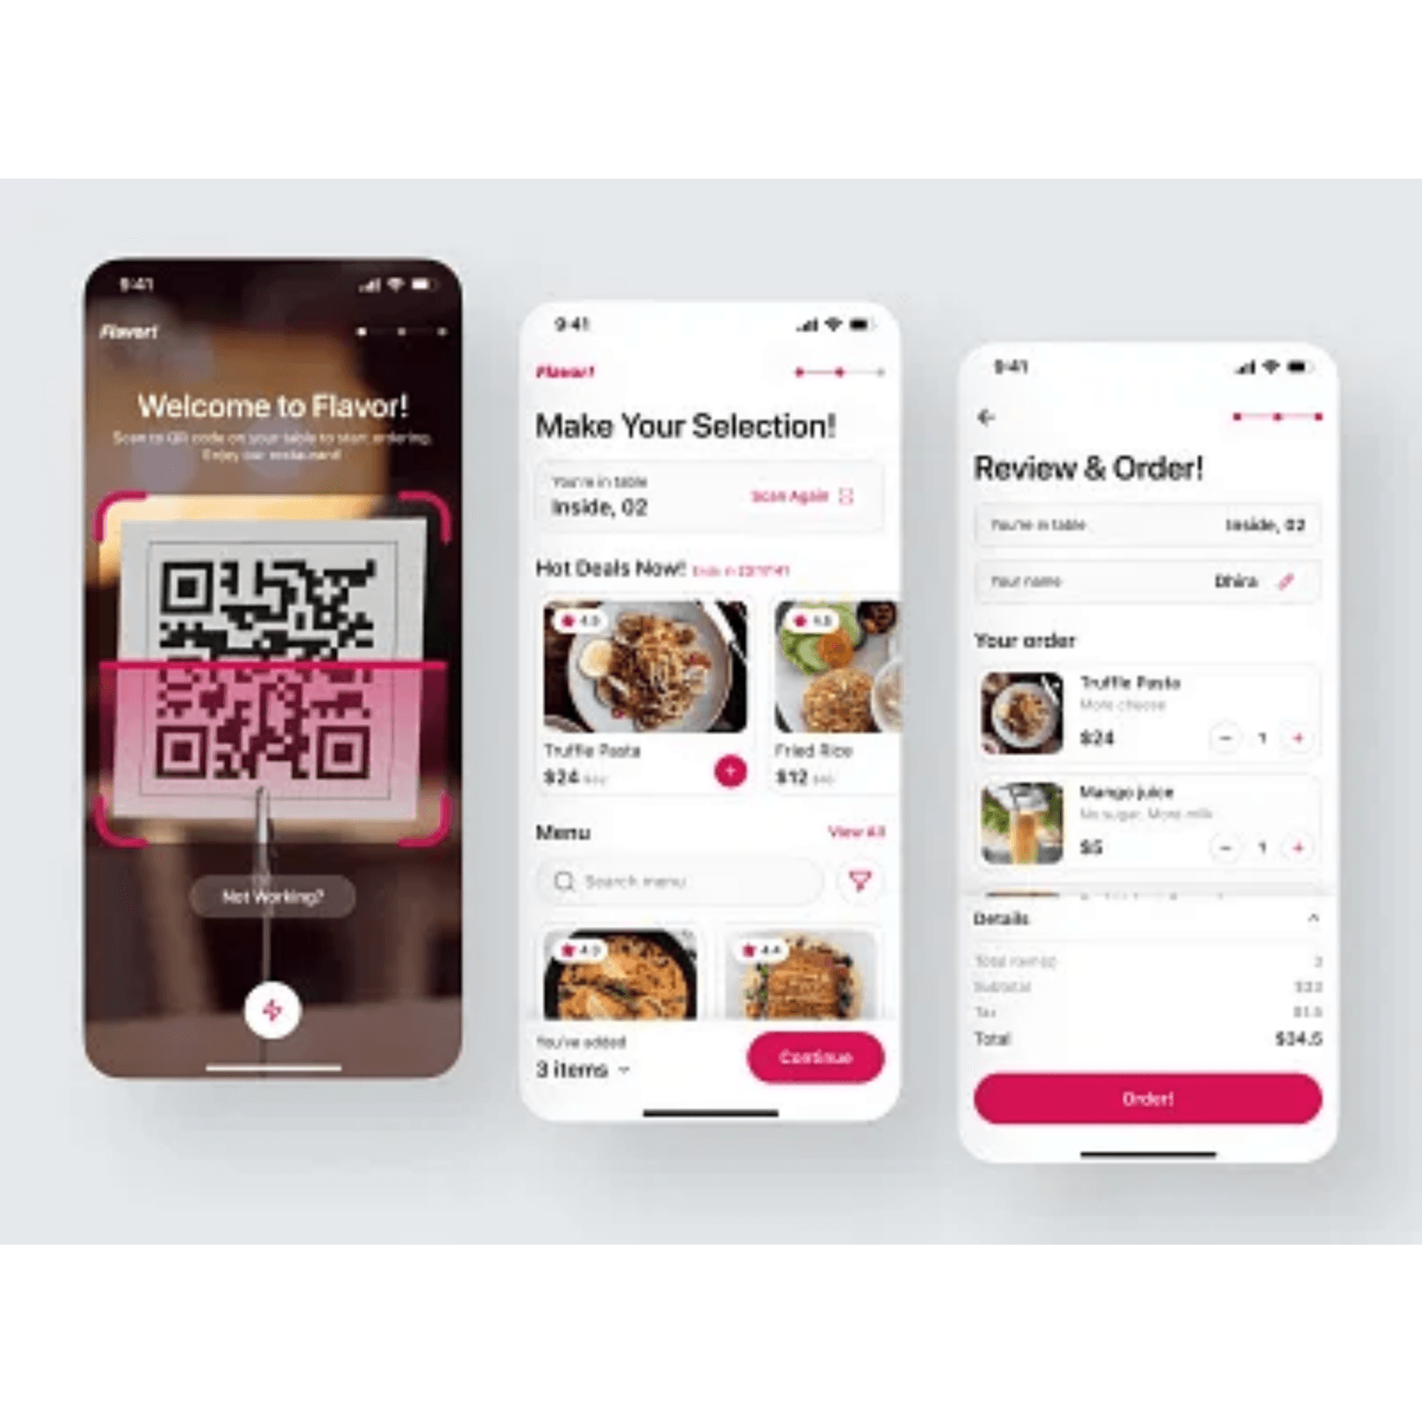
Target Users & Beneficiaries
University Students
Primary users seeking quick, reliable, and affordable food options during academic hours.
Urban Residents
Busy professionals and locals requiring efficient, trackable delivery services for daily meals.
Food Vendors
Small to medium businesses looking to digitize operations and expand their customer reach.
System Administrators
Staff responsible for platform maintenance, security, and ensuring smooth service delivery.

Slide 8

Technical Visibility
Modern Tech Stack
Frontend: React.js / EJS for dynamic UI
Backend: Node.js & Express.js Framework
Database: PostgreSQL for secure storage
Architecture & Readiness
Robust Client-Server model via RESTful APIs
Hardware: i5/Ryzen 3, 8GB RAM minimum
Team: Foundational JS & Web expertise

Slide 9

Economic Visibility
Estimated Budget
Cost-Effective Model
Expense Item
Cost (NLe)
Heavy reliance on free and open-source software (VS Code, Git, PostgreSQL) minimizes capital expenditure and ensures project sustainability.
Internet Data
500
Documentation / Printing
200
Miscellaneous
800
ROI Potential
Long-term savings are achieved through reduced manual errors, improved vendor efficiency, and elimination of paper-based record keeping.
Total Estimated Cost
1,500

Slide 10

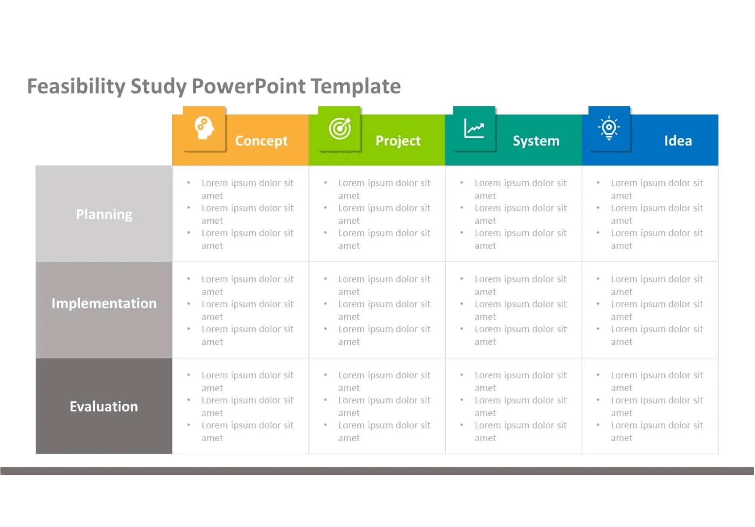
Operational Visibility
User-Friendly Interface
Designed for intuitive use, requiring minimal training for customers and vendors to navigate the platform effectively.
Workflow Integration
The system mirrors existing food ordering workflows and automates tracking, management, and reporting.
Maintenance & Support
Web-based deployment enables centralized updates, easier troubleshooting, and consistent performance monitoring.
Scalability
Modular architecture supports the seamless addition of more vendors and users as the service grows.

Slide 11

Legal & Ethical Considerations
Data Privacy
Security Protocols
Implementation of secure authentication and authorization protocols to protect sensitive user information and maintain confidentiality.
Use of advanced password hashing and role-based access control (Admin, Vendor, Customer) to prevent unauthorized system access.
Compliance
Ethical Handling
Strict adherence to acceptable use policies and local digital service regulations to ensure the platform operates within legal frameworks.
Ensuring transparency in order processing, fair representation of vendor offerings, and responsible management of customer feedback.

Slide 12

Potential Challenges & Risks
Technical Hurdles
Internet Connectivity
Potential complexities in full-stack integration and database management; mitigated by continuous team learning and documentation.
Reliance on stable internet for real-time updates remains a challenge in some local areas, requiring optimized data handling.
Adoption Rate
Resource Constraints
Encouraging traditional vendors to switch to a digital platform may face resistance; requires simple onboarding and clear value demonstration.
Managing development within a tight academic schedule and limited budget requires disciplined project management and prioritization.

Slide 13

Conclusion
The SwiftBite project is confirmed as technically, financially, and operationally viable.
Strategic Value
Project Readiness
SwiftBite addresses a clear gap in the local food service market, providing a modern digital solution that enhances efficiency and user satisfaction.
The team is fully equipped with the necessary open-source tools and foundational knowledge to proceed with the development phase immediately.

Slide 14

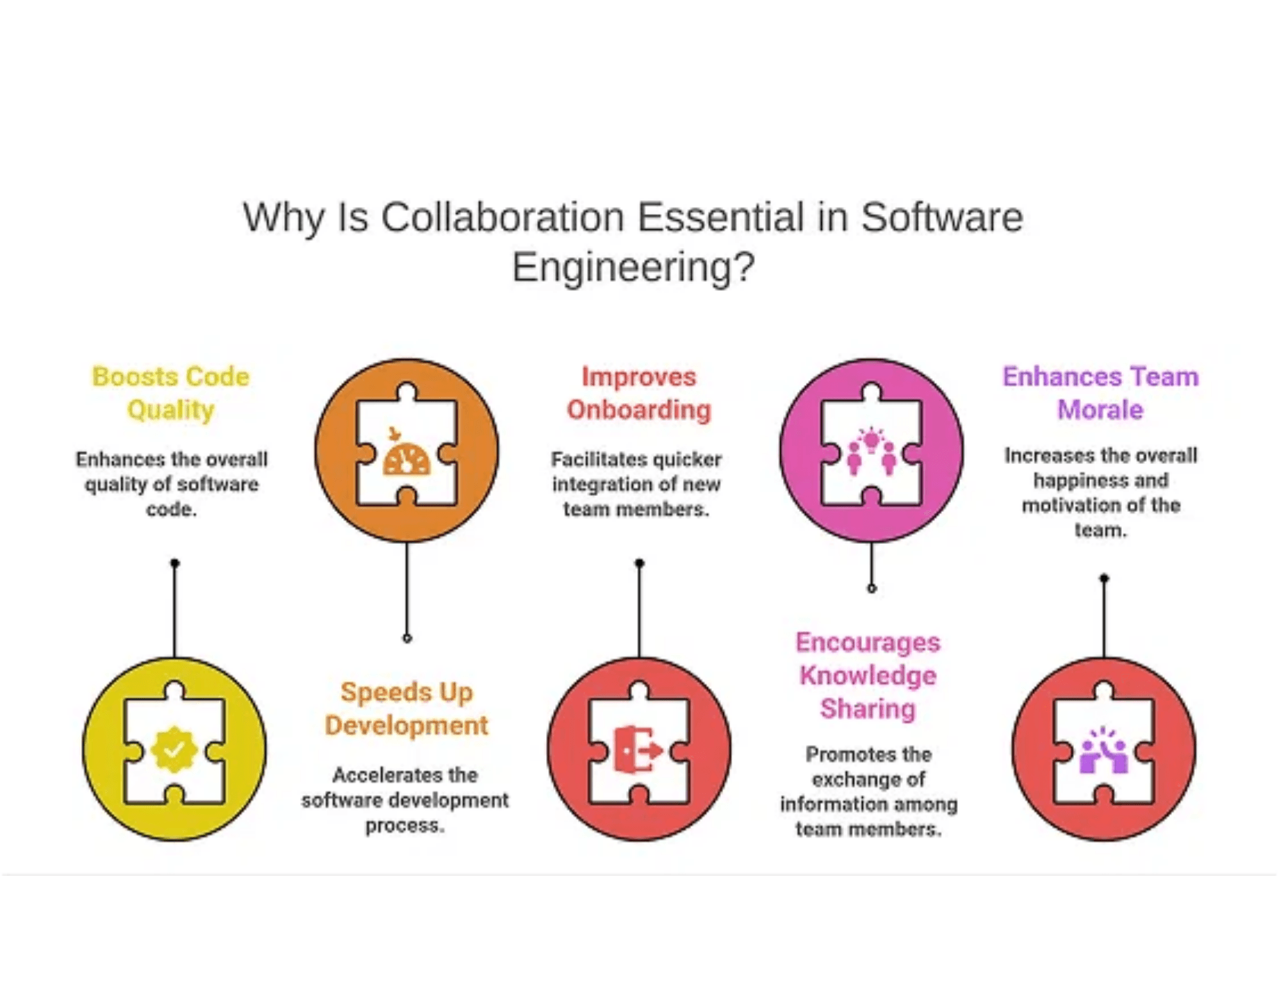
Recommendations
Phased Implementation
Launch a pilot program with a small group of vendors to gather initial feedback and refine the ordering workflow.
Feature Expansion
Prioritize the integration of secure digital payment systems in the next development phase to enable end-to-end transactions.
User Training & Onboarding
Develop simple, visual guides for vendors and customers to ensure smooth adoption and minimize technical friction.
Continuous Monitoring
Establish a robust feedback loop with students and residents to continuously refine the user experience and system performance.

