Slide 1
DevOps

Slide 2
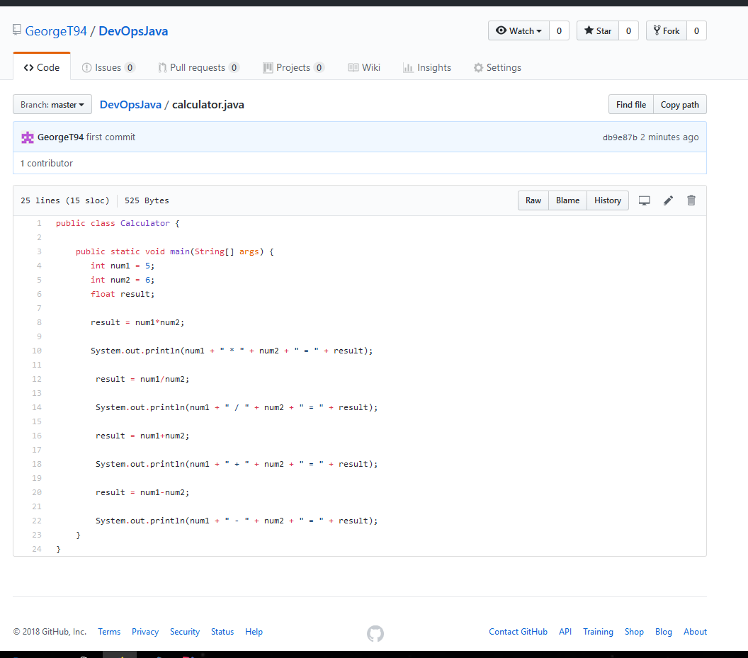
Java calculator program created and added to github

Slide 3
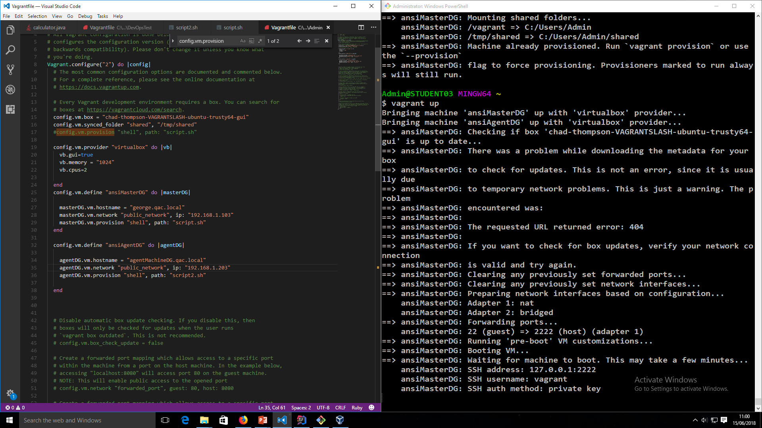
Created a vagrant file to load up two machines with a shared folder and provision scripts.

Slide 4
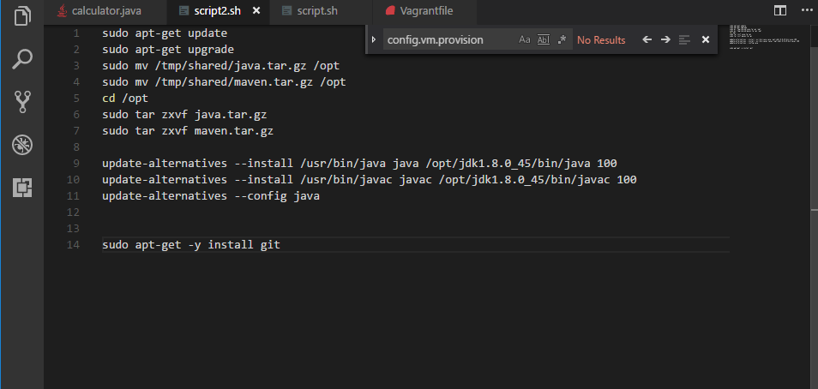
Created a bash script to unzip java tar file and install java and git.

Slide 5
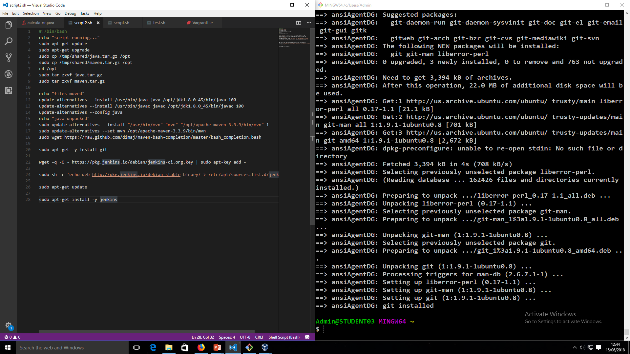
Created another bash script to also install maven and Jenkins on the other vm

Slide 6
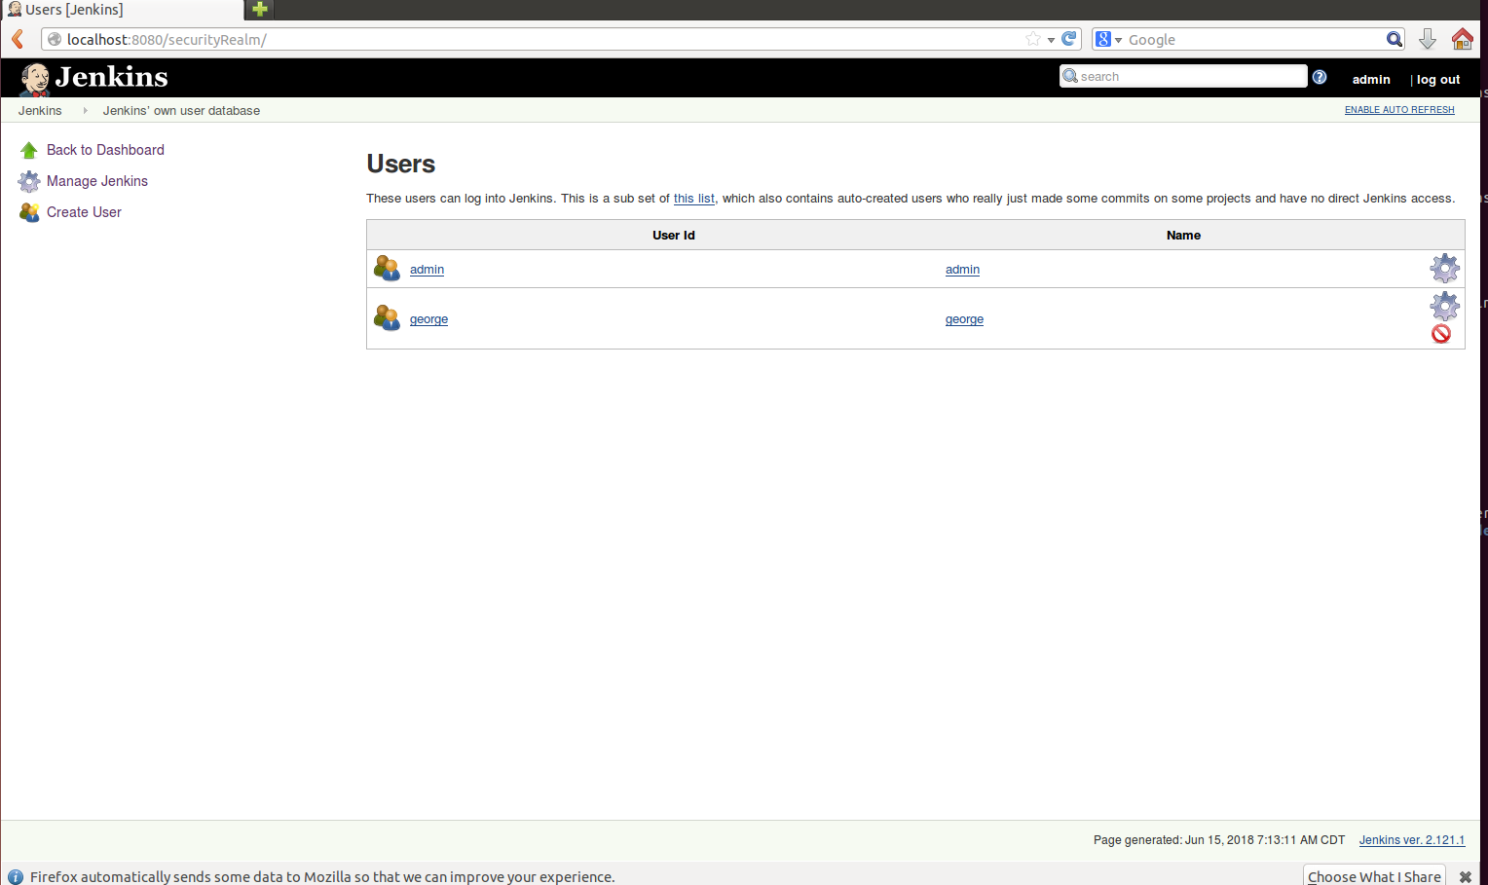
Jenkins installed successfully

Slide 7
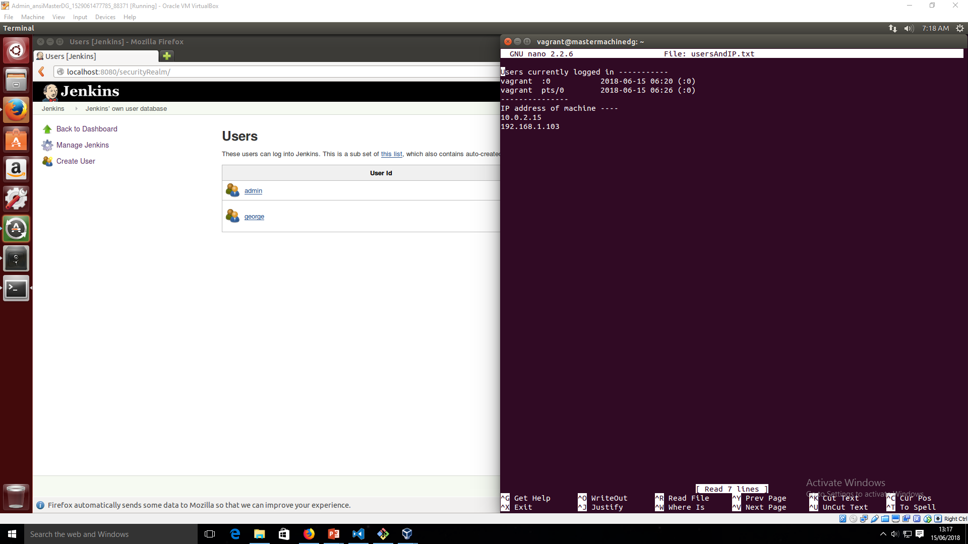
Created bash script to log users and IP address

Slide 8
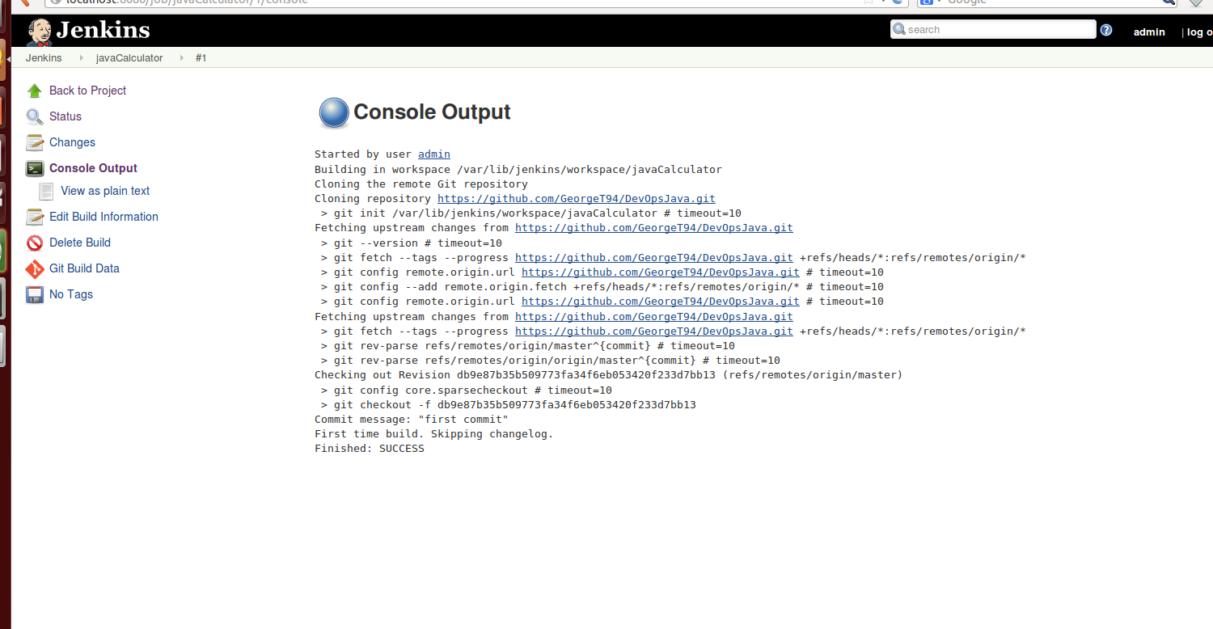
Successful build!

Slide 9
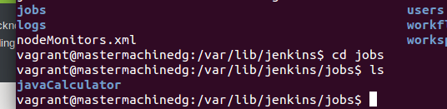
Java file archived

Slide 10
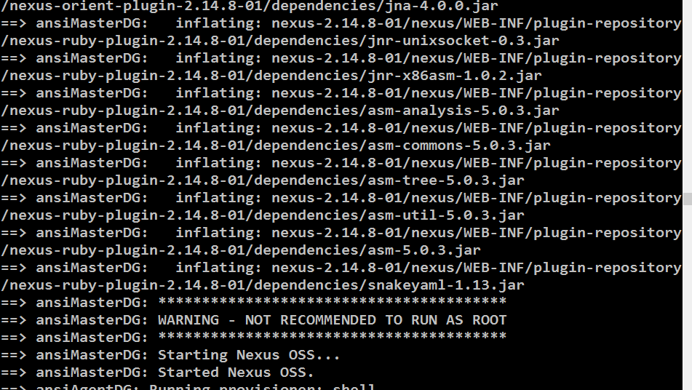
NEXUS installed

Slide 11
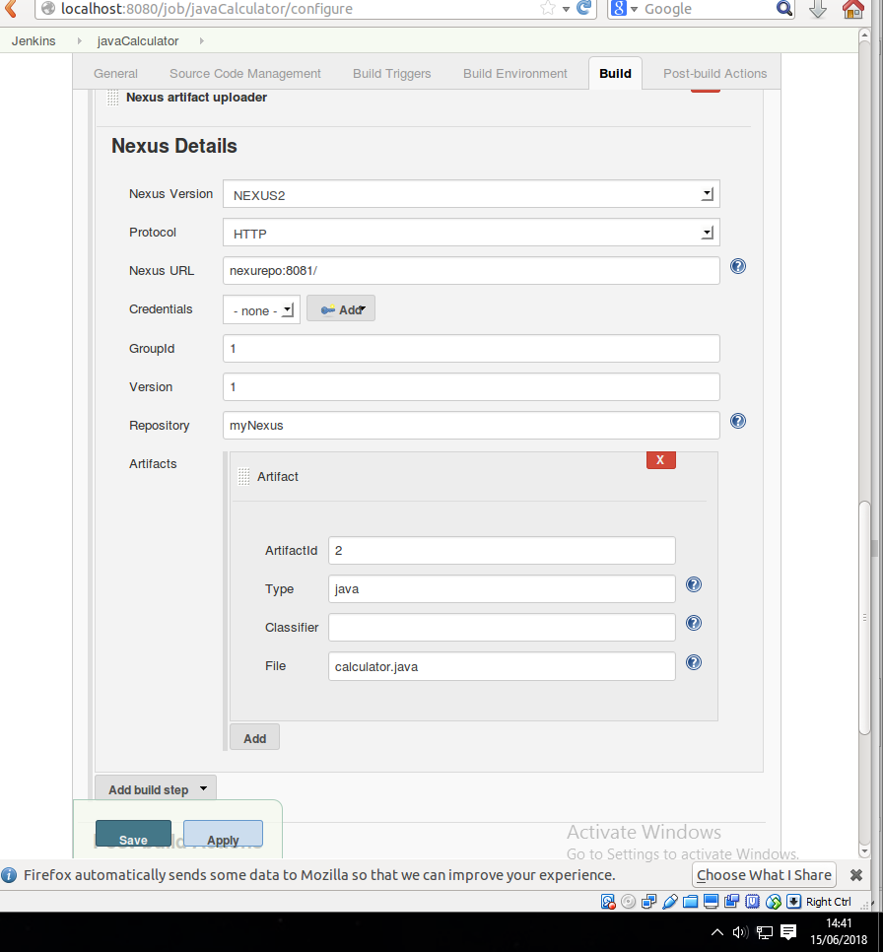
Nexus plugin added

Slide 12
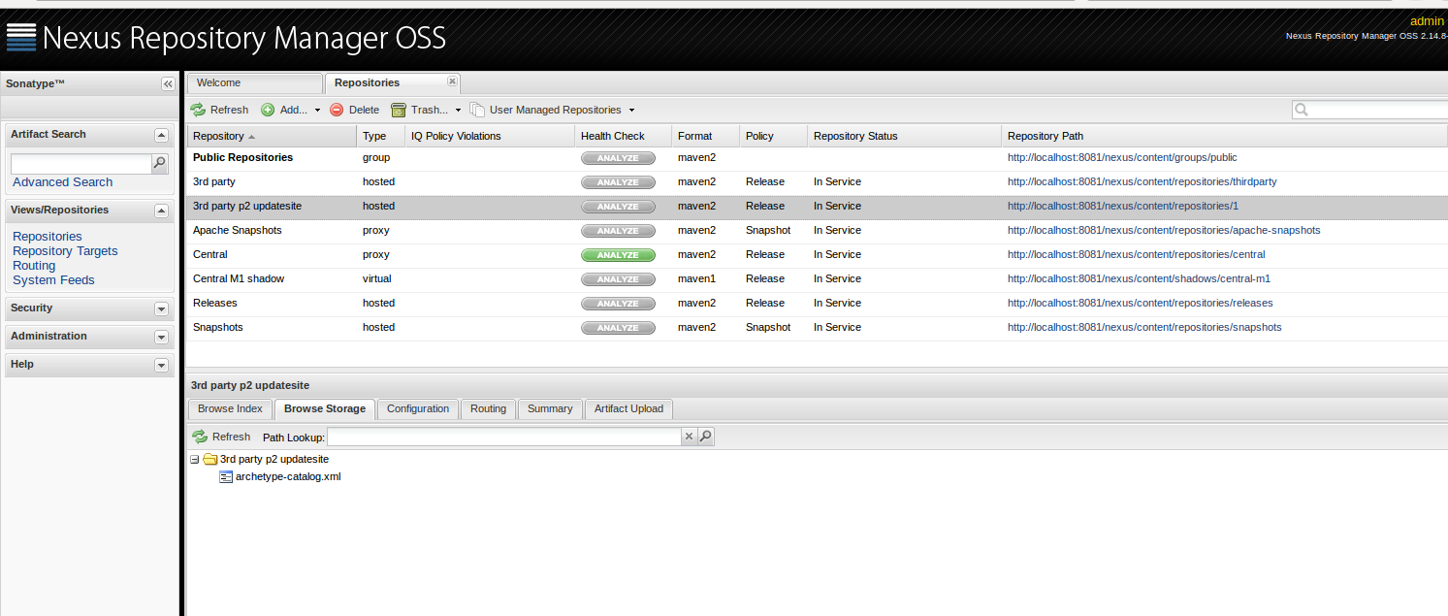
Nexus repositories created

Slide 13
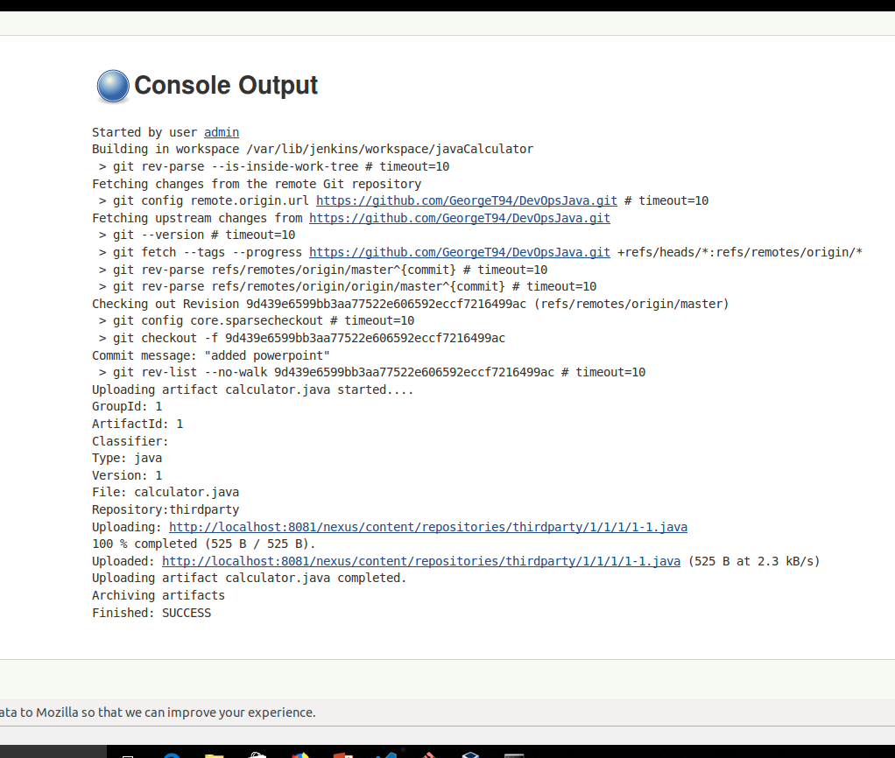
Successful nexus build

