Slide 1
Hotel Online Booking application Aegean Blue Hotel
Team 30
Christos Katsandris – 1072755
George Tsialios - 1072868

Slide 2
Application goals – Use cases Hotel customer
Account Creation – Login (optional)
Search for Available Rooms Based on Dates of Stay and Number of Guests
Room Booking – Enter Personal Details
Receive Booking Confirmation via Email
View and Manage Bookings (Change Dates, Cancel)
User story:
Nikos books two double rooms at the Aegean Blue Hotel for his family of four, for the dates June 25–28. His reservation includes breakfast and free cancellation. This is the fourth year he chooses our hotel for their vacation, so he is entitled to a discount on the final price. A few days later, due to unexpected obligations, he changes the booking dates to July 2–5.

Slide 3
Application goals– Use cases Hotel administrator
(In addition to customer functionalities)
Overview and management of all bookings (change rooms, modify dates, cancel)
Manage application administrators
User story:
Chrysa, the reservations manager at Aegean Blue Hotel, reviews the bookings for the upcoming week and makes the necessary changes to the rooms they occupy. She then adds Konstantina Petropoulou, a new hotel employee, as an administrator.

Slide 4
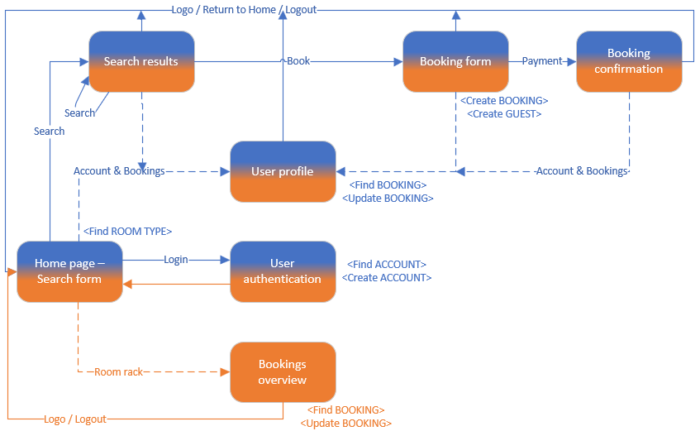
Navigation map

Slide 5
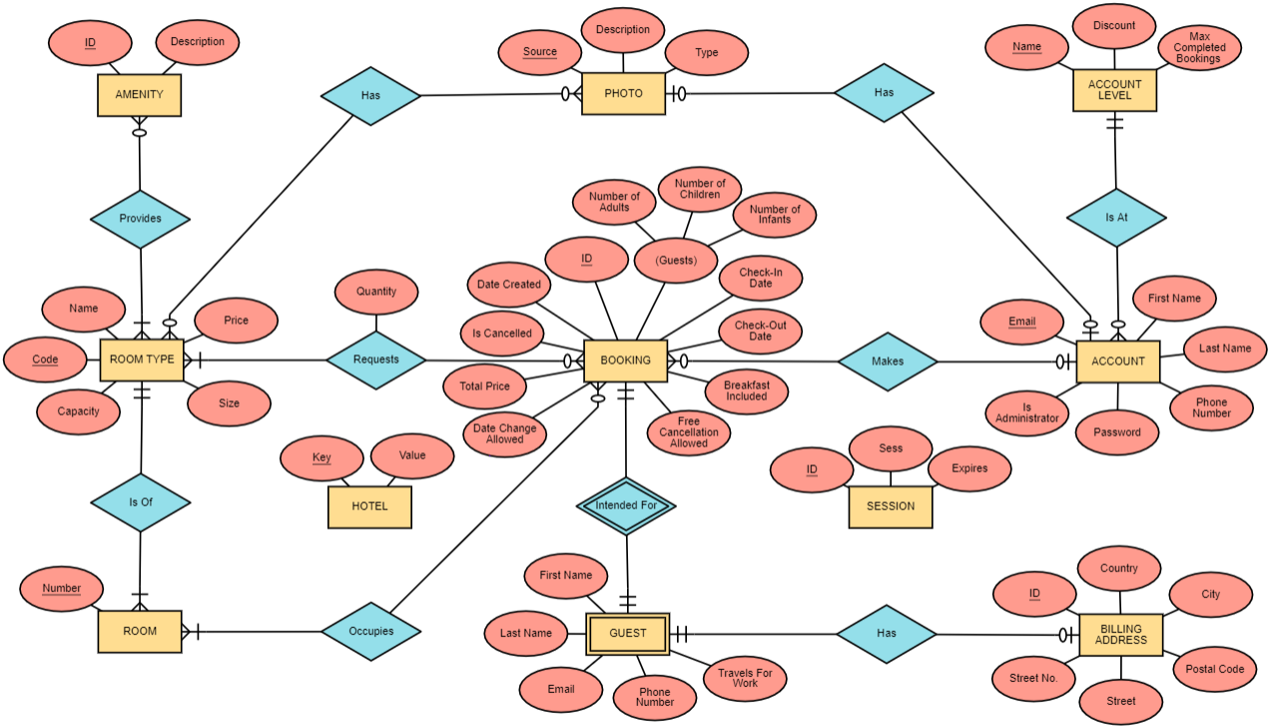
Entity Relationship Diagram

Slide 6
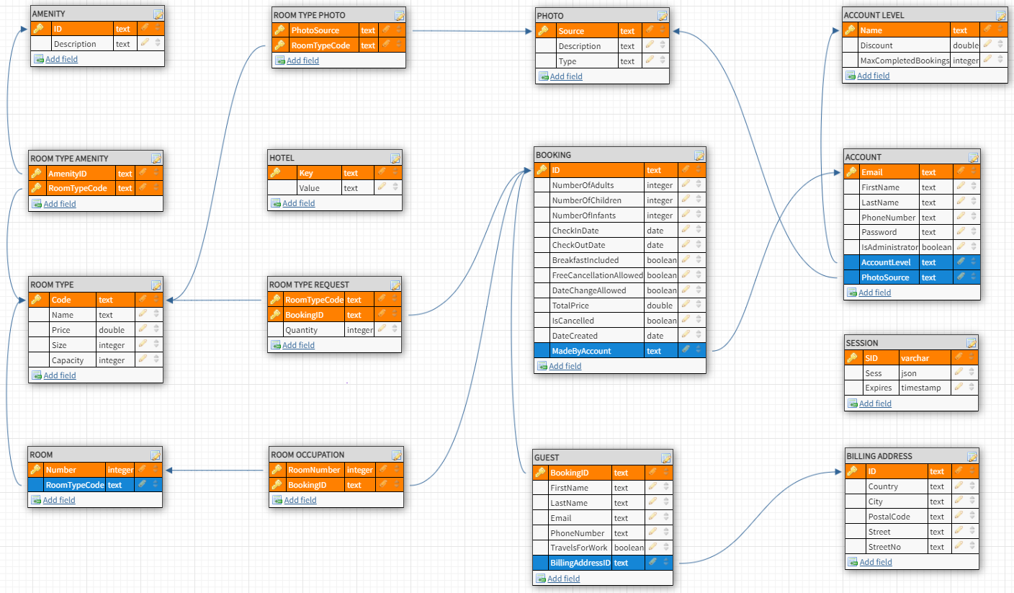
Schema

