Slide 1
Flight Ticket Search & Booking Application
Team 50
Christos Katsandris
George Tsialios

Slide 2
Problem Requirements & Application Goals
Flight Search
Based on the following criteria:
Ticket Booking
With the following features:
▶ Location (city, country or region)
▶ Departure date (specific or flexible)
▶ Price limit
▶ Airline
▶ Number of stops
▶ One-way / Round trip
▶ Fare selection
▶ Seat selection
▶ Option to add checked baggage
▶ Option for child / infant ticket
▶ Booking confirmation in PDF

Slide 3
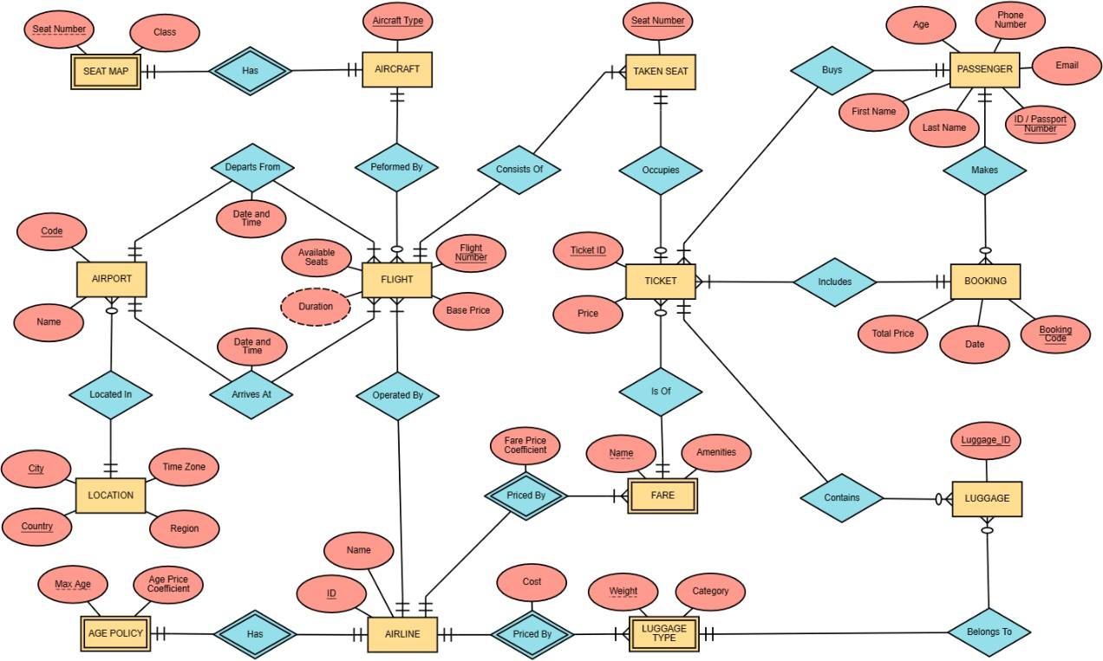
Entity Relationship Diagram

Slide 4
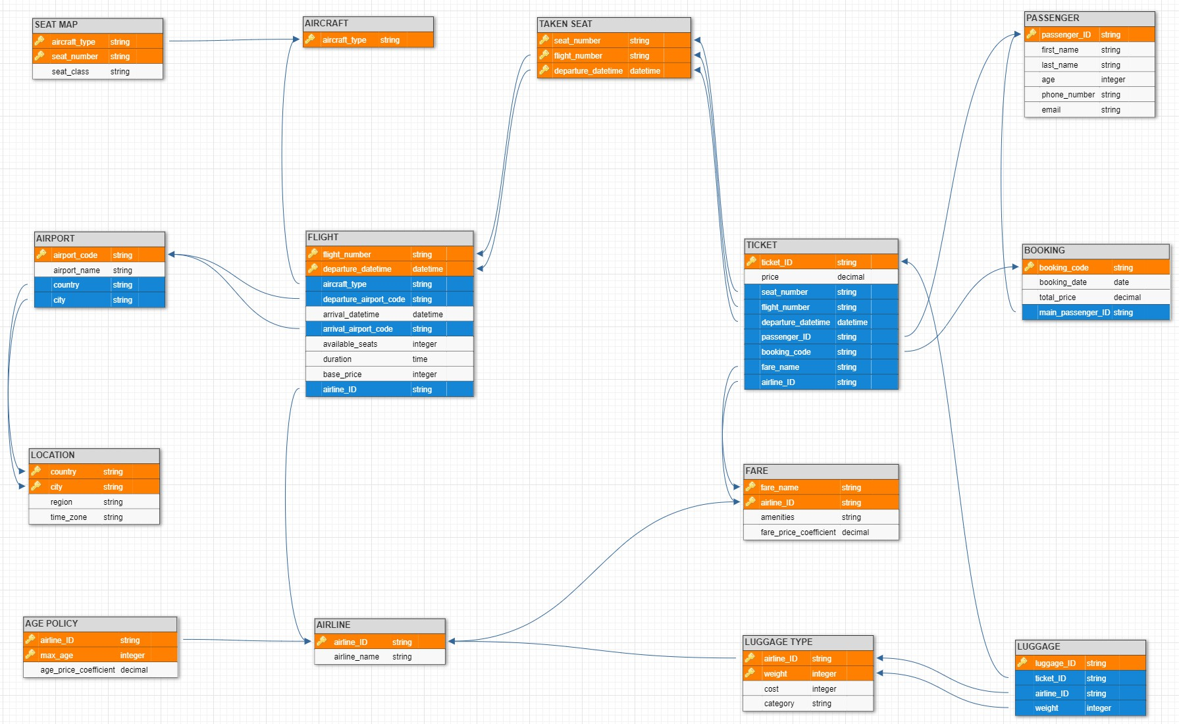
Schema

Slide 5
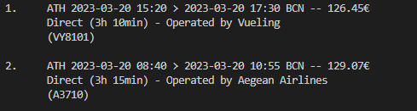
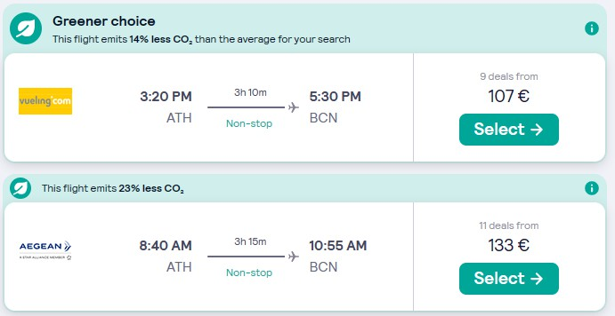
Results Check
FlyNow Results
Skyscanner Results

