Slide 1
SPORTS SCHEDULING PROBLEM FOR AMATEUR LEAGUES
Linear & Combinatorial Optimization
Electrical and Computer Engineering Department
GEORGE TSIALIOS

Slide 2
AMATEUR TOURNAMENTS
Non professional
Participation of athletes as a hobby
Student championships, short tournaments, local leagues

Slide 3
PROFESSIONAL vs AMATEUR LEAGUES
Professional leagues | Amateur leagues
Alternation of home and away games | Breaks are negligible, all matches are equivalent
Consideration for teams from the same city | Home advantage is insignificant
Commercial purposes (fans, TV coverage) | Few fans, no television coverage
Full season match schedule | Weekly match schedule
Rare postponement of matches | Frequent match postponements
Even distribution of matches throughout the season | Uneven distribution of matches throughout the season
Minimization of travel distance or breaks | Maximization of player availability

Slide 4
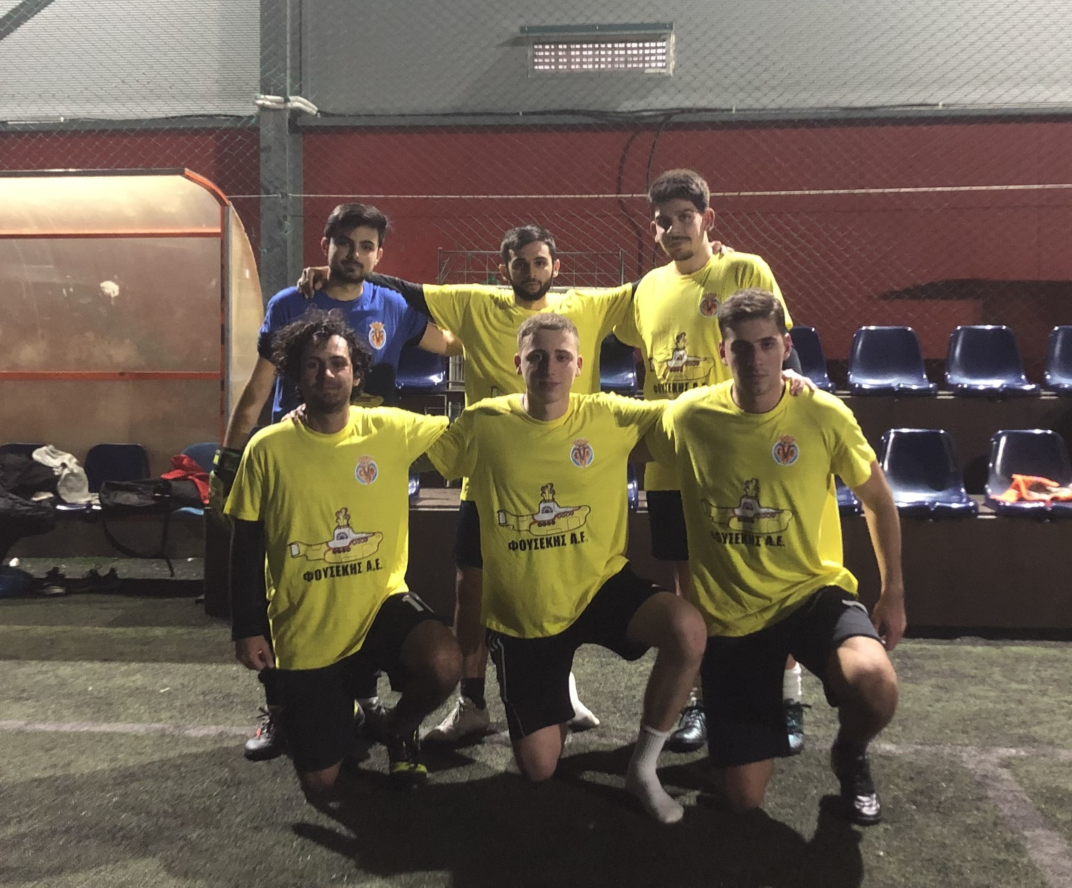
CASE STUDY Student 5X5 tournament
VILLARREMAL FC

Slide 5
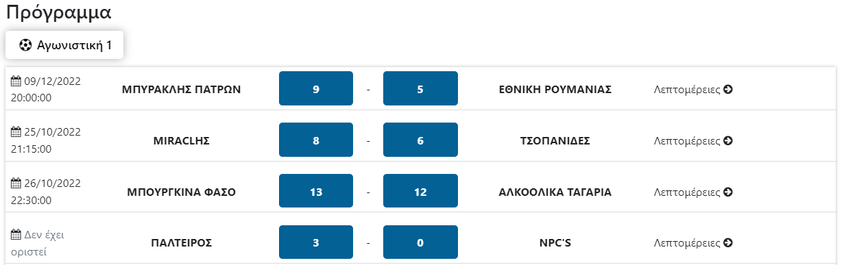
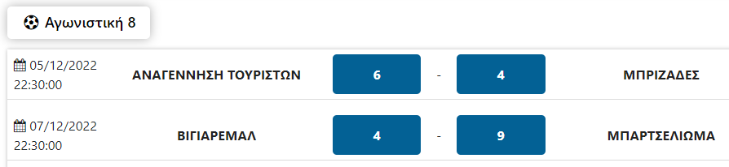
PROBLEM
MATCH SCHEDULING
Time-consuming, manual process
Inefficient outcomes
Missed matches (less revenue for organizers, fewer games for players)

Slide 6
GOAL
Development of a system for:
Automating the match scheduling process
Finding the optimal match schedule
Faster results

Slide 7
STUDENT 5X5 TOURNAMENT
Tournament rules:
Pending matches:
8 teams of 6 players
Asynchronous, single Round Robin tournament
5 available days [Monday – Friday]
Max 1 match / day
Available team when ≥ 5 players available
Occur when the maximum possible number of matches is not played in a week
They are rescheduled:
Either in a catch-up slot in the following weeks
Or in the extra (8th) week

Slide 8
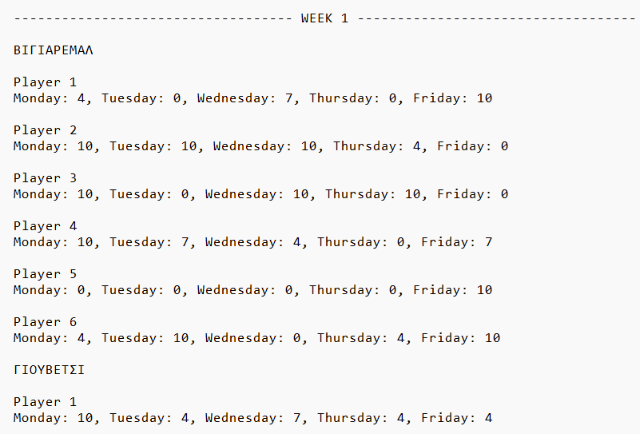
PLAYER AVAILABILITY
Weekly Preference Submission:
File: availability-8.txt (random value assignment)
0 → I am not available
4 → I am available, but do not prefer it
7 → I am available and quite prefer it
10 → I am available and strongly prefer it

Slide 9
PROBLEM MODELING
via Integer Linear Programming
Datasets
Constant
T: set of all Teams
D: set of available Days
Weekly Changing
M: set of Matches Played
Ε: set of pending matches (Extra)
P: set of players’ Preferences

Slide 10
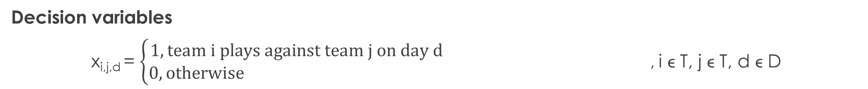
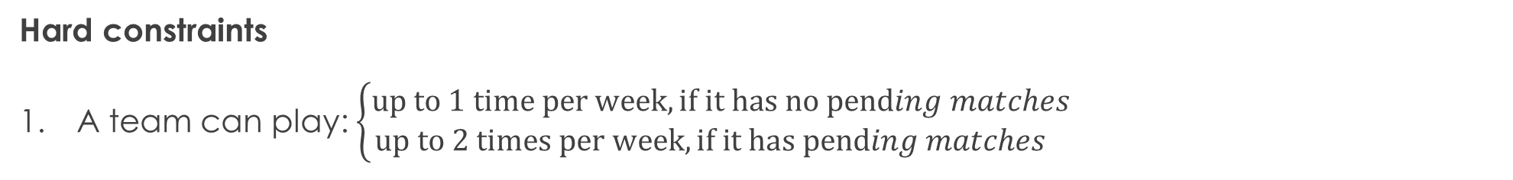
PROBLEM MODELING
Decision variables
x_{i,j,d} = $\left\{\begin{aligned}1, team i plays against team j on day d \\ 0, otherwise \end{aligned}\right.$ , i ϵ T, j ϵ T, d ϵ D
Hard constraints
A team can play: $\left\{\begin{aligned}up to 1 time per week, if it has no pending matches \\ up to 2 times per week, if it has pending matches \end{aligned}\right.$

Slide 11

PROBLEM MODELING
Hard constraints
2. A time can play up to 1 time with another team
3. A team (which has pending matches) can not play on 2 consecutive days.
4. Home court – away games are the same.

Slide 12

PROBLEM MODELING
Hard constraints
5. Up to 1 match can be played per day.
6. A team can play when at least 5 of its players are available.

Slide 13
MATCH SCHEDULE GOAL
Organizers:
Maximize games played per week
Players:
Maximize team availability on matchdays
Maximize team preference on matchdays
Minimize GPD (Games Played Difference)

Slide 14
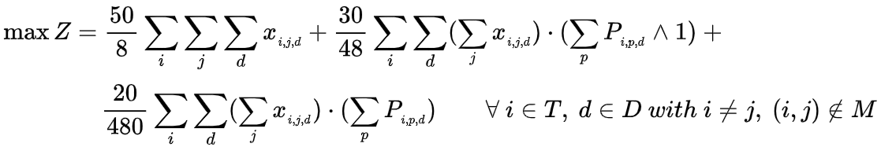
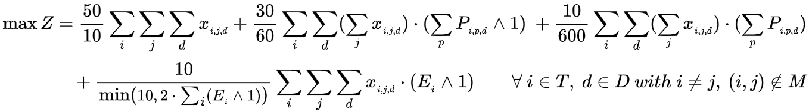
PROBLEM MODELING
Objective function
For weeks without pending matches:
For weeks with pending matches:

Slide 15
SOLUTION IMPLEMENTATION
Using Python and the PuLP library
3 different problem sizes:
8 teams
12 teams
16 teams

Slide 16
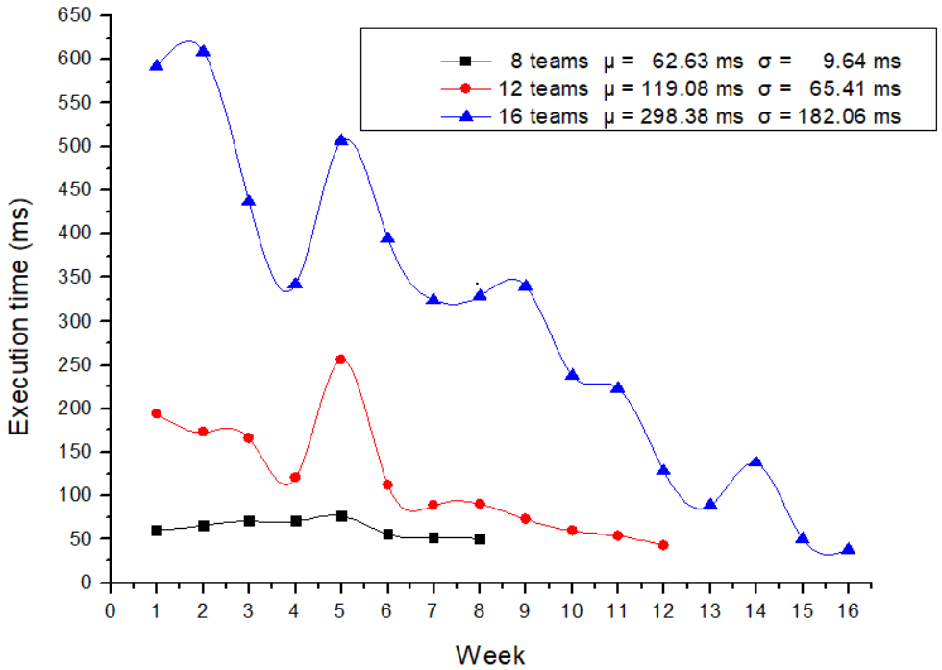
EFFICIENCY
On a system with a Intel® Core™ i5-8265U CPU @ 1.60GHz 1.80 GHz and 8GB RAM

Slide 17
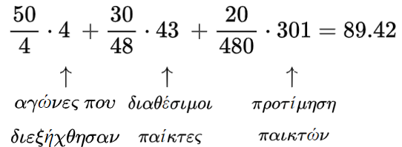
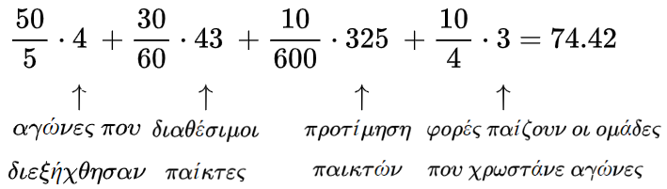
ΕΚΤΕΛΕΣΗ ΠΡΟΓΡΑΜΜΑΤΟΣ 8 ΟΜΑΔΩΝ
Επαλήθευση αντικειμενικής συνάρτησης
Week 1
Week 3

Slide 18
ΤΕΚΜΗΡΙΩΣΗ ΑΝΤΙΚΕΙΜΕΝΙΚΗΣ ΣΥΝΑΡΤΗΣΗΣ
Αντικειμενική συνάρτηση υπό εξέταση #1 - πλευρά διοργανωτών
Στόχος
Μεγιστοποίηση πλήθους αγώνων

Slide 19
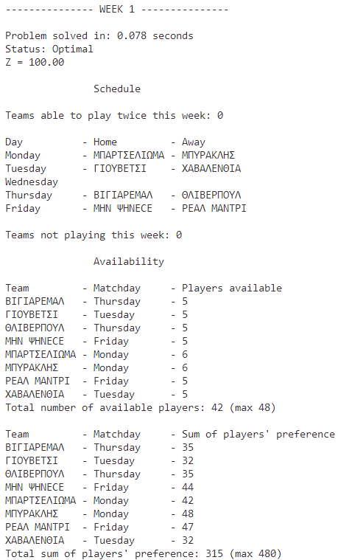
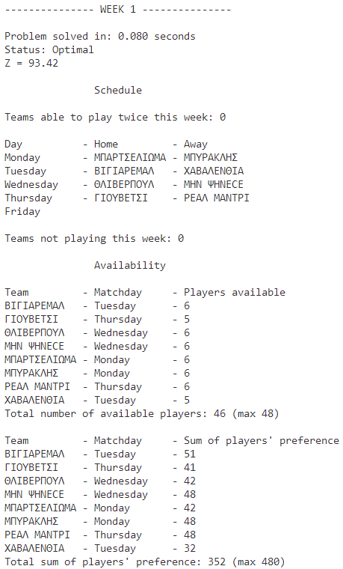
ΑΠΟΤΕΛΕΣΜΑΤΑ ΣΥΓΚΡΙΣΗΣ #1
Αντικειμενική Συνάρτηση υπό εξέταση #1
Τρέχουσα Αντικειμενική Συνάρτηση

Slide 20
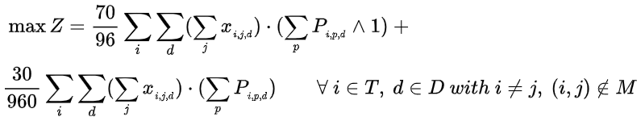
ΤΕΚΜΗΡΙΩΣΗ ΑΝΤΙΚΕΙΜΕΝΙΚΗΣ ΣΥΝΑΡΤΗΣΗΣ
Αντικειμενική συνάρτηση υπό εξέταση #2 - πλευρά παικτών
Στόχοι
Μεγιστοποίηση διαθεσιμότητας ομάδων την ημέρα που αγωνίζονται
Μεγιστοποίηση προτιμήσεων παικτών την ημέρα που αγωνίζονται

Slide 21
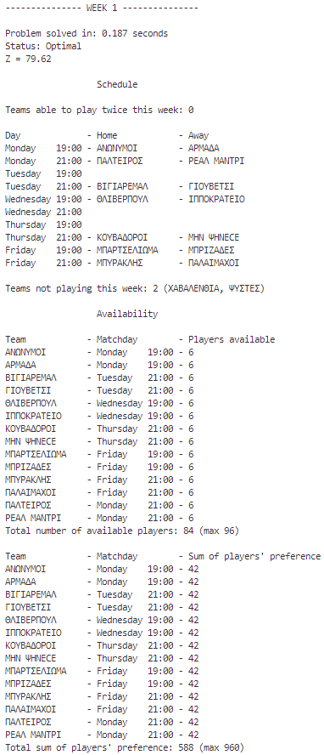
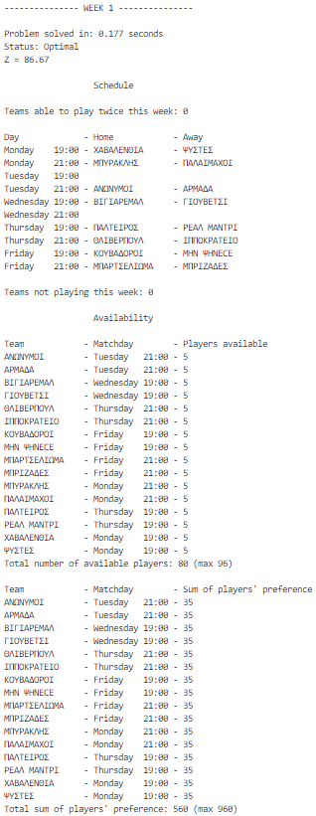
ΑΠΟΤΕΛΕΣΜΑΤΑ ΣΥΓΚΡΙΣΗΣ #2
Αντικειμενική Συνάρτηση υπό εξέταση #2
Τρέχουσα Αντικειμενική Συνάρτηση

Slide 22

CONCLUSION
Project goals:
Automating the match scheduling process
Finding the optimal match schedule
Faster results

Slide 23
Thank you for your time.

