Slide 1
DistilBERT – Paper Presentation
George Tzannetos

Slide 2
Introduction
Huge progress in NLP → main key is applying general pre-trained language representation model in the downstream tasks
Feature-based → like ELMo, task specific architectures, include pre-trained representations as additional features
Two approaches
Fine tuning → GPT, BERT, minimal task specific parameters, fine tune all pre-trained parameters on each task

Slide 3
BERT
BERT (Bidirectional Encoder Representations from Transformer)
was introduced after ELMo and GPT and outperforms them
- use of transformer network and bidirectionality
Recurrence is not used
Transformer based architecture
Global dependencies are drawn via self-attention mechanisms
What is a transformer?
[1] BERT: Pre-training of Deep Bidirectional Transformers for Language Understanding, Devlin, Chang, Lee, Toutanova

Slide 4
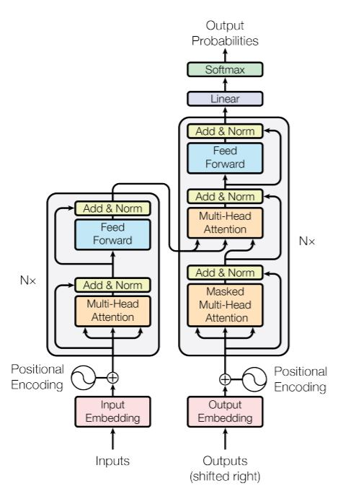
Transformer – Self Attention
decoder
Encoder part
Stacked encoder → multi-head attention + feed forward
Stacked decoder → masked multi-head attention + multi-head attention + feed forward
Residual connections
What is self-attention?
Idea: allow the inputs to interact with itself and find who they should
pay more attention to
query Q, key K, value V → abstractions introduced to calculate attention
[2] Attention Is All You Need, Vaswani, Shazeer, Parmar, Uszkoreit, Jones, Gomez, Kaiser, Polosukhin

Slide 5
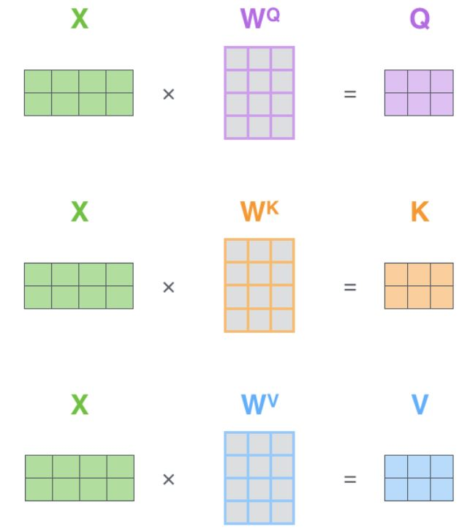
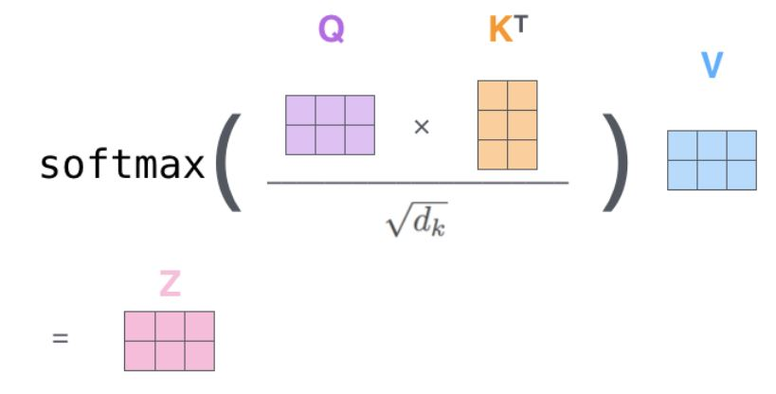

Self Attention
X → embedding of inputs packed
$$W^{Q},W^{K},W^{V}$$
→ Weight matrices that are trained
Attention output
Shows how much focus we should place on other parts of the sentence as we encode a word at a certain position

Slide 6
Transformer(2)
Helps determine position of each word, or distance between words in a seq
Positional encoding → vector added in the embedding
Multi-head attention → expands model’s ability to focus on different positions
8 attentions heads → procedure similar as explained, different Q,K,V for each head
Bidirectional encoder → each word is encoded using previous and next context
Decoder Side
- Similar components and structure
Self-attention allowed to “see” only earlier positions
of the output → masked future positions with -inf
- Differences
Keys and Values from the output of the encoder stack forwarded in the decoder’s attention

Slide 7
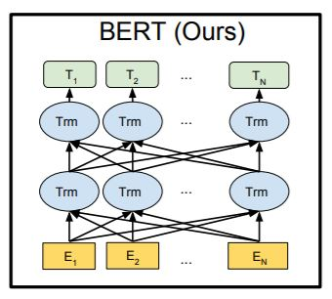
BERT(2)
Problem
→ a Transformer Encoder stack
Since bidirectional → would be possible for the words to “see itself” in a multilayer context
Trick → introduced the masked language model
output
Pre-Training → 2 novel unsupervised prediction tasks used
2. Next sentence prediction
Intermediate representations
Masked LM prediction
15 % of words are masked
Learns to handle relations between multiple sentences
Embedding representation
Fuses left and right context
[1] BERT: Pre-training of Deep Bidirectional Transformers for Language Understanding, Devlin, Chang, Lee, Toutanova

Slide 8
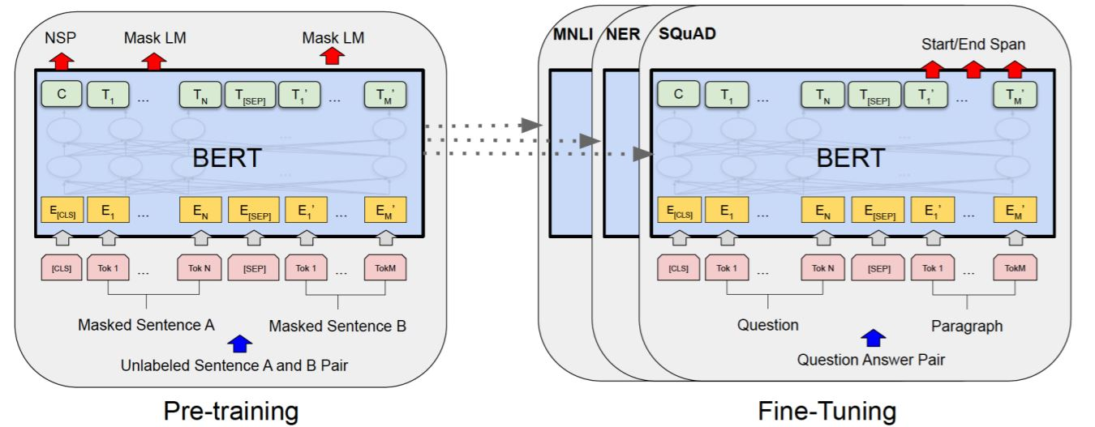
BERT(3) – Fine Tuning
Pretrained on these 2 tasks → all parameters are fine-tuned using labeled data for the downstream tasks
Unified architecture
Same parameters for initialization
Only output layer is task specific

Slide 9
DistilBERT - Paper
MegatronLM
BERT
Great progress in NLP
roBERTa
ELMO
Bigger Models → billions of parameters
Computational and memory requirements
Larger Datasets → GBs of text
Hard to adopt to production + deploy solutions on device
No energy efficient → GPU servers necessary → environmental cost
DistilBERT, a distilled version of BERT: smaller, faster, cheaper and lighter, Sanh, Debut, Chaumond, Wolf

Slide 10
Goal
quantization
Reduce size of models, with retaining the performance
Weight pruning
Distillation
Knowledge distillation → compression technique, where a small model(student) is trained to reproduce the behavior of a larger(teacher)one,
or of an ensemble)

Slide 11
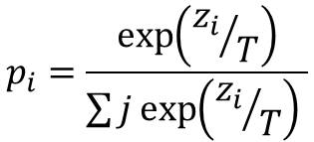
Knowledge Distillation
Exploit network’s “dark knowledge”
We consider the teacher’s full output probability distribution
Instead of training over hard targets(one hot encoding ground truth)
Train over the soft targets
$$p_{i}=\frac{\exp\left({z_{i}}/T\right)}{\sum{j\exp\left({z_{i}}/T\right) }}$$
Temperature-softmax introduced from Hinton → softens probabilities more
Distillation → similar to label smoothing, making model less overconfident

Slide 12
Training
Loss → distillation loss + supervised training loss
Masked language modelling loss + cosine embedding loss
Architecture of student
Identical with BERT
# of layers reduced by a factor of 2, token-type embeddings + pooler are removed → parameters are halved
Both have common hidden size
Initialization of weights of DistilBERT → from the teacher, taking one layer out of two
Improvements over BERT: Dynamic masking, gradient accumulation, w/o next sentence prediction
[5] RoBERTa: A Robustly Optimized BERT Pretraining Approach, Luke Zettlemoyer et al.

Slide 13
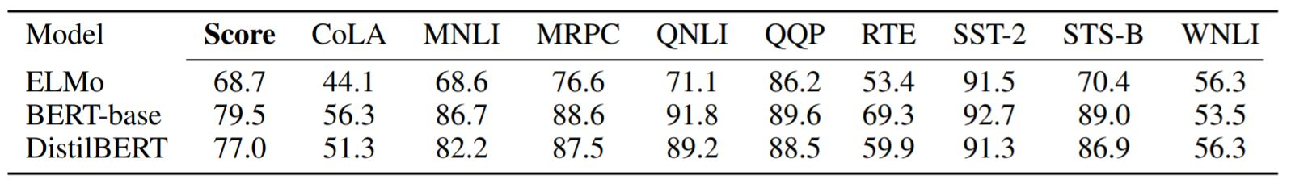
Experiments
General Language Understanding Evaluation → contains 9 tasks to eval NLU
Model’s performance is compared at the GLUE benchmark
Compared with ELMO and BERT-base(teacher) → better than ELMO, 97% of BERT performance - 40% fewer parameters
Size of model weights → ~200MB
Speed → 60% faster than BERT

Slide 14
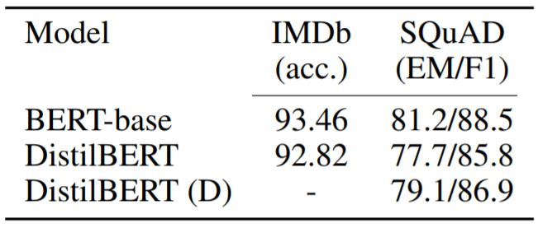
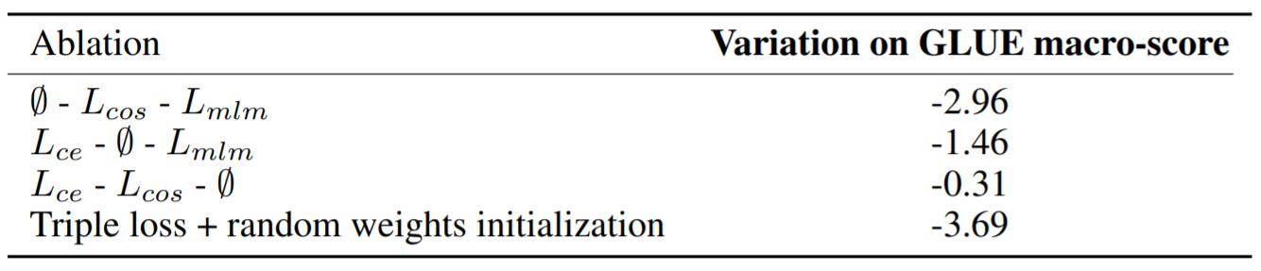
Experiments(2)
Comparable performance on 2 downstream tasks
IMDB sentiment classification, question answering
Ablation Study
→ wrt triple loss and weight initialization
Masked Language loss has the smaller impact in performance

Slide 15
Conclusion
A general purpose pre-training distillation rather than a task-specific one
40% smaller and 60% faster than BERT
Retains the 97% of BERT’s performance on GLUE benchmark
Outperforms ELMO on GLUE
Tricks from roBERTa where used
Comparable performance with BERT on downstream tasks
Plausible for edge applications

