Slide 1

ECE 383 – Embedded Computer Systems II Vivado Installation
Maj Jeffrey Falkinburg Room 2E46E 333-9193
1

Slide 2
Vivado Installation
Installing WebPack Version follow these instructions:
https://reference.digilentinc.com/vivado/installation
Follow the next few slides for the ECE 383 specific installation
2

Slide 3
Vivado Installation
If you want to download the 18 GB of installation files then click on Xilinx_Vivado_SDK_2016.4_1215_1_Win64.exe
***Note: This option is not advised since it will take several hours to download the installation files***
Otherwise skip the next two slides!
3

Slide 4
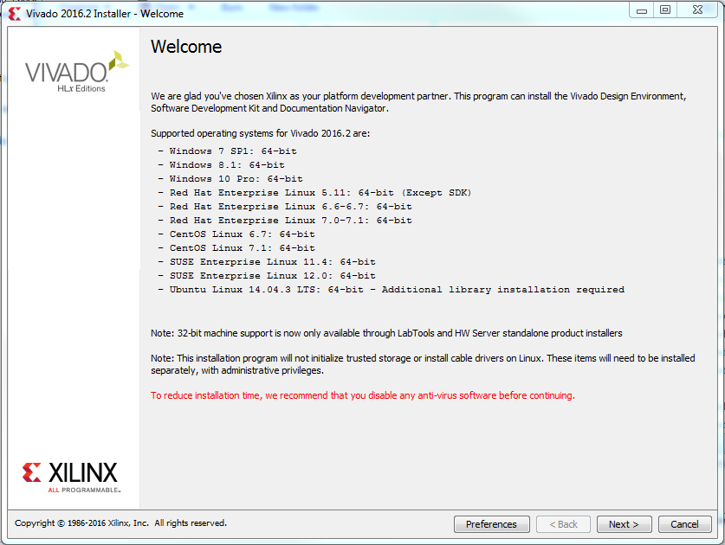
Vivado Installation
4

Slide 5
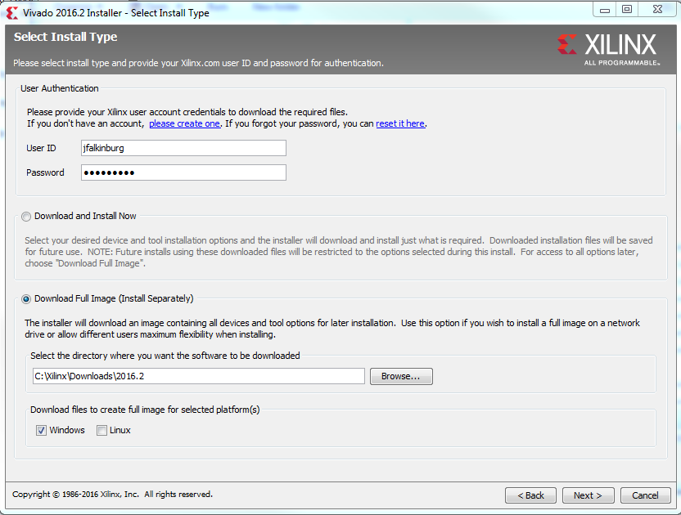
Vivado Installation
5

Slide 6
Vivado Installation
Run xsetup.exe in the Xilinx_2016.4 folder with full downloaded image
6

Slide 7
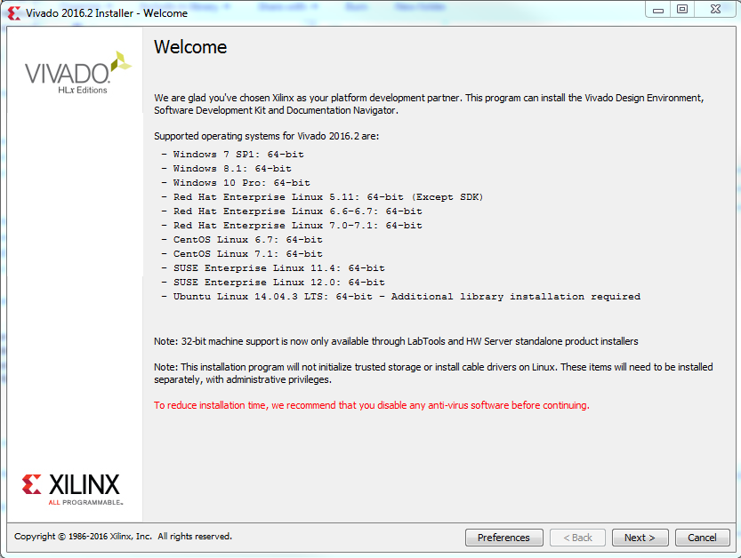
Vivado Installation
7

Slide 8
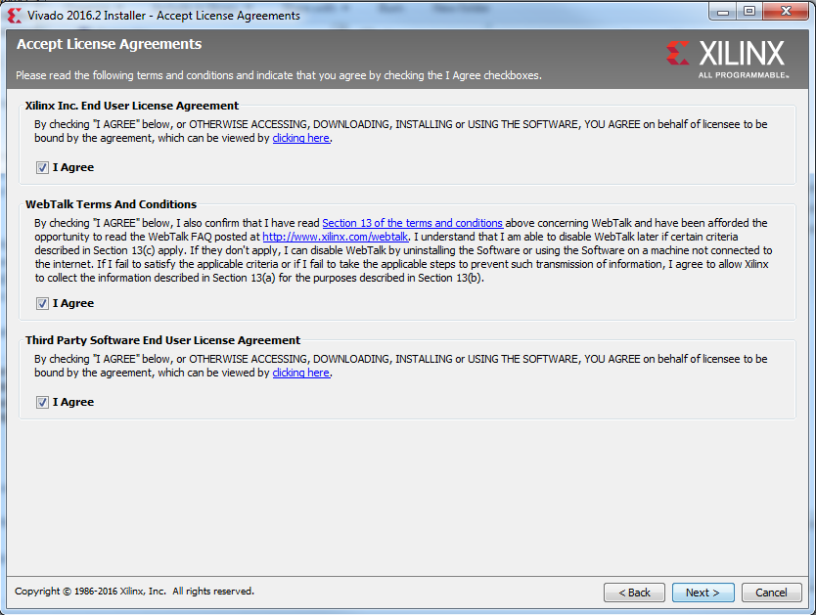
Vivado Installation
8

Slide 9
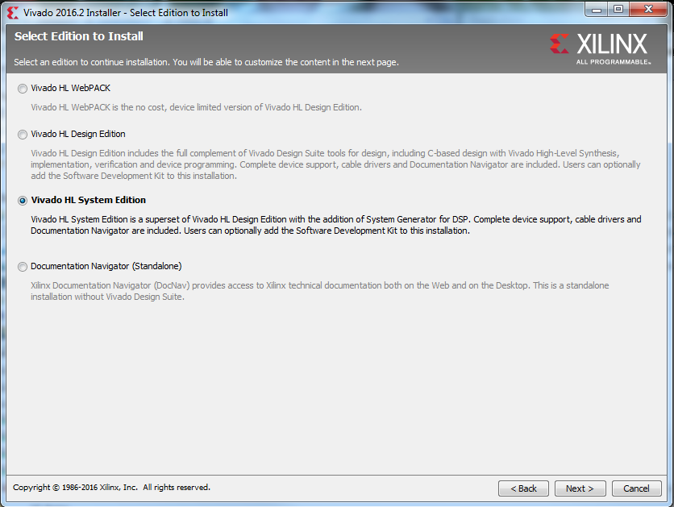
Vivado Installation
9

Slide 10
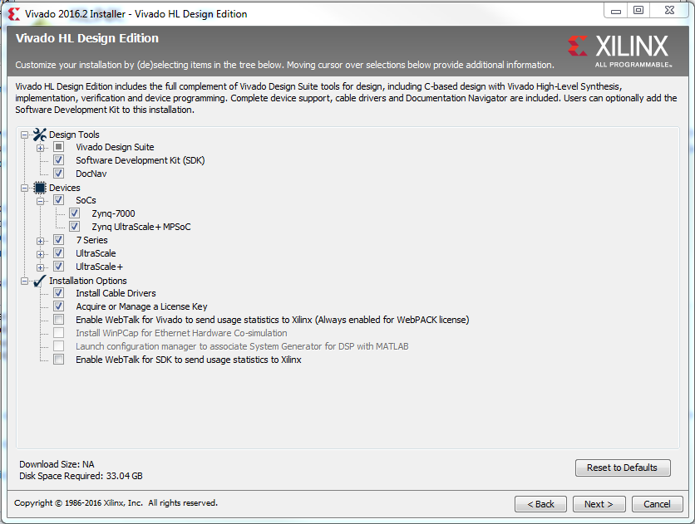
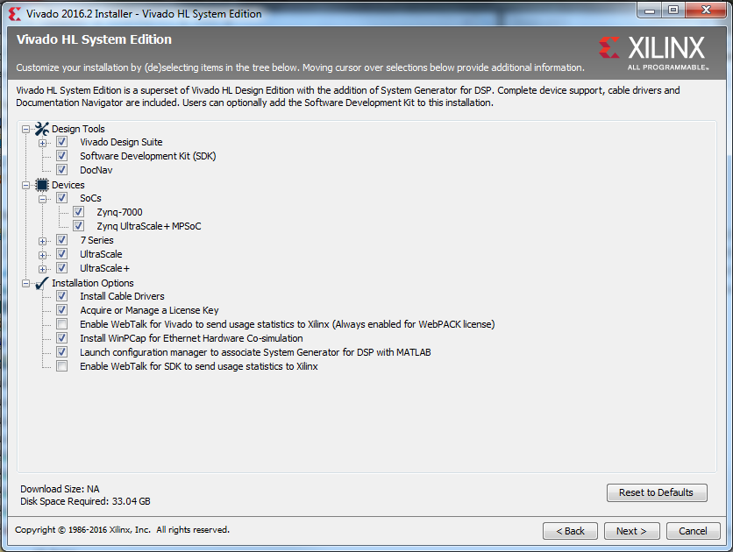
Vivado Installation
10

Slide 11
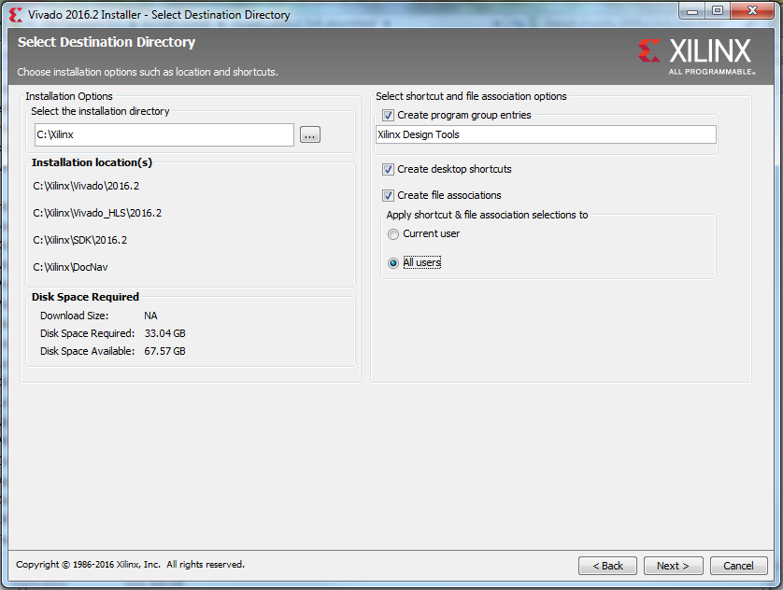
Vivado Installation
11

Slide 12
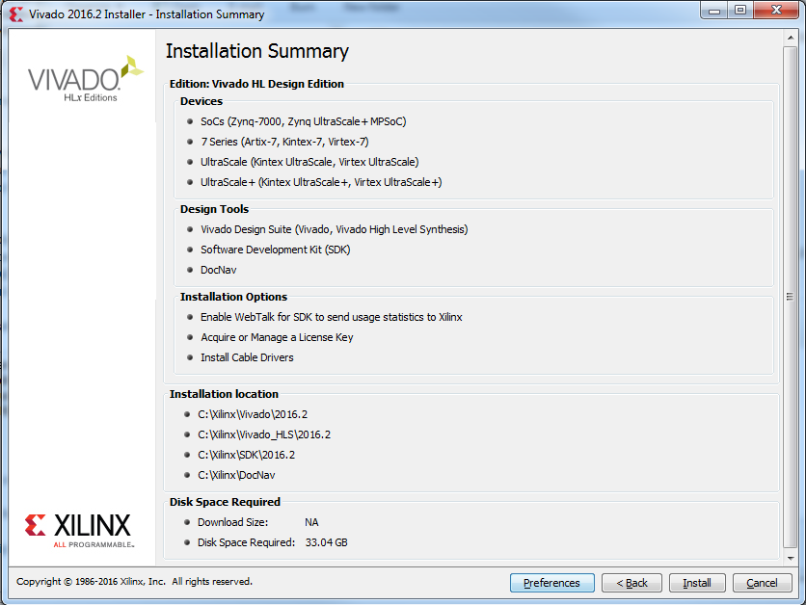
Vivado Installation
12

Slide 13
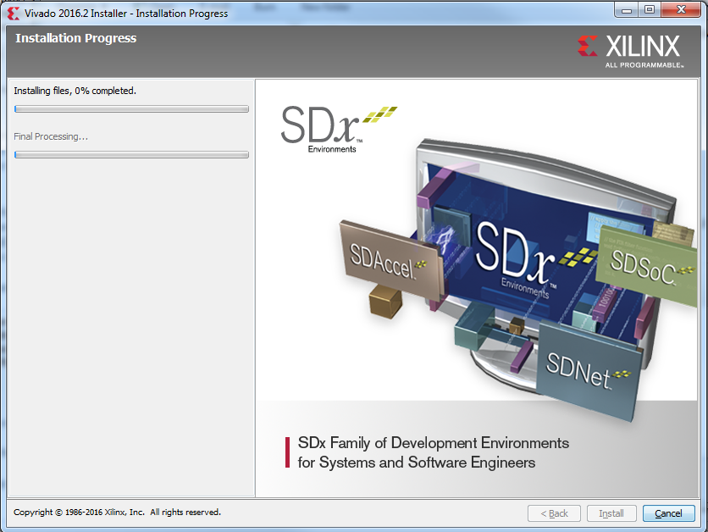
Vivado Installation
13

Slide 14
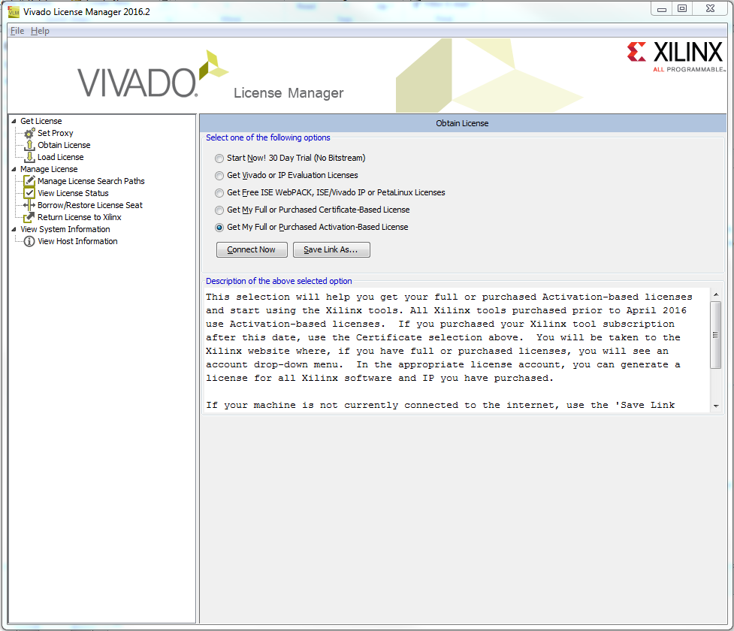
Vivado Installation
14

Slide 15
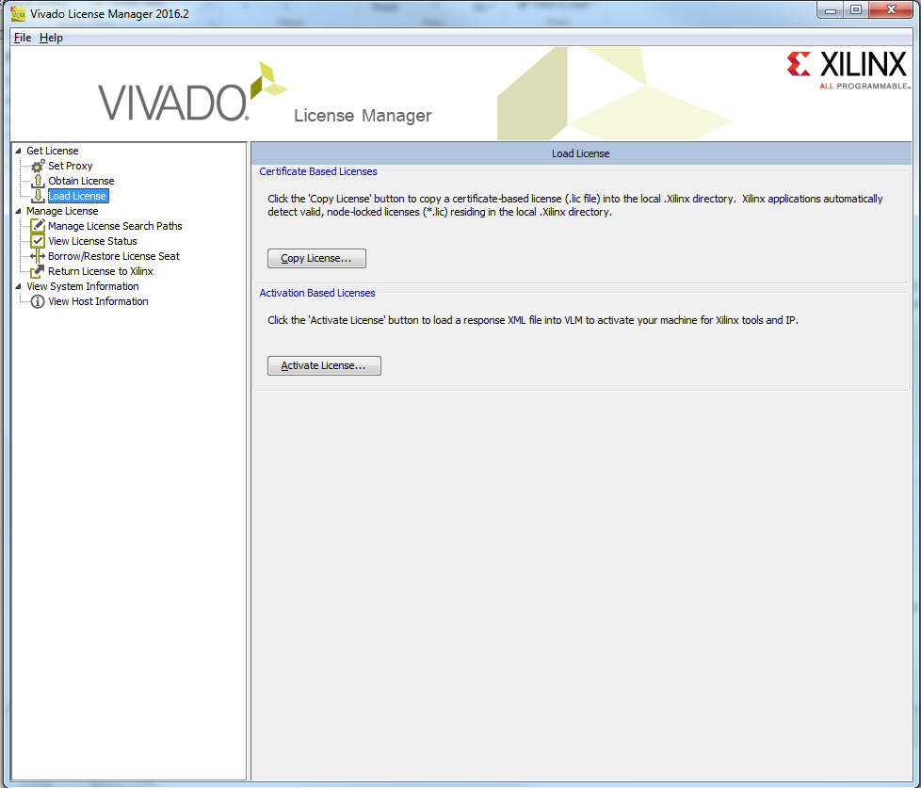
Vivado Installation
Load xilinx.lic file from drive otherwise retrieve a WebPack license from Xilinx.
15

Slide 16
Vivado Installation
16

Slide 17
Vivado Board Files
Install the Digilent Board Support Files: (also included on Drive)
https://reference.digilentinc.com/vivado/boardfiles2015
17

Slide 18
Vivado Tutorial
Vivado Tutorial:
http://www.xilinx.com/support/documentation/university/Vivado-Teaching/HDL-Design/2013x/Nexys4/Verilog/docs-pdf/Vivado_tutorial.pdf
18

Slide 19
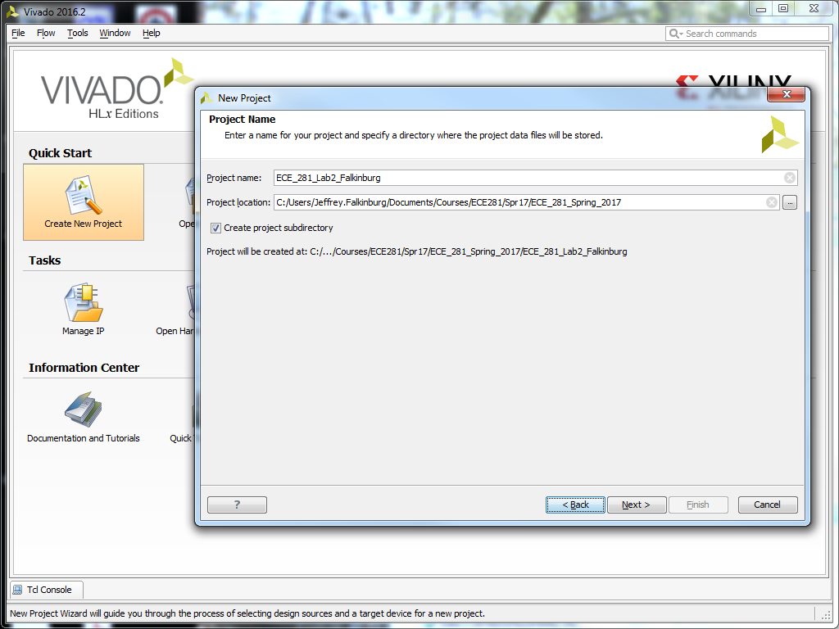
Vivado Project
19

Slide 20
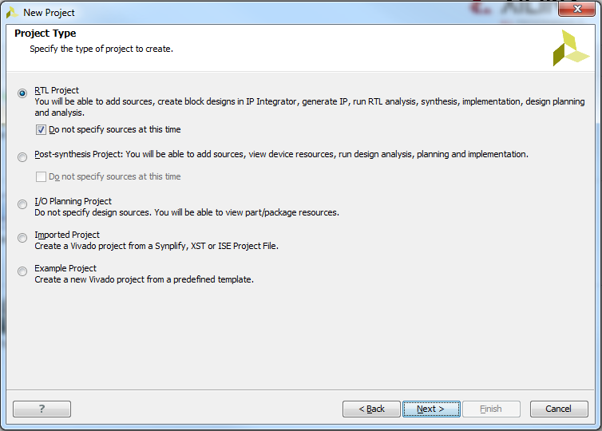
Vivado Project
20

Slide 21
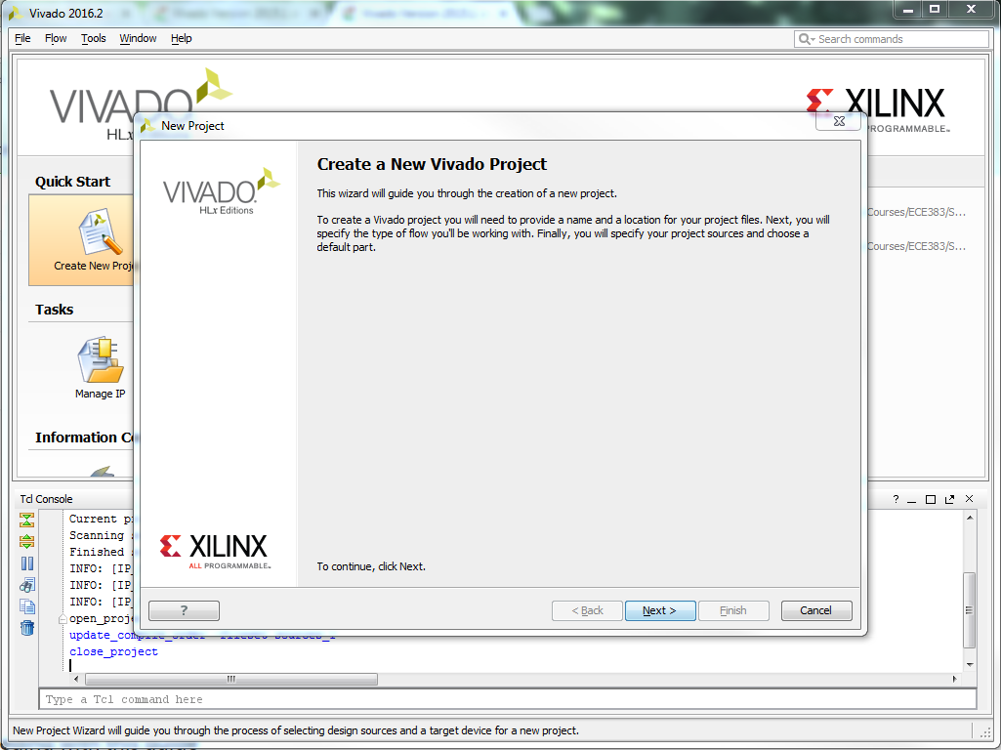
Vivado Tutorial
21

Slide 22
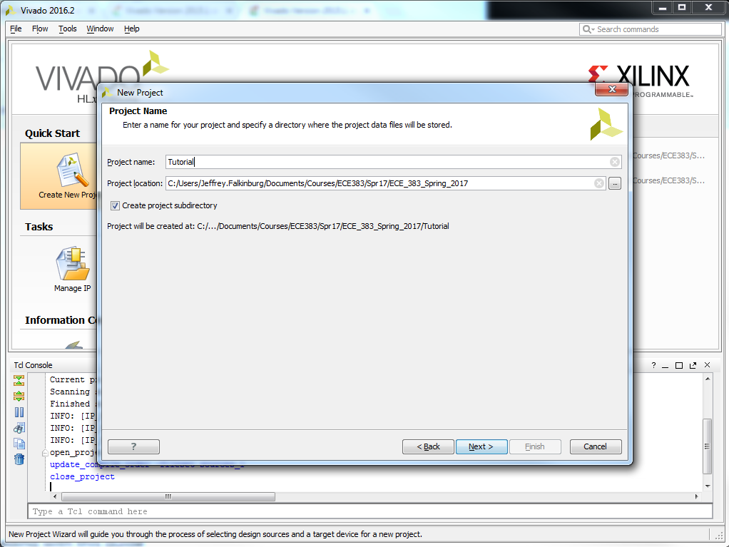
Vivado Tutorial
22

Slide 23
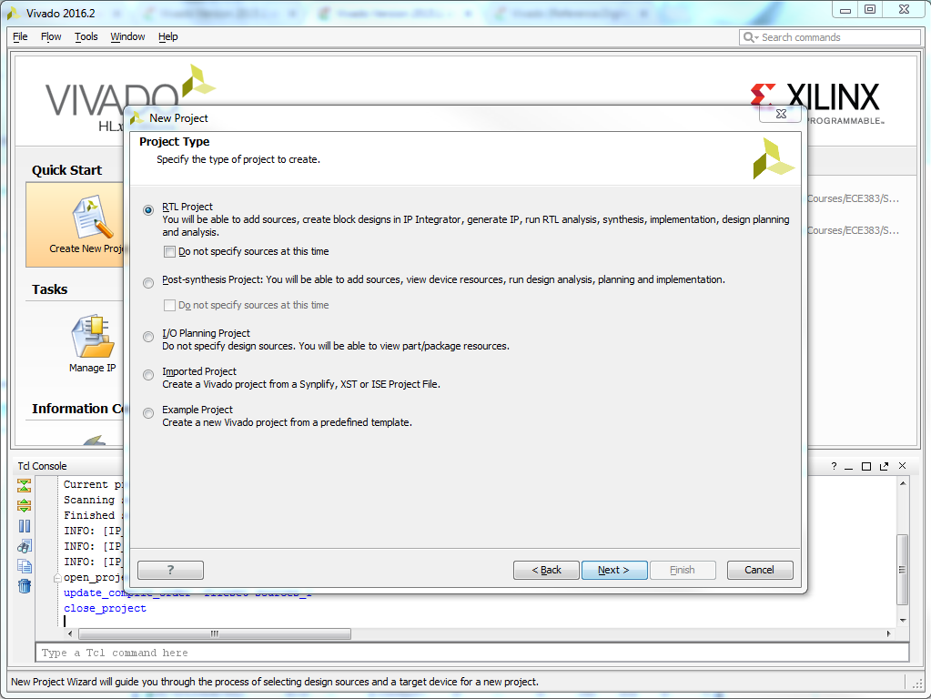
Vivado Tutorial
23

Slide 24
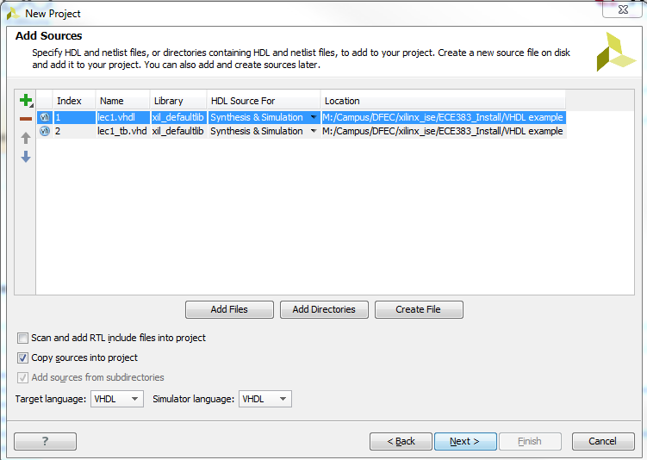
Vivado Tutorial
Select VHDL as the Target language and Simulator language in the Add Sources form.
Click on the Add Files… button, browse to the M:\Campus\DFEC\xilinx_ise\ECE383_Install\VHDL example directory, select lec1.vhdl, click Open, and then click Next.
24

Slide 25
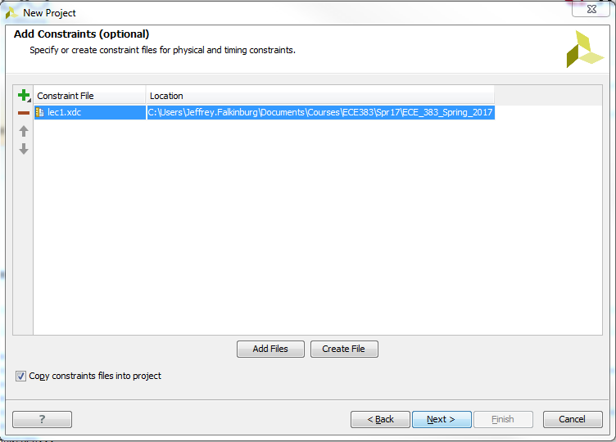
Vivado Tutorial
Click Next to get to the Add Constraints form.
Click Next if the entry is already auto-populated, otherwise click on the Add Files… button, browse to the M:\Campus\DFEC\xilinx_ise\ECE383_Install\VHDL example directory and select tutorial.xdc, and click Open.
25

Slide 26
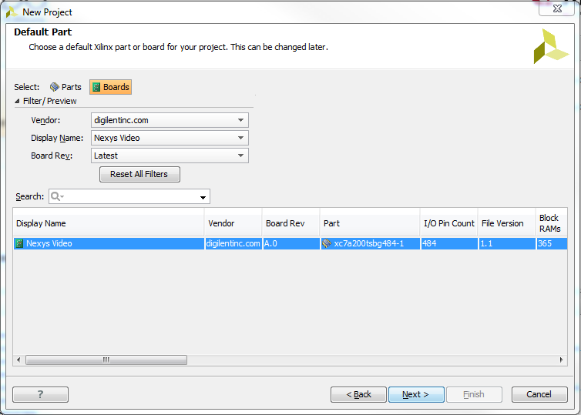
Vivado Tutorial
26

Slide 27
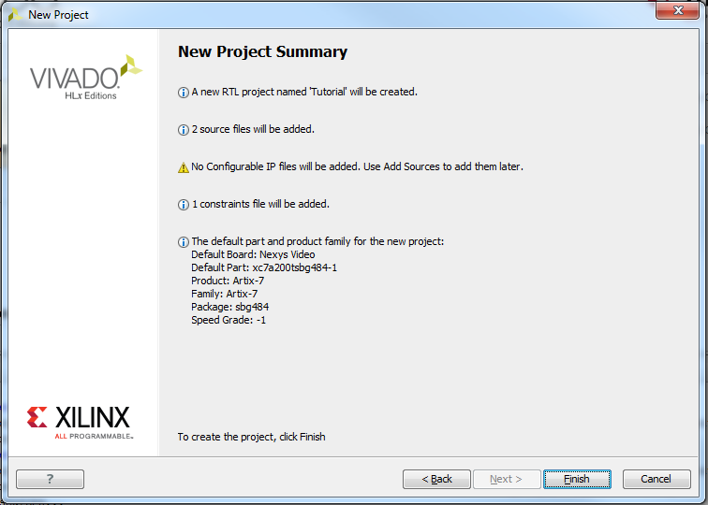
Vivado Tutorial
27

Slide 28
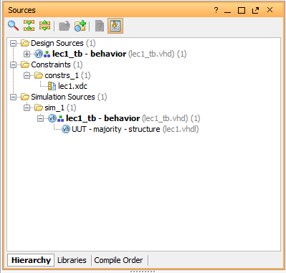
Vivado Tutorial
28

Slide 29
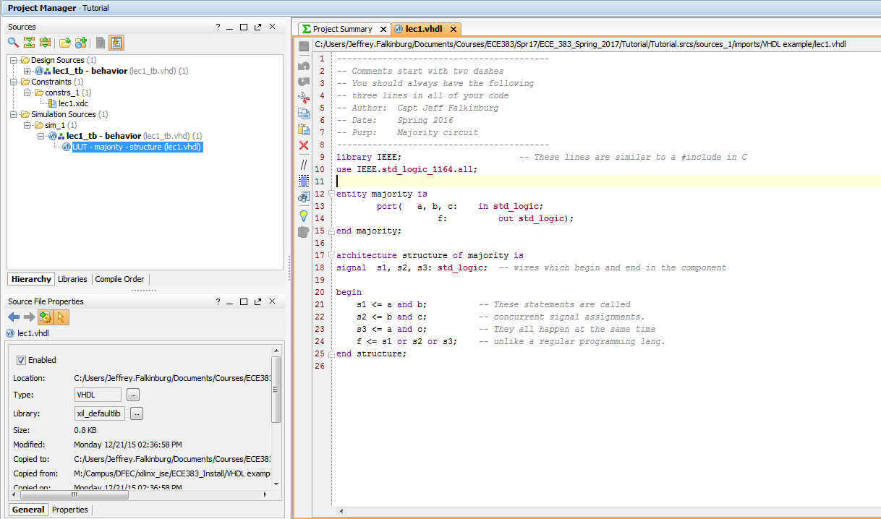
Vivado Tutorial
29

Slide 30
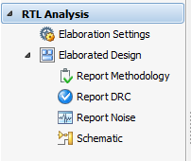
Vivado Tutorial
Perform RTL analysis on the source file.
Expand the Open Elaborated Design entry under the RTL Analysis tasks of the Flow Navigator pane and click on Schematic.
The model (design) will be elaborated and a logic view of the design is displayed.
30

Slide 31
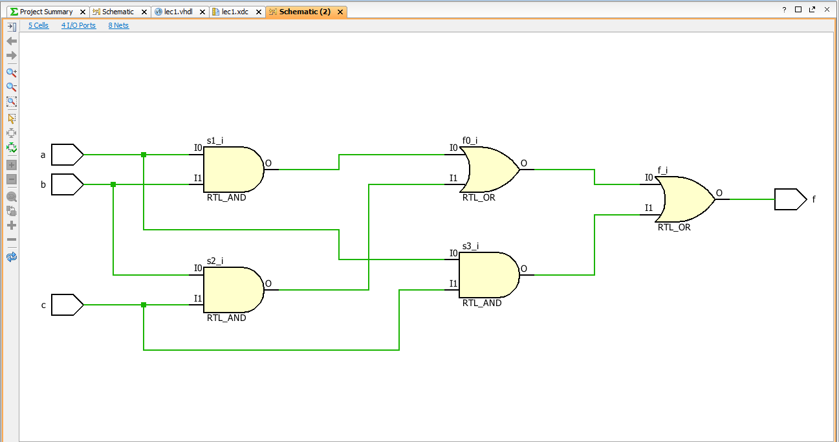
Vivado Tutorial
31

Slide 32

Implement Design
32

Slide 33
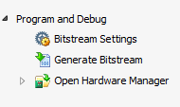
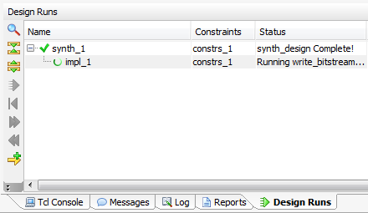
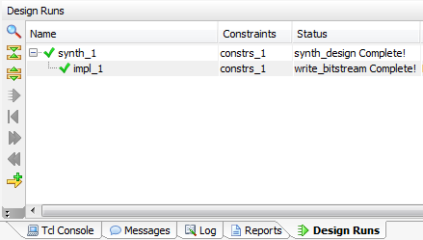
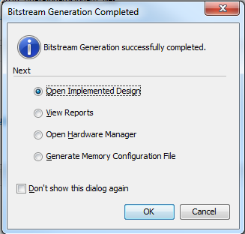
Generate Bitstream
Generate Bitstream
33

Slide 34
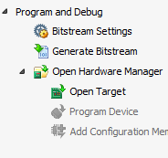
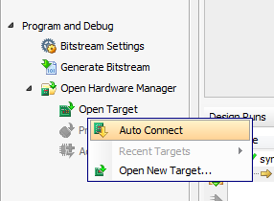
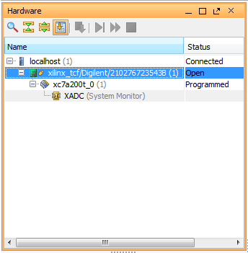
Open Target
Open Target
Board/Chip show up in Hardware list
34

Slide 35
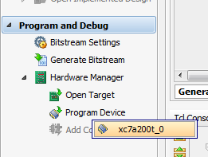
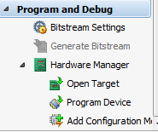
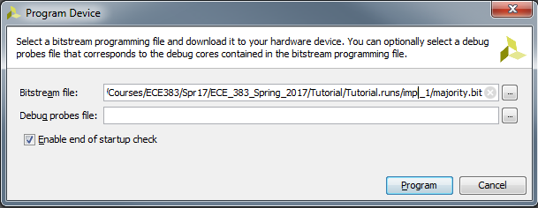
Program Device
Program Device
35

Slide 36

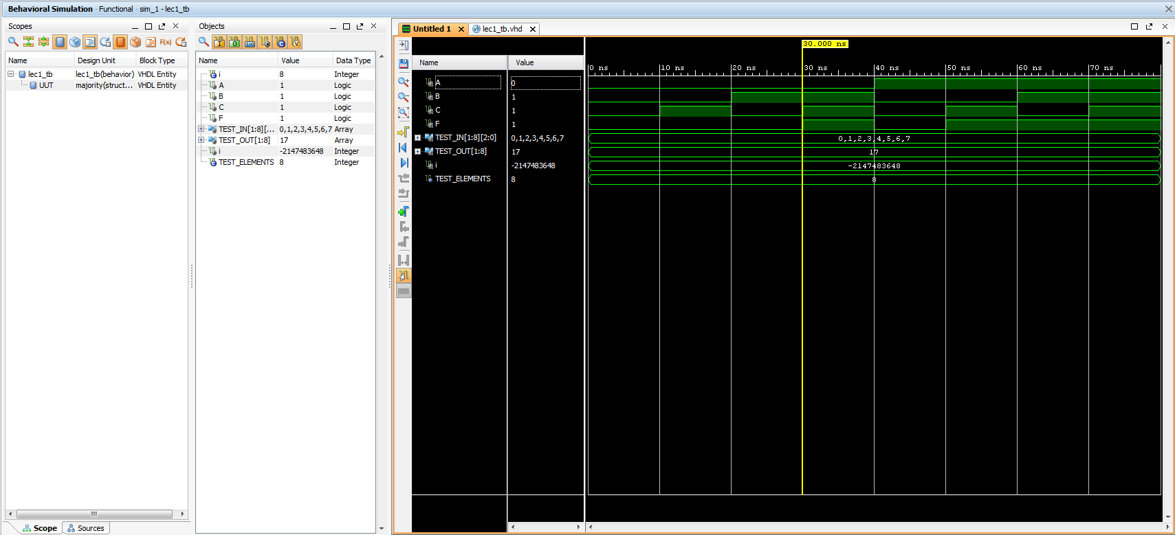
XSim Simulator
Simulate the Design using the XSim Simulator
36

Slide 37
XSim Simulator
37

Slide 38
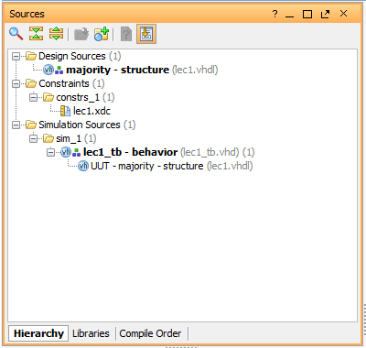
Lecture 1

Slide 39

39

